Slide 1
Software Testing
Decision Tables

Slide 2
Decision table
A decision table is a good way to deal with different combination inputs with their associated outputs and also called cause-effect table.
Conditions (inputs, rules)
Actions (what system should do)
If these condition happen, what should the system do?

Slide 3
Loan app (approve/ reject)
Age>18
Income>50k
No criminal recorder
3 => 2^n = 8
8

Slide 4
Decision table
Decision table testing is black box test design technique to determine the test scenarios

Slide 5
Decision table
Step A (RE phase)
“We use decision tables to make sure we understand all business rules correctly.”
Step B (Testing phase)
“We use the same decision table to ensure we test every rule systematically.”
Key message to students:
“Requirements define the rules; testing ensures every rule is exercised.”

Slide 6
Big Picture Relationship
Technique | What it models | Main idea
Equivalence Partitioning (EP) | Input domains | Divide inputs into valid/invalid groups
Boundary Value Analysis (BVA) | Input boundaries | Test edges of partitions
Decision Tables (DT) | Condition combinations | Test logical rules across multiple conditions
EP and BVA focus on single input variables, while decision tables focus on multiple interacting conditions.

Slide 7
Decision table
Example 1: Decision Base Table for Login Screen
Let's create a decision table for a login screen.

Slide 8
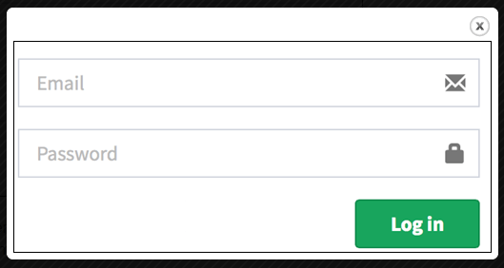
Example

Slide 9
 | Rule 1 | R2 | R3 | R4
Email | T | T | F | F
Password | T | F | T | F
Direct to home screen | +
Error message |  | + | + | +
TC_001 | CHECK THE LOGIN | ABC@GH QWERTY | Direct to home screen

Slide 10
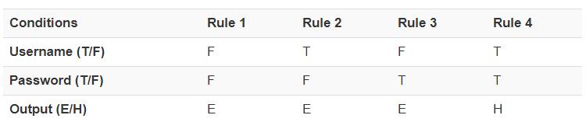
Example
Legend:
T – Correct username/password
F – Wrong username/password
E – Error message is displayed
H – Home screen is displayed

Slide 11
Example 2:
Decision Base Table for Upload Screen, Now consider a dialogue box which will ask the user to upload photo with certain conditions like –
You can upload only '.jpg' format image
file size less than 32kb
resolution 137*177.

Slide 12
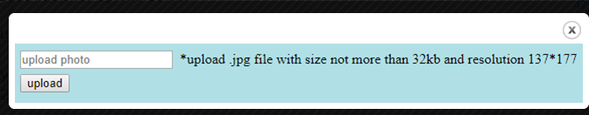
Example 2:

Slide 13
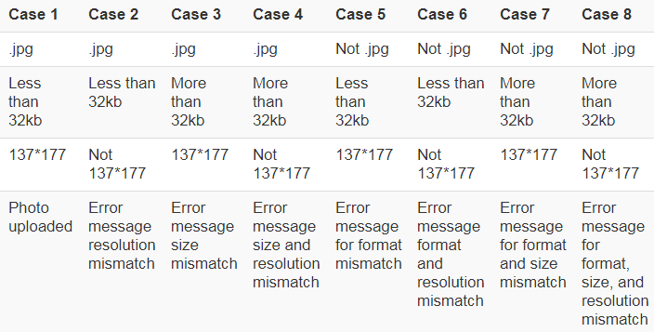
Decision table

Slide 14
Example #3
Let us consider the following description of a payment procedure. Consultants working for more than 40 hours per week are paid at their hourly rate for the first 40 hours and at two times their hourly rate for subsequent hours. Consultants working for less than 40 hours per week are paid for the hours worked. at their hourly rates and an absence report is produced. Permanent workers working for less than 40 hours a week are paid their salary and an absence report is produced. Permanent workers working for more and equal to 40 hours a week are paid their salary.
We need to describe the above payment procedure using a decision table and generate test cases from the table.

Slide 15
Cause and Effects
C1: Permanent workers
C2: Worked < 40 hours
C3: Worked exactly 40 hours
C4: Worked > 40 hours
E1: Pay salary
E2: Produce an absence report
E3: Pay hourly rate
E4: Pay 2 × hourly rate

Slide 16
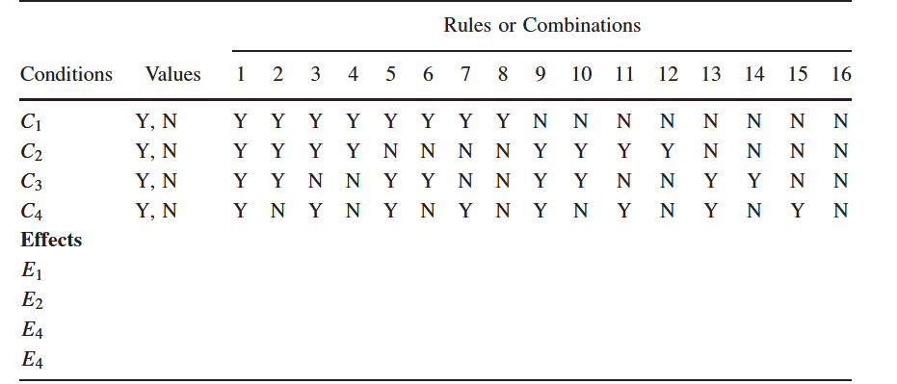
Decision Table
+ + + +

Slide 17
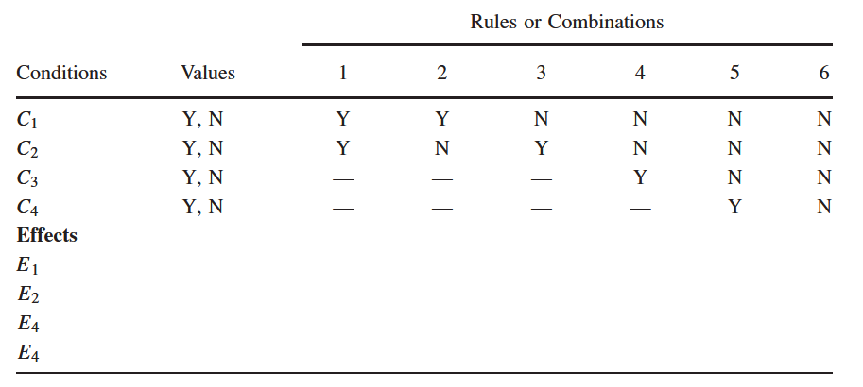
Reduced Table

Slide 18
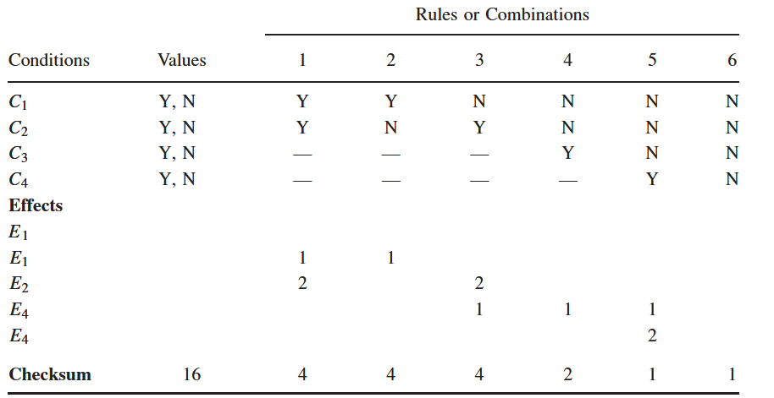
Table With Check Sum

