Slide 1
Software Architecture

Slide 2
What is Software Architecture?
High-level structure of a system
Components and their interactions
Blueprint of software

Slide 3
Analogy
Like a house blueprint
Rooms = components
Doors = communication

Slide 4
Why Architecture Matters
Manages complexity
Improves scalability
Enhances maintainability
Supports teamwork

Slide 5
Basic Concepts
Components
Connectors
Data Flow

Slide 6
Layered Architecture
System divided into layers
Each layer has a specific role

Slide 7
Layered Architecture Example
UI → Business Logic → Data Access → Database

Slide 8
The Layered architecture pattern
Name | Layered architecture
Description | Organizes the system into layers with related functionality associated with each layer. A layer provides services to the layer above it so the lowest-level layers represent core services that are likely to be used throughout the system. See Figure 6.6.
Example | A layered model of a system for sharing copyright documents held in different libraries, as shown in Figure 6.7.
When used | Used when building new facilities on top of existing systems; when the development is spread across several teams with each team responsibility for a layer of functionality; when there is a requirement for multi-level security.
Advantages | Allows replacement of entire layers so long as the interface is maintained. Redundant facilities (e.g., authentication) can be provided in each layer to increase the dependability of the system.
Disadvantages | In practice, providing a clean separation between layers is often difficult and a high-level layer may have to interact directly with lower-level layers rather than through the layer immediately below it. Performance can be a problem because of multiple levels of interpretation of a service request as it is processed at each layer.

Slide 9
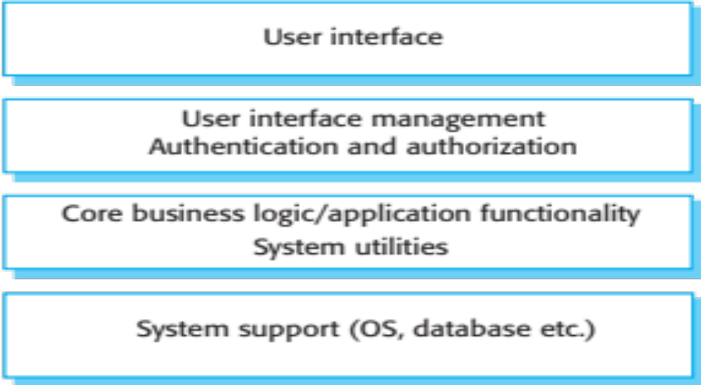
A generic layered architecture

Slide 10
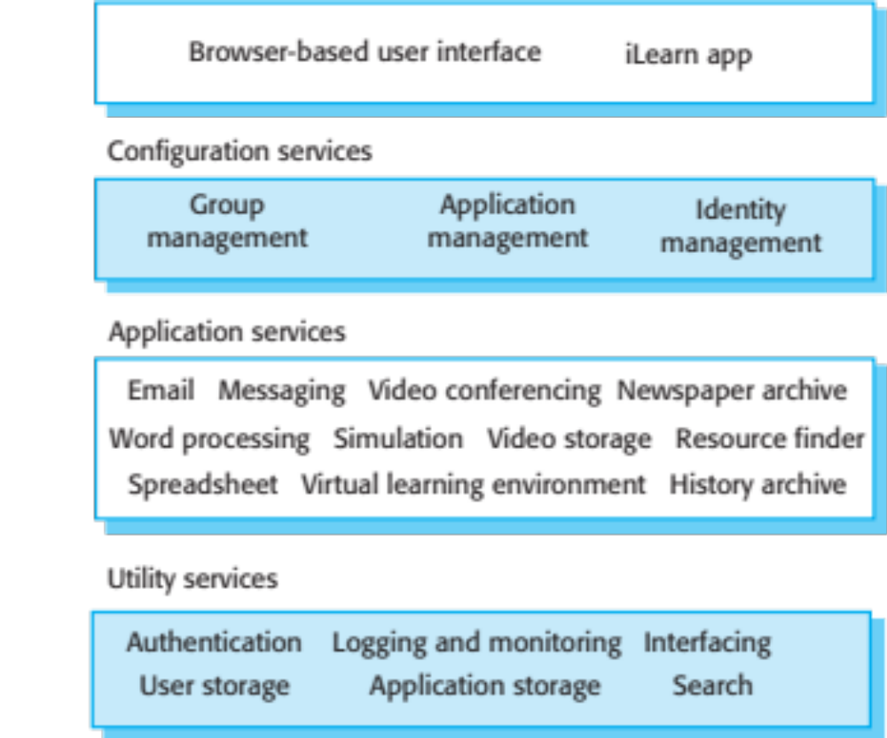
The architecture of the iLearn system

Slide 11
Layered Advantages
Easy to understand
Maintainable
Reusable layers

Slide 12
Layered Disadvantages
Performance overhead
Changes affect multiple layers

Slide 13
Repository Architecture
Central data storage
All components access shared repository

Slide 14
The Repository pattern
Name | Repository
Description | All data in a system is managed in a central repository that is accessible to all system components. Components do not interact directly, only through the repository.
Example | Figure 6.9 is an example of an IDE where the components use a repository of system design information. Each software tool generates information which is then available for use by other tools.
When used | You should use this pattern when you have a system in which large volumes of information are generated that has to be stored for a long time. You may also use it in data-driven systems where the inclusion of data in the repository triggers an action or tool.
Advantages | Components can be independent—they do not need to know of the existence of other components. Changes made by one component can be propagated to all components. All data can be managed consistently (e.g., backups done at the same time) as it is all in one place.
Disadvantages | The repository is a single point of failure so problems in the repository affect the whole system. May be inefficiencies in organizing all communication through the repository. Distributing the repository across several computers may be difficult.

Slide 15
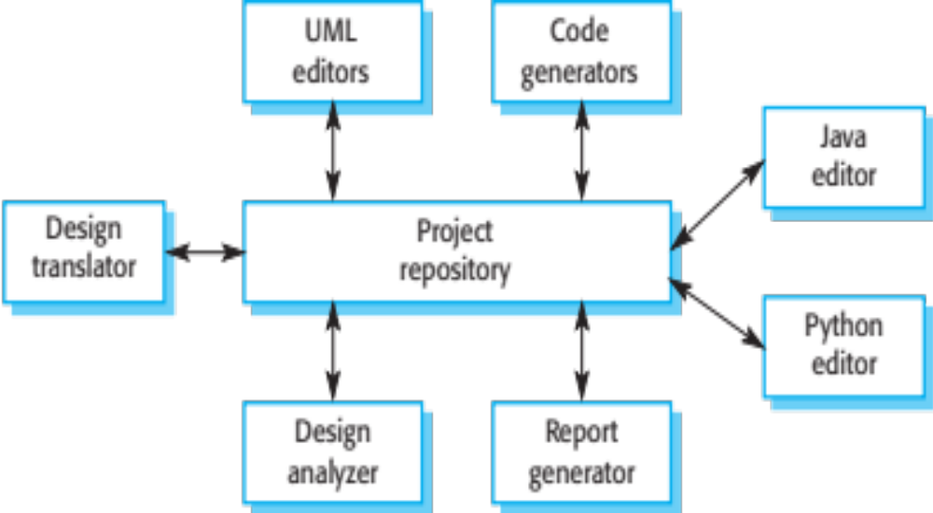
A repository architecture for an IDE

Slide 16
Repository Advantages
Data consistency
Central control

Slide 17
Repository Disadvantages
Single point of failure
Performance bottleneck

Slide 18
Client-Server Architecture
Clients request services
Server provides services

Slide 19
The Client–server pattern
Name | Client-server
Description | In a client–server architecture, the functionality of the system is organized into services, with each service delivered from a separate server. Clients are users of these services and access servers to make use of them.
Example | Figure 6.11 is an example of a film and video/DVD library organized as a client–server system.
When used | Used when data in a shared database has to be accessed from a range of locations. Because servers can be replicated, may also be used when the load on a system is variable.
Advantages | The principal advantage of this model is that servers can be distributed across a network. General functionality (e.g., a printing service) can be available to all clients and does not need to be implemented by all services.
Disadvantages | Each service is a single point of failure so susceptible to denial of service attacks or server failure. Performance may be unpredictable because it depends on the network as well as the system. May be management problems if servers are owned by different organizations.

Slide 20
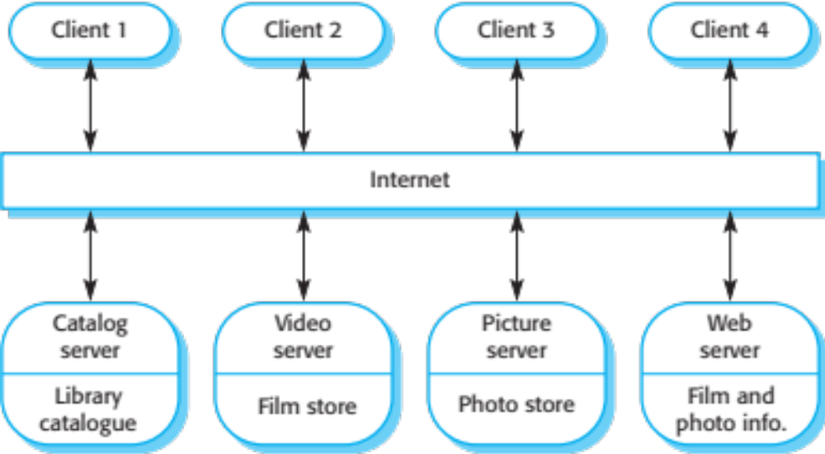
A client–server architecture for a film library

Slide 21
Client-Server Advantages
Centralized control
Scalable

Slide 22
Client-Server Disadvantages
Server dependency
Network issues

Slide 23
Pipe and Filter Architecture
Data flows through filters
Each filter processes data

Slide 24
The pipe and filter pattern
Name | Pipe and filter
Description | The processing of the data in a system is organized so that each processing component (filter) is discrete and carries out one type of data transformation. The data flows (as in a pipe) from one component to another for processing.
Example | Figure 6.13 is an example of a pipe and filter system used for processing invoices.
When used | Commonly used in data processing applications (both batch- and transaction-based) where inputs are processed in separate stages to generate related outputs.
Advantages | Easy to understand and supports transformation reuse. Workflow style matches the structure of many business processes. Evolution by adding transformations is straightforward. Can be implemented as either a sequential or concurrent system.
Disadvantages | The format for data transfer has to be agreed upon between communicating transformations. Each transformation must parse its input and unparse its output to the agreed form. This increases system overhead and may mean that it is impossible to reuse functional transformations that use incompatible data structures.

Slide 25
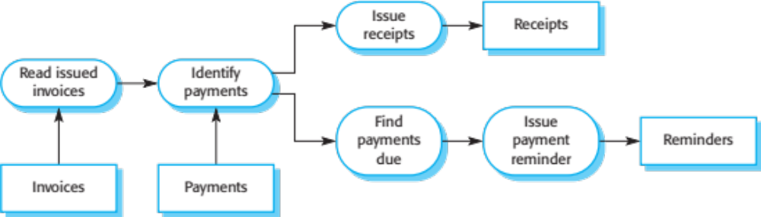
An example of the pipe and filter architecture used in a payments system

Slide 26
Pipe and Filter Advantages
Modular
Reusable
Supports parallelism

Slide 27
Pipe and Filter Disadvantages
Difficult debugging
Not suitable for interactive systems

Slide 28
Comparison
Layered: simple, but slower
Repository: consistent, but risky
Client-Server: scalable, but dependent
Pipe-Filter: modular, but complex

Slide 29
Conclusion
Choose architecture based on system needs
No single best solution

