Slide 1

Project Presentation on Sentiment Analysis And Opinion Mining Using LLM
Madan Mohan Malaviya University of Technology, Gorakhpur
Presented By:
Kashish Gupta (2021021140)
Pragati Yadav (2021021152)
Computer Science and Engineering Department
Madan Mohan Malaviya University of Technology, Gorakhpur
*

Slide 2

Madan Mohan Malaviya Univ. of Technology, Gorakhpur
Content
Abstract
Objective
Introduction
Description of Software Structure
Basic Data Analysis
Optimizing the performance
Technology Used
Working
Code Design
Conclusion
References
*

Slide 3
Madan Mohan Malaviya Univ. of Technology, Gorakhpur
Abstract
The Project’s Goal: This project addresses the critical need for accurate sentiment analysis in a world overwhelmed by textual data. By leveraging BERT the system achieves a nuanced understanding of text, far surpassing traditional methods. Our tool performs real-time predictions and bulk analysis, offering sentiment classifications (Positive, Negative, Neutral) with high contextual accuracy. It finds applications in industries such as e-commerce, social media monitoring, and customer feedback systems.
Model used :
BERT (Bidirectional Encoder Representations from Transformers): Pre-trained transformer-based model known for its bidirectional context understanding. Fine-tuned specifically for sentiment classification tasks using the IMDB dataset and some public datasets.
Softmax Activation: Converts raw logits into class probabilities for sentiment predictions.
*

Slide 4
Madan Mohan Malaviya Univ. of Technology, Gorakhpur
Objective
Achieve Contextual Precision: Exploit BERT's bidirectional transformer architecture for sentiment predictions that consider the entire context of a sentence, unlike unidirectional models.
Real-World Scalability: Create a system that works seamlessly for individual inputs and large datasets, ensuring flexibility across domains.
Insight-Driven Decision Making: Equip users with actionable insights from textual data, fostering informed decision-making in marketing, product development, and customer experience.
User-Friendly Deployment: Offer a streamlined interface that combines advanced machine learning with accessibility, enabling non-technical users to perform sentiment analysis effortlessly.
*

Slide 5
Multi-Head Self-Attention to capture contextual relationships.
Madan Mohan Malaviya Univ. of Technology, Gorakhpur
INTRODUCTION
Understanding Sentiment Analysis: Sentiment analysis involves determining the emotional tone behind a body of text, essential for interpreting opinions and attitudes.
Large Language Models (LLMs) like ChatGPT are increasingly being used in Sentiment Analysis due to their ability to understand and generate human-like text. These models are trained on vast amounts of data, allowing them to generate coherent and contextually relevant responses.
The model used in this project, BERT, adopts the encoder part of the Transformer. The encoder uses Multi-Head Self-Attention to capture contextual relationships, Feed-Forward Neural Networks to refine token embeddings, Positional Encoding to retain the order of words in a sentence.
*

Slide 6
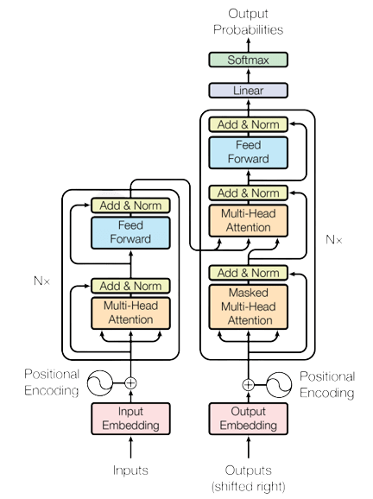

Slide 7
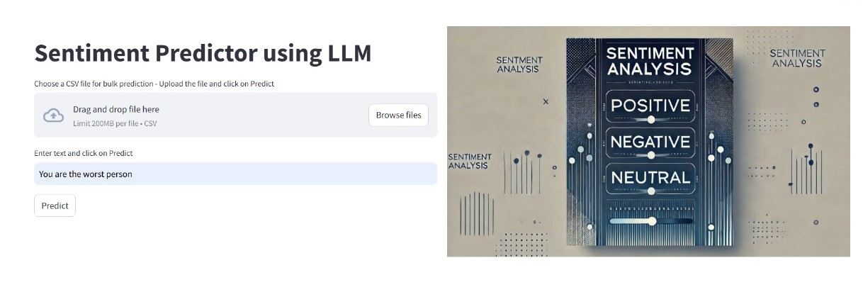
Madan Mohan Malaviya Univ. of Technology, Gorakhpur
Description of Software structure
FRONTEND / USER INTERFACE:
The frontend of the sentiment analysis tool is designed to ensure an intuitive and seamless user experience, enabling users to interact with the system effortlessly. The interface is built using Streamlit, a Python library known for its simplicity and rapid development capabilities. Input can be taken as a single statement or bulk.
Single Text Analysis: Users can enter any text (e.g., "The product quality is amazing!") for instant sentiment prediction.
Bulk Prediction: CSV files with hundreds of reviews can be uploaded, enabling large-scale sentiment classification.
*

Slide 8
Madan Mohan Malaviya Univ. of Technology, Gorakhpur
BACKEND :
Preprocessing: Text is tokenized using the BertTokenizer, of transformers library. Each tokenized sequence is padded or truncated to a fixed length of 512 for compatibility with the model.
Model Architecture: The core is a pre-trained Bert-base-uncased model, fine-tuned for sentiment classification tasks.
Prediction: The model outputs logits (raw scores) for each sentiment class, converted to probabilities using the softmax function.
Visualization: Results are presented interactively using Plotly, showcasing sentiment distributions for clear insights.
*

Slide 9
Madan Mohan Malaviya Univ. of Technology, Gorakhpur
DATA COLLECTION
The dataset used : 1) “imdb” dataset for Binary Sentiment classification 2) Kaggle public dataset for muti-class Sentiment classification
“imdb”
Its size : 25,000
Input Column: 2
Output Labels: 1
“public dataset”
Its size : 27,481
Input Column: 2
Output Labels: 1
*

Slide 10
Optimizing Parameters
Learning rate- for “imdb” – 2e-5 and for “public dataset” – 1e-5.
Hyperparameter Tuning: Experimentation with batch sizes (6 and 4) revealed that smaller batches improved gradient updates and maintained performance.
Epoch – The model was trained multiple times to determine the optimal epoch number, ensuring a balance between underfitting and overfitting.
Handling Imbalanced Data: Weighted loss metrics ensure minority classes like neutral reviews are adequately learned by the model.

Slide 11
Madan Mohan Malaviya Univ. of Technology, Gorakhpur
TECHNOLOGIES USED
Data Collection Tool :
Kaggle : Kaggle is an online platform that provides data science competitions, datasets, and a collaborative environment for data science.
Libraries :
Streamlit (st): This is used to create the web application. It helps display things like text, buttons, images, and other components on a webpage.
Pandas (pd), numpy: This is used for reading and processing data, especially from CSV files.
Transformers & TensorFlow: These are used for loading a pre-trained machine learning model (BERT) to perform sentiment analysis.
OTHER TOOLS:
Github
Kaggle
Google Colab
*

Slide 12
Madan Mohan Malaviya Univ. of Technology, Gorakhpur
WORKING
Initial Data Handling and Input Preparation: The backend begins with receiving input from the user, either as single text entries or bulk data uploaded via a CSV file.
The core of the backend is the pre-trained BERT model. This model is loaded using the Hugging Face Transformers library. Specifically, the TFBertForSequenceClassification class is used, which is pre-configured for text classification tasks. This model has been fine-tuned on a sentiment-labeled dataset (e.g., IMDB reviews) to specialize in distinguishing positive, negative, and neutral sentiments.
It internally uses a prediction function that loads the data and generates predictions.
If the input is a single sentence, the model simply returns its sentiment. For bulk files, it processes all sentences and provides the percentage distribution across classification classes.
Optimizer – Adam Optimizer
Loss Function - SparseCategoricalCrossentropy
*

Slide 13
Madan Mohan Malaviya Univ. of Technology, Gorakhpur
PERFORMANCE METRICS
“imdb”-
Accuracy on test dataset: 90.98%
Accuracy on valid dataset: 97.72%
“public dataset”-
Accuracy on test dataset: 81.76%
Accuracy on valid dataset: 76.48%
*

Slide 14
Madan Mohan Malaviya Univ. of Technology, Gorakhpur
CONCLUSION
This project demonstrated the power and versatility of transformer-based models, specifically BERT, in performing sentiment analysis. By leveraging BERT’s bidirectional context understanding, we created a tool capable of discerning complex sentiments. The combination of pre-processing techniques, model fine-tuning, and an interactive frontend ensures that the solution is both effective and user-friendly.
Key Achievements: Implemented state-of-the-art sentiment analysis with 97.72% accuracy on “imdb” dataset. Integrated user-friendly features like CSV upload, real-time feedback, and interactive visualizations.
Impact: Empowers businesses to make data-driven decisions based on customer sentiment. Enhances trust in reviews by providing consistent and reliable predictions.
*

Slide 15
REFRENCES
Vaswani, A., Shazeer, N., Parmar, N., Uszkoreit, J., Jones, L., Gomez, A., Kaiser, Ł., & Polosukhin, I. (2017). Attention is all you need. Proceedings of NeurIPS 2017. Retrieved from https://proceedings.neurips.cc/paper_files/paper/2017/file/3f5ee243547dee91fbd053c1c4a845aa-Paper.pdf
Public Dataset - https://www.kaggle.com/datasets/abhi8923shriv/sentiment-analysis-dataset/code
• Hugging Face. (2021). Transformers Documentation. Hugging Face. Retrieved from https://huggingface.co/docs/transformers
• Streamlit. (2021). Streamlit Documentation. Streamlit. Retrieved from https://docs.streamlit.io/
Plotly. (2021). Plotly Python Graphing Library. Plotly. Retrieved from https://plotly.com/python/
Google Colab. (2021). Google Colab Documentation. Google Colab. Retrieved from https://colab.research.google.com/

Slide 16
Madan Mohan Malaviya Univ. of Technology, Gorakhpur
THANK YOU
*

