Slide 1
Introduction to Spring Framework

Slide 2
Spring Framework
Spring framework is an open source Java platform and it was initially written by Rod Johnson.
The technology that Spring is most identified with is the Dependency Injection (DI) flavor of Inversion of Control (IoC).

Slide 3
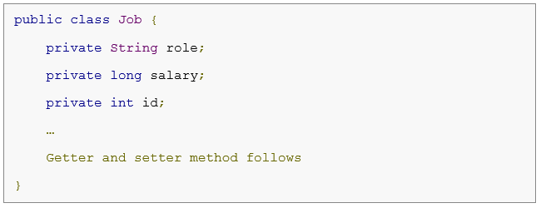
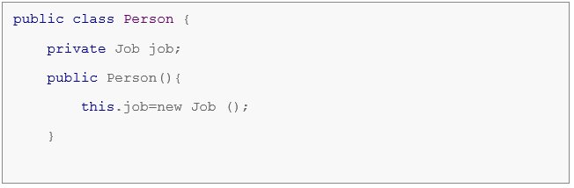
An Example …

Slide 4
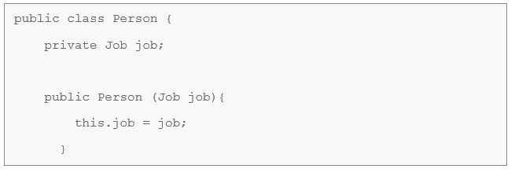
An Example …

Slide 5
Advantages of Spring Framework
Predefined Templates
Loose Coupling
Easy to test

Slide 6
IoC Container
The IoC container is responsible to instantiate, configure and assemble the objects.
The IoC container gets information from the XML file and works accordingly.

Slide 7
Two Types of IoC Containers 1) Bean Factory 2) Application Context

Slide 8
Two Types of IoC Containers 1) Bean Factory
Resource resource=new ClassPathResource("applicationContext.xml");
BeanFactory factory=new XmlBeanFactory(resource);

Slide 9
Two Types of IoC Containers 1) Bean Factory 2) Application Context ApplicationContext context = new ClassPathXmlApplicationContext( "applicationContext.xml");
Resource resource=new ClassPathResource("applicationContext.xml");
BeanFactory factory=new XmlBeanFactory(resource);

Slide 10
How to perform Dependency Injection ? 1) Dependency Injection by Constructor 2) Dependency Injection by Setter method

Slide 11
How to perform Dependency Injection ? 1) Dependency Injection by Constructor 2) Dependency Injection by Setter method
<bean id="e" class=" com.ajp.ClassName ">
<constructor-arg value="10" type="int" ></constructor-arg>
<constructor-arg value="ABC"></constructor-arg>
</bean>

Slide 12
How to perform Dependency Injection ? 1) Dependency Injection by Constructor 2) Dependency Injection by Setter method <bean id="obj" class="com.ajp.ClassName"> <property name="id"> <value>20</value> </property> </bean>

Slide 13
Spring Beans
A bean is an object that is instantiated, assembled, and managed by a Spring IoC container.
These beans are created with the configuration metadata that you supply to the container, for example, in the form of XML <bean/> definitions.

Slide 14
Spring Beans Configuration Metadata
PROPERTIES | DESCRIPTION
class | This attribute is mandatory and specify the bean class to be used to create the bean.
name | This attribute specifies the bean identifier uniquely. In XML-based configuration metadata, you use the id and/or name attributes to specify the bean identifier(s).
scope | This attribute specifies the scope of the objects created from a particular bean definition
constructor-arg | This is used to inject the dependencies using constructor
properties | This is used to inject the dependencies using setter method
lazy-initialization mode | A lazy-initialized bean tells the IoC container to create a bean instance when it is first requested, rather than at startup.

Slide 15
Scope of Beans
SCOPE | DESCRIPTION
singleton | This scopes the bean definition to a single instance per Spring IoC container (default).
prototype | This scopes a single bean definition to have any number of object instances.
request | This scopes a bean definition to an HTTP request. Only valid in the context of a web-aware Spring ApplicationContext.
session | This scopes a bean definition to an HTTP session. Only valid in the context of a web-aware Spring ApplicationContext.
global-session | This scopes a bean definition to a global HTTP session. Only valid in the context of a web-aware Spring ApplicationContext.

Slide 16
Spring JdbcTemplate
Spring JdbcTemplate is a powerful mechanism to connect to the database and execute SQL queries.
It internally uses JDBC API, but eliminates a lot of problems of JDBC API.

Slide 17
Spring JdbcTemplate
METHODS | FUNCTIONALITY
public int update(String query) | To insert, update and delete records.
public int update(String query, Object... args) | To insert, update and delete records using PreparedStatement using given arguments.
public void execute(String query) | To execute DDL query.
Public T execute(String sql, PreparedStatementCallback action) | To execute the query by using PreparedStatement callback.
public List query(String sql, RowMapper rse) | To fetch records using RowMapper.

