Slide 1


Android Introduction

Slide 2

What is Android?
Android is a software stack for mobile devices that includes an operating system, middleware and key applications.

Slide 3




Versions of Android
Android Beta
Android Cupcake 1.5
Android Donut 1.6

Slide 4
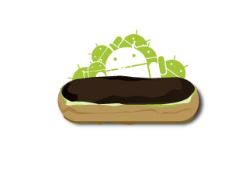
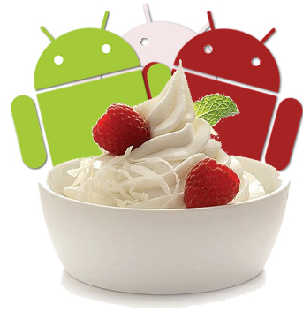

Android Éclair 2.0/2.1
Android Froyo 2.2-2.2.3
Android Gingerbread 2.3-2.3.7

Slide 5

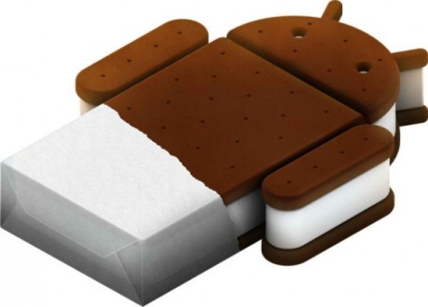

Android Honeycomb 3.0-3.2.6
Android IceCreamSandwich
(ICS) 4.0 – 4.0.4
Android JellyBean 4.1- 4.3.1

Slide 6
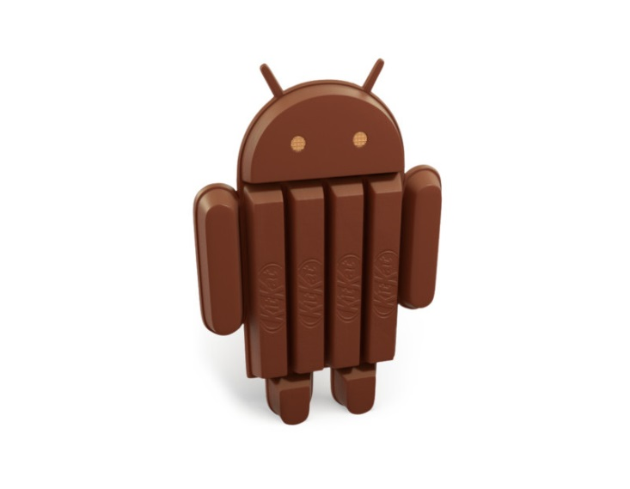

Android KitKat 4.4 – 4.4.4
Android Lollipop 5.0 – 5.1.1

Slide 7
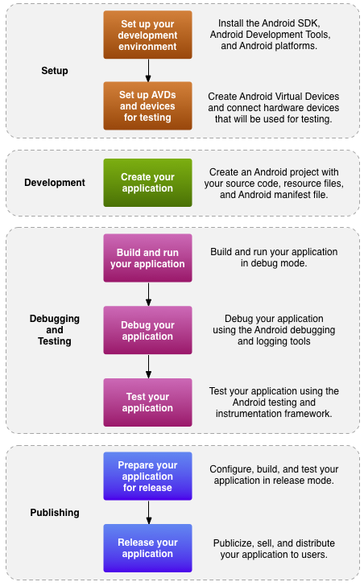
Development process for an Android app
http://developer.android.com/guide/developing/index.html

Slide 8
Android Apps
Built using Java and new SDK libraries
No support for some Java libraries like Swing & AWT
Java code compiled into Dalvik byte code (.dex)
Optimized for mobile devices (better memory management, battery utilization, etc.)
Dalvik VM runs .dex files

Slide 9
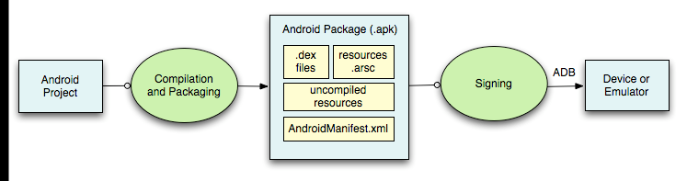
Building and running
ADB is a client server program that connects clients on developer machine to devices/emulators to facilitate development.
An IDE like Eclipse handles this entire process for you.
Compiled resources
(xml files)
Android Debug Bridge
http://developer.android.com/guide/developing/building/index.html#detailed-build

Slide 10
Basics of Android
The programming language for Android is Java
Projects consist mainly of ----
Activities and other java classes
Xml layout files
Resource folder
Properties file
Manifest file

Slide 11
Android Application Development
Eclipse IDE
Android SDK
Android mobile
Device
Android Emulator

Slide 12
Application Fundamentals
Applications are written using Java
Apk (Android Package) : The Android Asset Packaging Tool generates files containing the code and any data and resources needed
Each application runs in its own Linux process
Each application has its own VM

Slide 13
Application Components
A central feature of Android is that one application can make use of elements of other applications (provided those applications permit it)
Android applications don't have a single entry point for everything in the application (no main() function, for example)

Slide 14
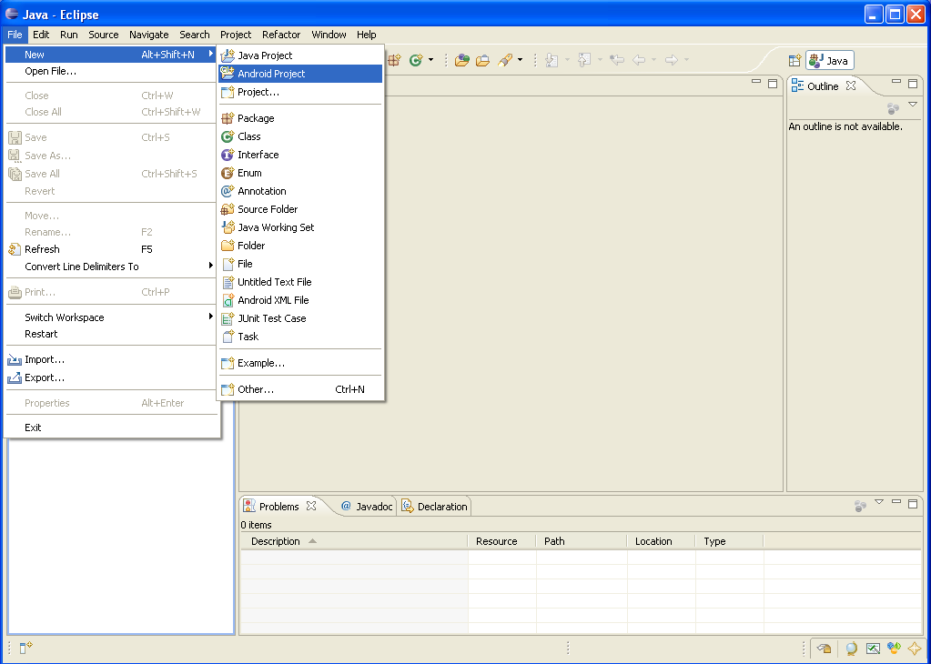
Creating a Project (1)

Slide 15
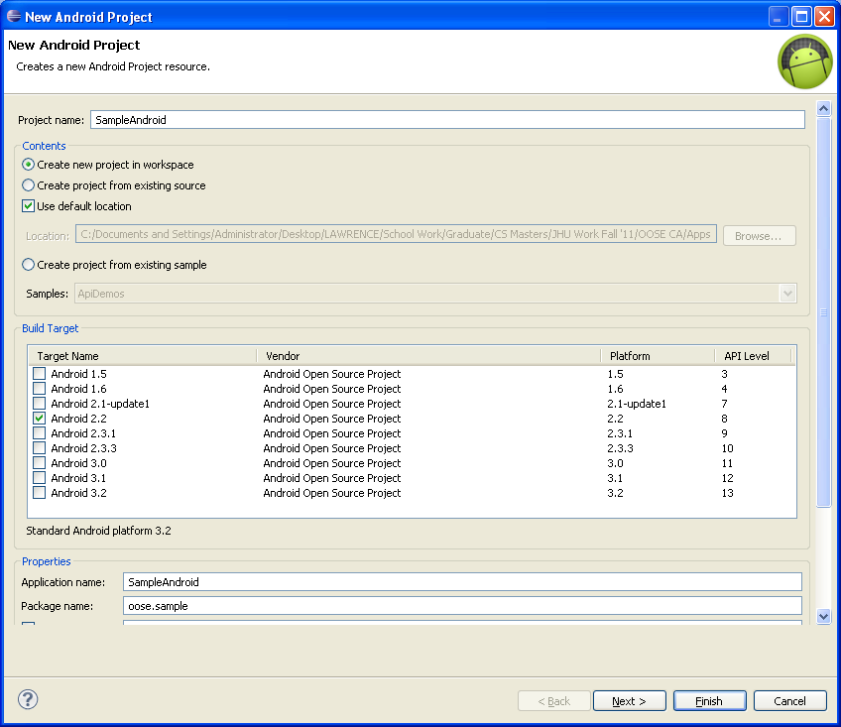
Creating a Project (2)
Need
the
items
circled
Then
click
Finish

Slide 16
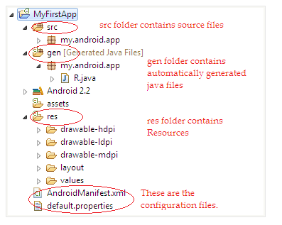
Project Components
src – your source code
gen – auto-generated code (usually just R.java)
Included libraries
Resources
Drawables (like .png images)
Layouts
Values (like strings)
Manifest file

Slide 17
XML
Used to define some of the resources
Layouts (UI)
Strings
Manifest file
Shouldn’t usually have to edit it directly, Eclipse can do that for you
Preferred way of creating UIs
Separates the description of the layout from any actual code that controls it
Can easily take a UI from one platform to another

Slide 18
R Class
Auto-generated: you shouldn’t edit it
Contains IDs of the project resources
Enforces good software engineering
Use findViewById and Resources object to get access to the resources
Ex. Button b = (Button)findViewById(R.id.button1)
Ex. getResources().getString(R.string.hello));

Slide 19
Layouts (1)
Eclipse has a great UI creator
Generates the XML for you
Composed of View objects
Can be specified for portrait and landscape mode
Use same file name, so can make completely different UIs for the orientations without modifying any code

Slide 20
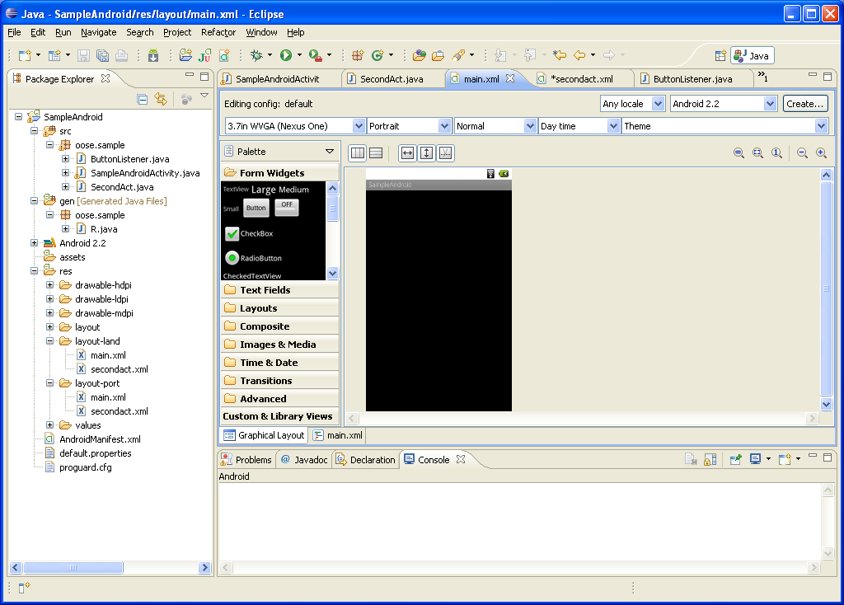
Layouts (2)

Slide 21
Layouts (3)
Click ‘Create’ to make layout modifications
When in portrait mode can select ‘Portrait’ to make a res sub folder for portrait layouts
Likewise for Landscape layouts while in landscape mode
Will create folders titled ‘layout-port’ and ‘layout-land’
Note: these ‘port’ and ‘land’ folders are examples of ‘alternate layouts’, see here for more info
http://developer.android.com/guide/topics/resources/providing-resources.html
Avoid errors by making sure components have the same id in both orientations, and that you’ve tested each orientation thoroughly

Slide 22
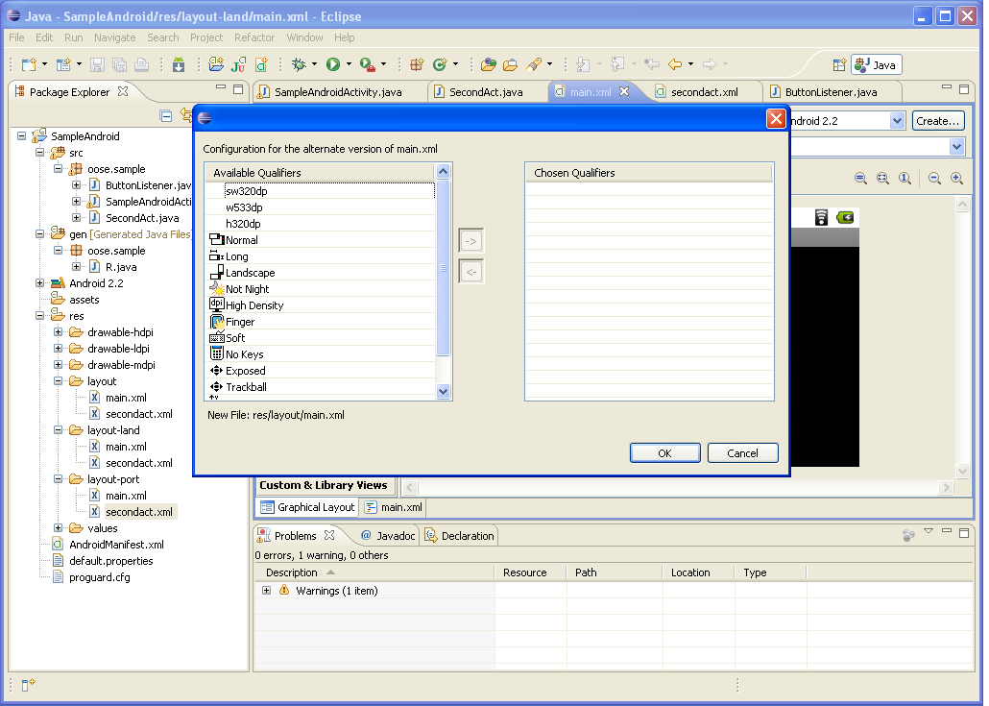
Layouts (4)

Slide 23
Strings
In res/values
strings.xml
Application wide available strings
Promotes good software engineering
UI components made in the UI editor should have text defined in strings.xml
Strings are just one kind of ‘Value’ there are many others

Slide 24
Manifest File (1)
Contains characteristics about your application
When have more than one Activity in app, NEED to specify it in manifest file
Go to graphical view of the manifest file
Add an Activity in the bottom right
Browse for the name of the activity
Need to specify Services and other components too
Also important to define permissions and external libraries, like Google Maps API

Slide 25
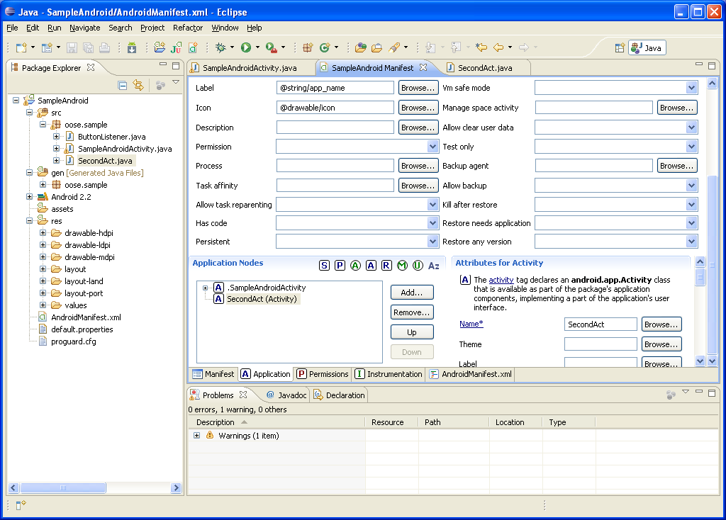
Manifest File (2) – Adding an Activity

Slide 26
Starting with an activity
The main starting point of most applications
There is no concept of “main” program
Each activity can be executed or invoked at any time
One application can have multiple “activities”
An Activity can have several “Views” or “View Groups” to define its user inteface.

Slide 27
Views in an activity
The user interface is built using View and ViewGroup objects
Views are basic units of user interface on the Android platform
ViewGroup is a special view that can contain other views.

Slide 28
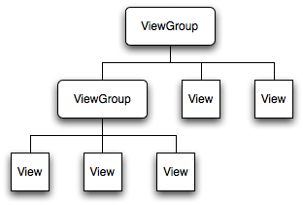
View Hierarchy
Activity must call the setContentView()

Slide 29
If you have worked with C, C++ or Java programming language then you must have seen that your program starts from main() function. Very similar way, Android system initiates its program with in an Activity starting with a call ononCreate() callback method. There is a sequence of callback methods that start up an activity and a sequence of callback methods that tear down an activity as shown in the below Activity life cycle diagram:

Slide 30
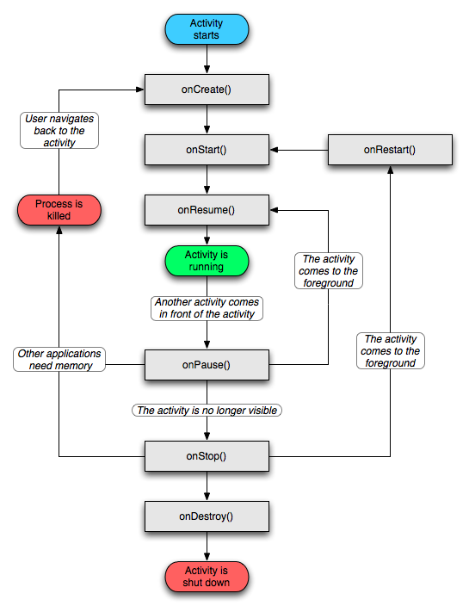
Activity Lifecycle

Slide 31
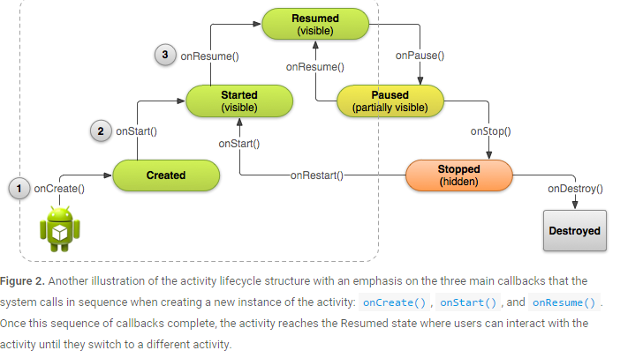
Activity Life Cycle

Slide 32
Callback | Description
onCreate() | This is the first callback and called when the activity is first created.
onStart() | This callback is called when the activity becomes visible to the user.
onResume() | This is called when the user starts interacting with the application.
onPause() | The paused activity does not receive user input and cannot execute any code and called when the current activity is being paused and the previous activity is being resumed.
onStop() | This callback is called when the activity is no longer visible.
onDestroy() | This callback is called before the activity is destroyed by the system.
onRestart() | This callback is called when the activity restarts after stopping it

Slide 33
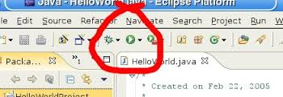
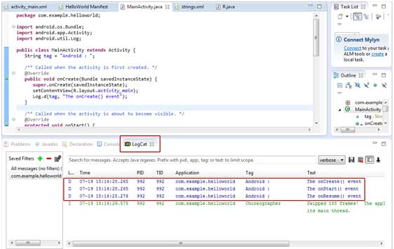

Slide 34


Slide 35


Slide 36



Slide 37
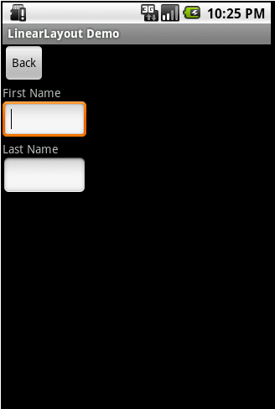
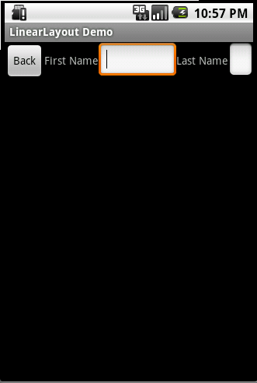
Different Layouts
Linear Layout

Slide 38
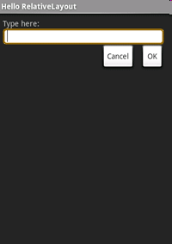
Relative Layout

Slide 39
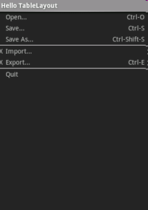
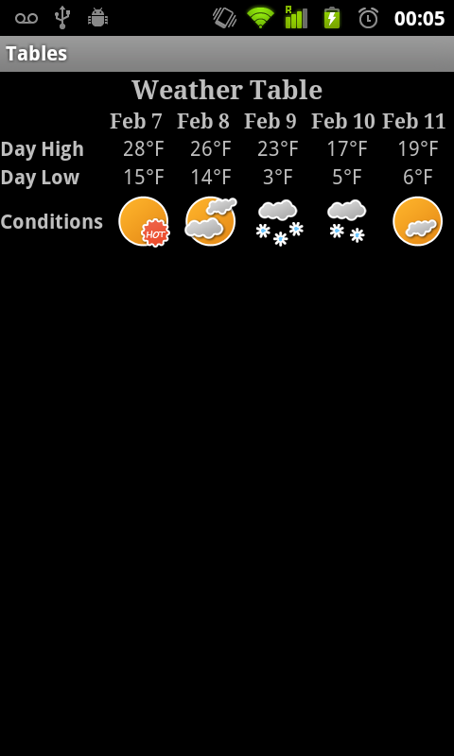
Table Layout

Slide 40
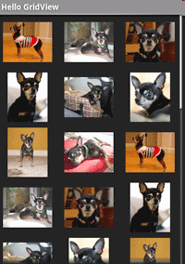
Grid View

Slide 41
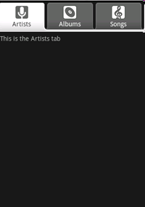
Tab Layout

Slide 42
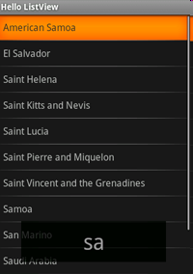
List View

Slide 43
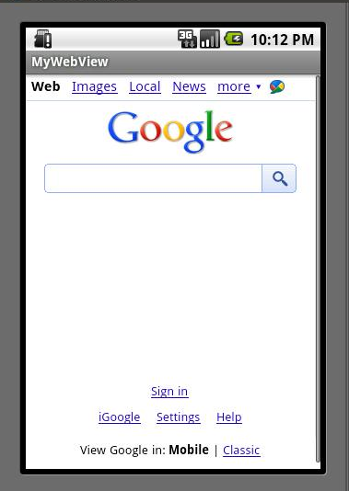
Web View

Slide 44
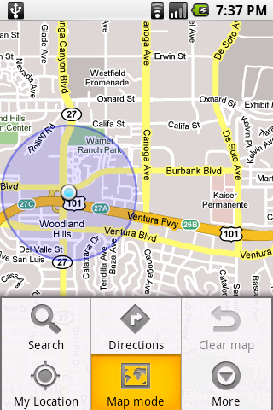
Map View
One of the most exciting features of android is that it can directly integrate Google maps in an app with Google map library that comes with the API, map activities like zooming, finding, tagging etc. can be easily accomplished and with GPS many location based services can be created.

Slide 45
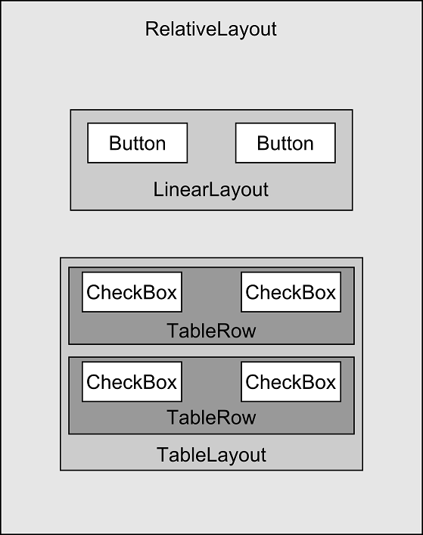
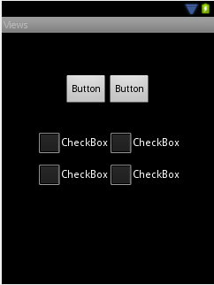
Example of GUI

Slide 46
The Android Developer Website
http://developer.android.com/index.html
This should be your homepage for the next semester!

