Slide 1
Data Mining Project – Telecommunications
Presented by: Kashish Gupta
Roll Number - 1240258223
Course: BCA – Data Science & Artificial Intelligence
Software Used: IBM SPSS Modeler

Slide 2
Introduction
Customer churn is an important business problem in the telecommunications industry.
The aim of this project is to identify customers who are likely to leave the company by using historical customer data and a CHAID decision-tree model.
The trained model is then applied to current customers to identify those who are at high risk of churn.
Goal: Predict churn → Identify high-risk customers → Help the company take retention action
Customer Data
↓
Churn Prediction
↓
High-Risk Customers
↓
Retention Action

Slide 3
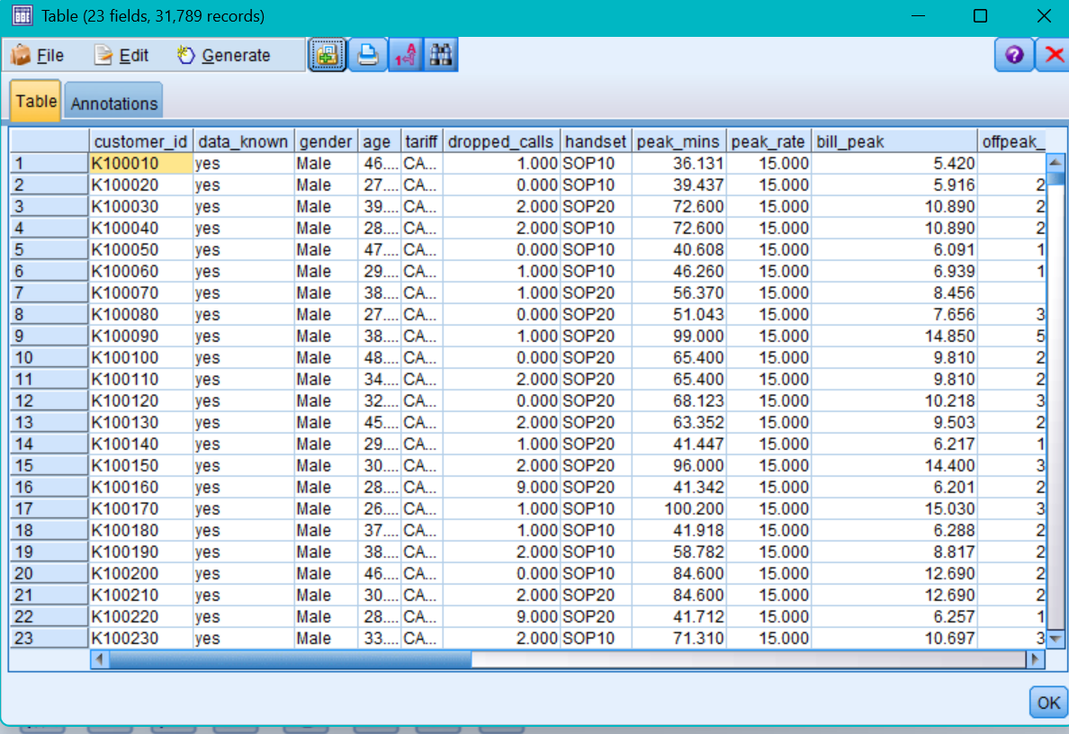
Dataset Used
1. Historical / Modeling Dataset
File: telco x modeling data.xlsx
Purpose:
Used to build and train the
prediction model.
2. Deployment Dataset
File:
telco x deployment data.xlsx
Purpose:
Used to apply the trained model
to current customers.

Slide 4
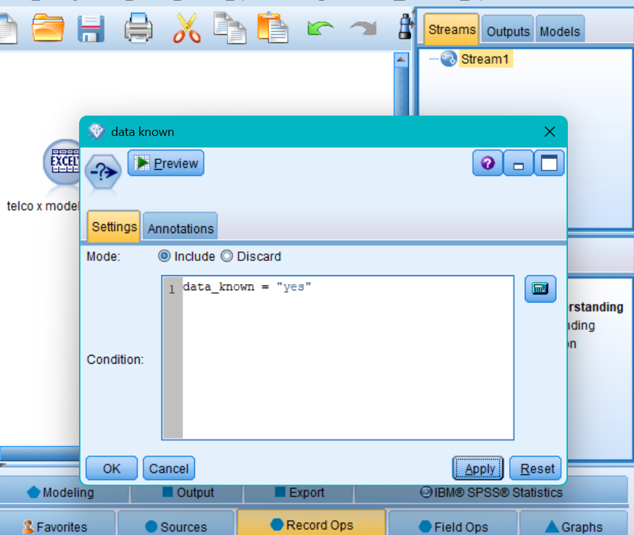
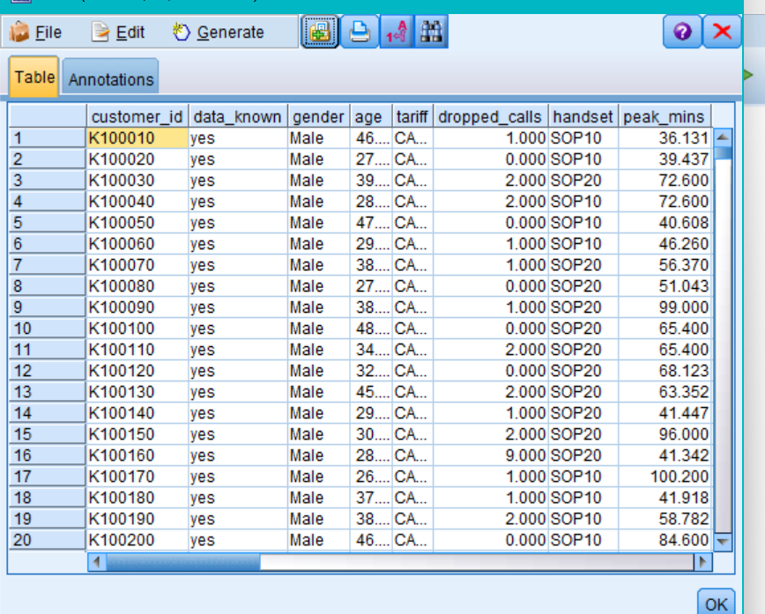
Data Preprocessing
Before building the model, the dataset was checked and records with unknown data were removed.

Slide 5
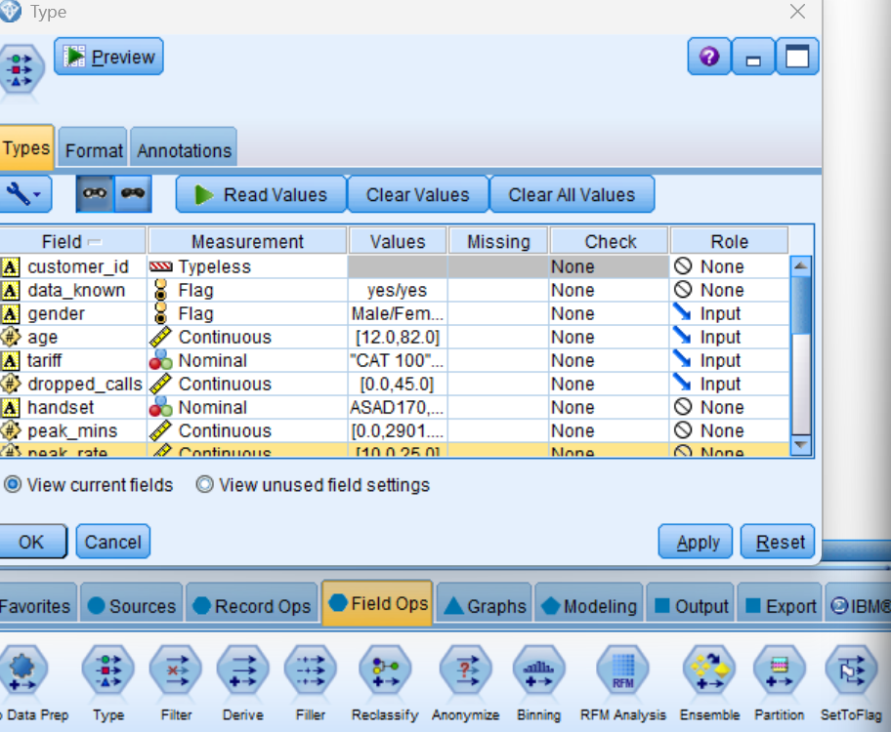
Field Roles
The Type node was used to define the role of each field before building the model.
Field | Role
Gender | Input
Age | Input
Tariff | Input
Dropped Calls | Input
Handset | Input

Slide 6
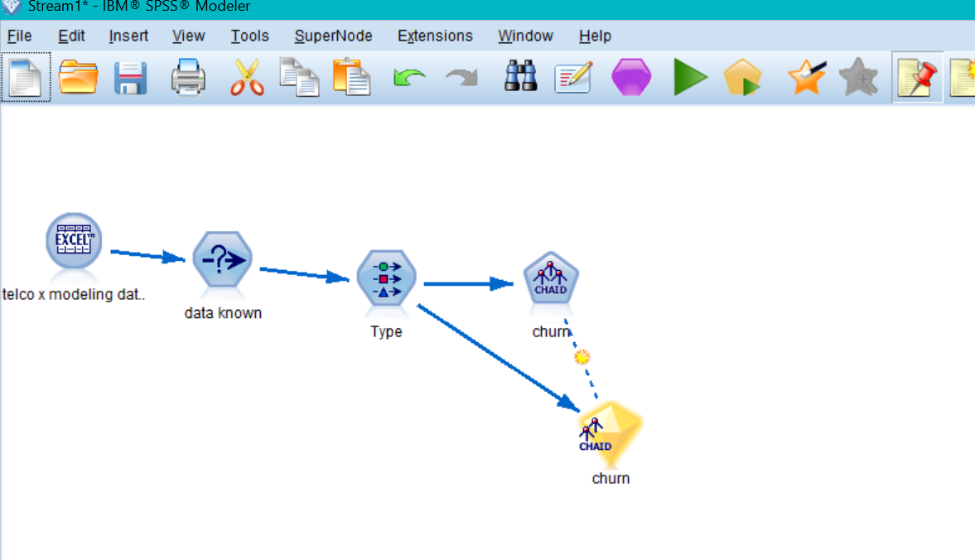
CHAID Model
CHAID (Chi-squared Automatic Interaction Detection) was used to build the customer churn prediction model.
Historical Data
↓
Data Selection
↓
Type Node
↓
CHAID
↓
Churn Prediction Model

Slide 7
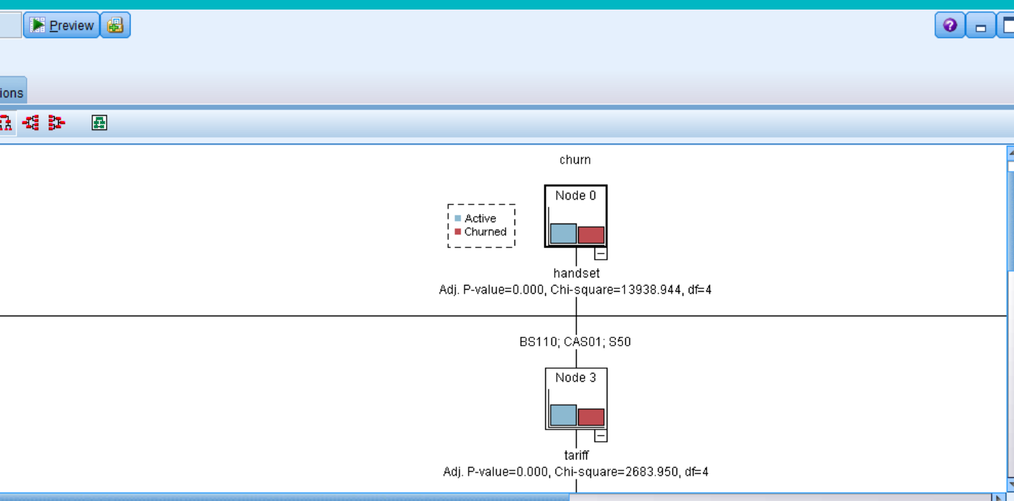
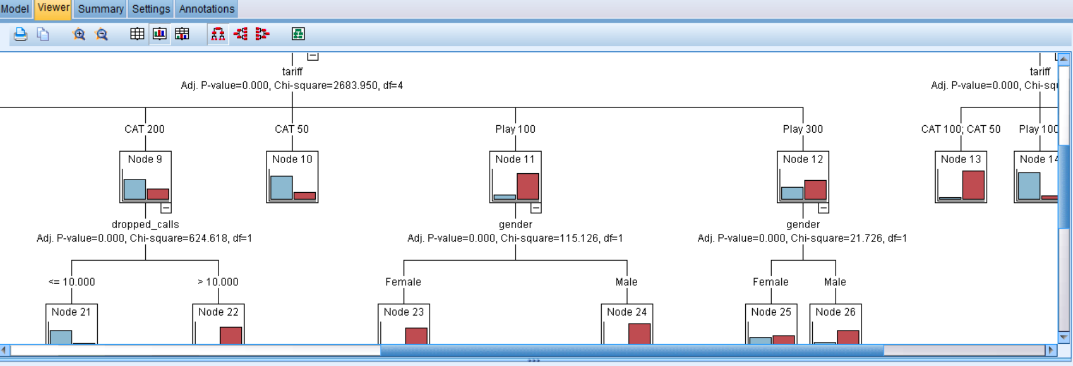
CHAID Decision Tree
The CHAID model generated a decision tree showing how customer characteristics are related to churn.
Key result from the project:
The first major split in the example model is based on:
Handset
Further splits include variables such as:
Tariff
Gender
The project output shows:
Total customers: 31,769
Active: 17,056 (53.688%)
Churned: 14,713 (46.312%)

Slide 8
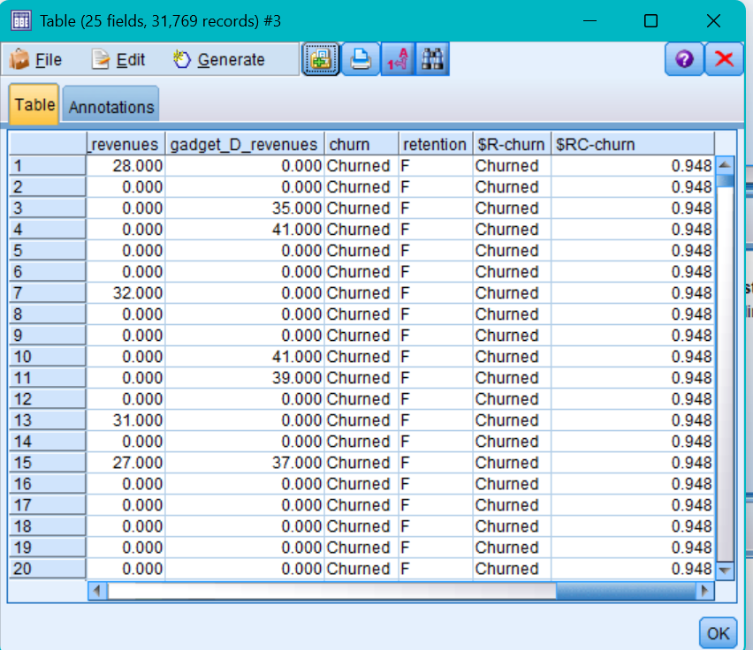
Model Prediction
After building the model, IBM SPSS Modeler generated prediction fields for each customer.
$R-churn Predicted churn category.
$RC-churn Confidence associated with the prediction.
$R-churn → Churned
$RC-churn → 0.948

Slide 9
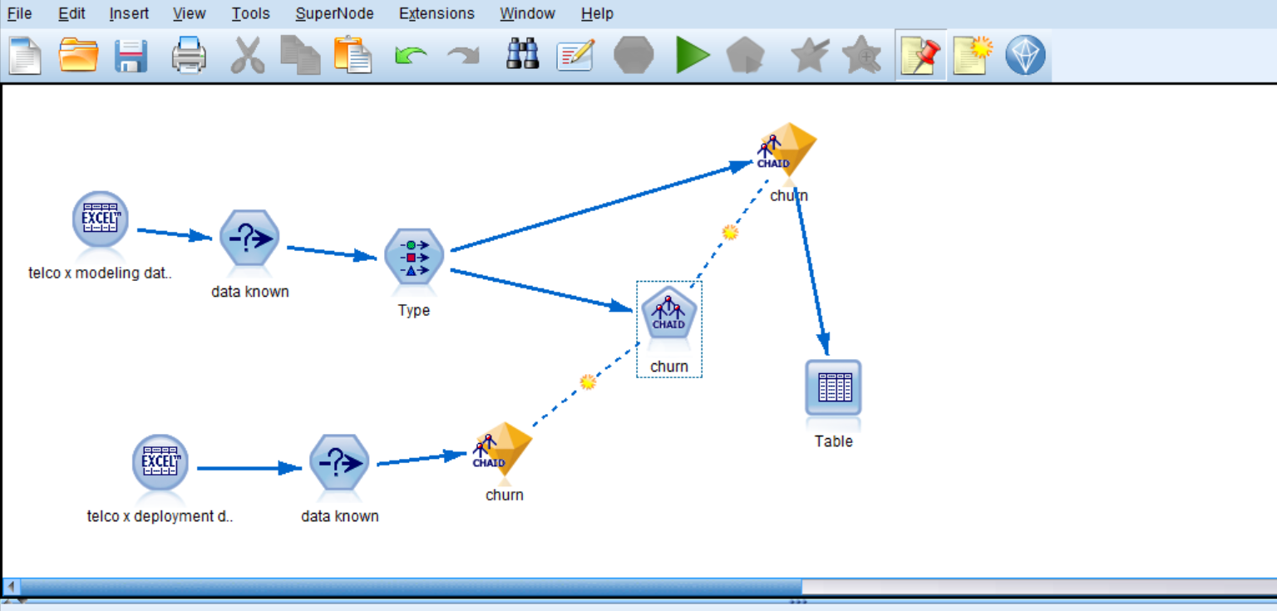
Scoring Current Customers
After building the model using historical data, the trained CHAID model was applied to the current customer dataset.
Dataset: telco x deployment data.xlsx
Current Customers
↓
Data Validation
↓
Trained CHAID Model
↓
Churn Prediction
↓
Risk Identification

Slide 10
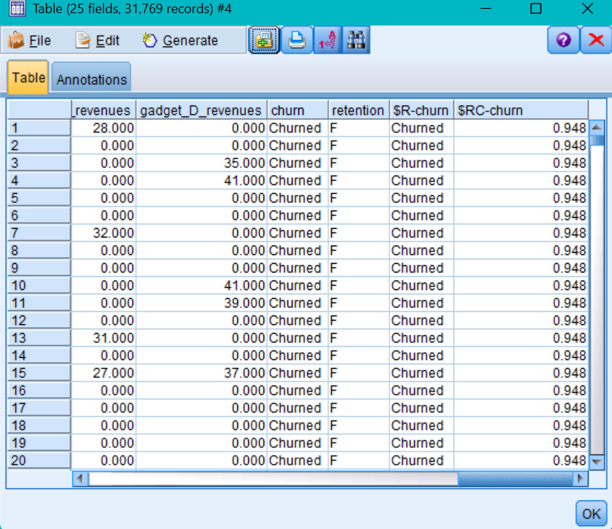
Identifying Customers at Risk
Customers were selected as high-risk customers when the model predicted them as "Churned" and the confidence value was greater than 0.9.
$R-churn = "Churned"
AND
$RC-churn > 0.9

Slide 11
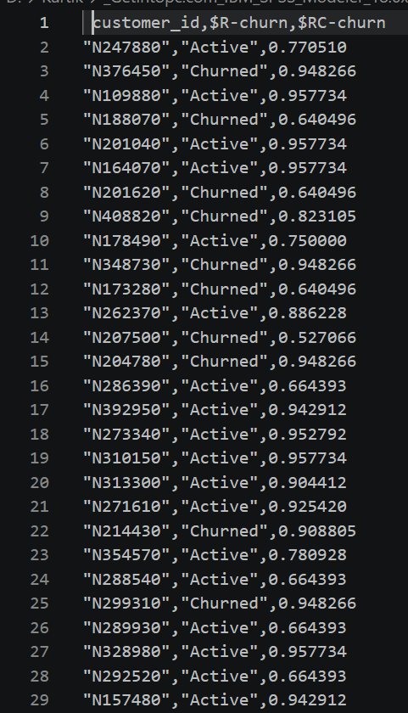
Final Output
After identifying high-risk customers, unnecessary fields were removed and the prediction fields were renamed for easier interpretation.
customer_id
predicted value
probability to churn
Customers at Risk
↓
Filter
↓
Flat File
↓
customers at risk.dat

Slide 12
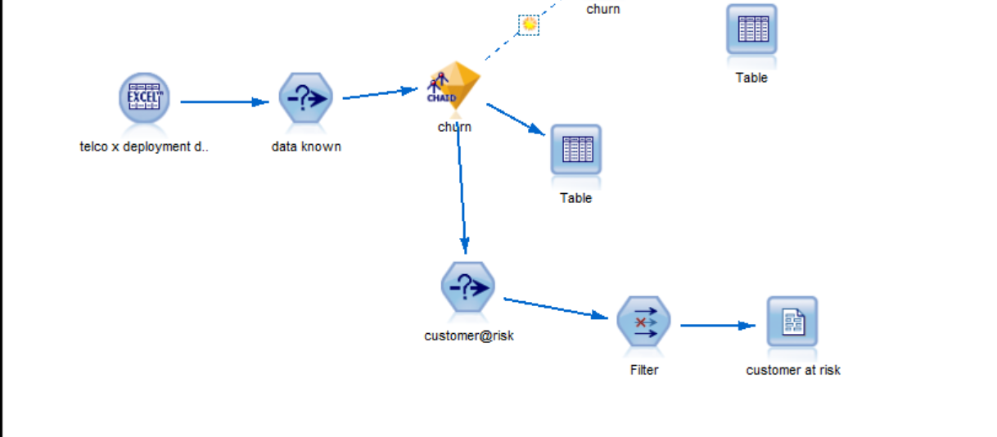
Complete Workflow
HISTORICAL DATA
↓
Excel Import
↓
Data Selection
↓
Type Node
↓
CHAID Model
↓
Churn Prediction
↓
CURRENT CUSTOMERS
↓
Excel Import
↓
Apply CHAID Model
↓
Identify High-Risk
Customers
↓
Filter Data
↓
customers at risk.dat

