Slide 1
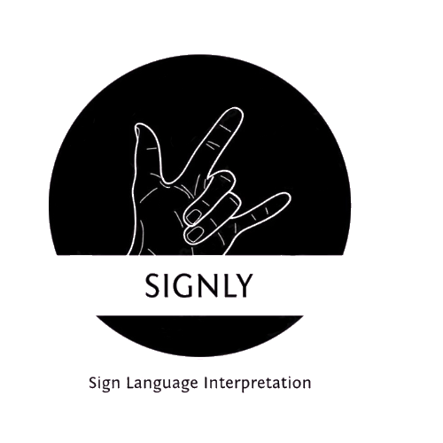
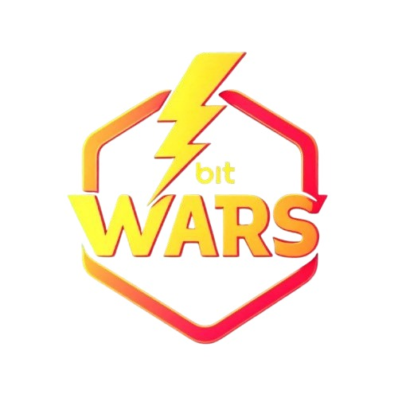
BITWARS – 2025
TITLE PAGE
Problem Statement – Sign Language Interpretation For Deaf and Mute
Theme – Education and Social Services
PS Category – Software and AI
Team Name – SignVerse
Team Member 1 – Kashish Sharma
Team Member 2 – Piyush Rathore
Team Member 3 – Prajjwal Kumar Singh
Team Member 4 - Aniket Raj

Slide 2
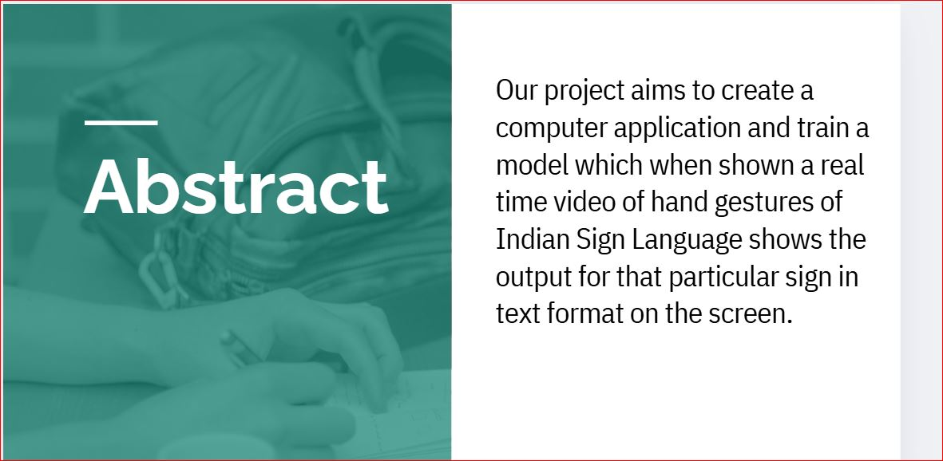
Challenge - Communication barrier for deaf and mute individuals
Objective - More than 70 million deaf people around the world use sign languages to communicate. Sign language allows them to learn, work, access services, and be included in the communities.
It is hard to make everybody learn the use of sign language with the goal of ensuring that people with disabilities can enjoy their rights on an equal basis with others.

Slide 3
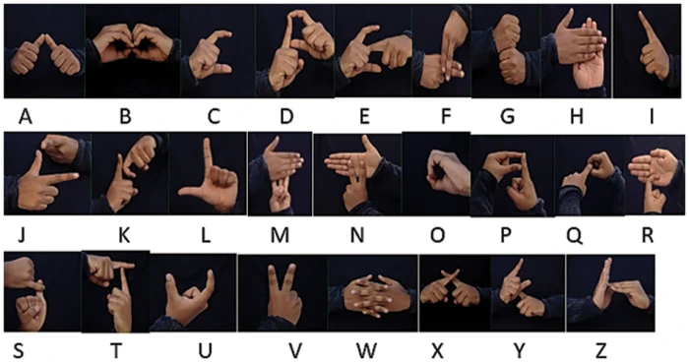
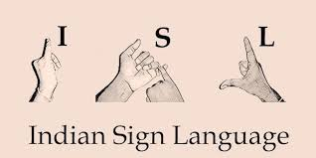
introduction
Presenting to you – SignLy, an AI integrated sign language interpretation model which takes an image of Hand Gesture of Indian Sign Language and shows the output of the particular sign language in text format. It includes speech to text conversion as well.

Slide 4
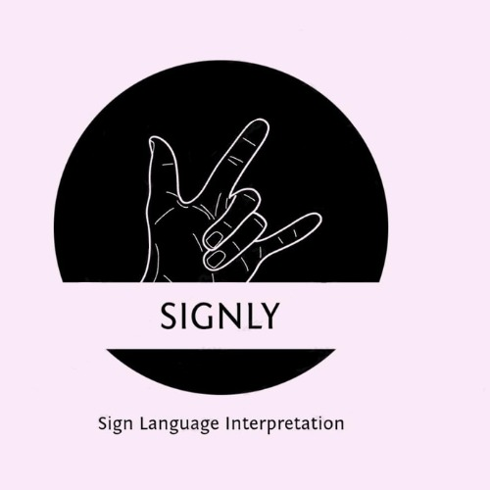
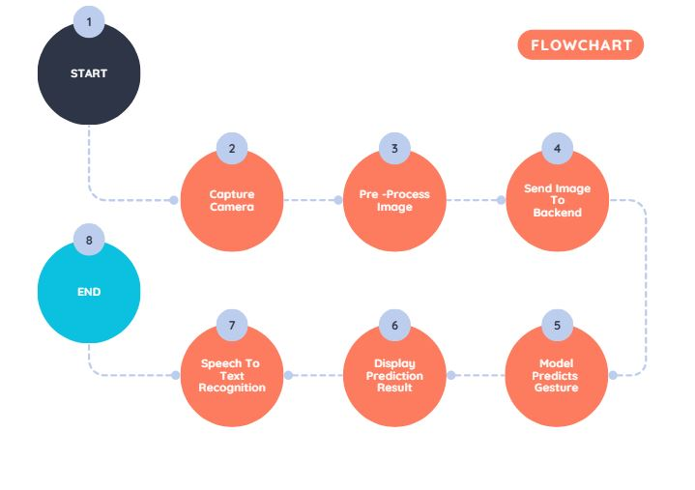
SYSTEM FLOWCHART
Here is a flowchart that illustrates the process of how the Sign Language Recognition system works:
1. Start - The system begins.
2. Capture Image from Camera - The user captures an image or video of a gesture using a camera.
3. Pre-process Image - The image is pre-processed (resized, normalized, etc.) for model input.
4. Send Image to Backend - The processed image is sent to the backend server.
5. Model Predicts Gesture - The model predicts the gesture based on the image.
6. Display Prediction Result - The predicted result (text) is displayed to the user.
7. Speech to Text Recognition - If there's speech input, it's converted into text for further interaction.
8. End - The process completes.

Slide 5
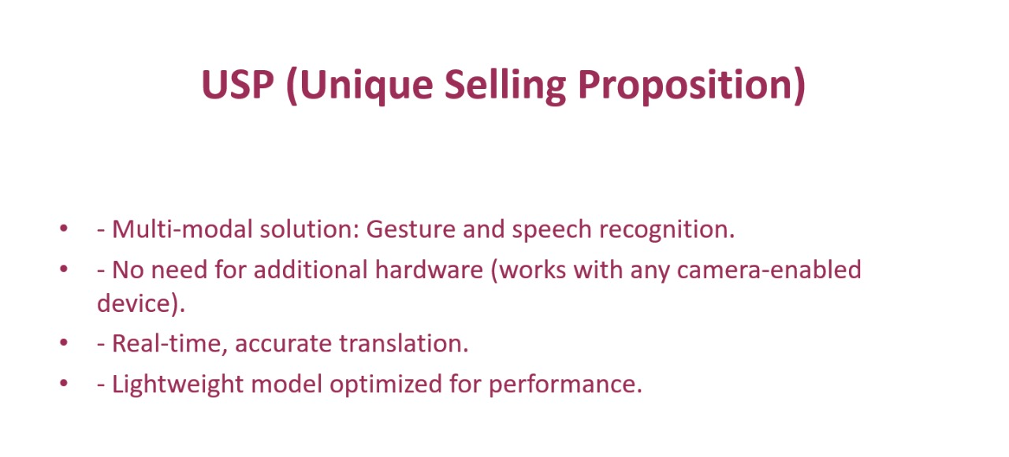
Technologies Used
FRONTEND
Html, css, js
BACKEND/ MACHINE LEARNING
Flask (python framework)
TensorFlow (keras)
NumPy
OpenCV
DEPLOYMENT
Flask API

Slide 6
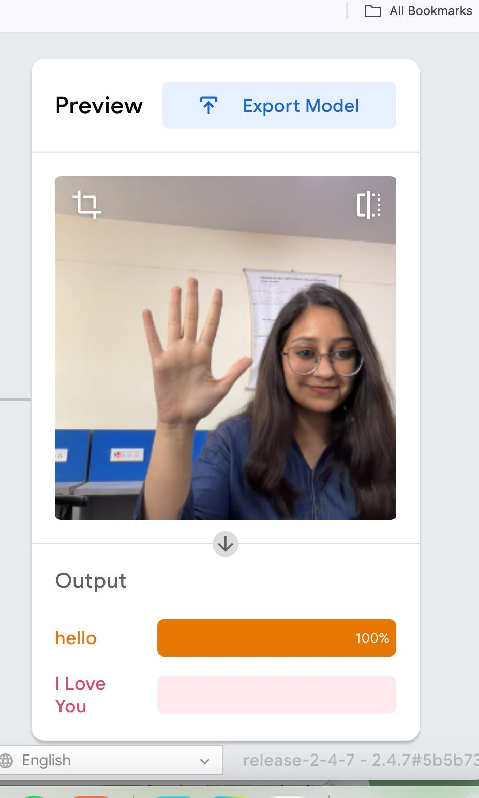

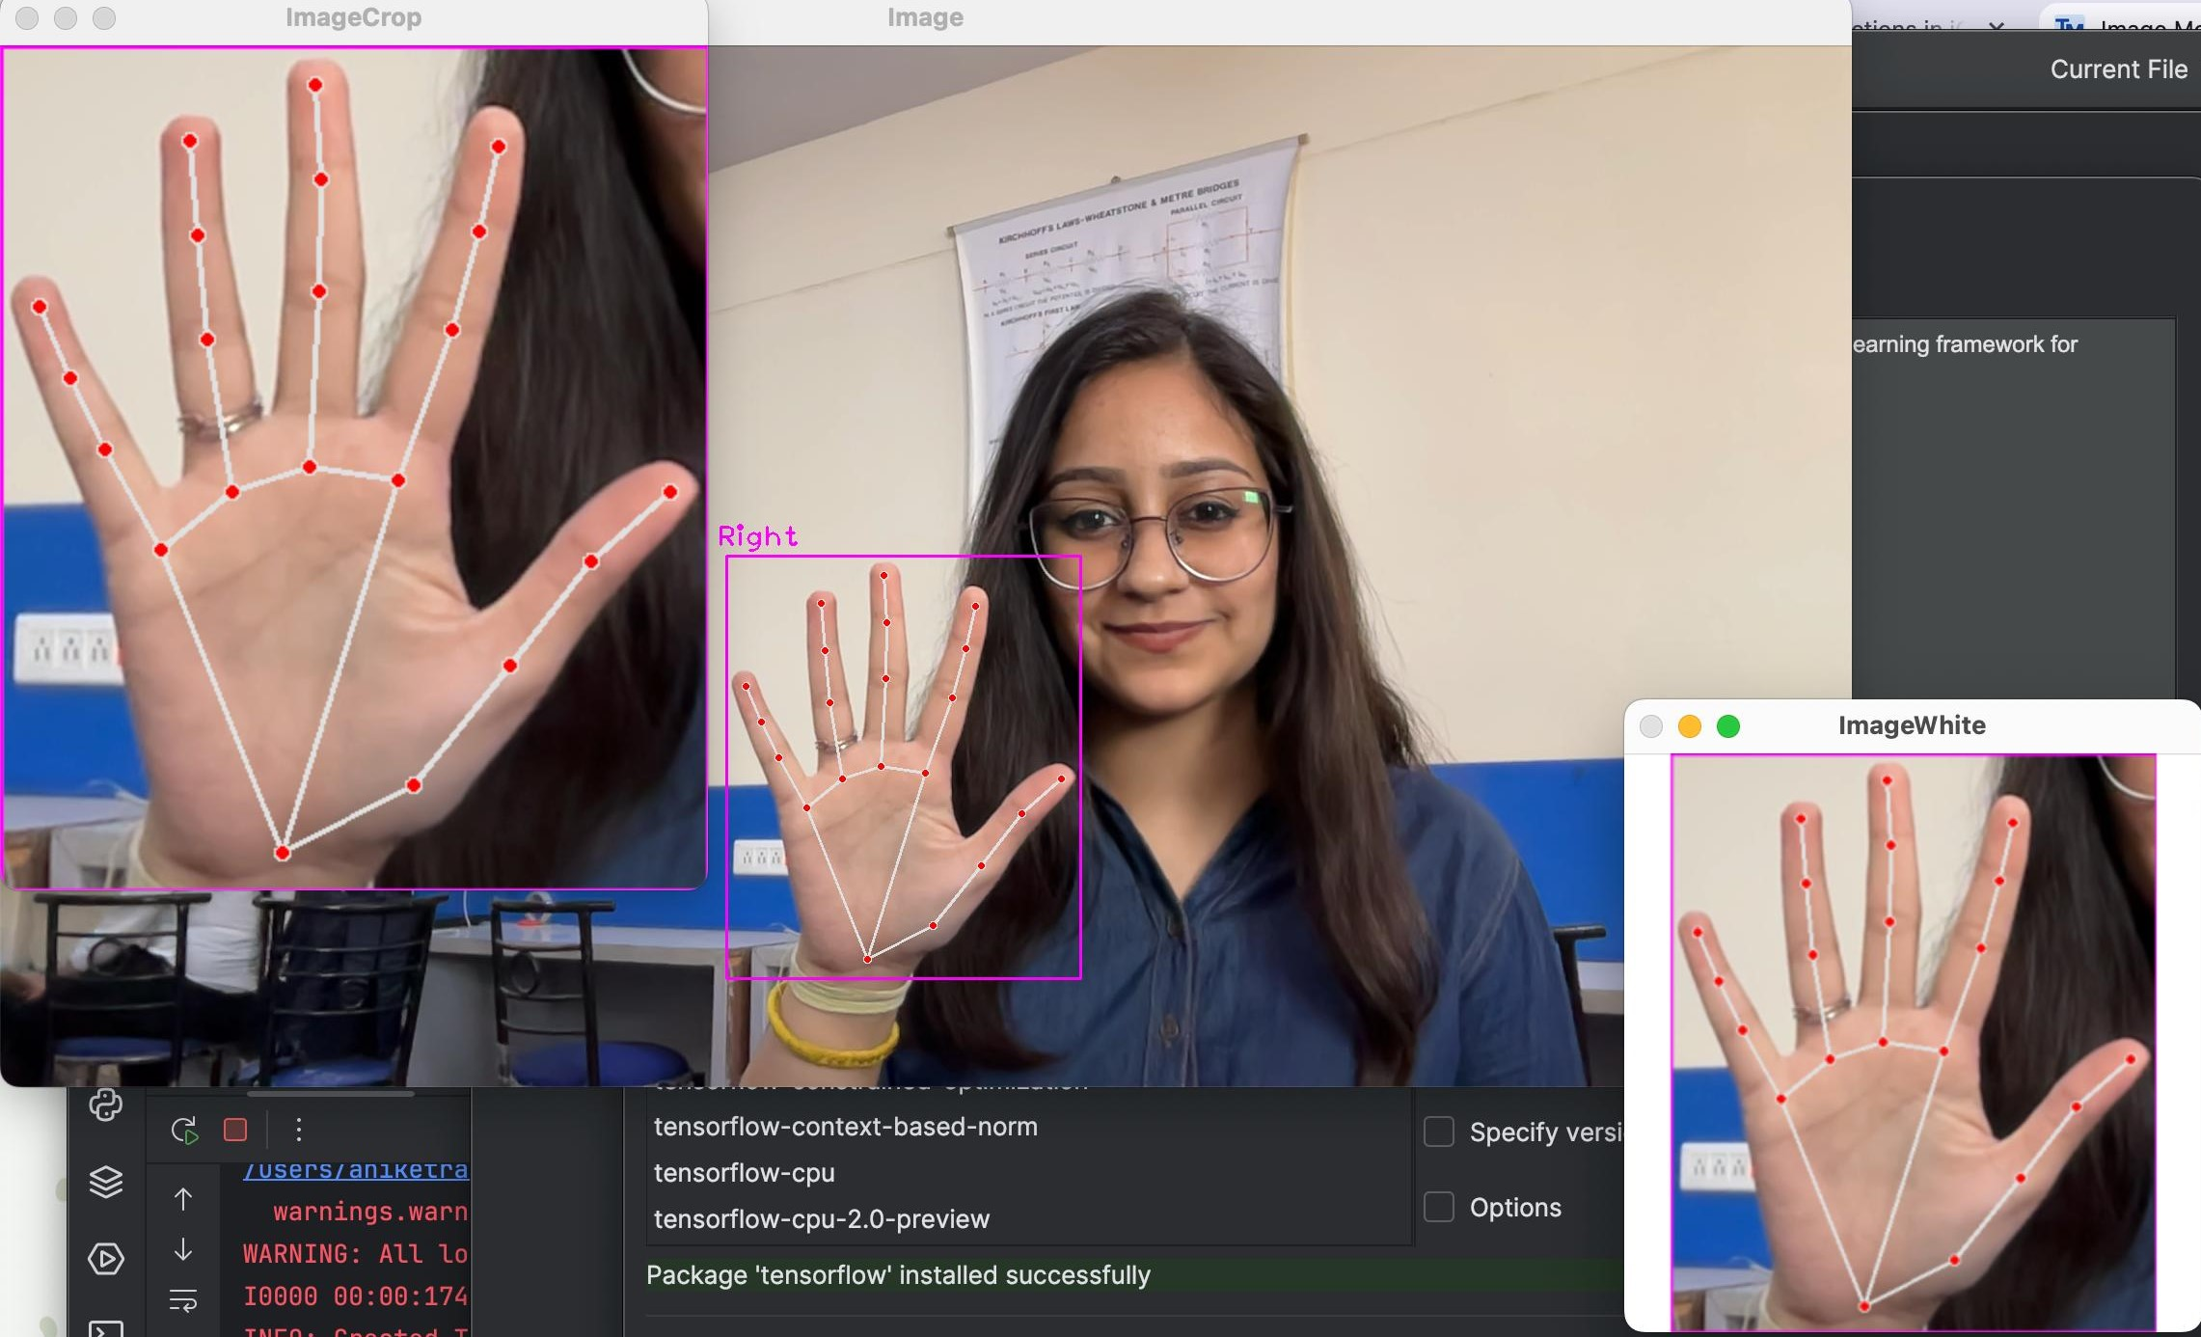
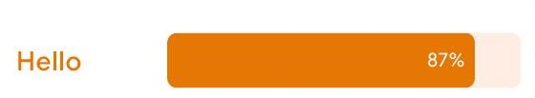
Generation Of Data Set And Data Processing

Slide 7
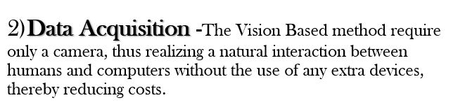
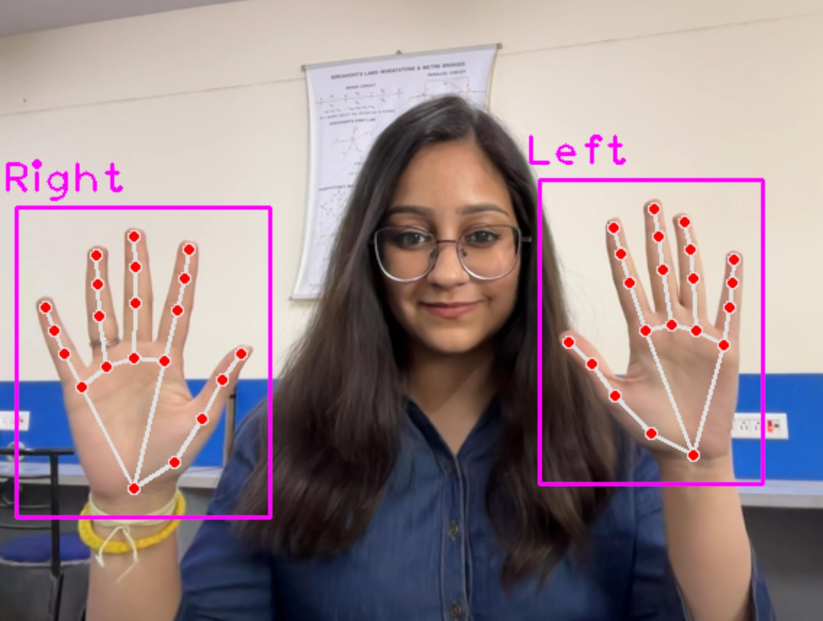
Project Modules
1) Image Gallery - The ISL (Indian Sign Language) Image Gallery on website is an invaluable resource designed to bridge the communication gap for the deaf and mute community. By featuring a wide array of images, it visually represents the signs and gestures used in Indian Sign Language, making it easier for users to learn and understand sign language in an engaging, intuitive way.
Comprehensive Visual Resource: The gallery showcases clear, detailed images of sign language symbols for various words and expressions in ISL. Users can browse through different categories, helping them expand their vocabulary.
Easy Navigation: The user-friendly design ensures that visitors can quickly find the specific signs they are looking for. The images are arranged in a well-organized manner, making it accessible to both beginners and more advanced learners.

Slide 8
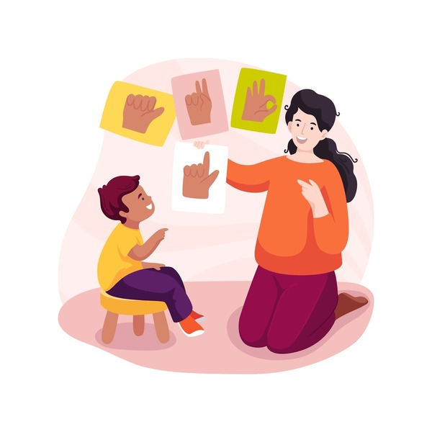
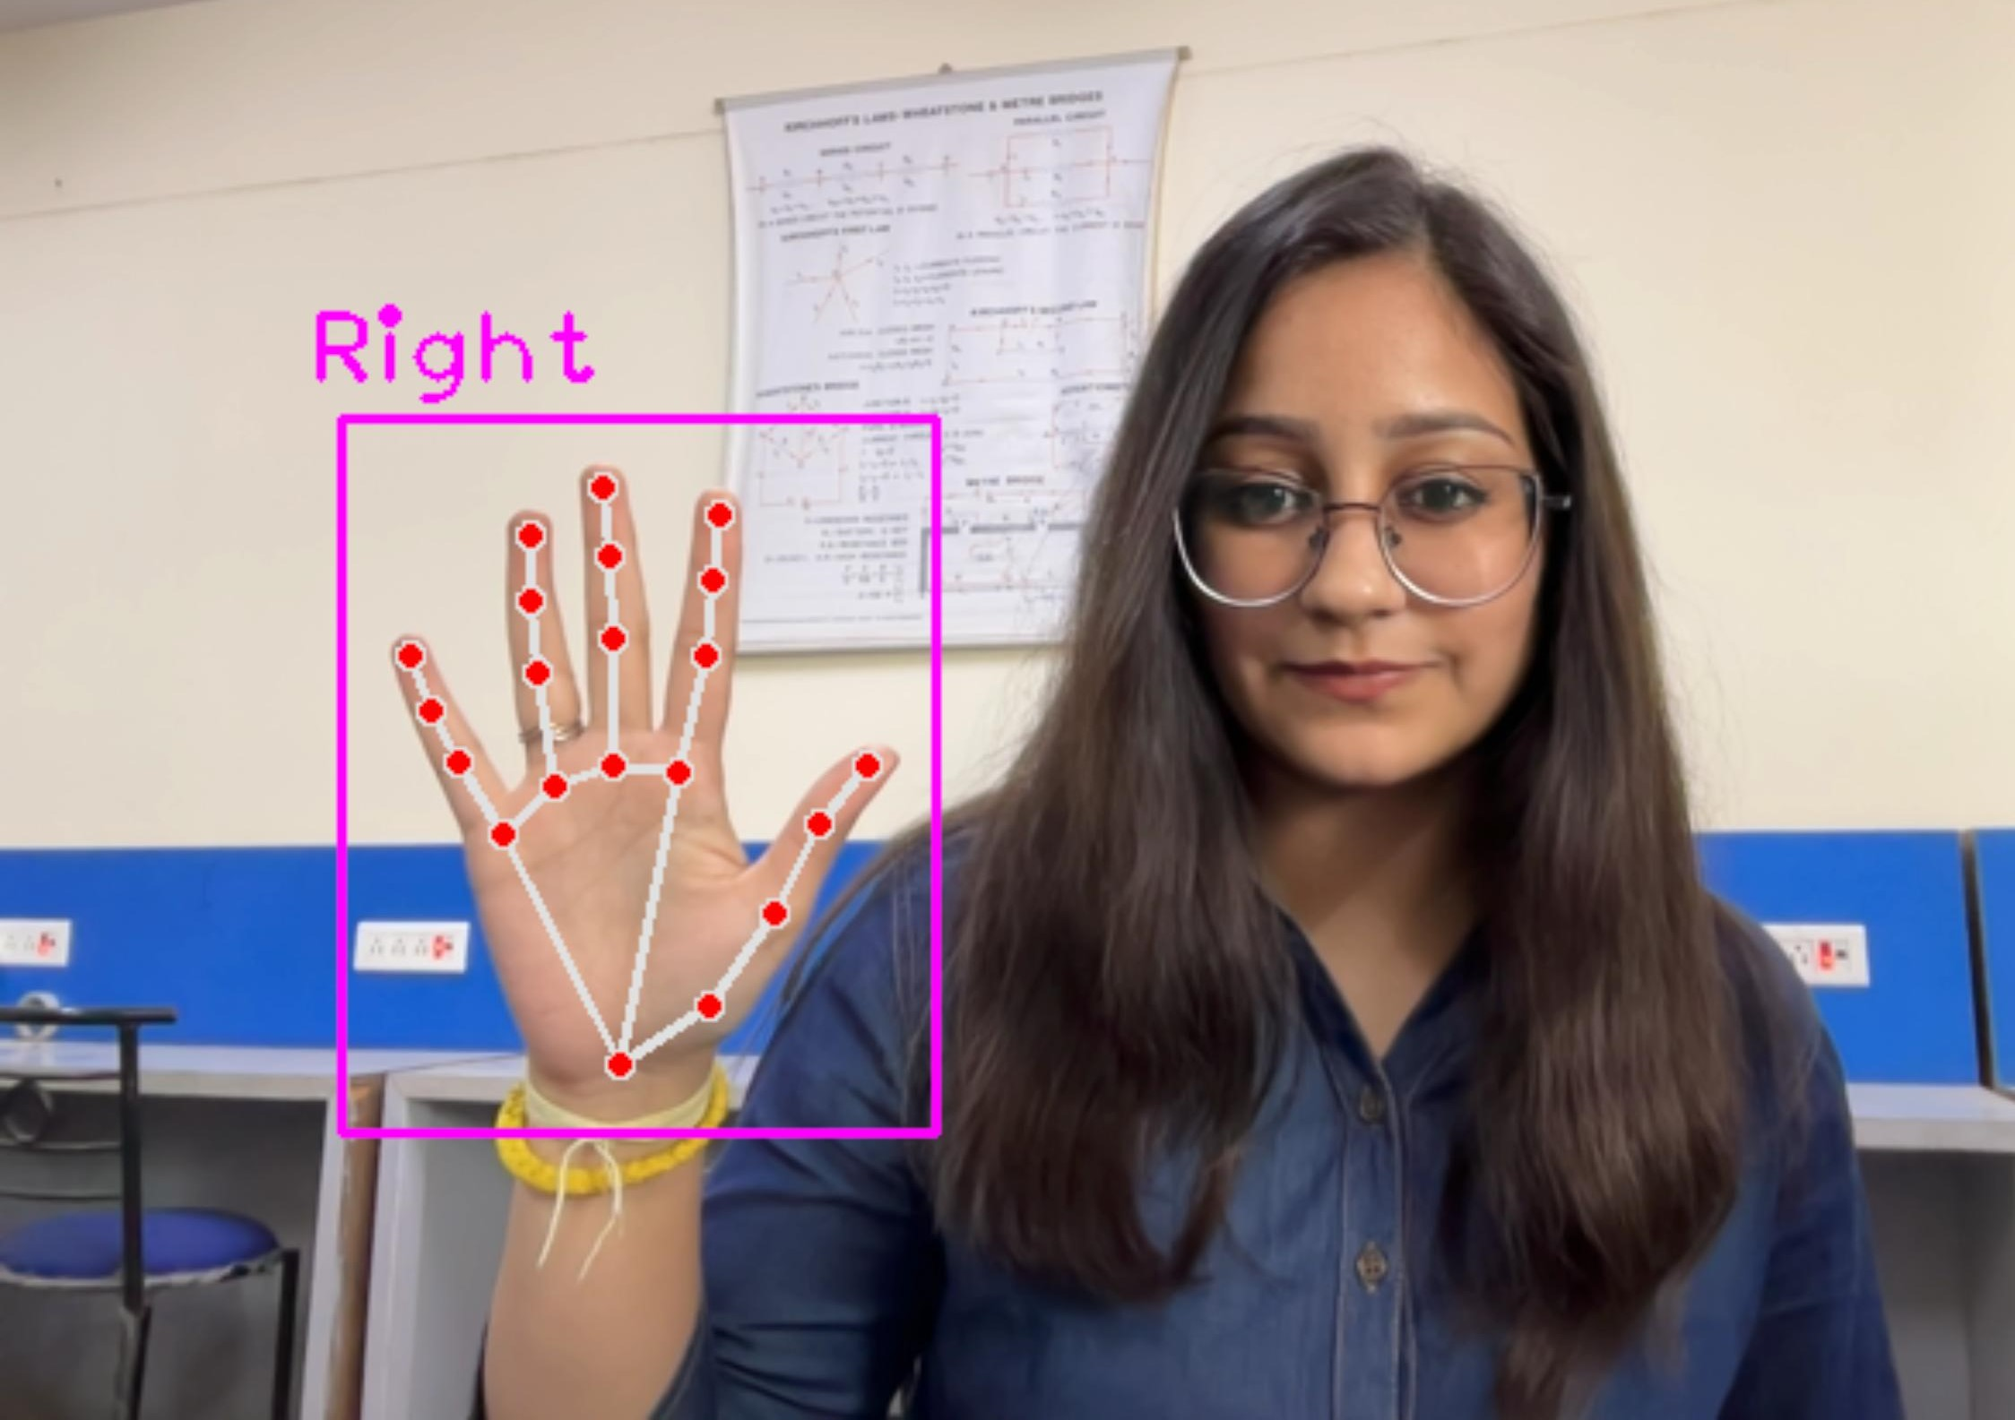
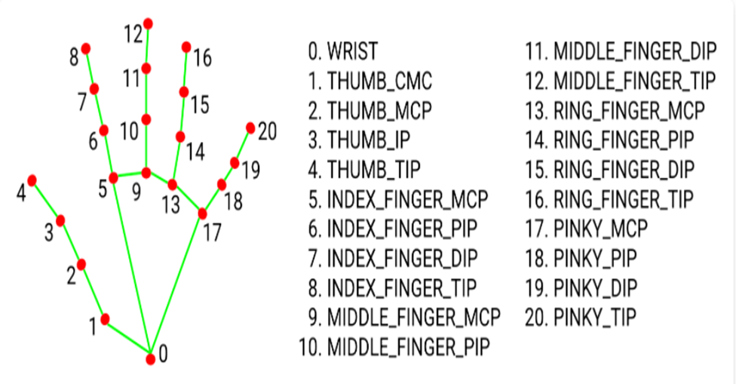
3)Mediapipe Landmark System- Firstly we detect hand from frame using mediapipe and get the hand landmarks of hand present in that image. Now we will get this landmark points and draw it in plain white background using opencv library .by doing this we tackle the situation of background and lightning conditions because the mediapipe labrary will give us landmark points in any background and mostly in any lightning conditions.

Slide 9
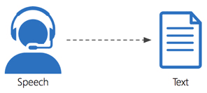
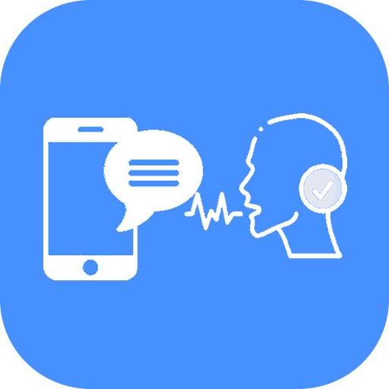
Speech To Text Module
The Speech-to-Text Module of SignLy is a powerful tool designed to enhance communication for individuals who are deaf or mute. This module leverages advanced speech recognition technology to instantly convert spoken language into written text, enabling smoother interactions between hearing and non-hearing individuals.
1. Real-Time Speech Recognition
The speech-to-text technology allows for the immediate conversion of spoken words into text, displayed on the screen as the conversation unfolds. This real-time translation provides instant access to information for deaf and mute users, allowing them to keep up with conversations without delay.
2. Universal Use Case: This feature makes the system accessible to people with various disabilities, not just those who use sign language, but also those who may struggle with typing or reading.

Slide 10
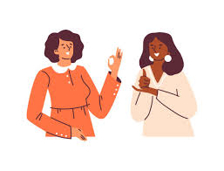
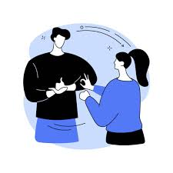
Conclusion
At its core, the platform is about breaking down barriers, promoting accessibility, and creating a more inclusive digital world. With these features, we will be making an important step towards a society where communication is not limited by language, and where every individual can participate fully, regardless of their abilities.
Scalability
Sign Language Lessons: Teach basic signs, phrases, and grammar, progressing to complex sentences.
Interactive Quizzes: Users practice signs, get feedback on accuracy, and improve.
Gamification: Points, levels, and badges to motivate users. Streaks and achievements for mastering different sign languages.
Real-Time Communication: Users sign in front of the webcam, and the system converts it to text for messaging.
THANK YOU

