Slide 1
Applied Linear Algebra PROJECT
Movie Recommender System using Collaborative Filtering
GROUP MEMBERS:
Jeel Kadivar AU2140181
Shrey Bhadja AU2140030
Kashish Jethmalani AU2140029
Vishwa Joshi AU2140112
Milan Godhaviya AU2140078
Instructed by Professor Eshita Mazumdar

Slide 2
Table Of Contents
1 | Introduction
2 | Problem Statement
3 | Concepts Used
4 | Explanation
5 | Output Samples
6 | Graphs

Slide 3
Introduction
In the vast field of mathematics known as linear algebra, vectors, matrices, linear combinations, and vector spaces are all studied. The topic of linear algebra has advanced, and it now finds use in many other contexts. In recommender systems, one may use linear models to forecast a product's rating based on the rating (or implicit feedback) matrix. In addition to this, one of the most often used similarity metrics for collaborative filtering recommender systems to determine how much two users are associated is the Pearson Correlation Coefficient (PCC).

Slide 4
Problem Statement
This project aims to tackle the topic of recommender systems utilizing applied linear algebra learnings. To generate fresh suggestions, the Collaborative filtering approach for recommender systems only relies on the historical interactions that have been recorded between users and products. The project's prediction would be made via Pearson Correlation and k Nearest Neighbors. Finally, predicting the ratings of the new item for the given user using programming language to automate the process will be accomplished utilizing the similarity of the k nearest neighbors.

Slide 5
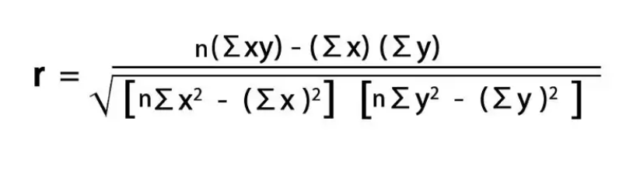
Concepts Used
Pearson Coefficient
Finding how one variable changes linearly with regard to another can be done extremely quickly and easily using Pearson's correlation coefficient. We can take advantage of this and apply this idea to create a recommender system.

Slide 6
Two variables are directly proportional to one another if their correlation coefficients are closer to 1. These variables are inversely related to one another if the value is closer to -1. If the correlation coefficient's value is smaller or nearer zero, there is generally not much of a relationship between the variables.

Slide 7
Explanation
Here, we make movie recommendations using a matrix and correlation coefficient. In the event that a user selects a specific movie, we look at its columns and determine how closely it correlates with all the other movie data to provide a list of films. This works because each row represents a person, and a user may have similar tastes in movies. We may therefore utilize the correlation coefficient to suggest movies to users.

Slide 8
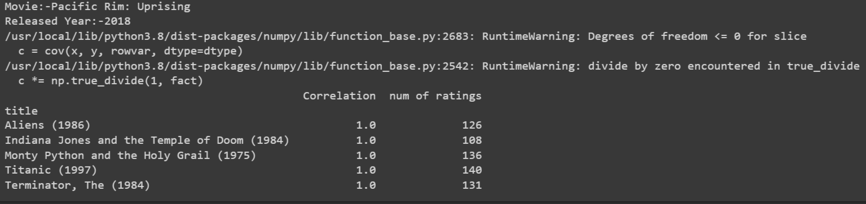
Output Sample

Slide 9
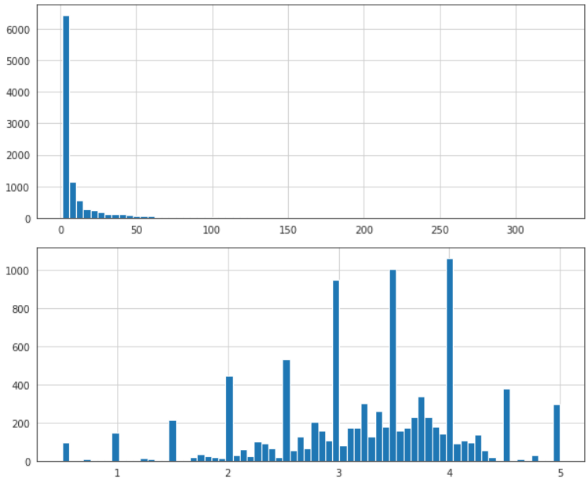
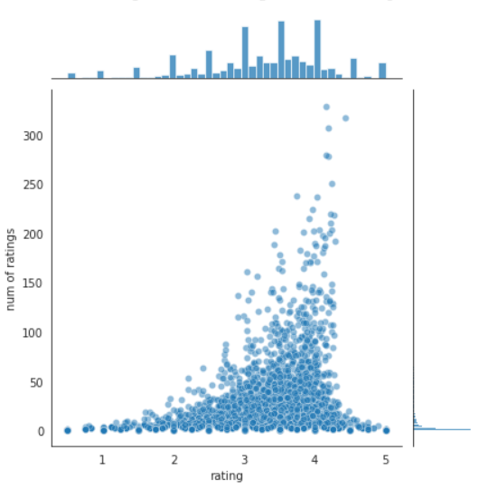
Graphs

Slide 10
THANK YOU!

