Slide 1
MODULE-3

Slide 2
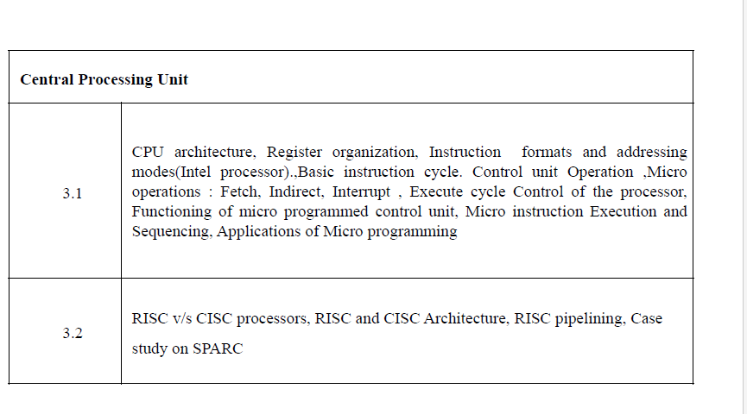

Slide 3
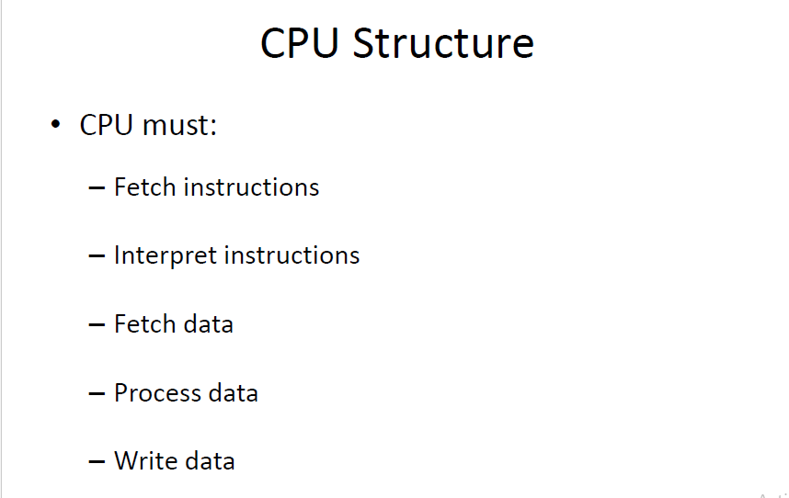

Slide 4
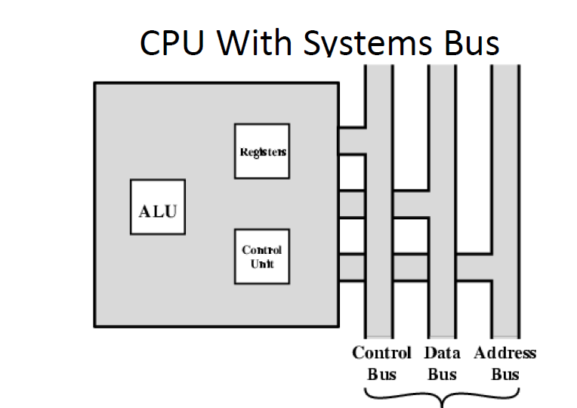

Slide 5
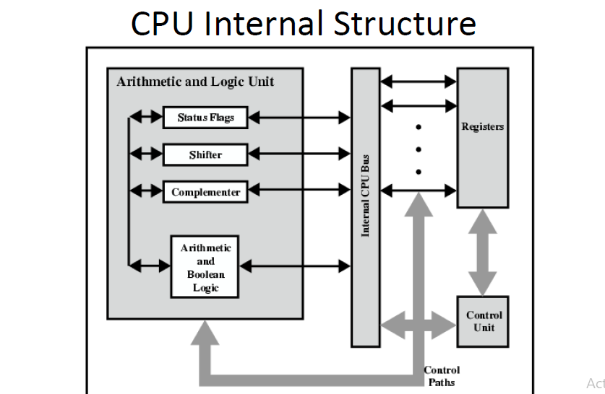

Slide 6
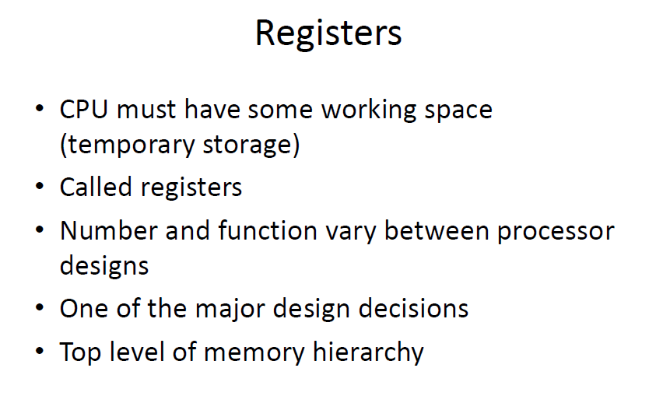

Slide 7
Registers in the processor
User –Visible Registers -Referenced by means of Assembly or machine language. Optimizing these can reduce reference to main memory.
Control & Statue Registers- To Control the operation of processor, not visible to user.

Slide 8
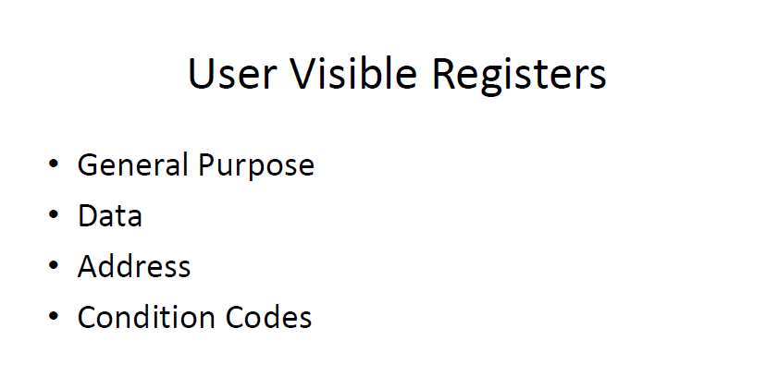

Slide 9
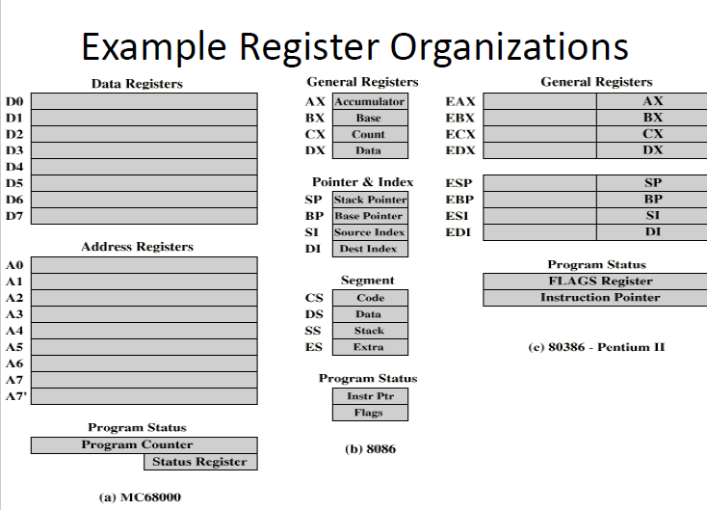

Slide 10
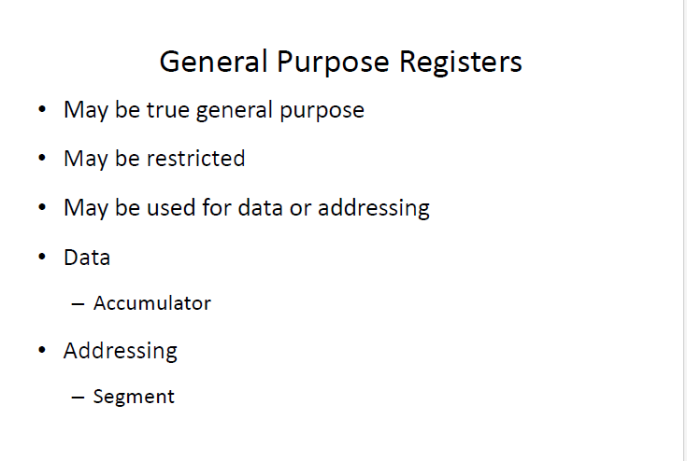

Slide 11
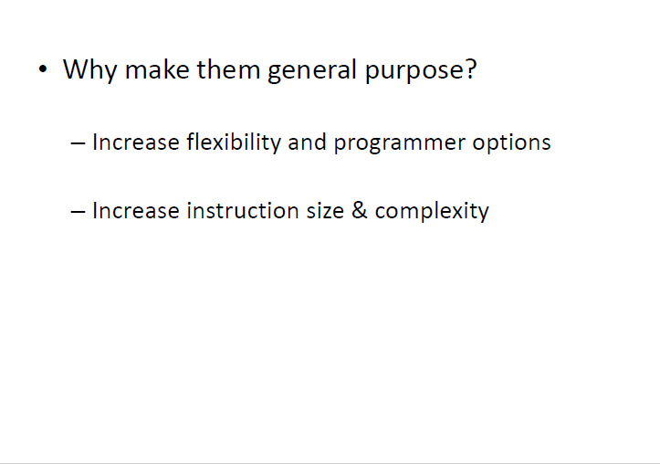

Slide 12
Why make them general purpose?
–Increase flexibility and programmer options
–Instruction size & complexity.

Slide 13


Slide 14
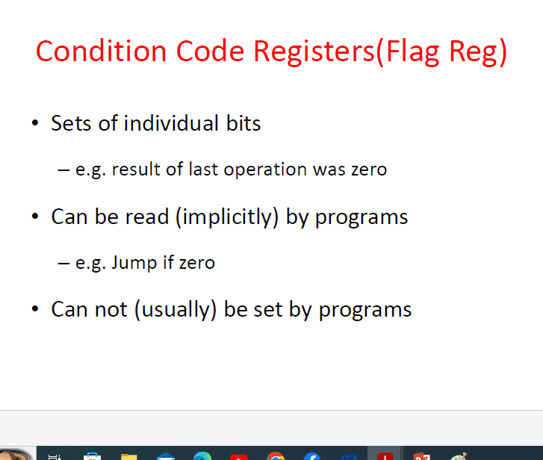

Slide 15
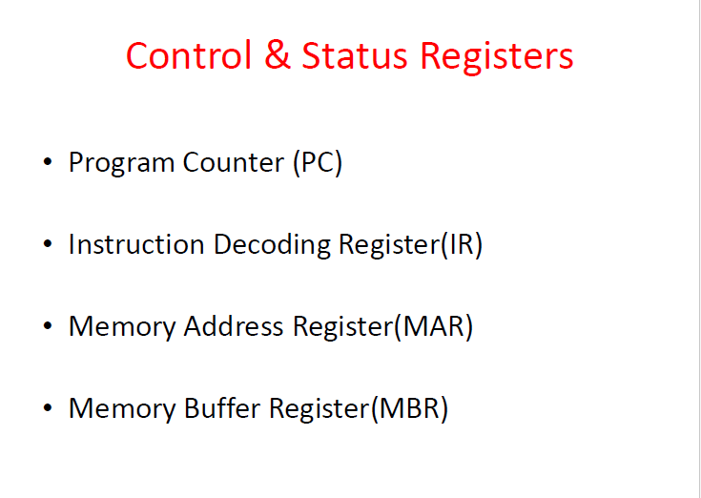

Slide 16
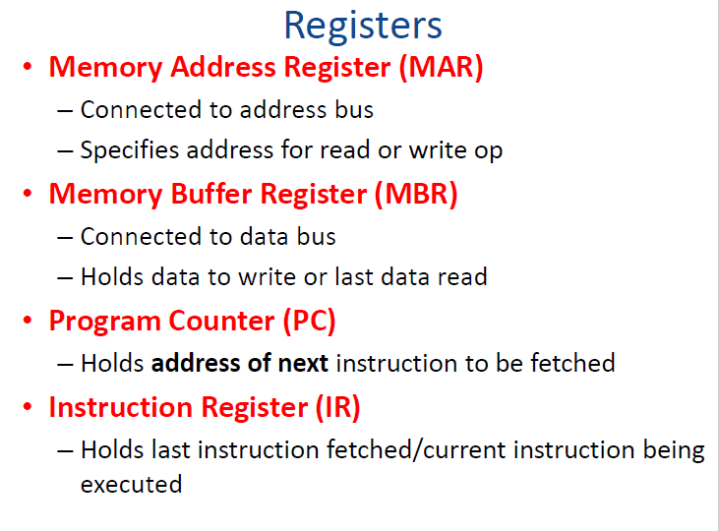

Slide 17
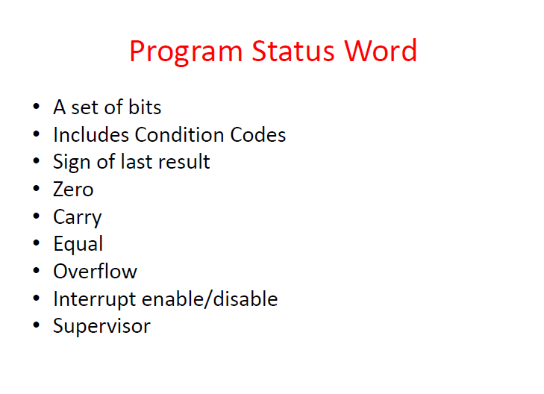

Slide 18
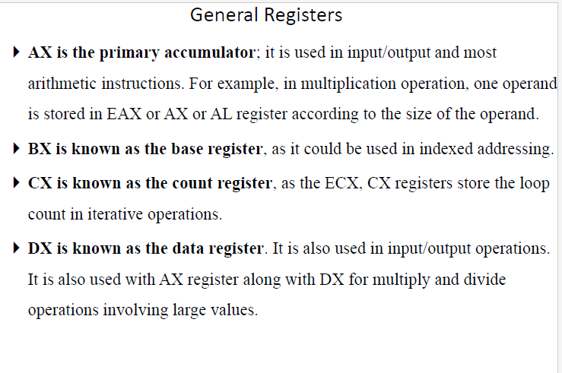

Slide 19
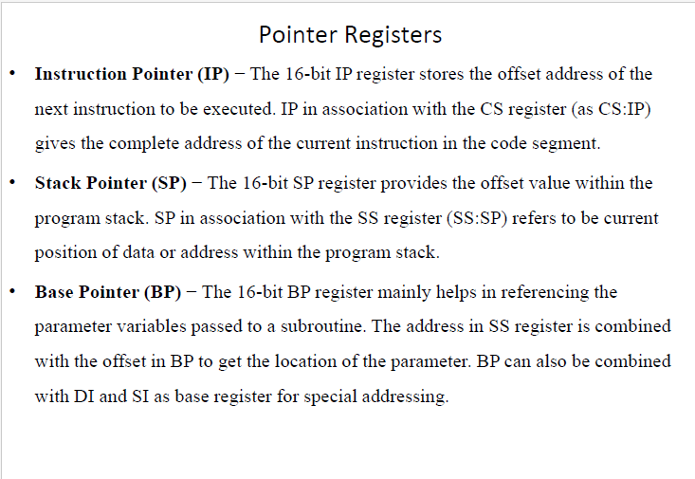

Slide 20
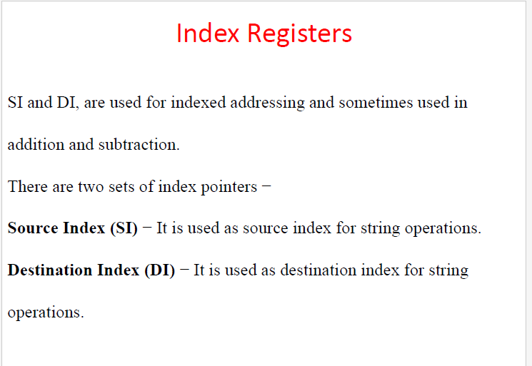

Slide 21
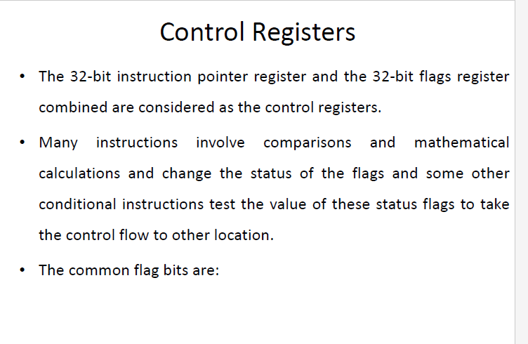

Slide 22
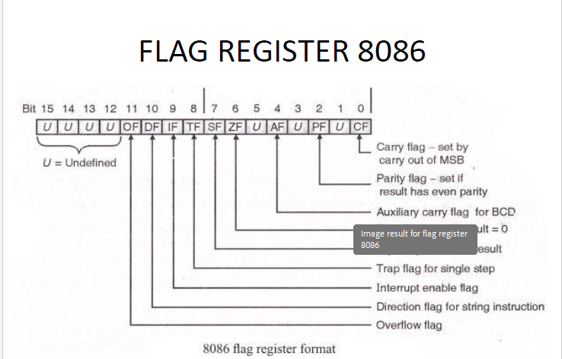

Slide 23
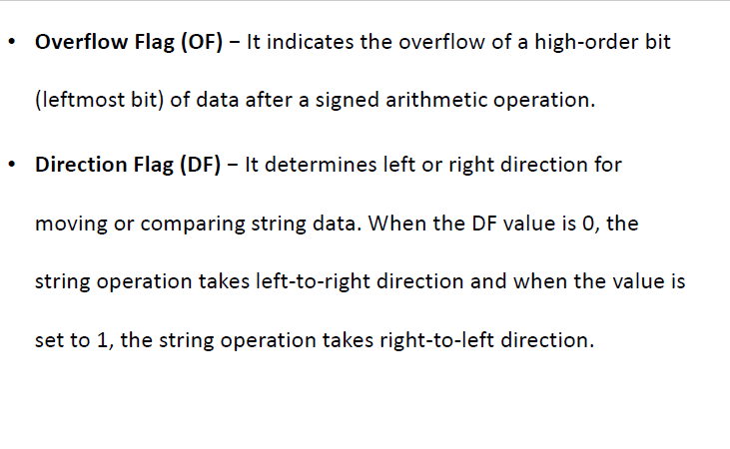

Slide 24
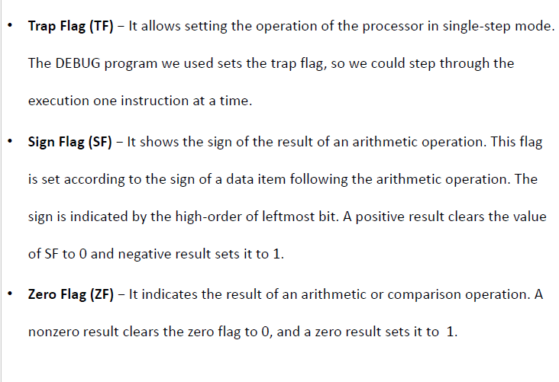

Slide 25
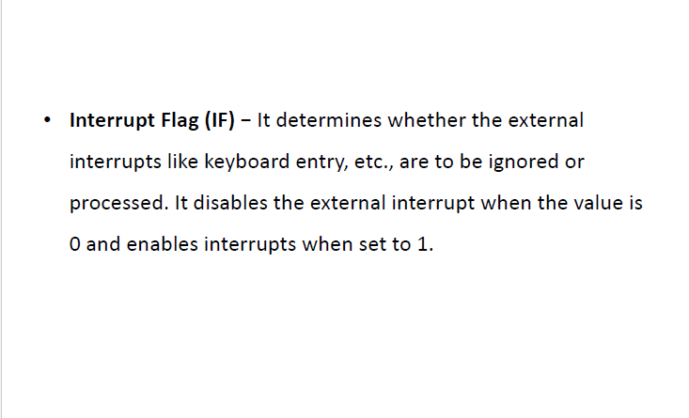

Slide 26
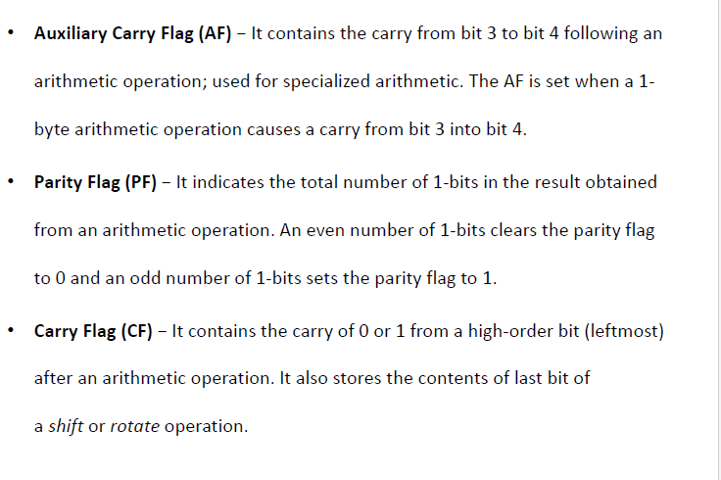

Slide 27
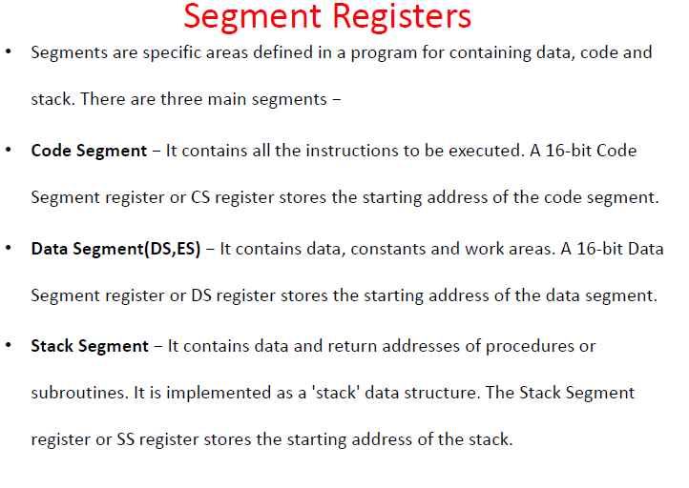

Slide 28
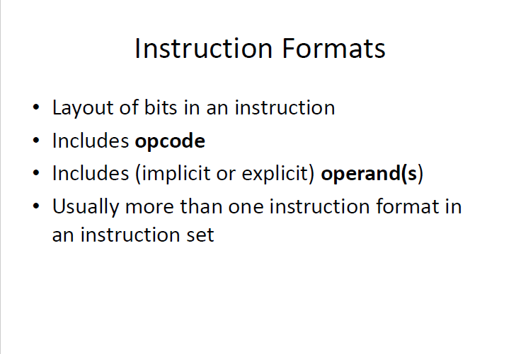

Slide 29
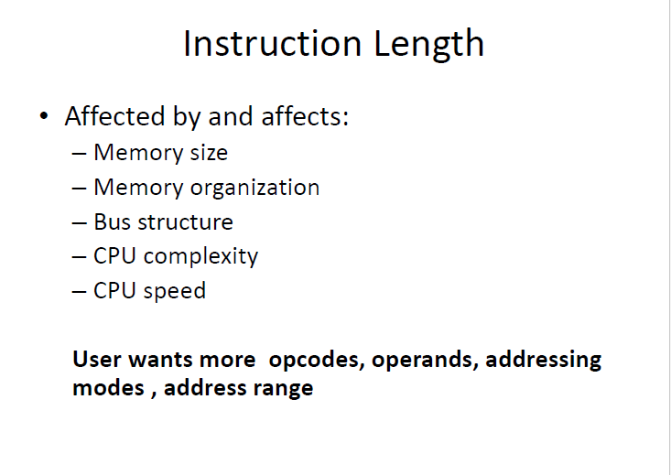

Slide 30
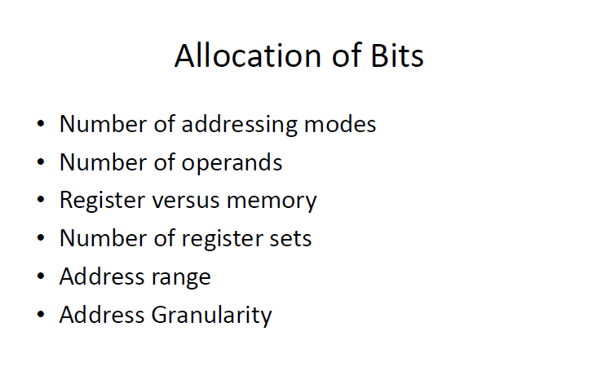

Slide 31
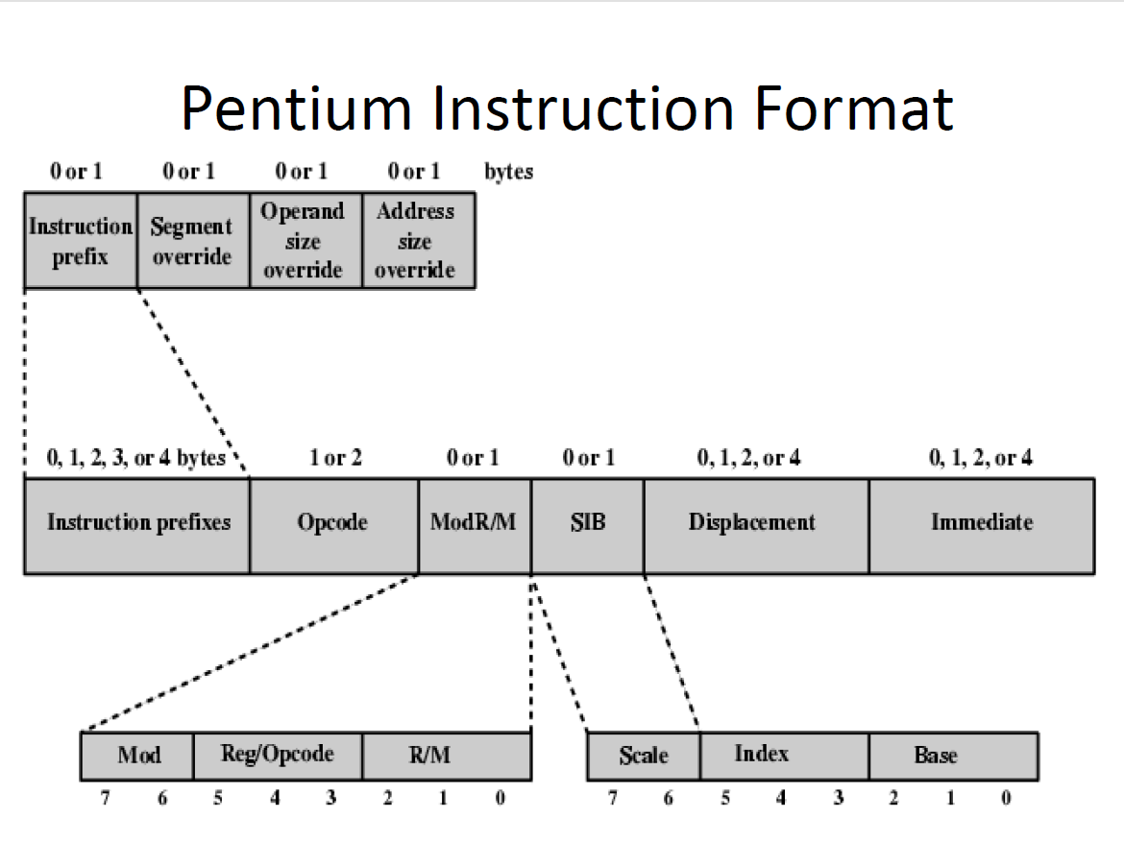

Slide 32
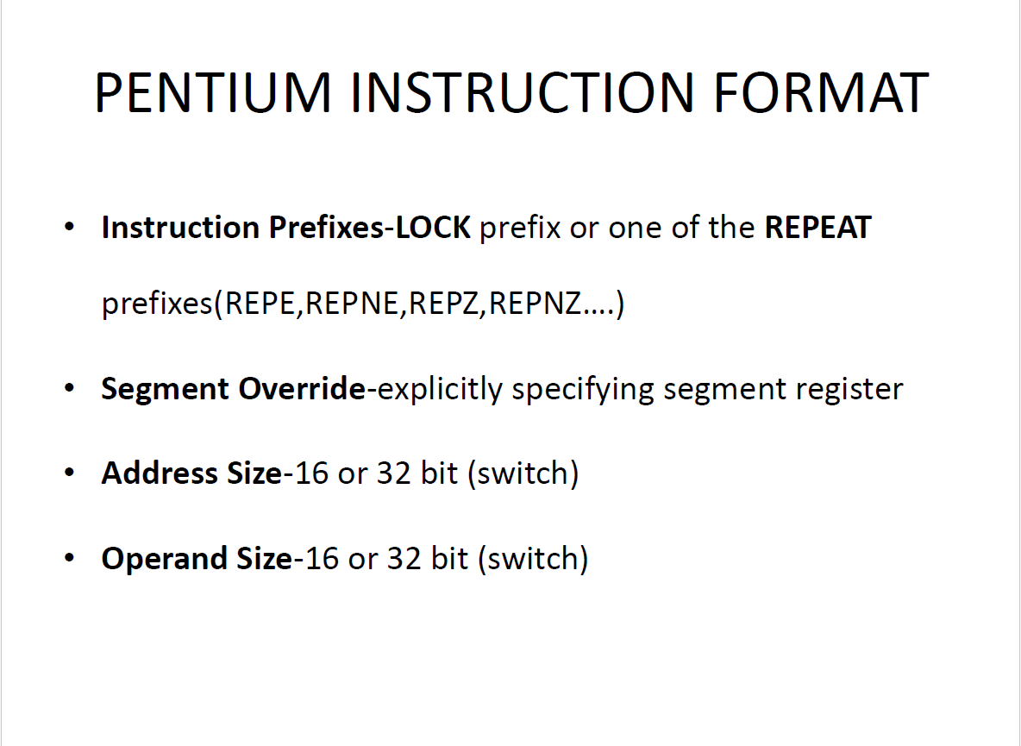

Slide 33
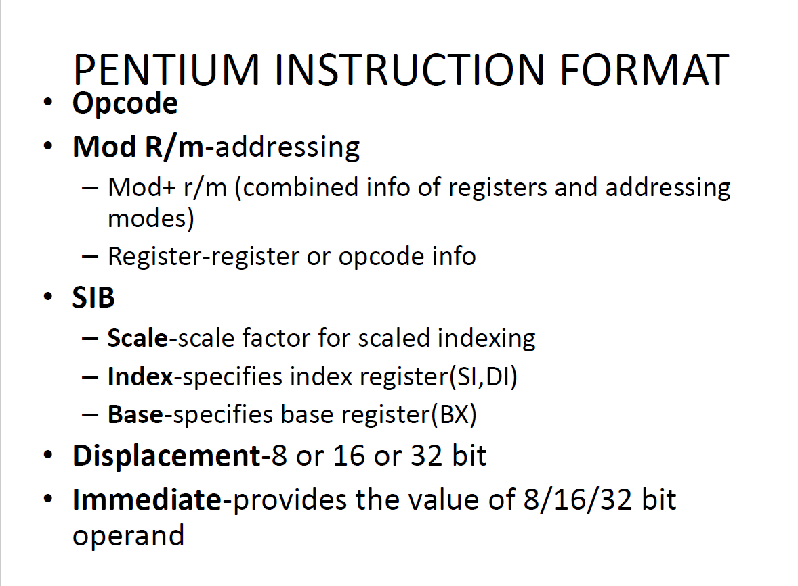

Slide 34
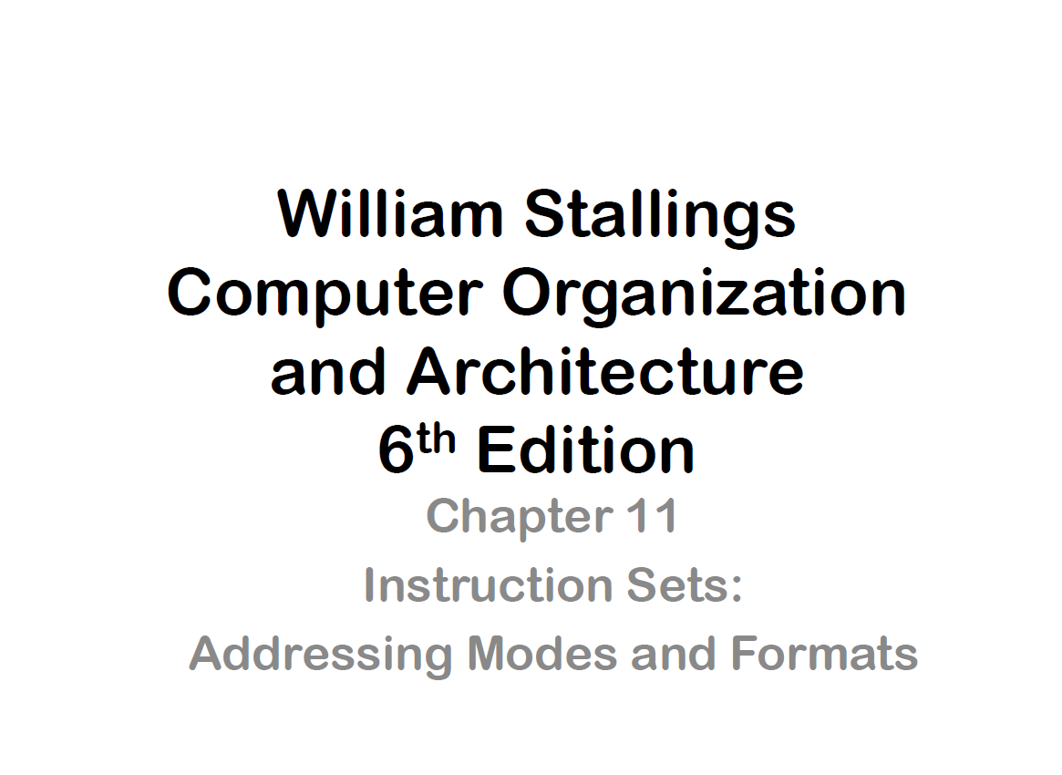

Slide 35
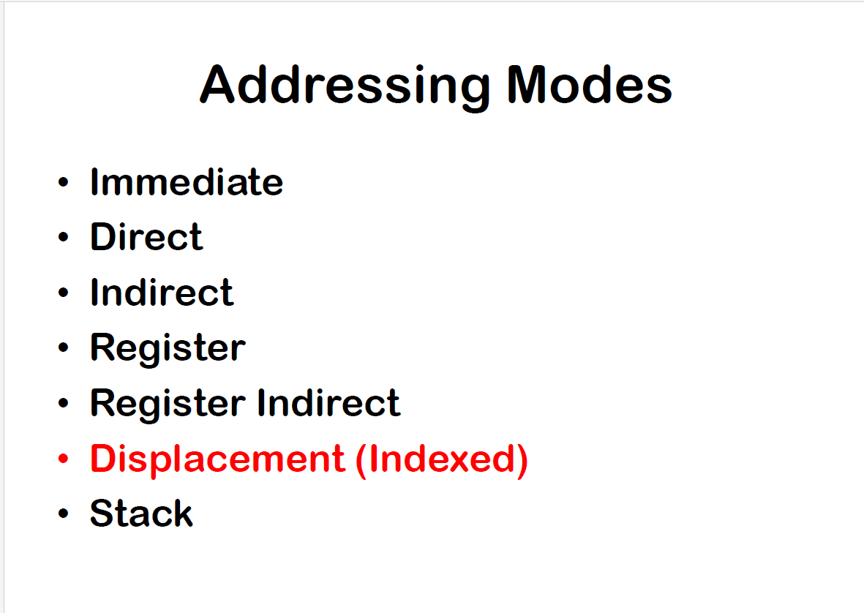

Slide 36
Notations and Meanings
In this section, we use the following notation:
(X) = contents of memory location X or register X
EA = actual (effective) address of the location containing the referenced operand
R = contents of an address field in the instruction that refers to a register
A = contents of an address field in the instruction

Slide 37
Immediate Addressing
The simplest form of addressing is immediate addressing, in which the operand value is present in the instruction.
This mode can be used to define and use constants or set initial values of variables.

Slide 38
Immediate Addressing
The advantage of immediate addressing is that no memory reference other than the instruction fetch is required to obtain the operand, thus saving one memory or cache cycle in the instruction cycle.
The disadvantage is that the size of the number is restricted to the size of the address field, which, in most instruction sets, is small compared with the word length.

Slide 39
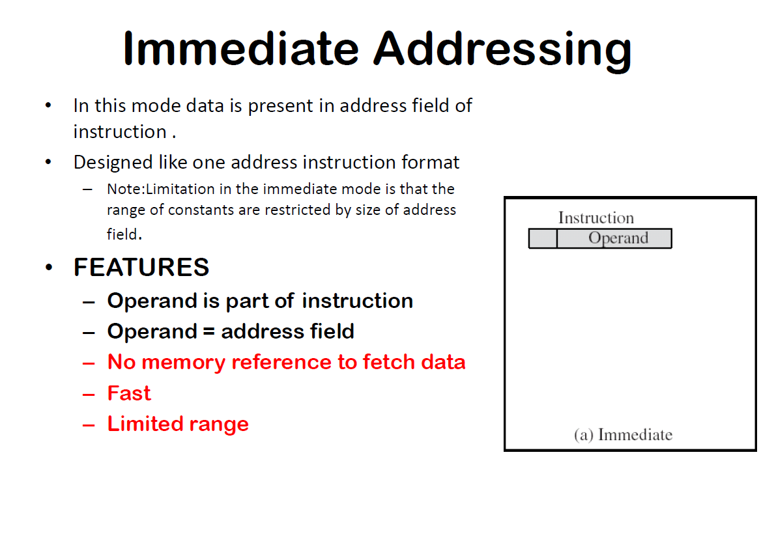

Slide 40
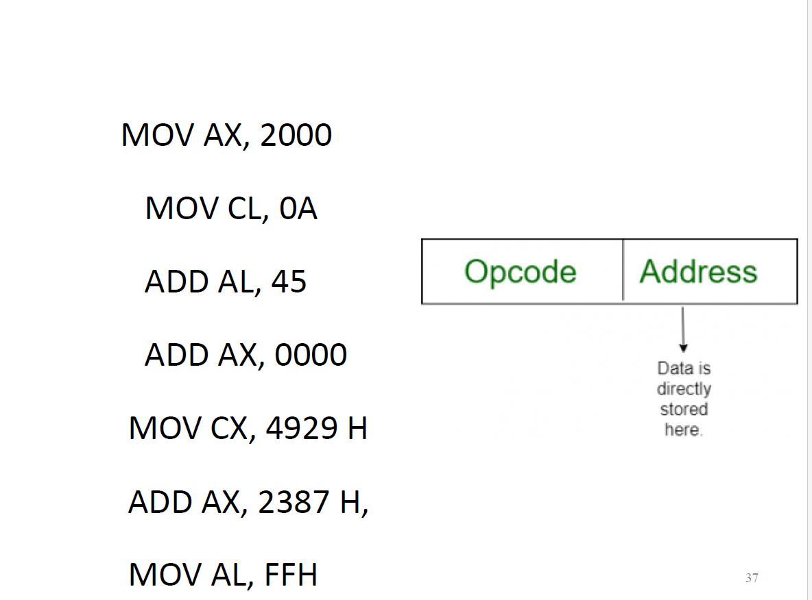

Slide 41
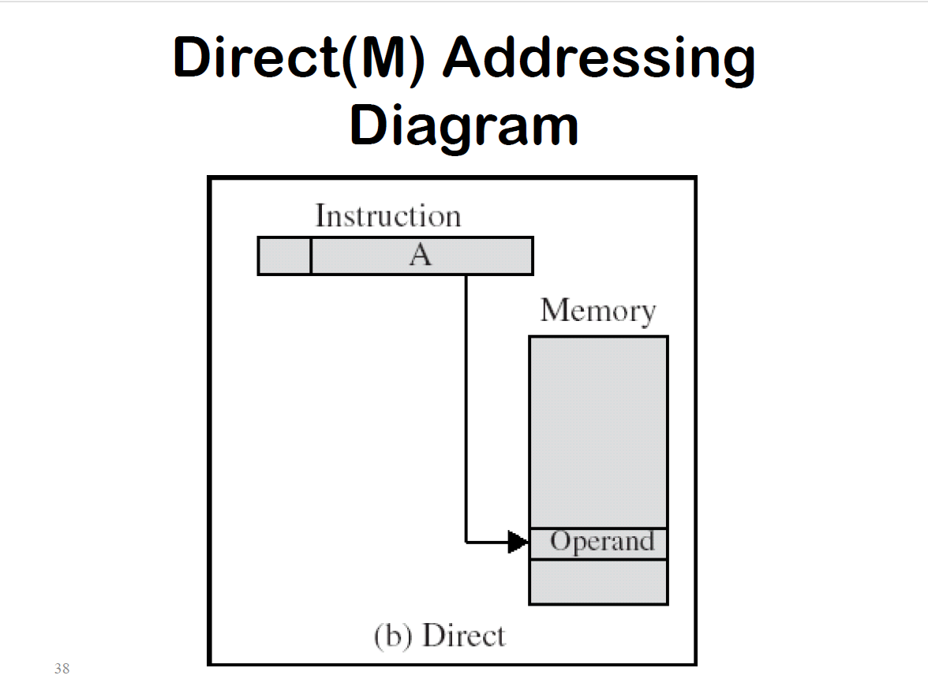

Slide 42
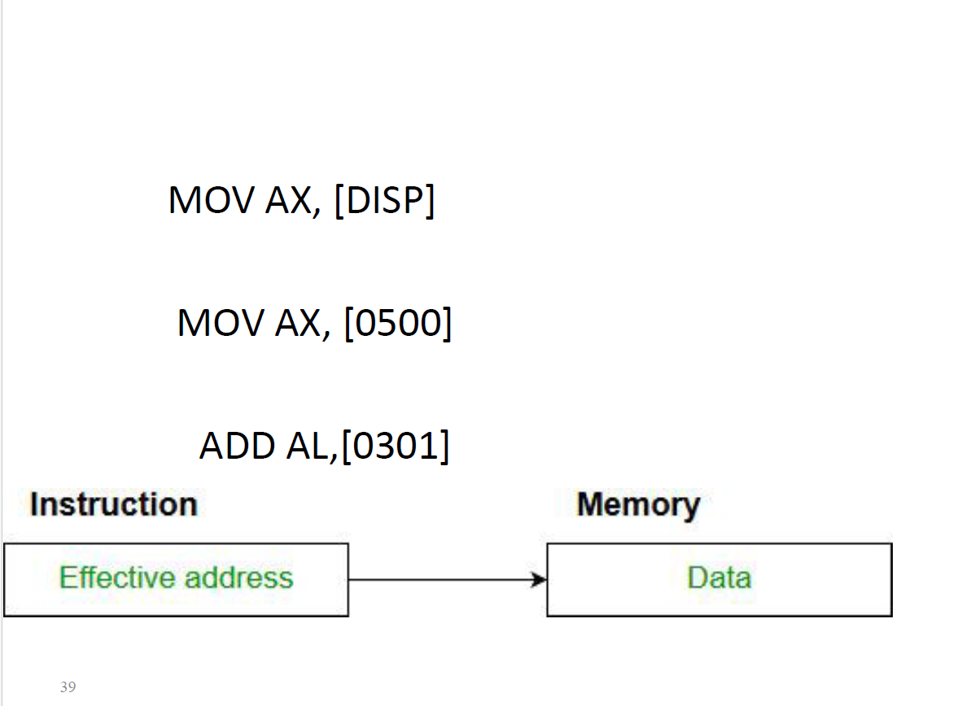

Slide 43
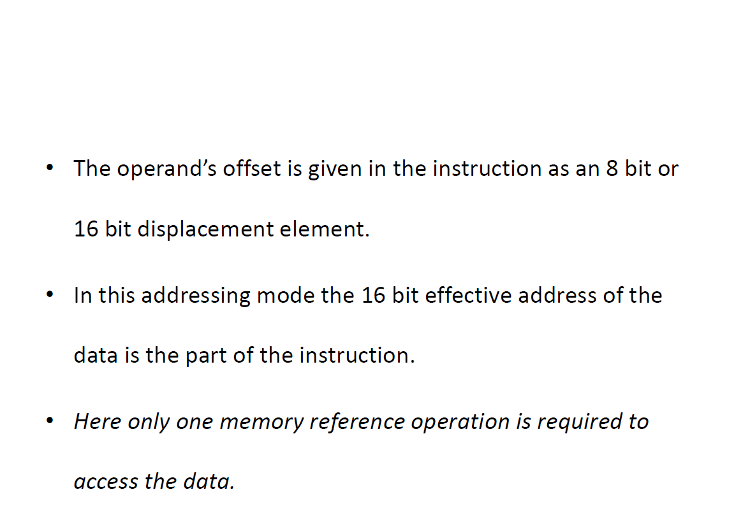

Slide 44
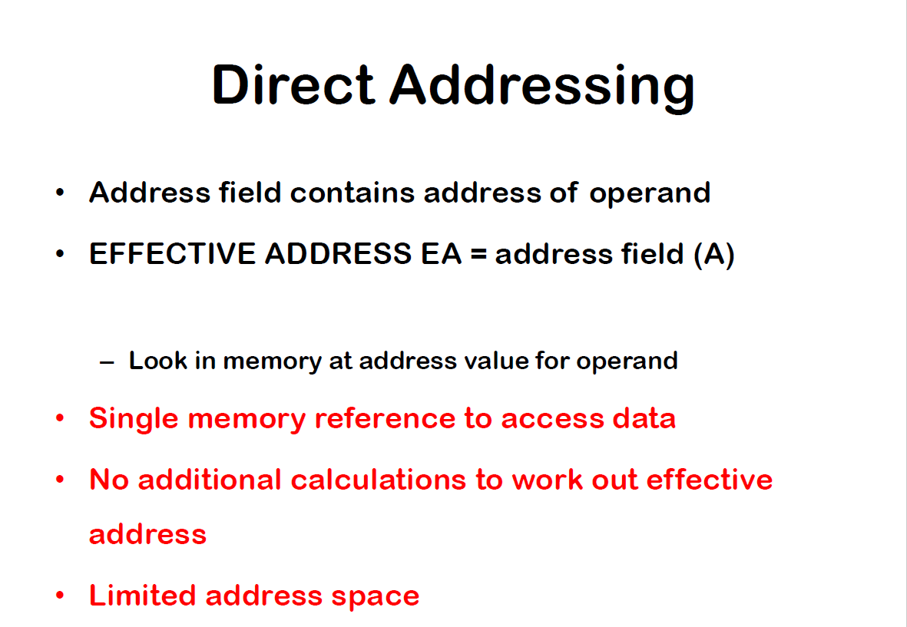

Slide 45
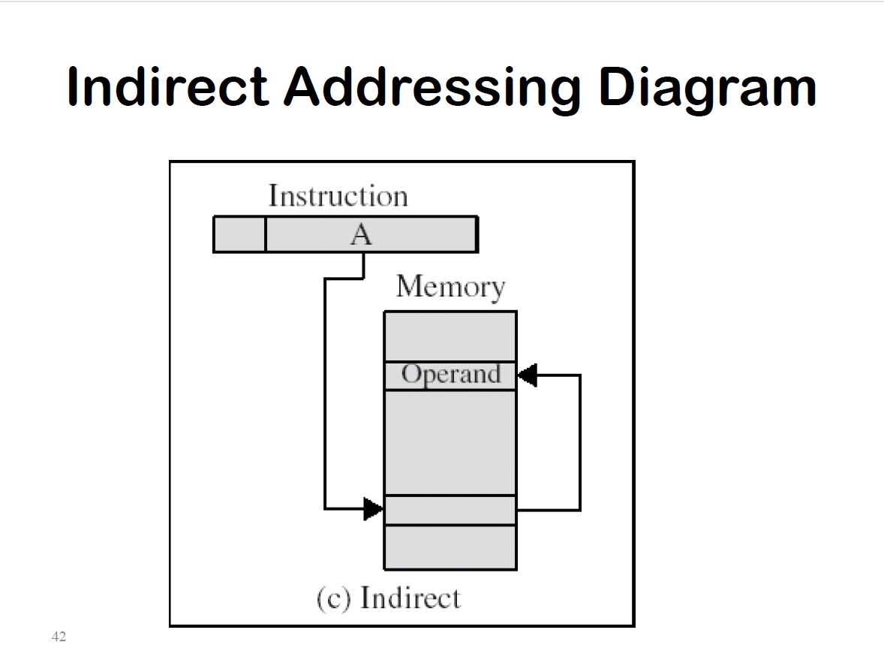

Slide 46
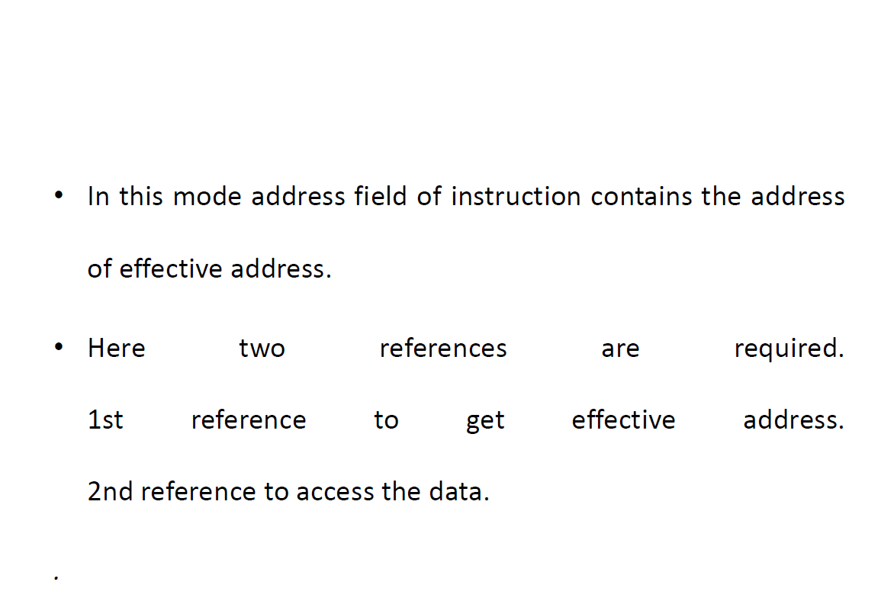

Slide 47
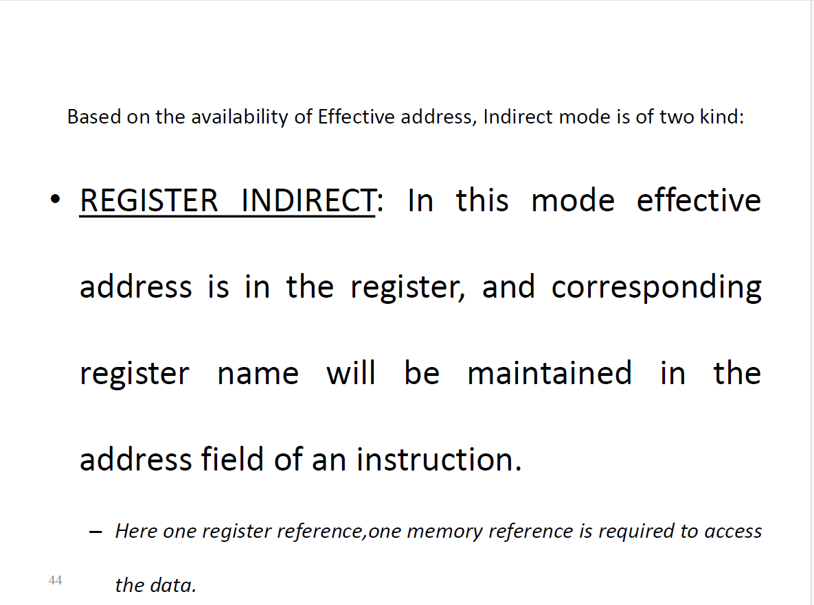

Slide 48
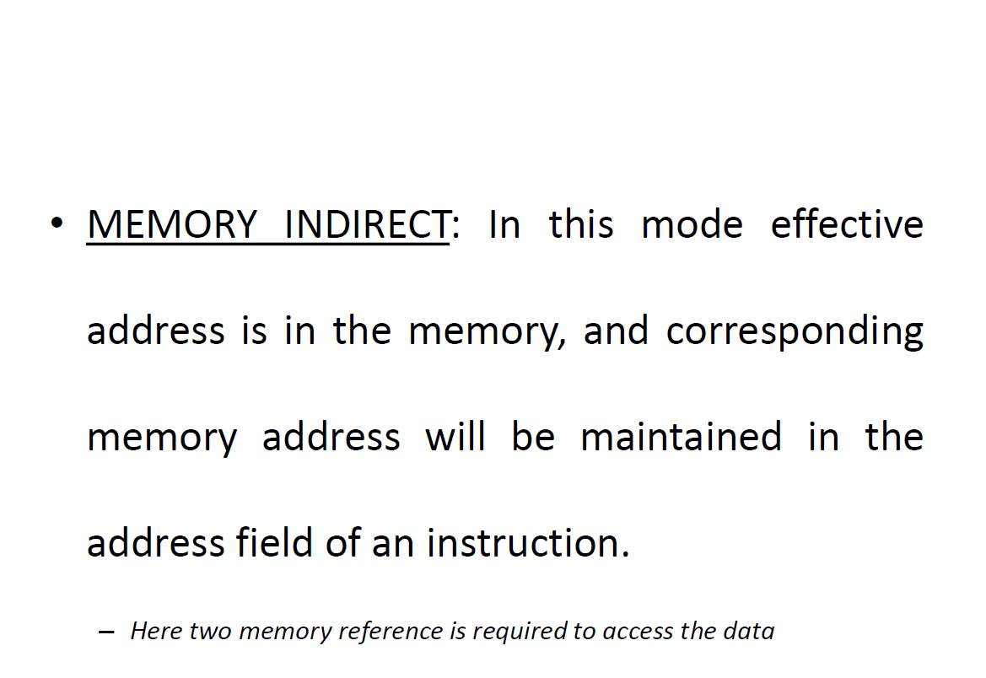

Slide 49
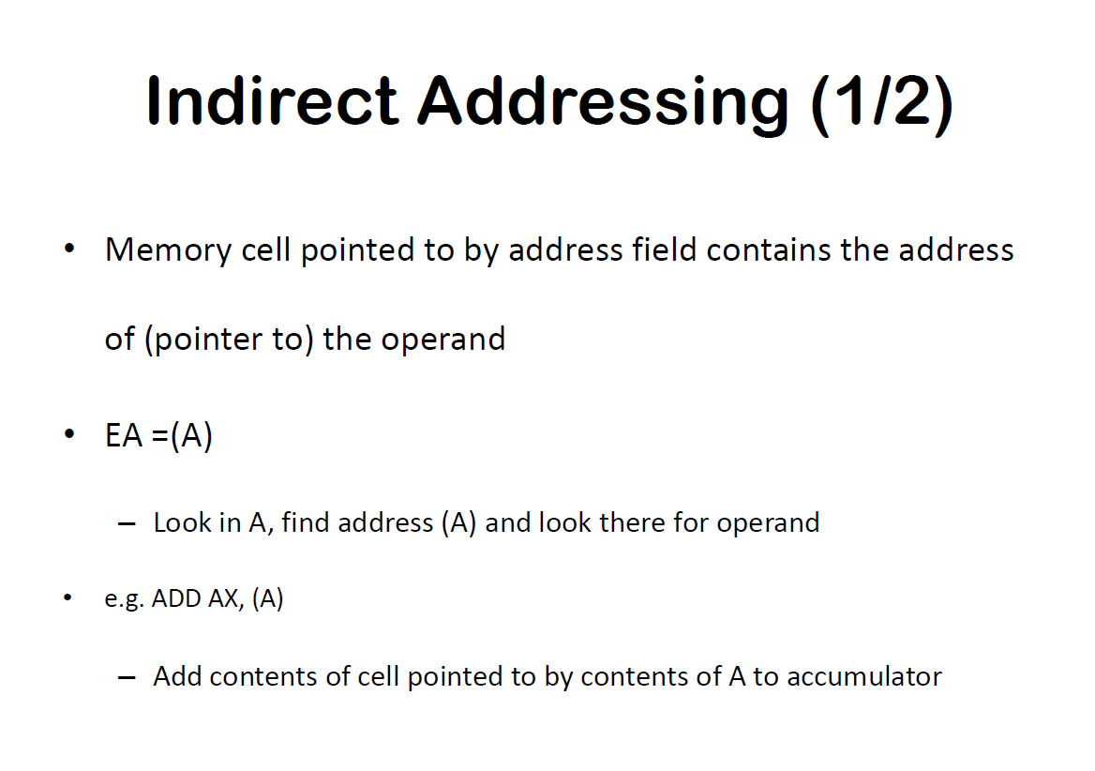

Slide 50
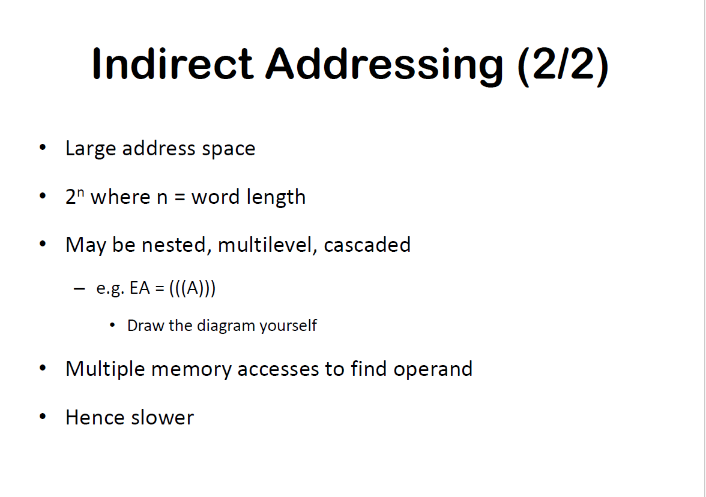

Slide 51
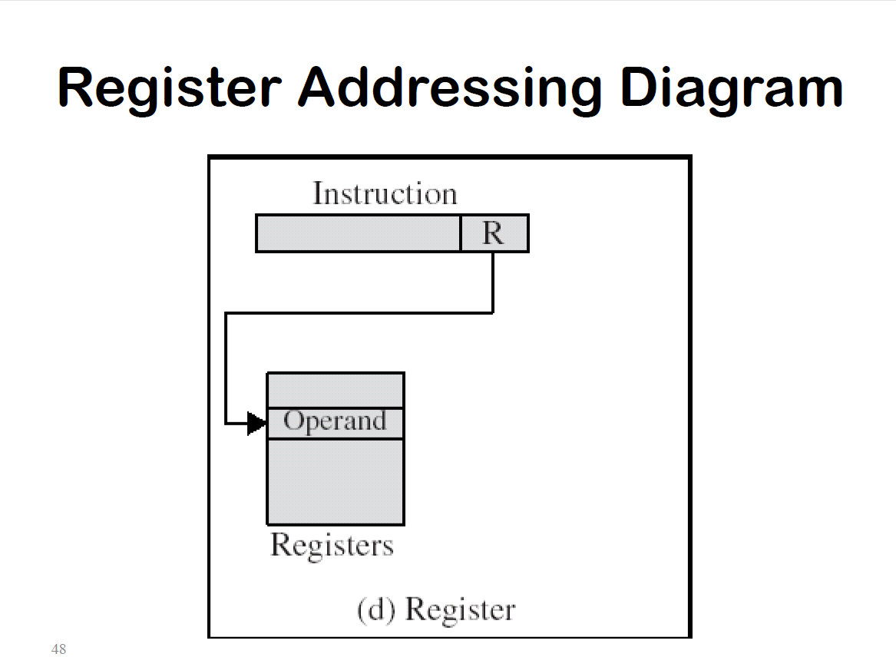

Slide 52
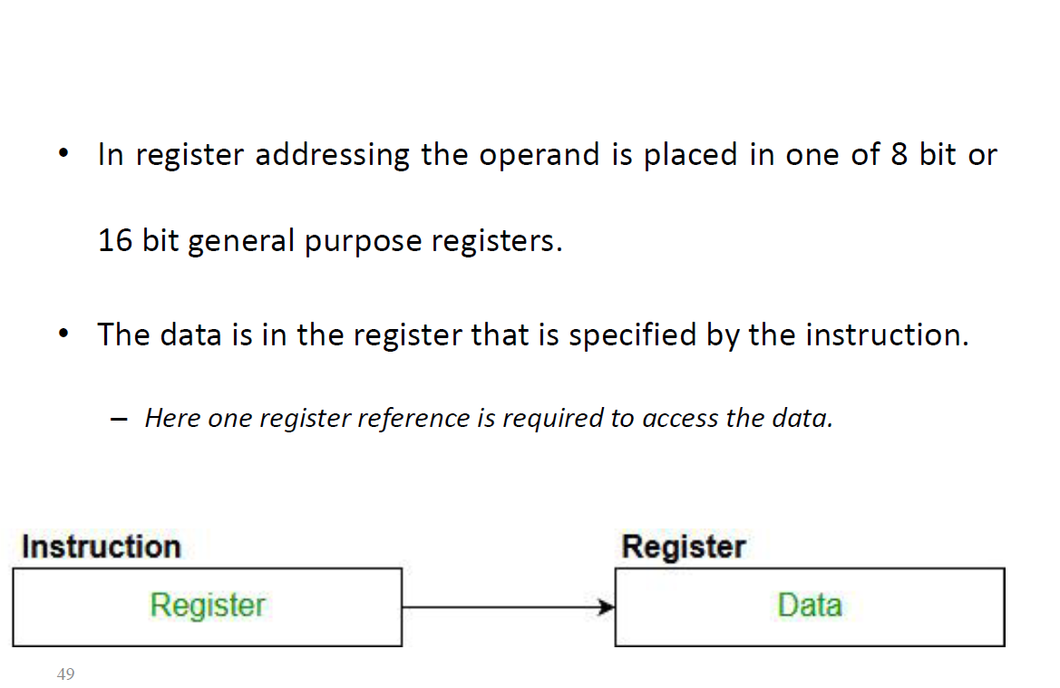

Slide 53
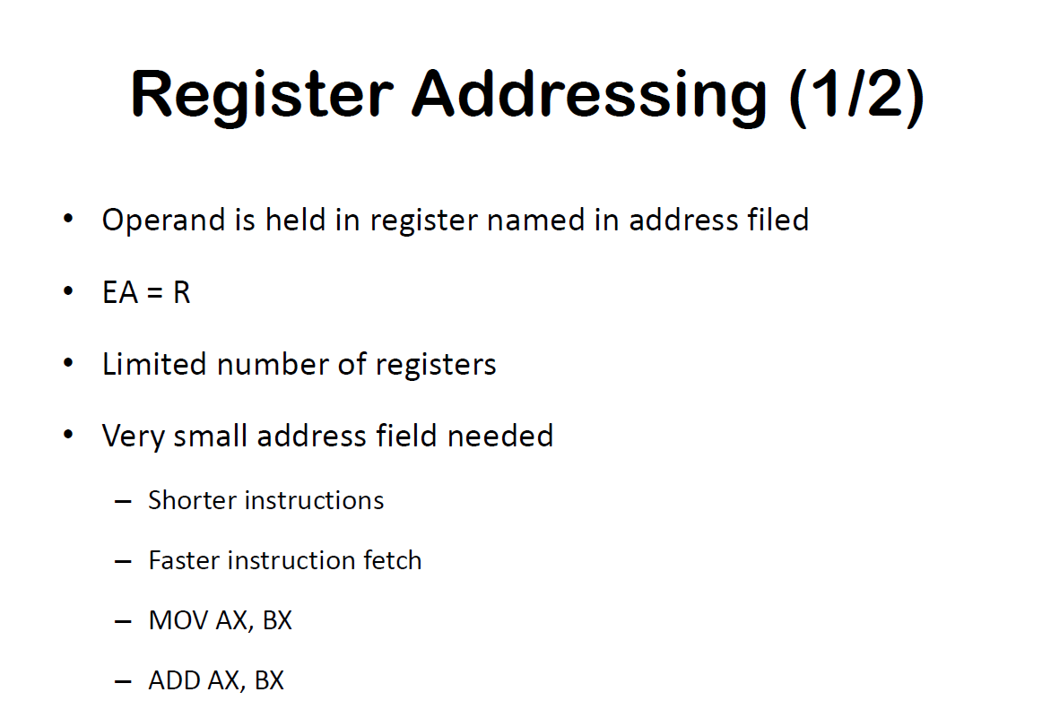

Slide 54
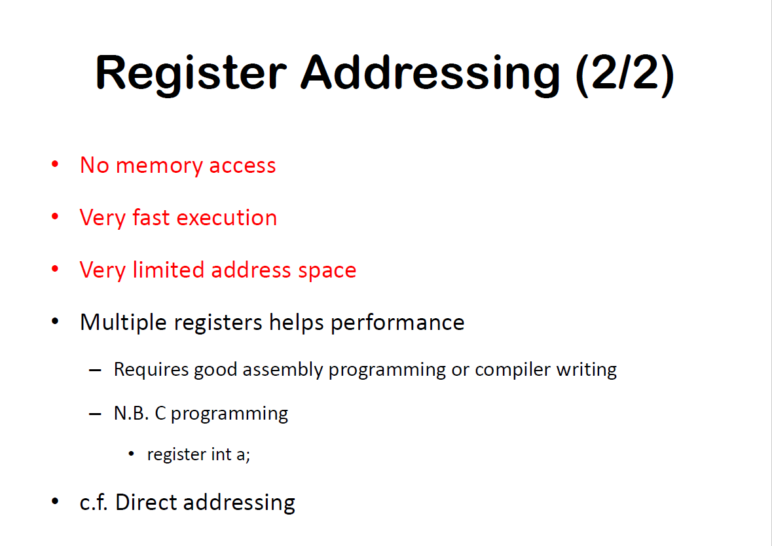

Slide 55
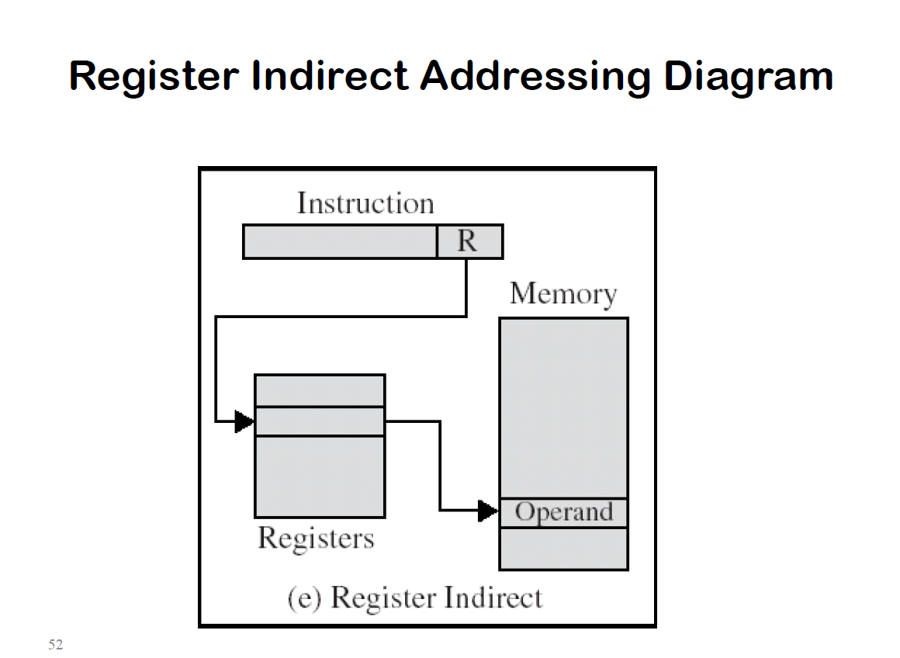

Slide 56
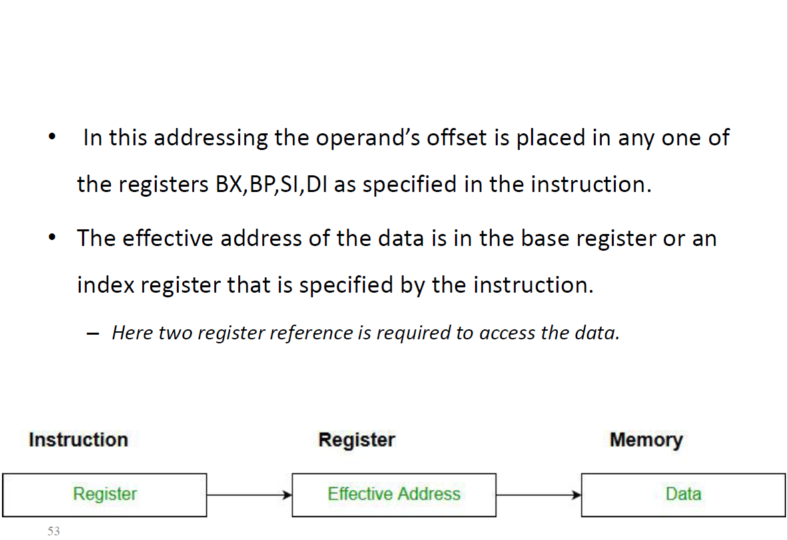

Slide 57
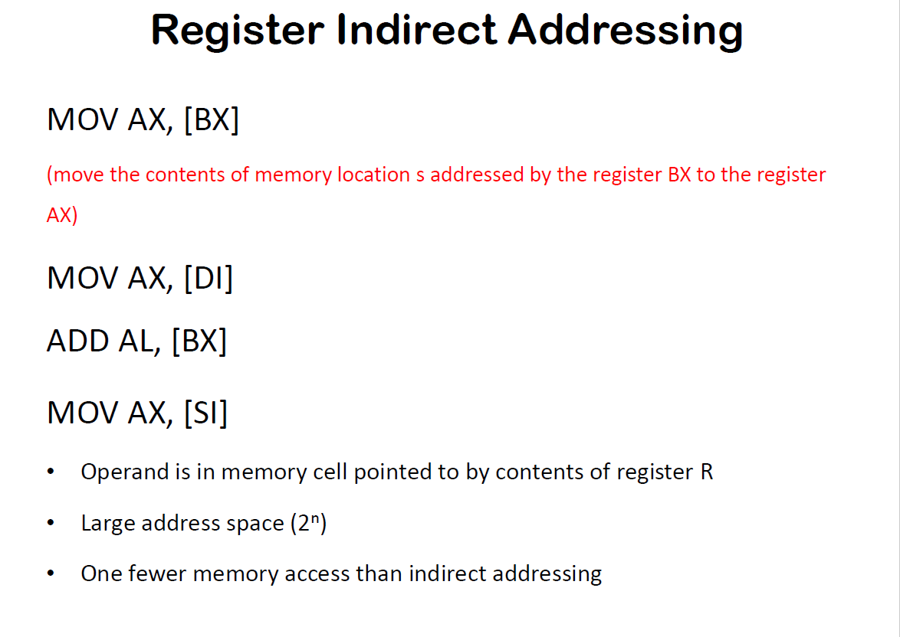

Slide 58


Slide 59


Slide 60


Slide 61


Slide 62


