Slide 1
Module-6

Slide 2
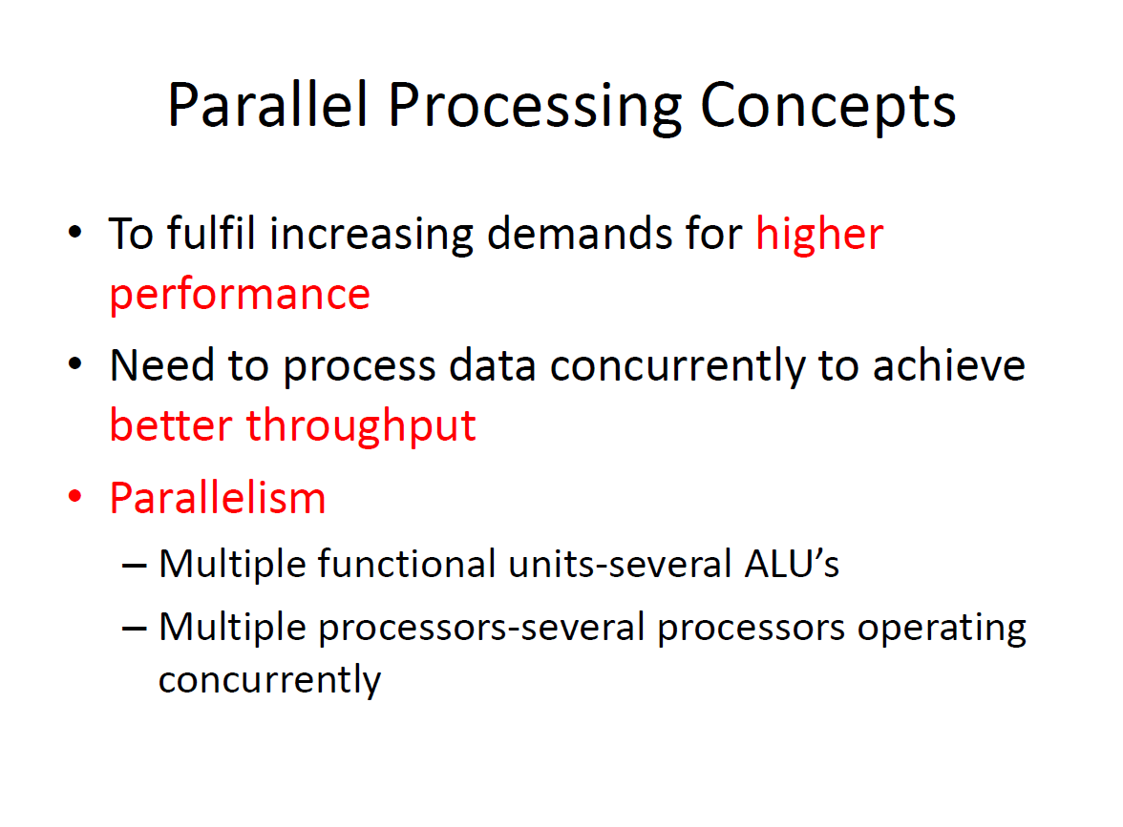

Slide 3
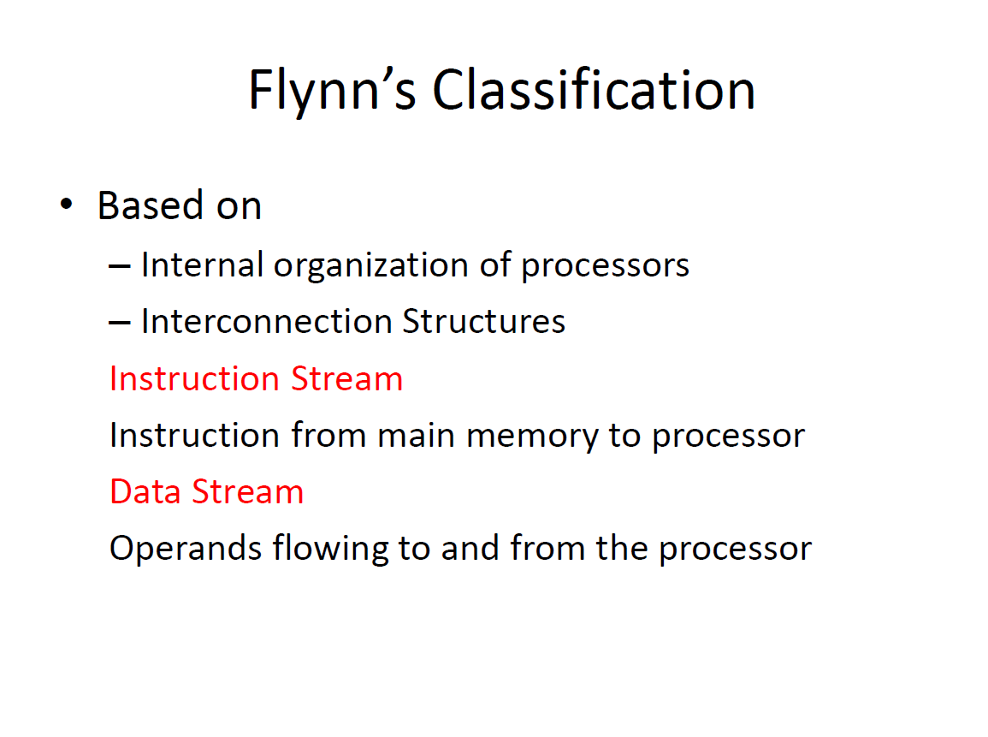

Slide 4
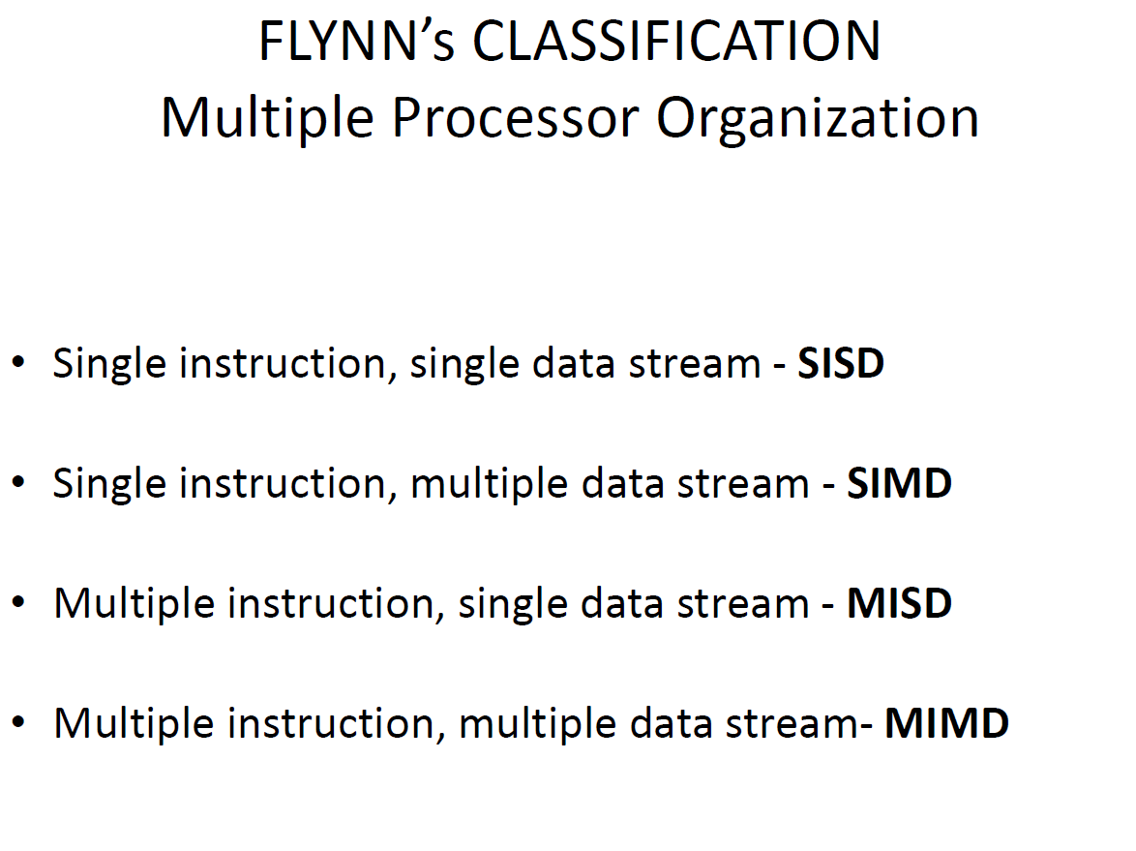

Slide 5
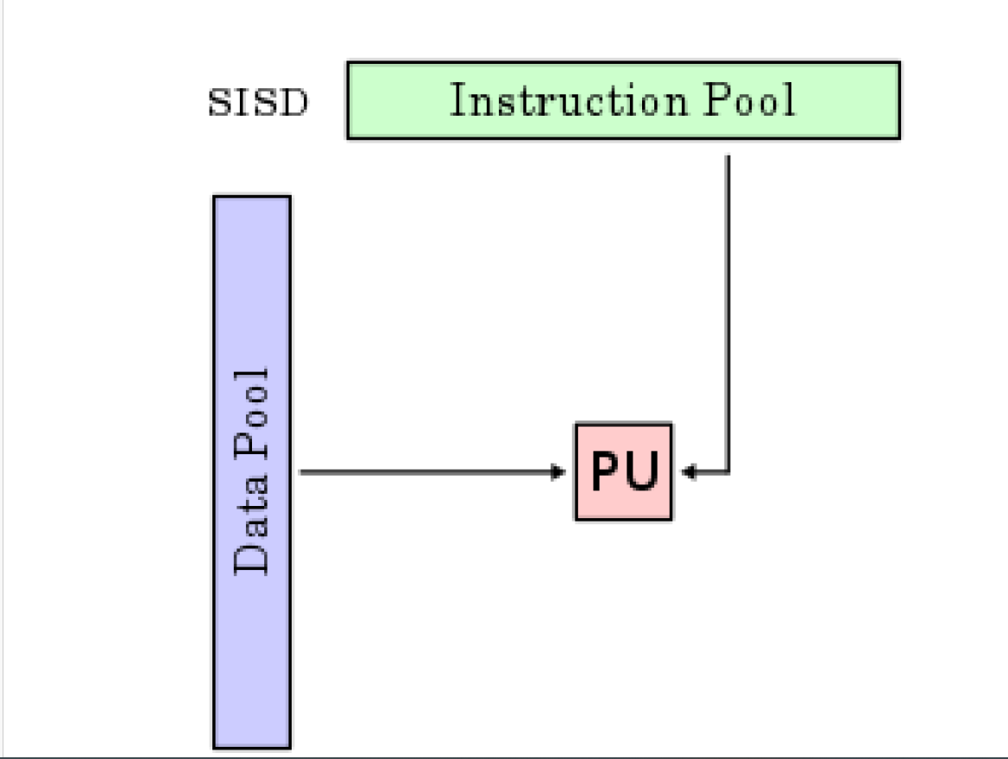

Slide 6
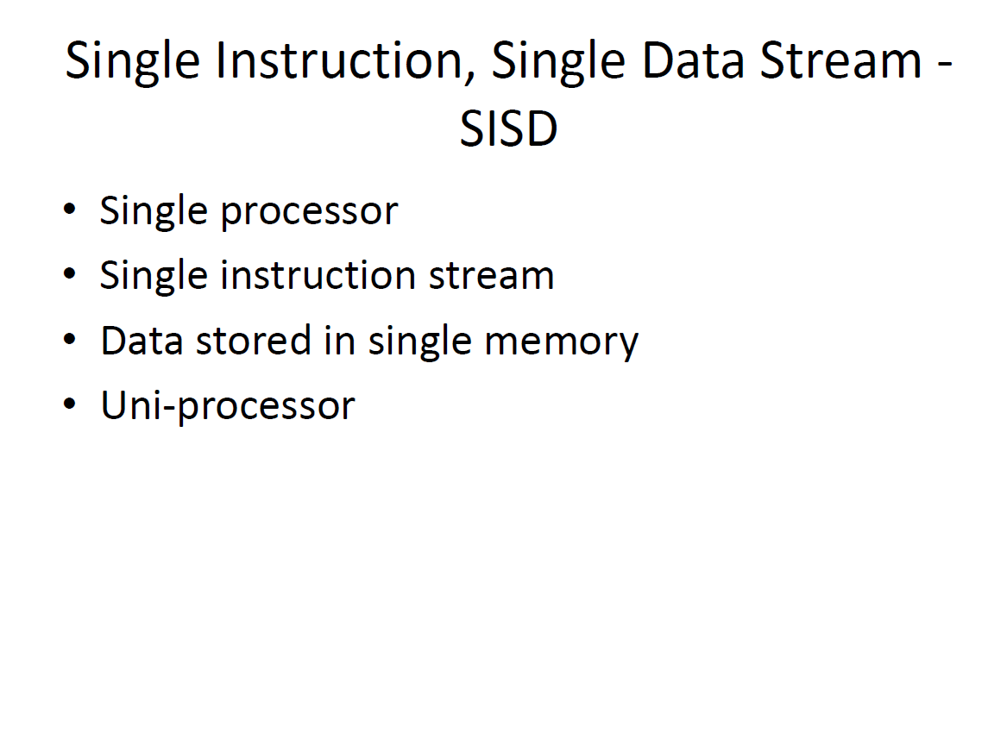

Slide 7
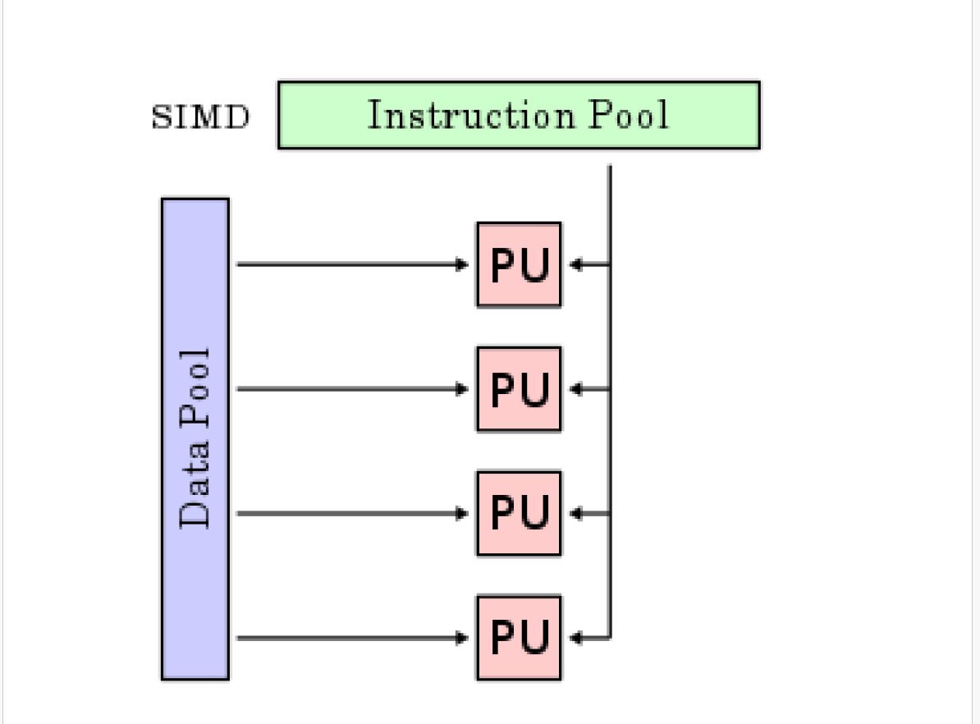

Slide 8
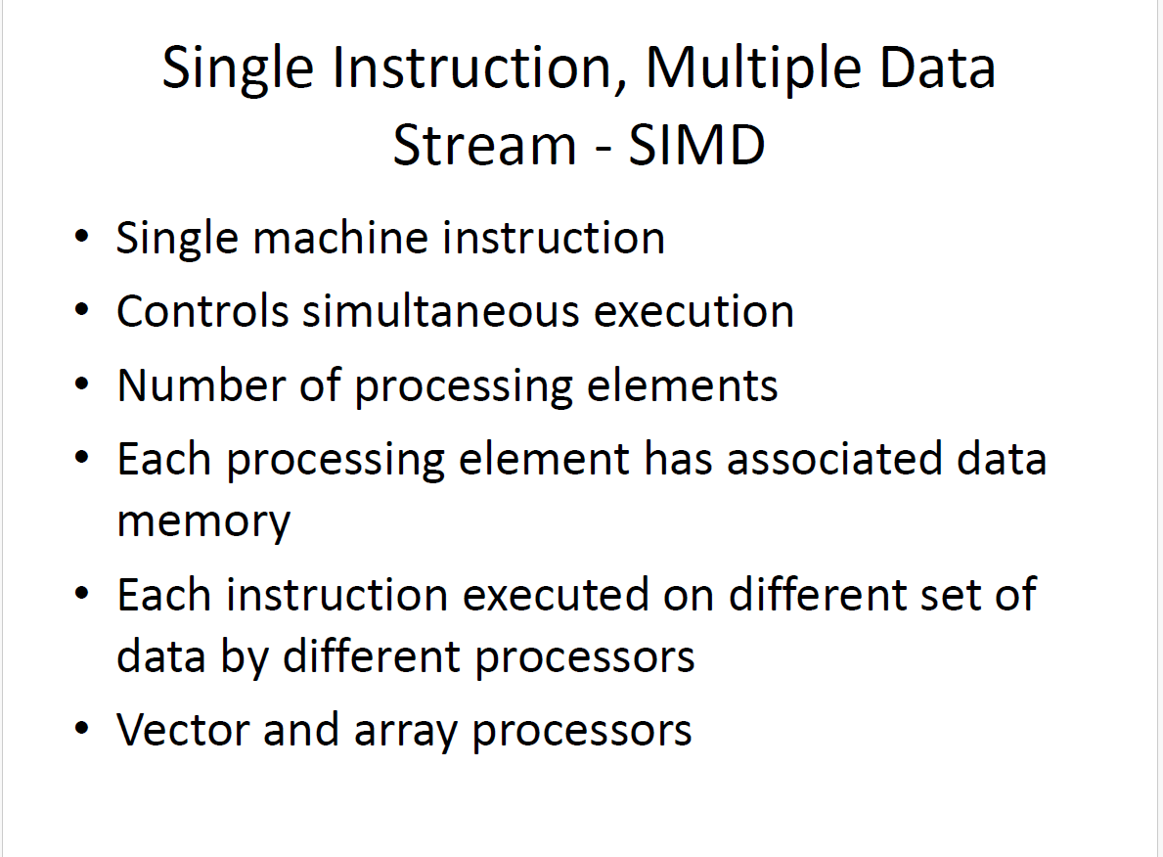

Slide 9
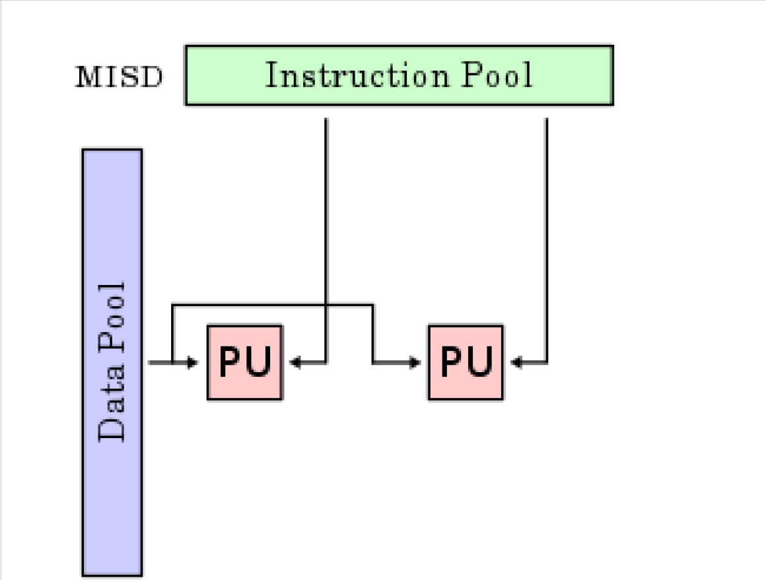

Slide 10
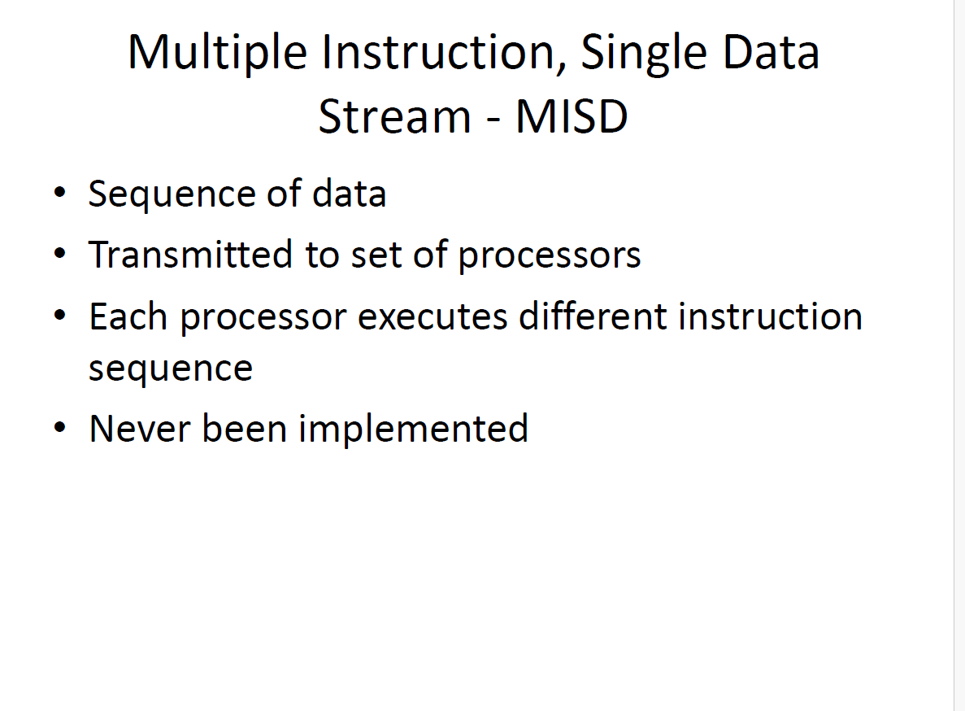

Slide 11
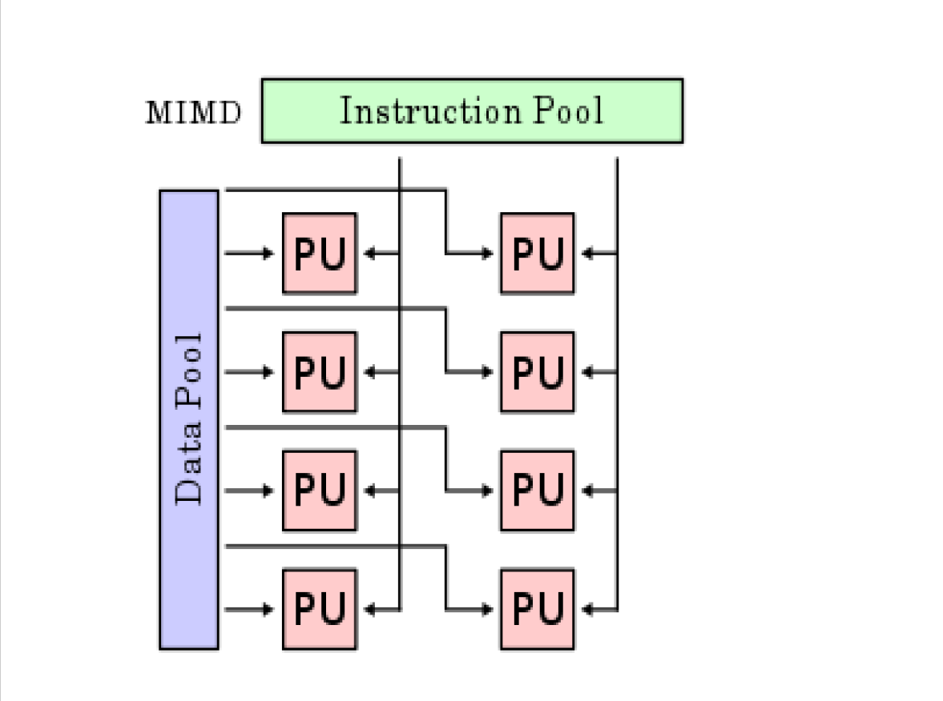

Slide 12
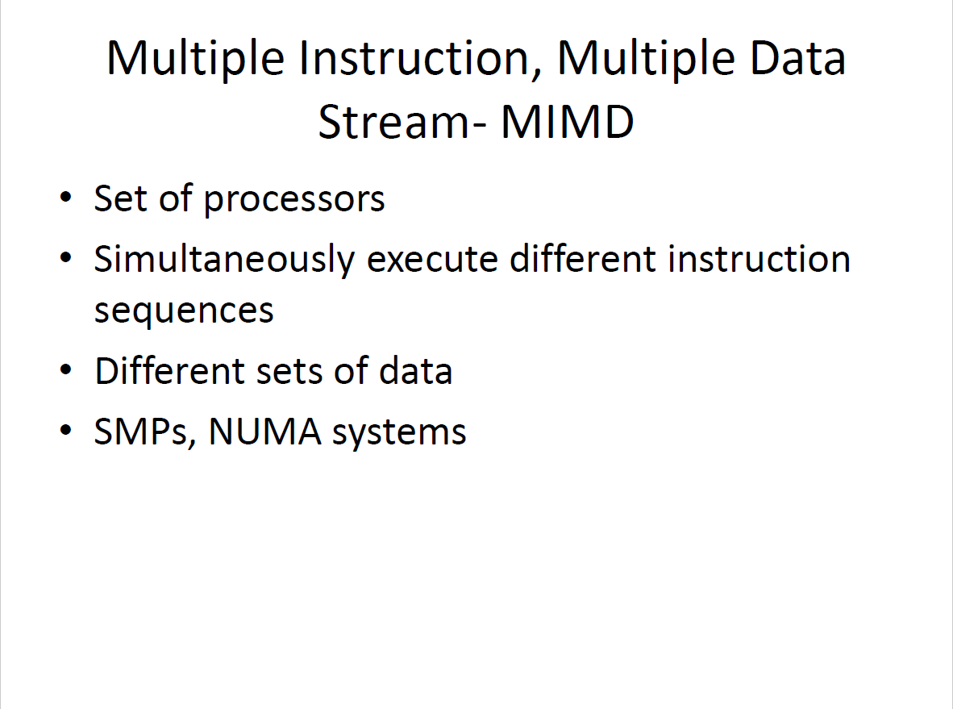

Slide 13
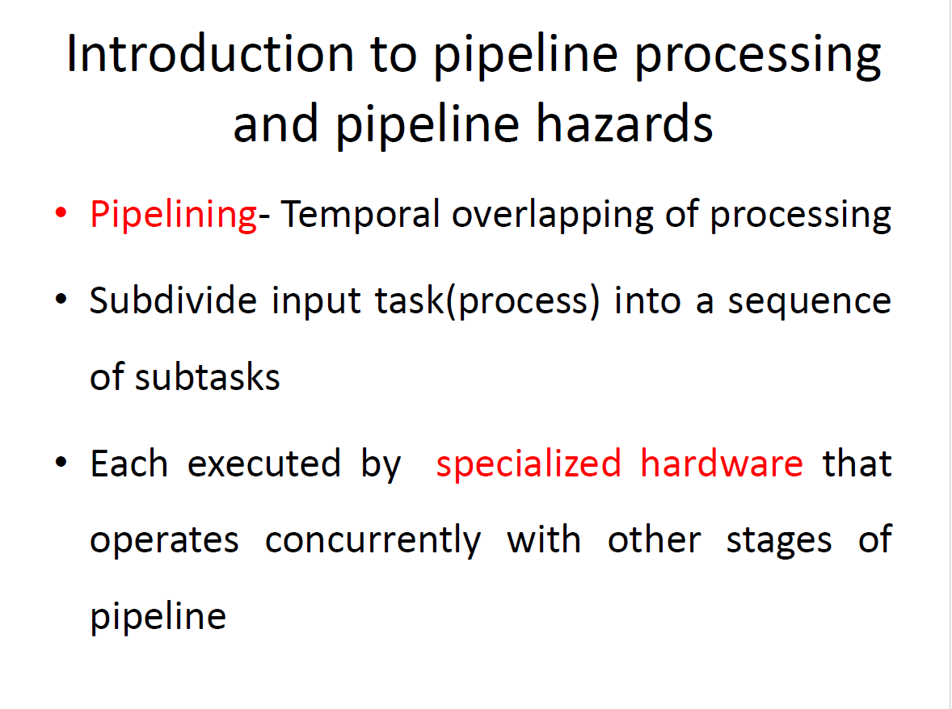

Slide 14
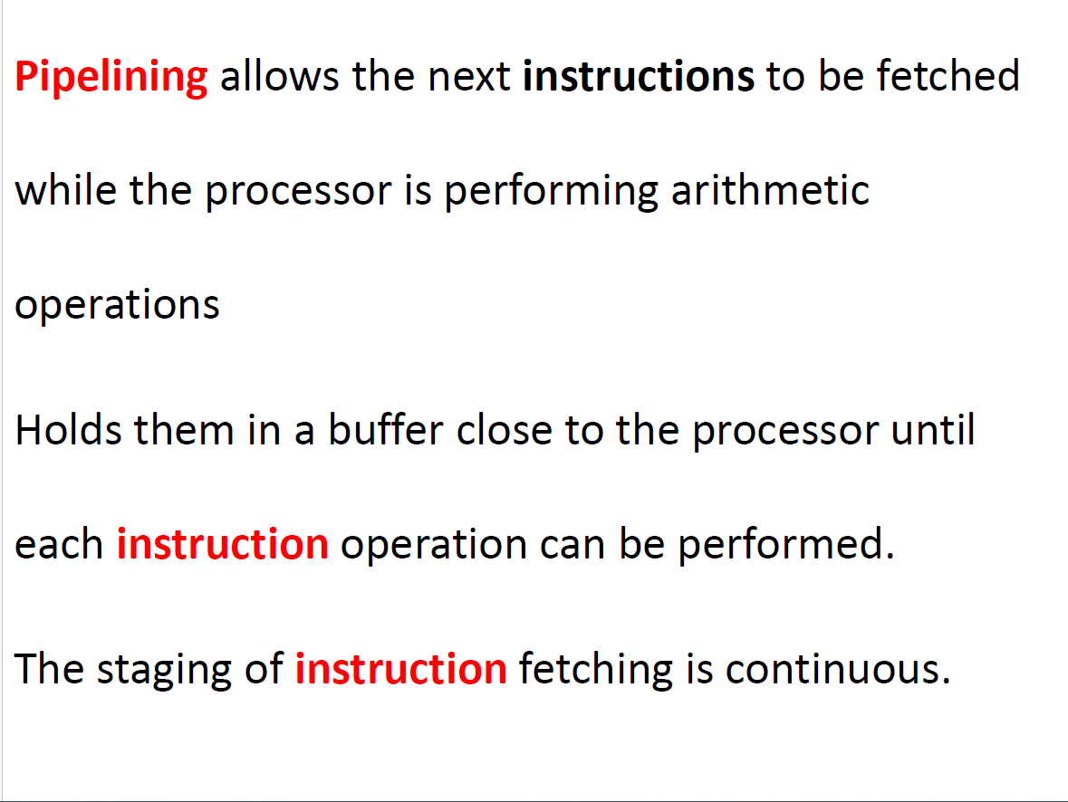

Slide 15
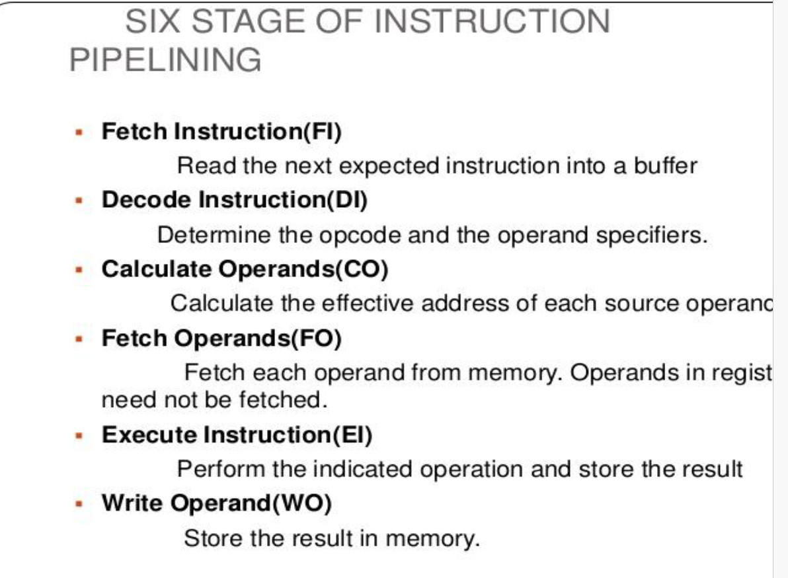

Slide 16
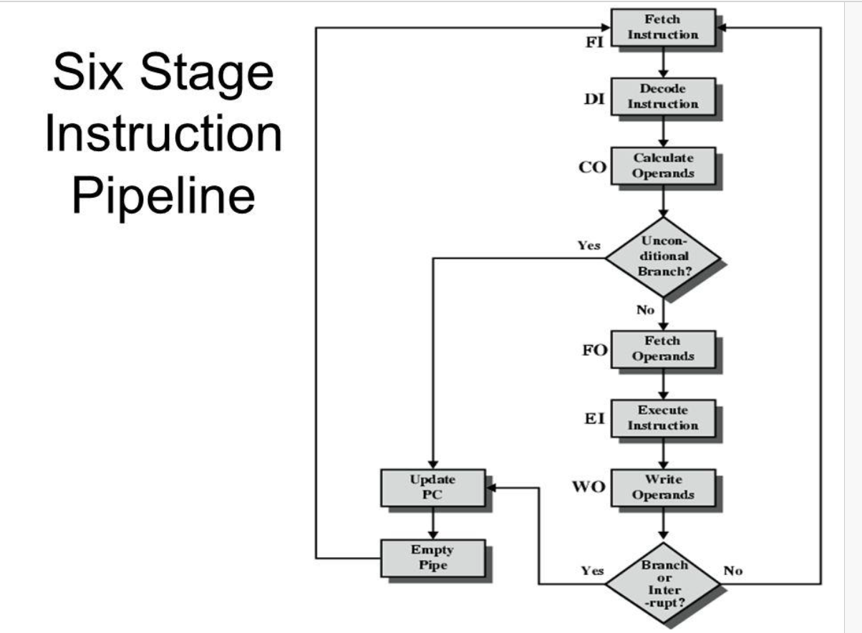

Slide 17
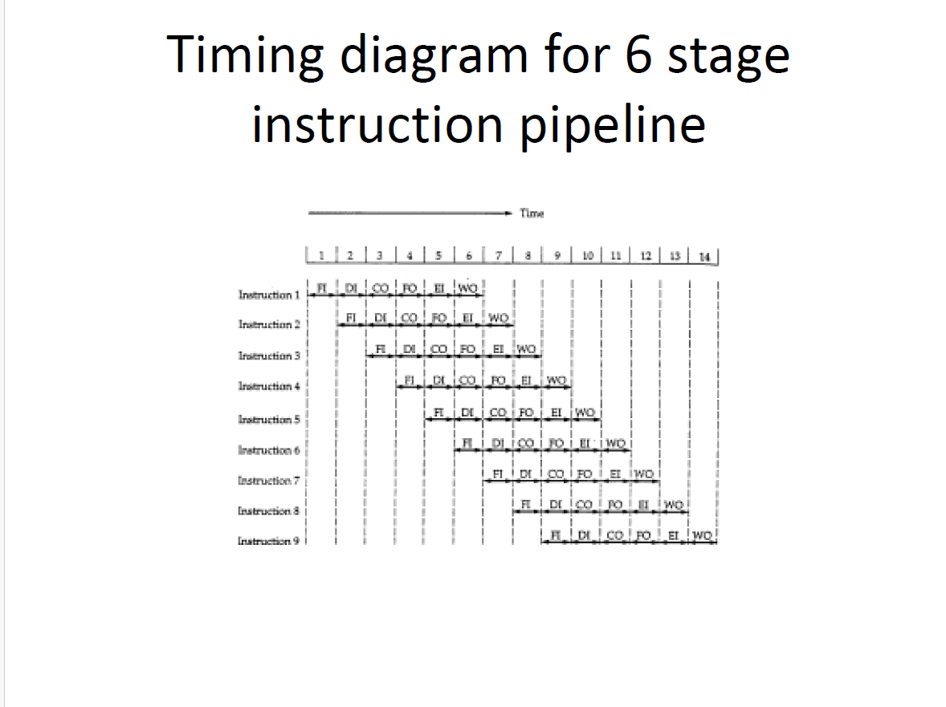
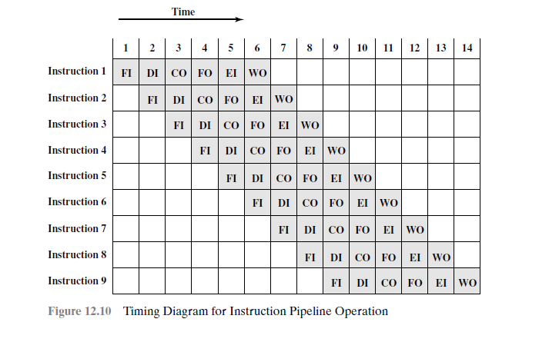

Slide 18
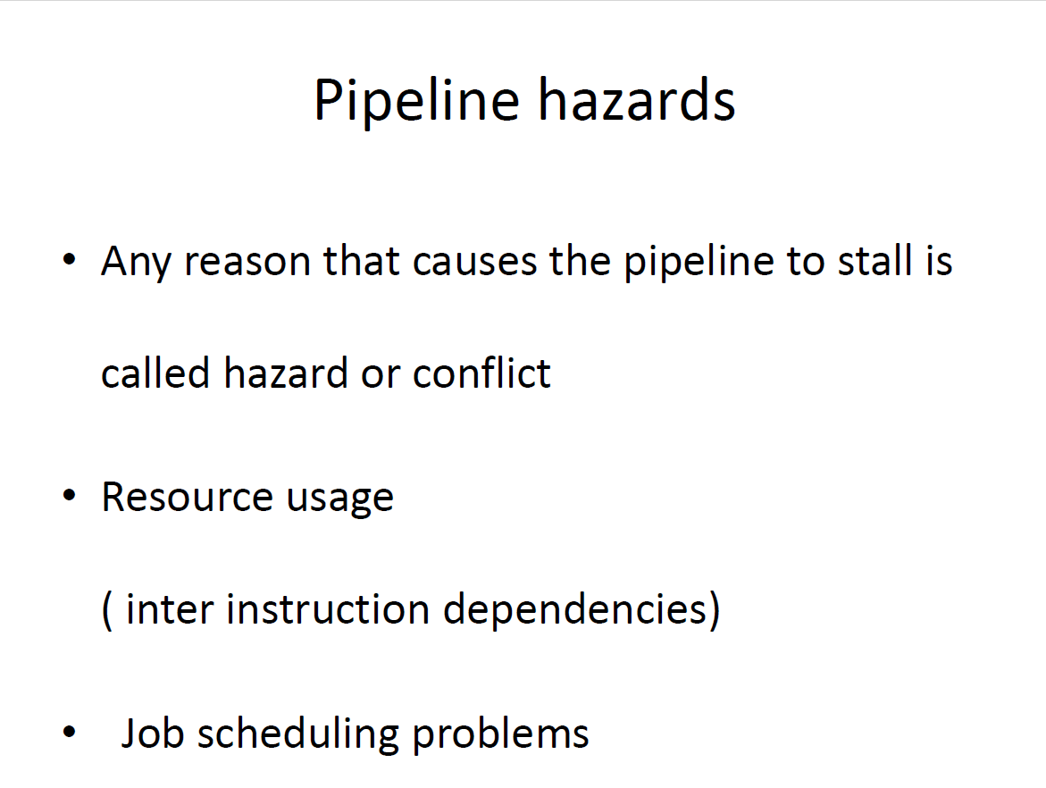

Slide 19
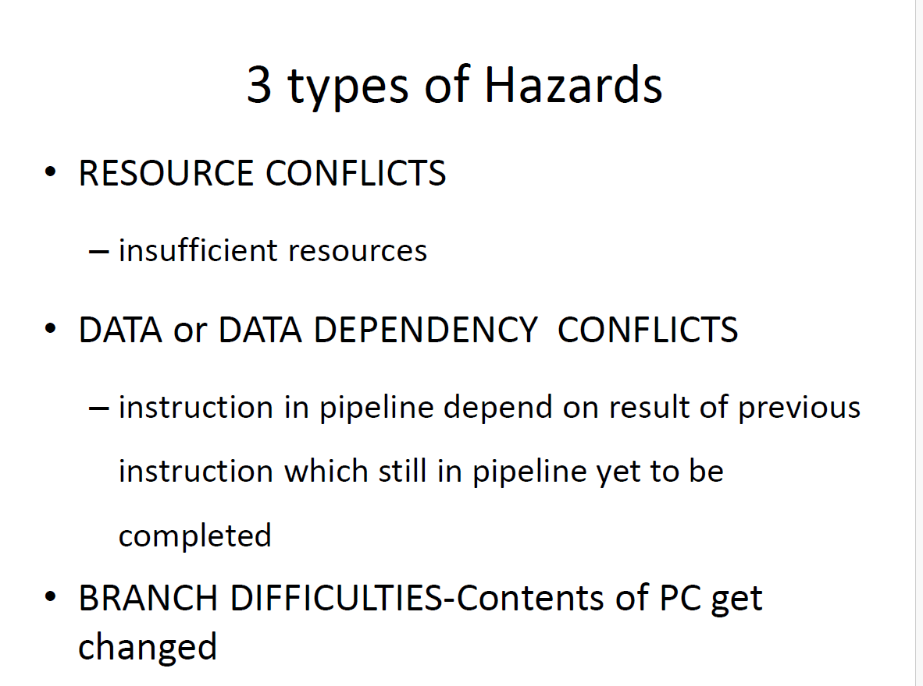

Slide 20
3 Types of HAZARD
RESOURCE HAZARDS(Structural hazard)
DATA HAZARDS
CONTROL HAZARDS

Slide 21
Resource hazard
If an operand for an instruction is in memory , rather than a register. Operand read to or write from memory cannot be performed in parallel with an instruction Fetch.
Another example of a resource conflict is a situation in which multiple Instructions are ready to enter the execute instruction phase and there is a single ALU.

Slide 22
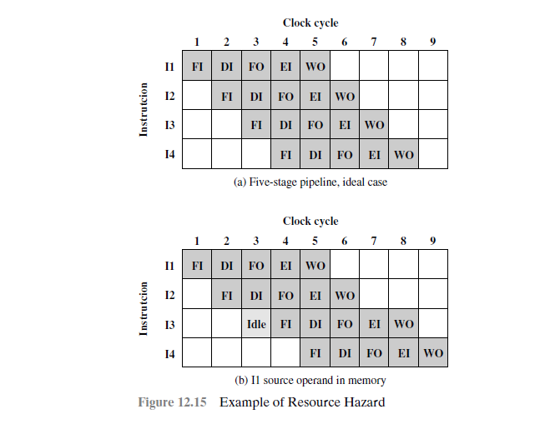
Resource Hazard

Slide 23
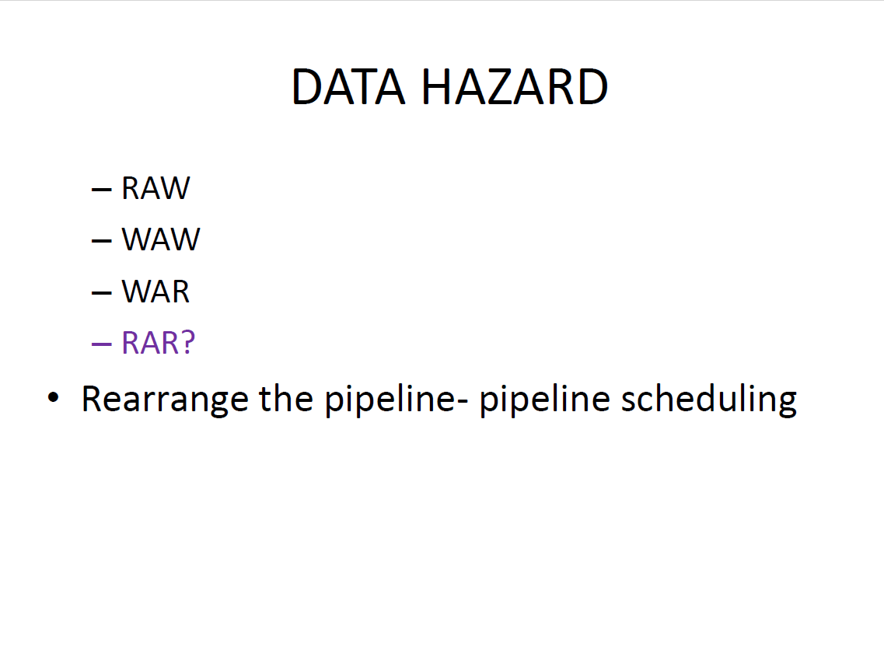

Slide 24
DATA HAZARD
Occurs when-conflict in the access of an operand location.
Two instructions in a program are to be executed in sequence and both access a particular memory or register operand.
The operand value to be updated –producing a different result than would occur with strict sequential execution.
The destination of one instruction should not be a source of immediate next instruction.
Example, :
ADD EAX, EBX
/* EAX = EAX + EBX
SUB ECX, EAX
/* ECX = ECX - EAX

Slide 25
DATA HAZARD
To maintain correct operation, the pipeline must stall for two clocks cycles.
Otherwise-results in inefficient pipeline usage.
Eg;-add
Nop
Nop
Sub

Slide 26
3-types of Data Hazards
Read after write (RAW), or true dependency: An instruction modifies a register or memory location and a succeeding instruction reads the data in that
memory or register location. A hazard occurs if the read takes place before the write operation is complete.
Write after read (RAR), or antidependency: An instruction reads a register or memory location and a succeeding instruction writes to the location. A hazard occurs if the write operation completes before the read operation takes place.
Write after write (WAW), or output dependency: Two instructions both write
to the same location. A hazard occurs if the write operations take place in the
reverse order of the intended sequence.

Slide 27
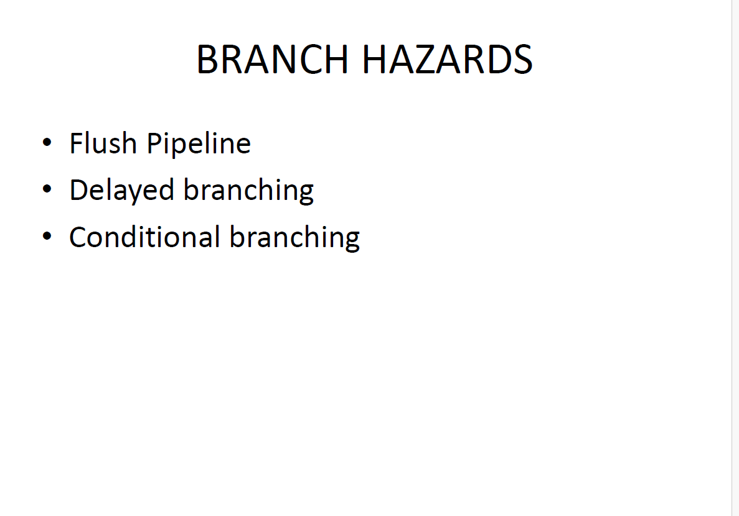

Slide 28
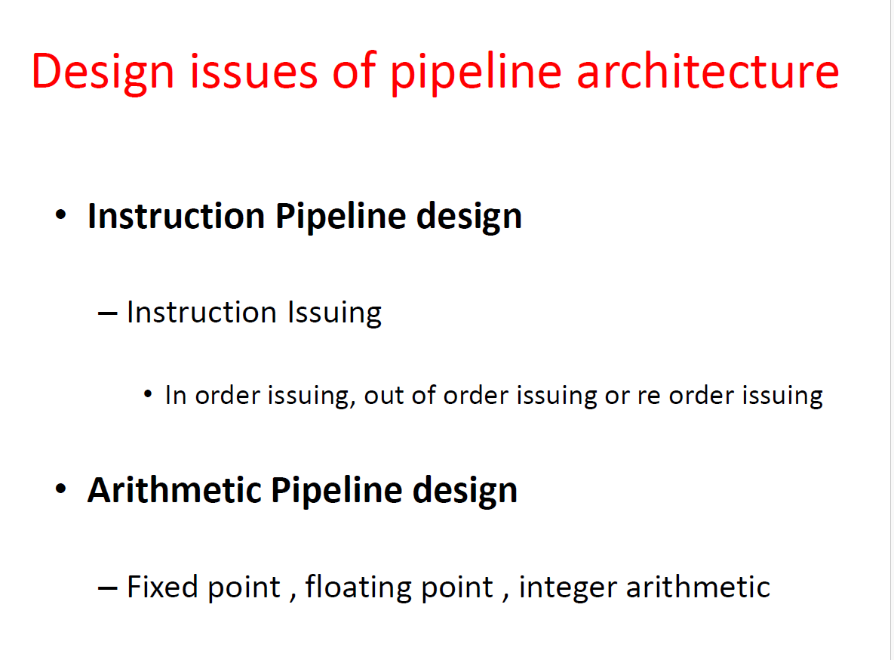

Slide 29
