Slide 1
MODULE-5
I/O

Slide 2
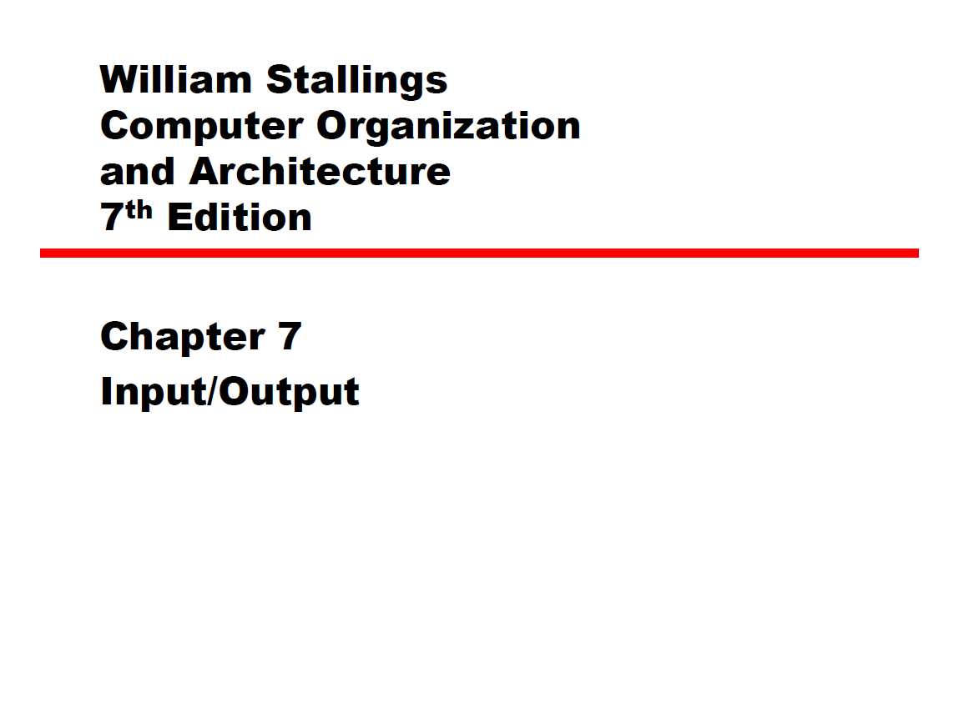

Slide 3
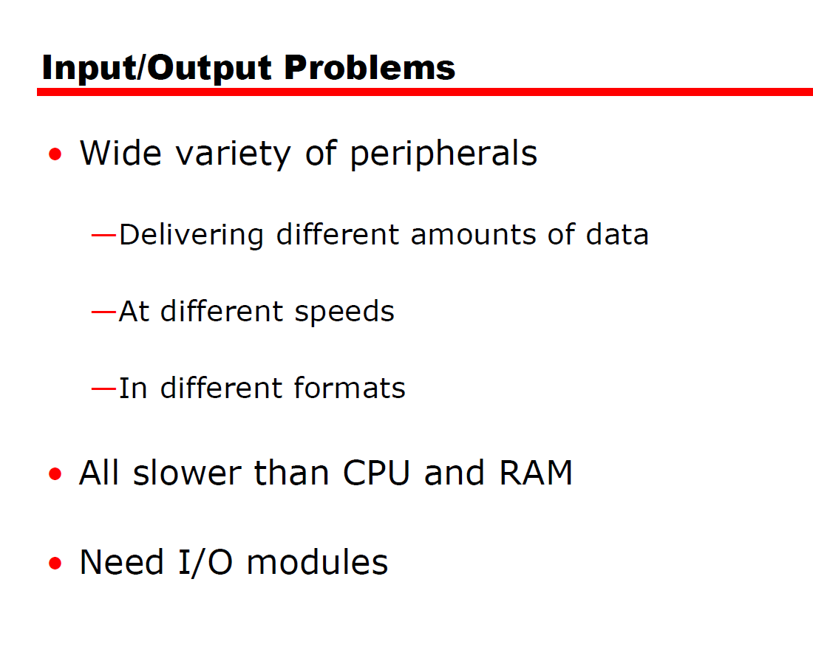

Slide 4
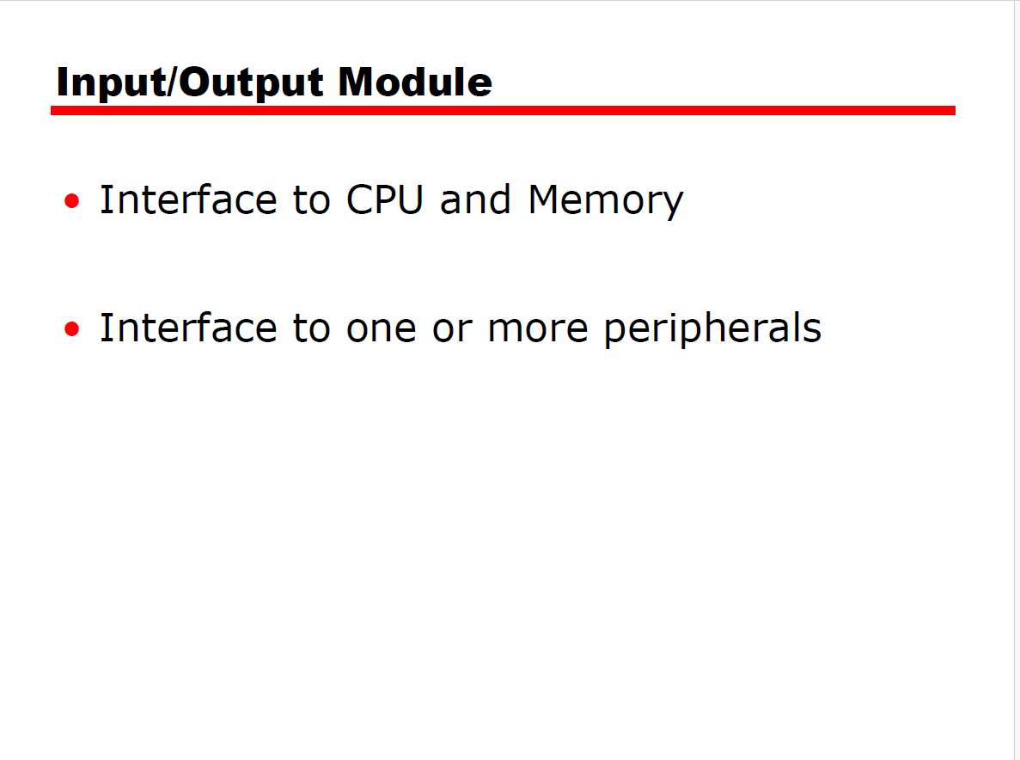

Slide 5
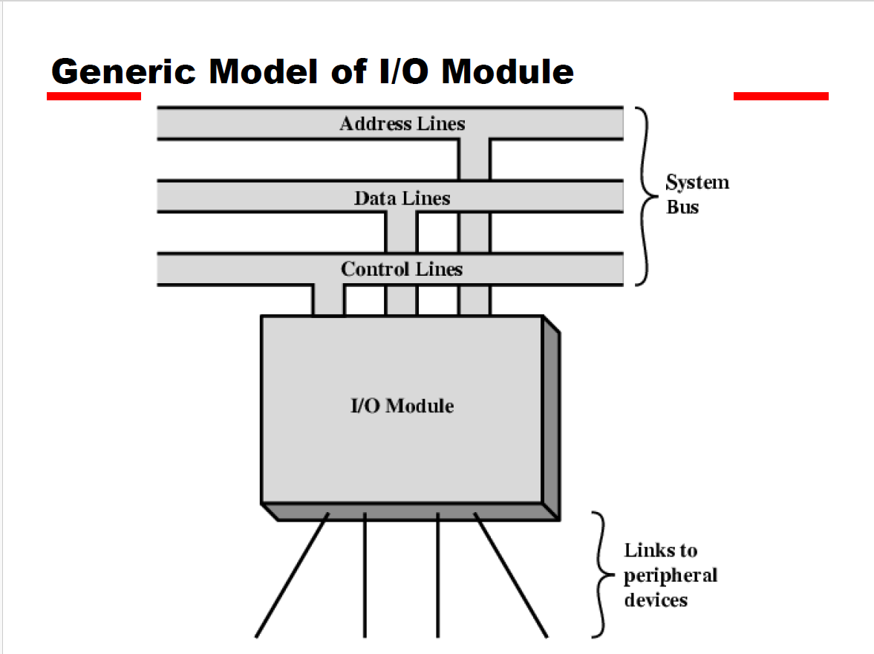

Slide 6
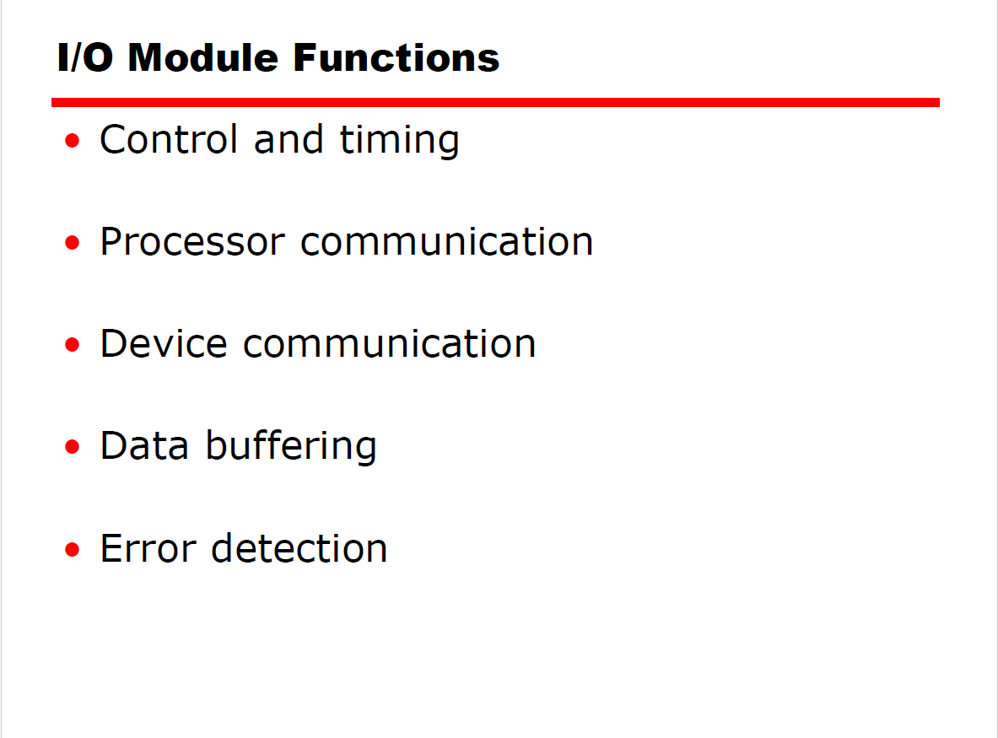

Slide 7
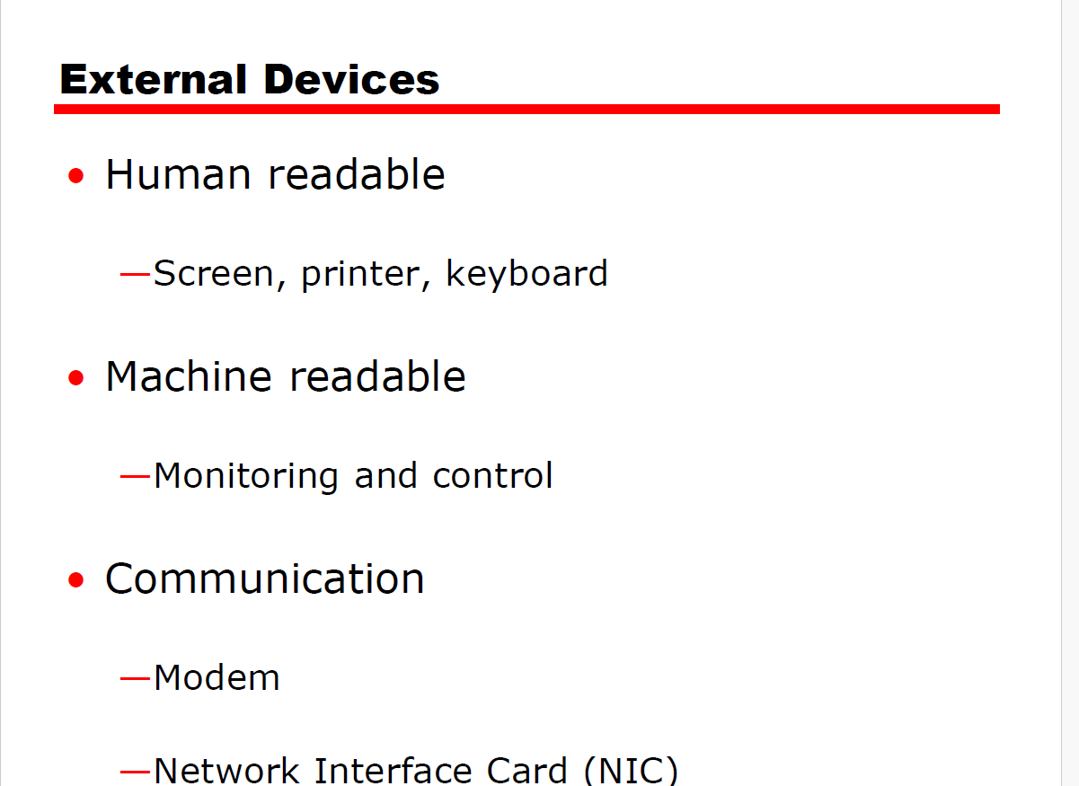

Slide 8
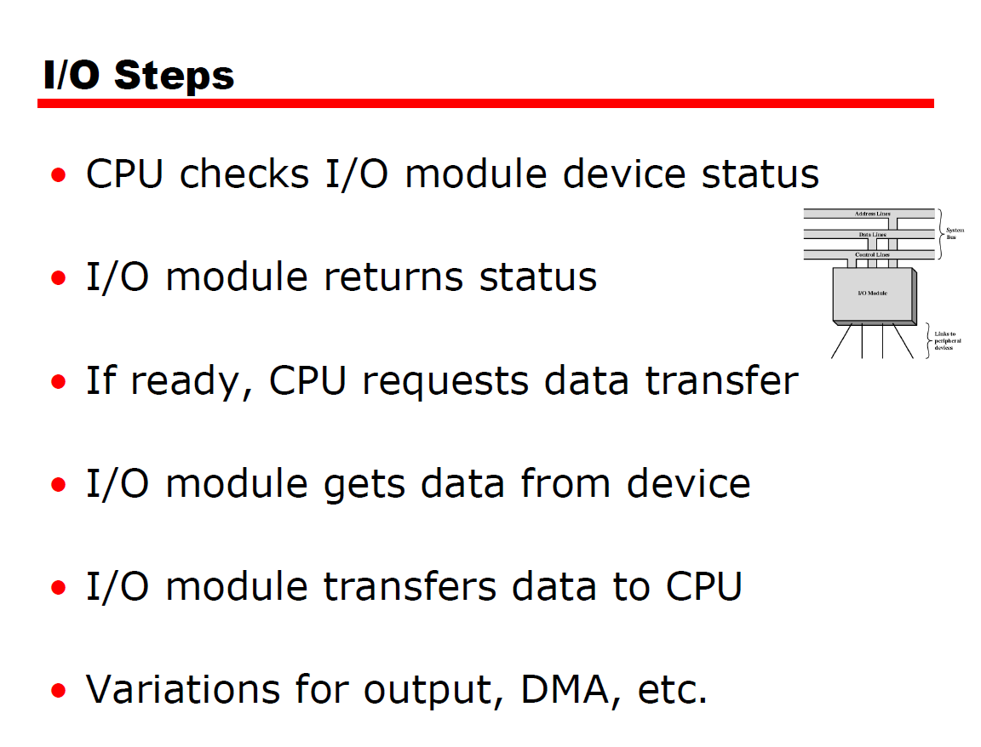

Slide 9
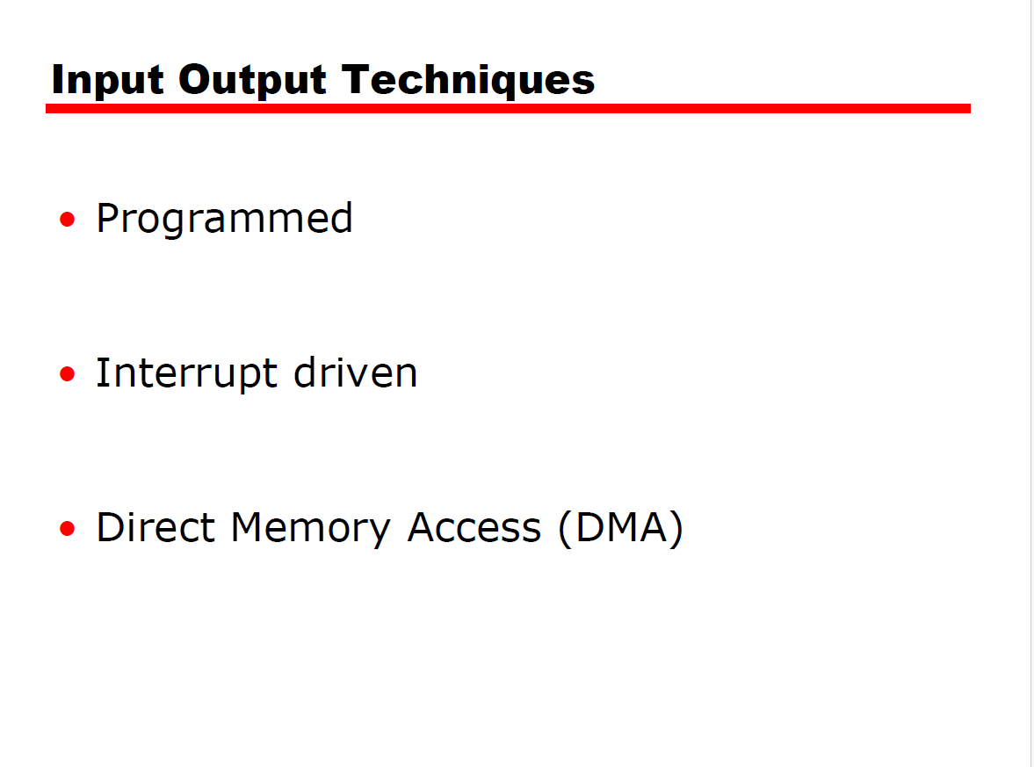

Slide 10
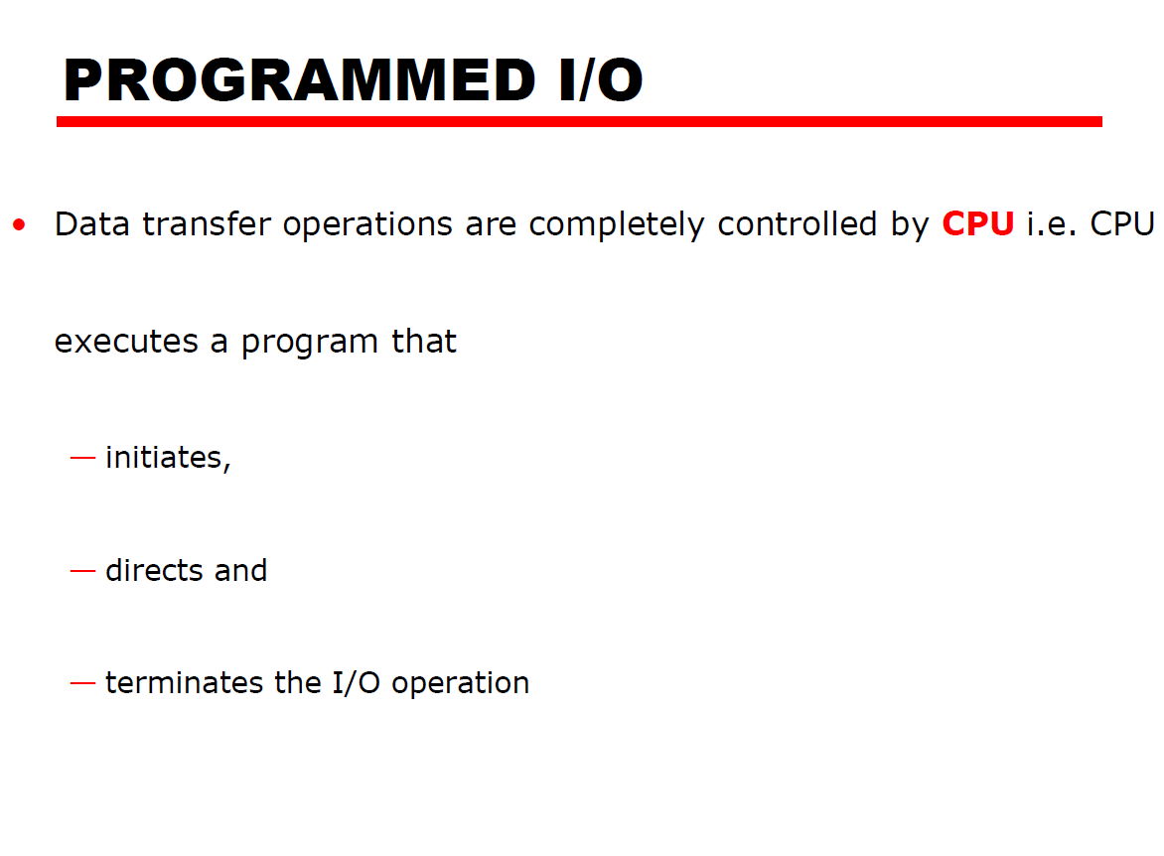

Slide 11
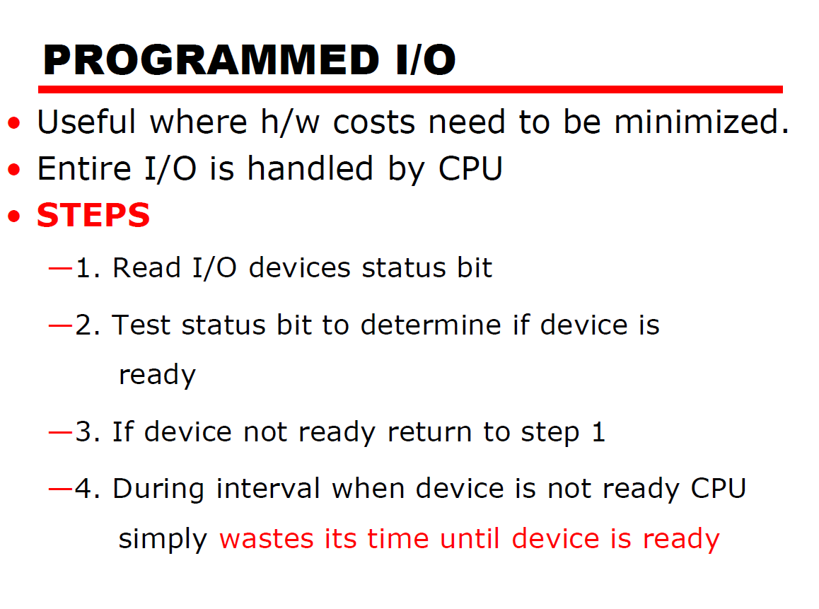

Slide 12
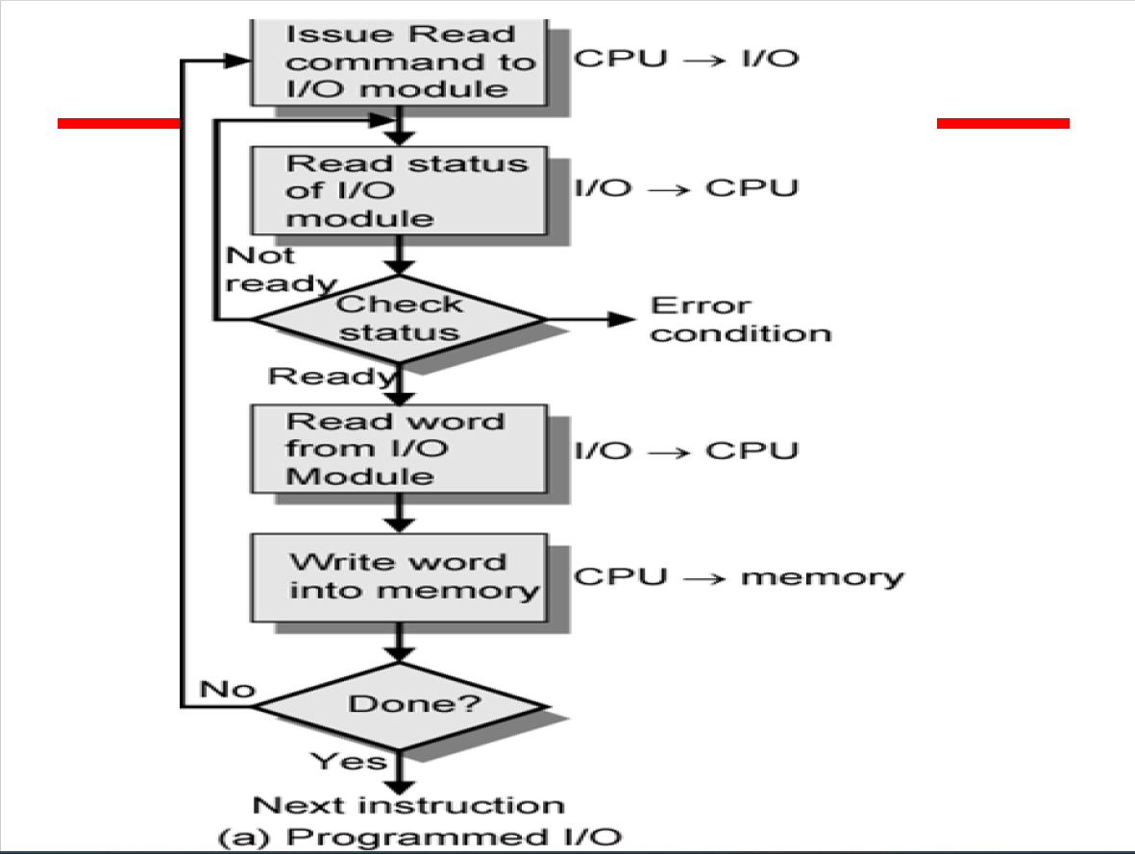

Slide 13
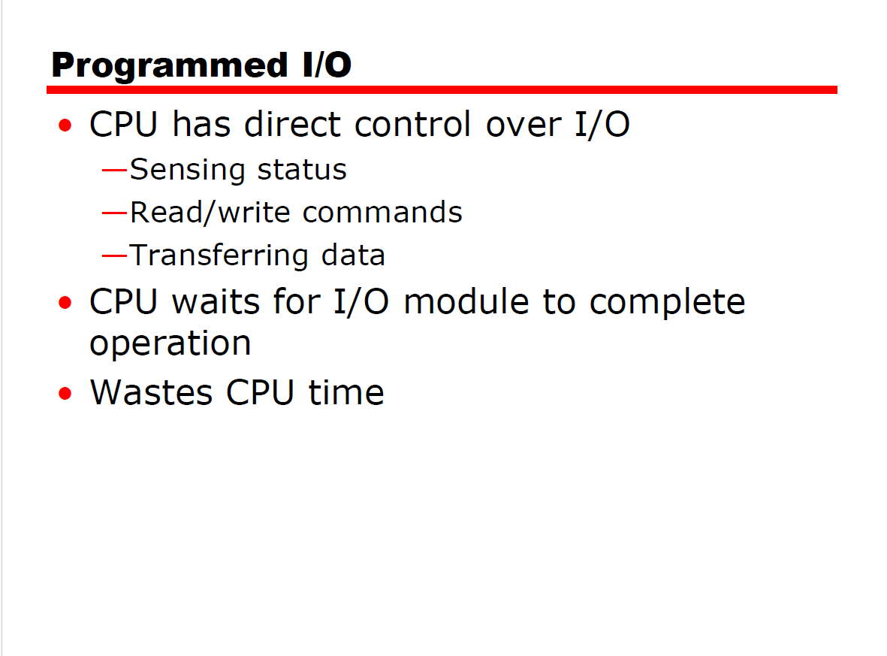

Slide 14
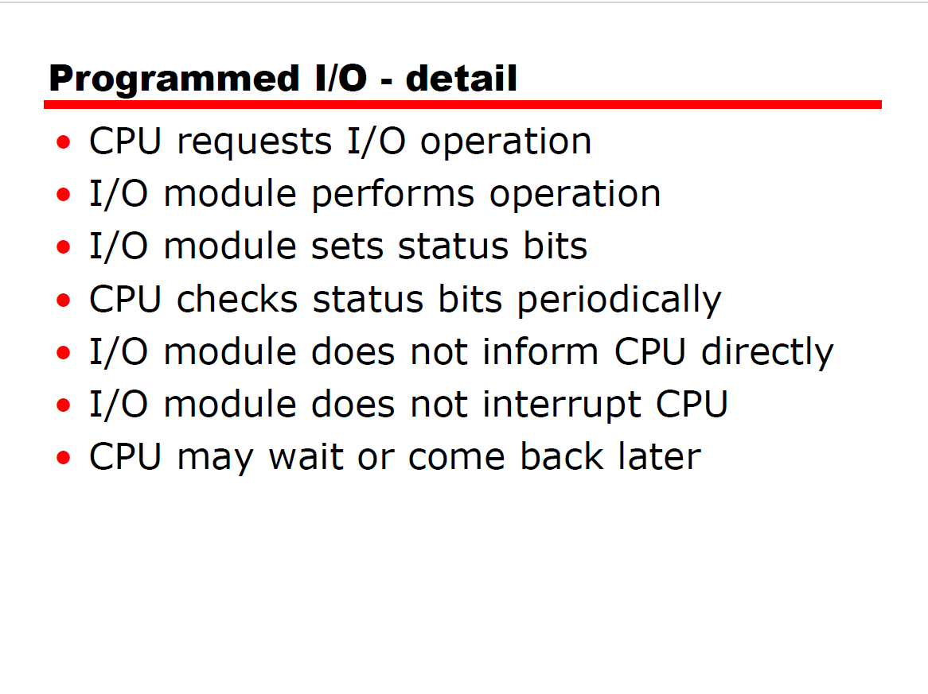

Slide 15
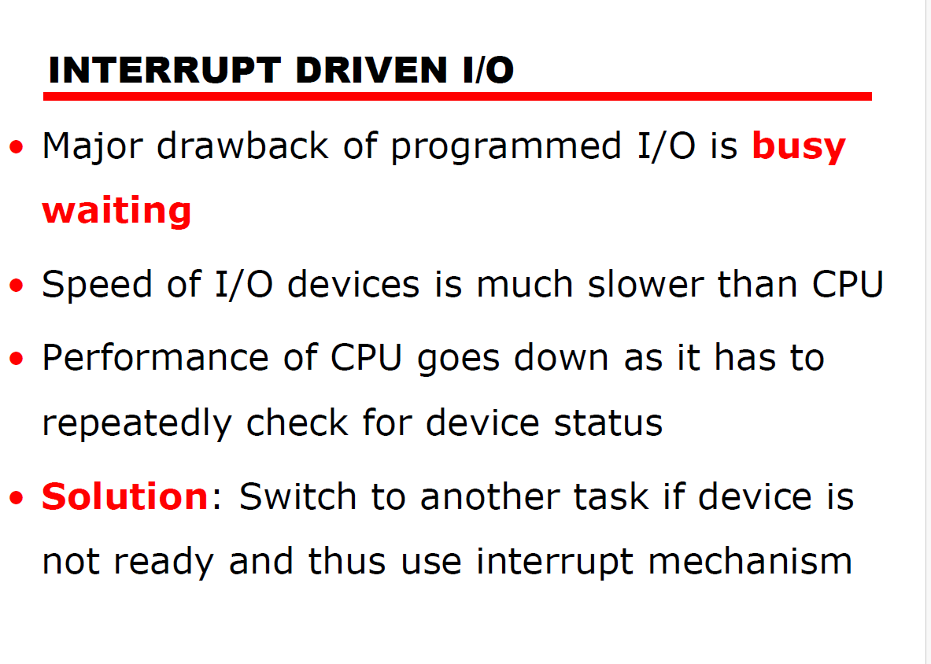

Slide 16
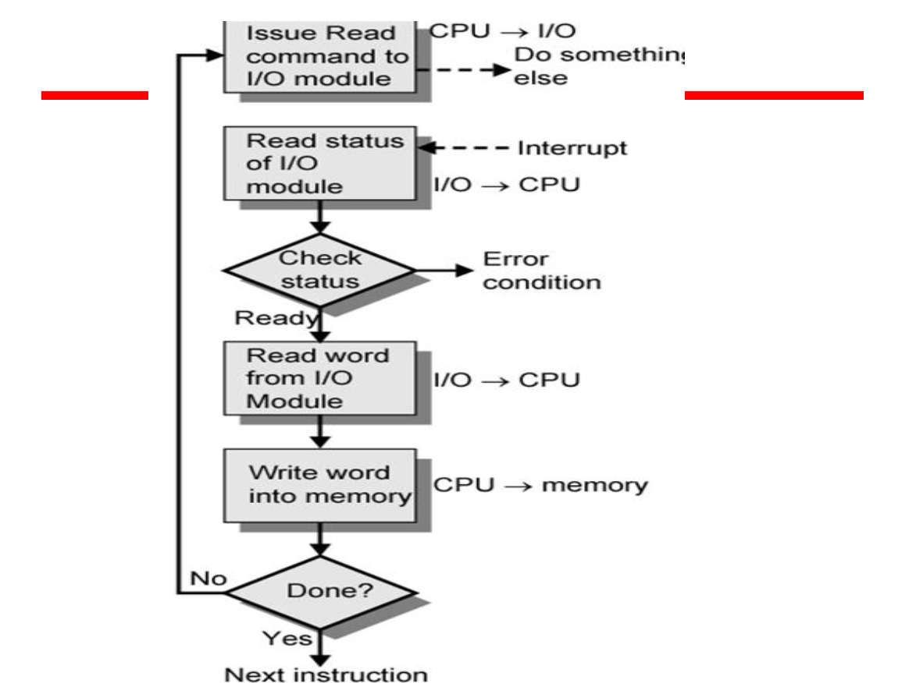

Slide 17
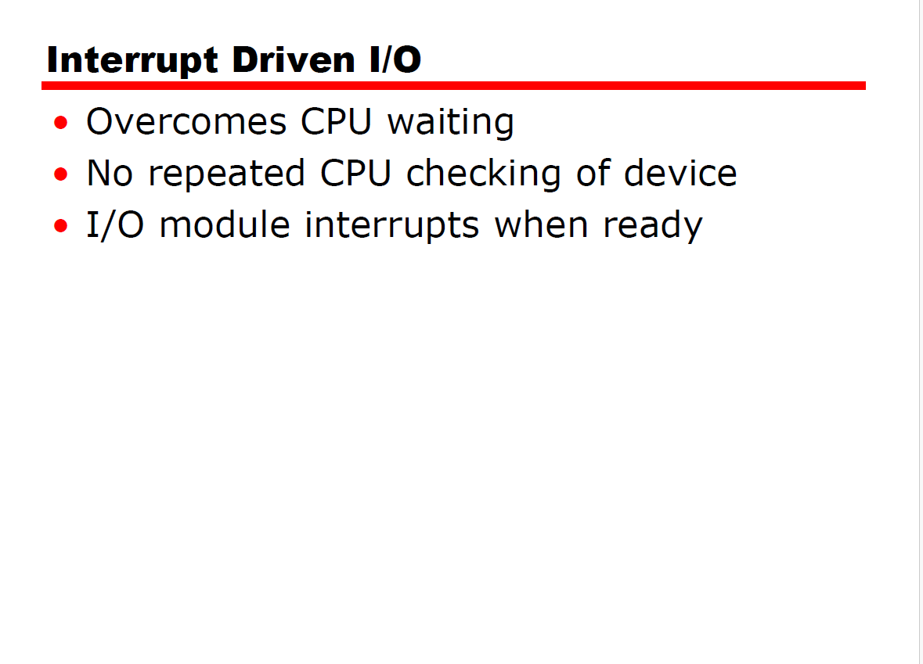

Slide 18
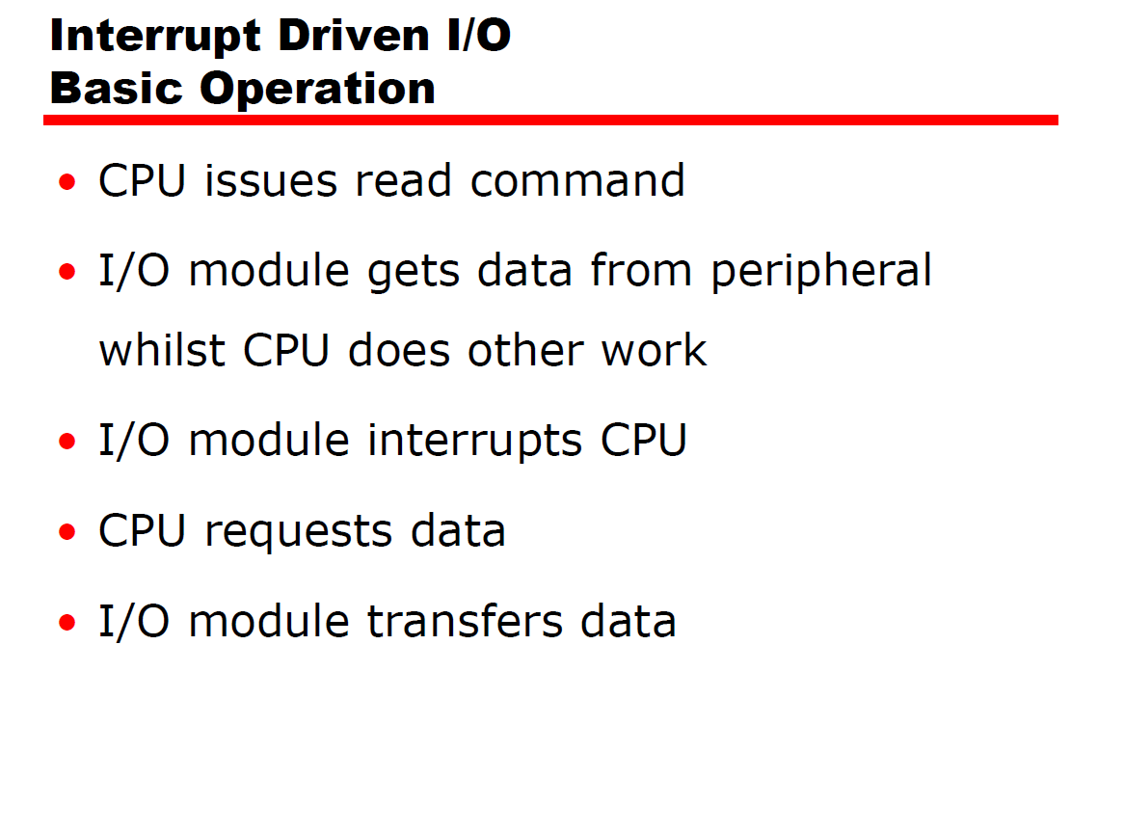

Slide 19
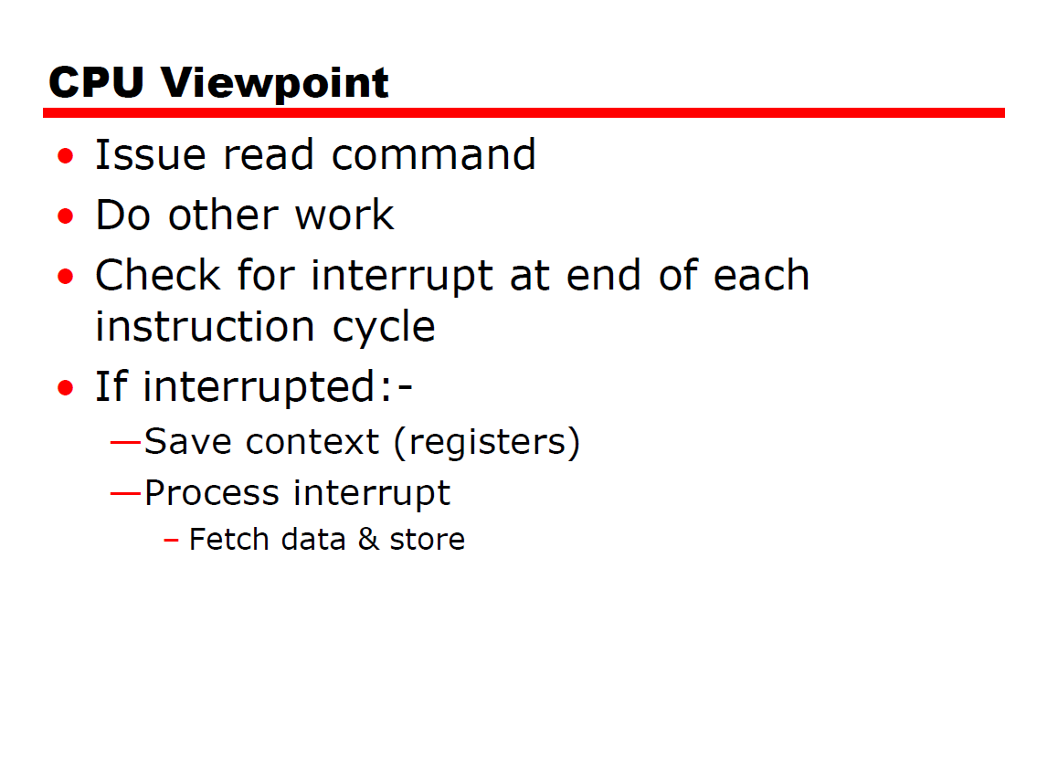

Slide 20
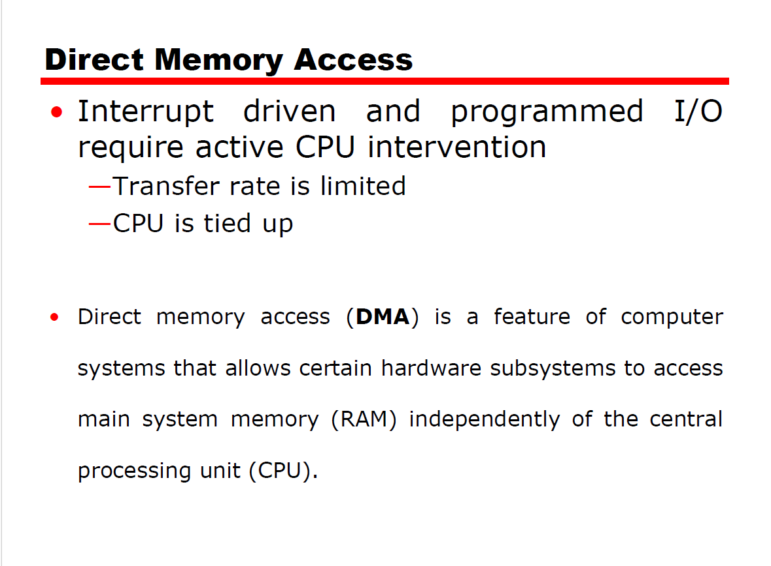

Slide 21
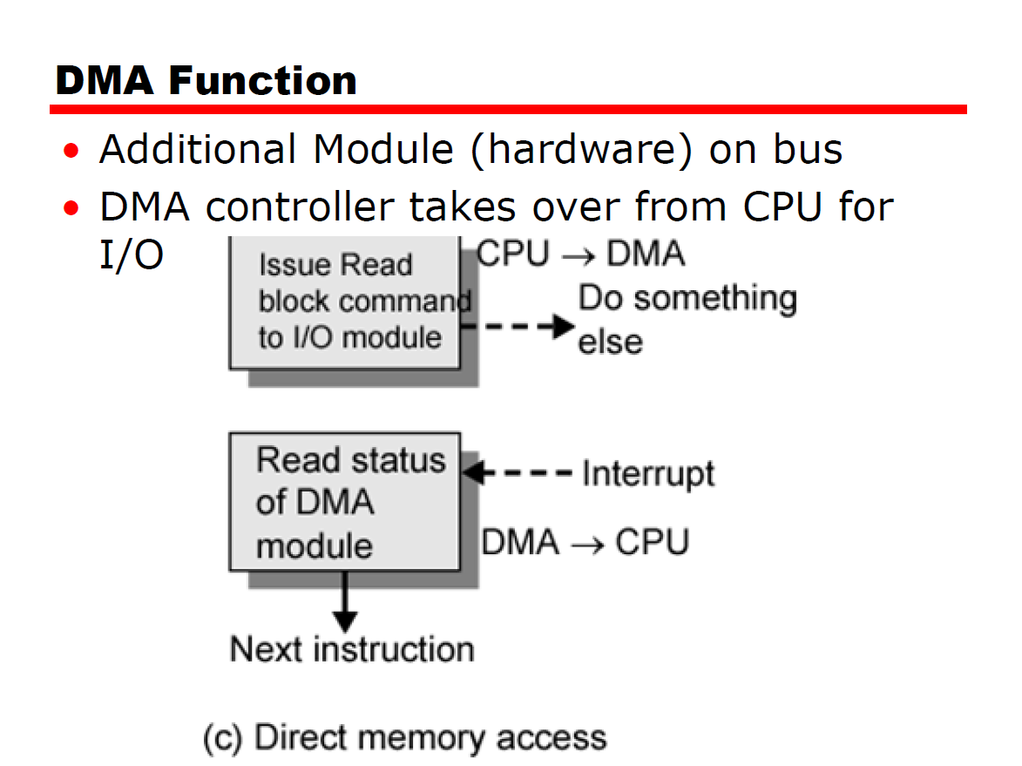

Slide 22
How it’s done
When Processor wishes to read or write a block of data- issues a command to the DMA module, sending to the DMA module the following information:
1.Whether a read or write is requested, using the read or write control line between the processor and the DMA module.
2. The address of the I/O device involved, communicated on the data lines.
3. The starting location in memory to read from or write to, communicated on the data lines and stored by the DMA module in its address register.
4. The number of words to be read or written, again communicated via the data lines and stored in the data count register.

Slide 23
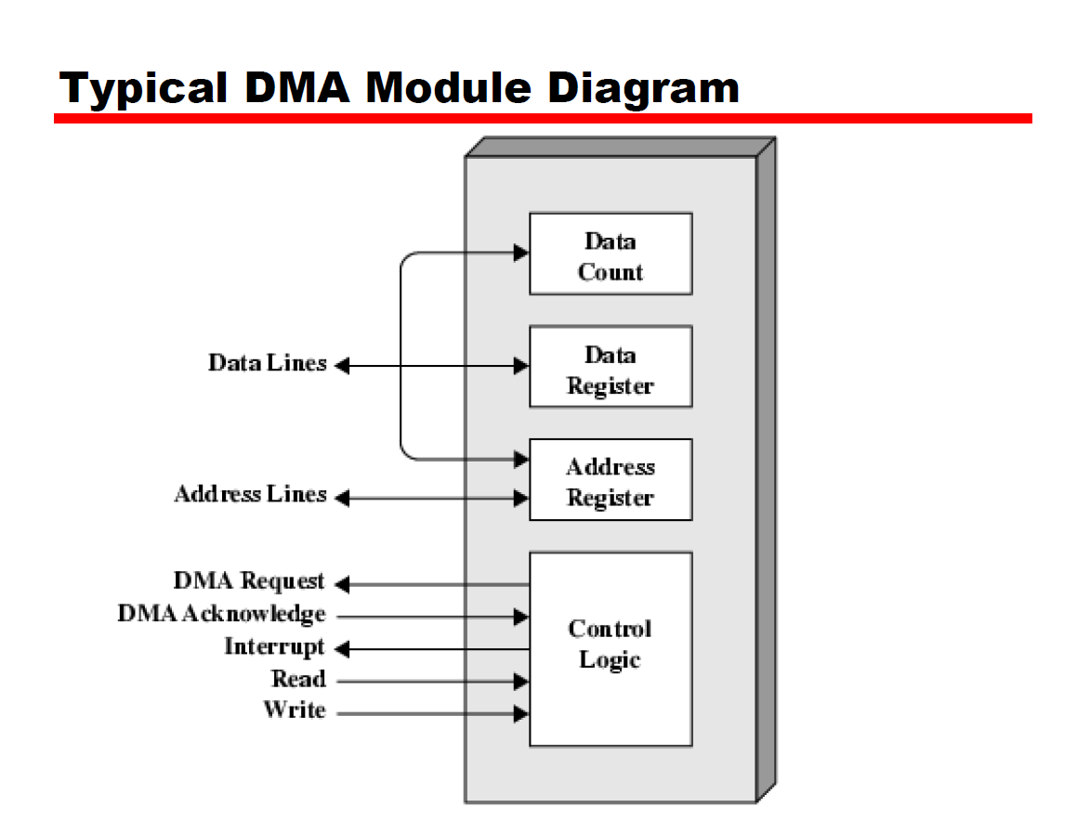

Slide 24
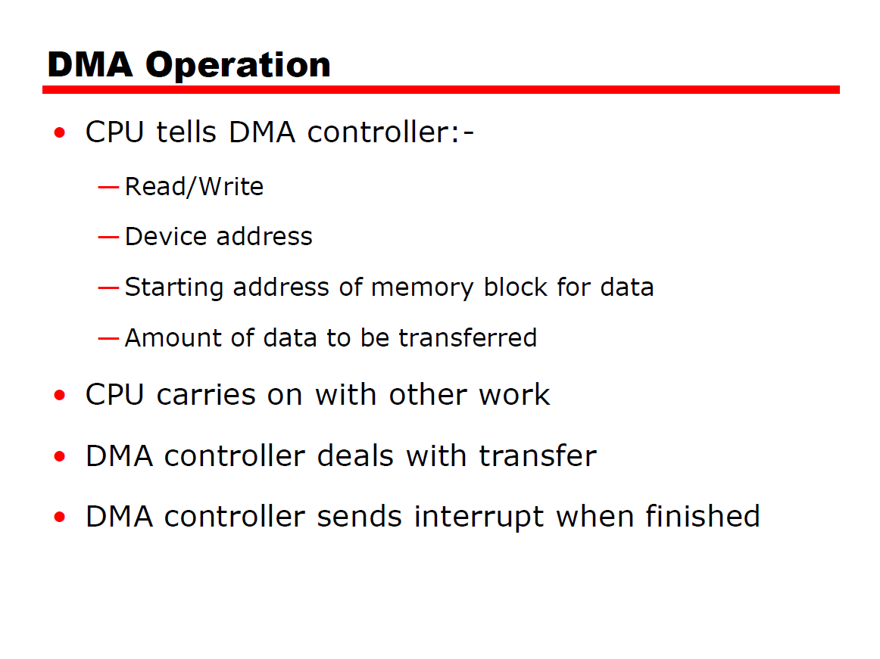

Slide 25
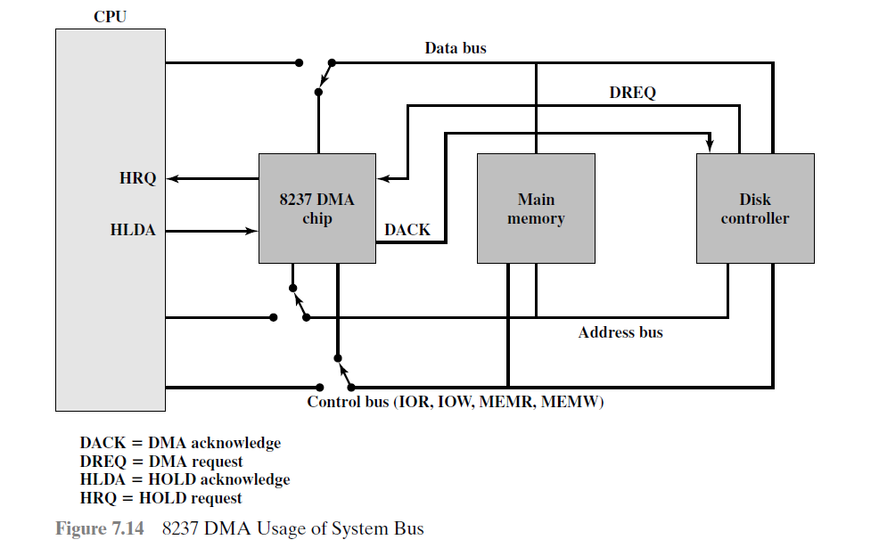

Slide 26
Steps in DMA data transfer
The peripheral device (such as the disk controller) will request the service of DMA by pulling DREQ (DMA request) high.
2. The DMA will put a high on its HRQ (hold request), signaling the CPU through its HOLD pin that it needs to use the buses.
3. The CPU will finish the present bus and respond to the DMA request by putting high on its HDLA, indicating that the DMA module can use the buses.
4. DMA will activate DACK (DMA acknowledge), which tells the peripheral device that it will start to transfer the data.

Slide 27
Steps in DMA data transfer
5. DMA starts to transfer the data from memory to peripheral.
6. After the DMA has finished its job it will deactivate HRQ, (hold made zero) signaling the CPU that it can regain control over its buses.
7.Processor again becomes the bus master.

Slide 28
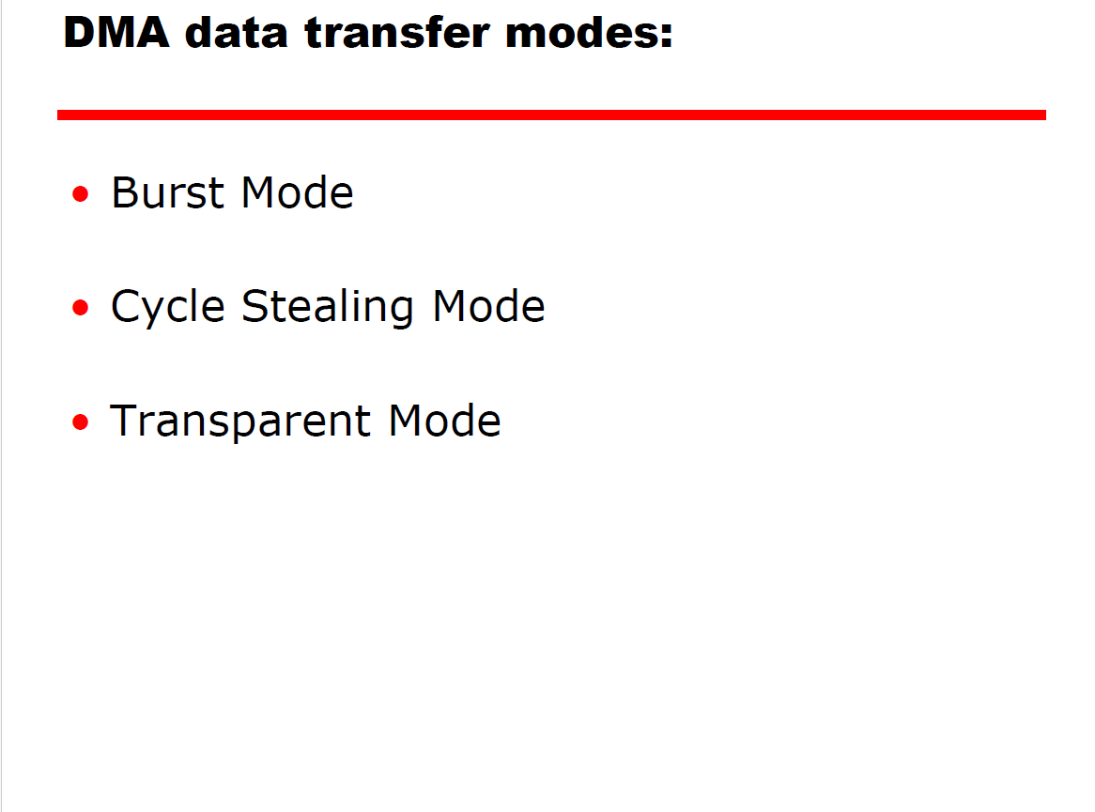

Slide 29
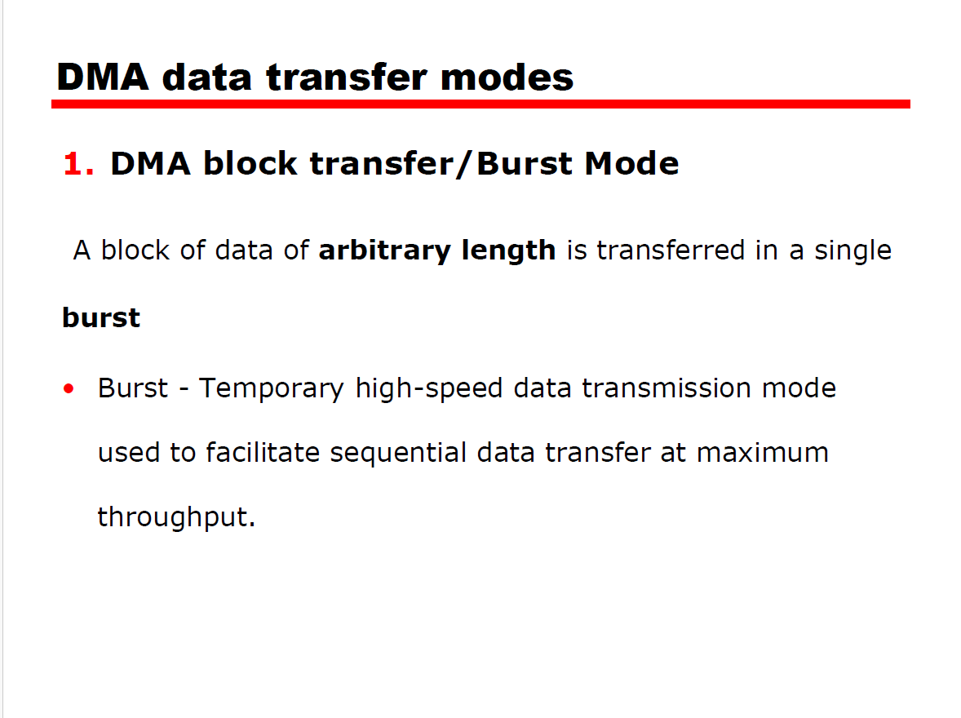

Slide 30
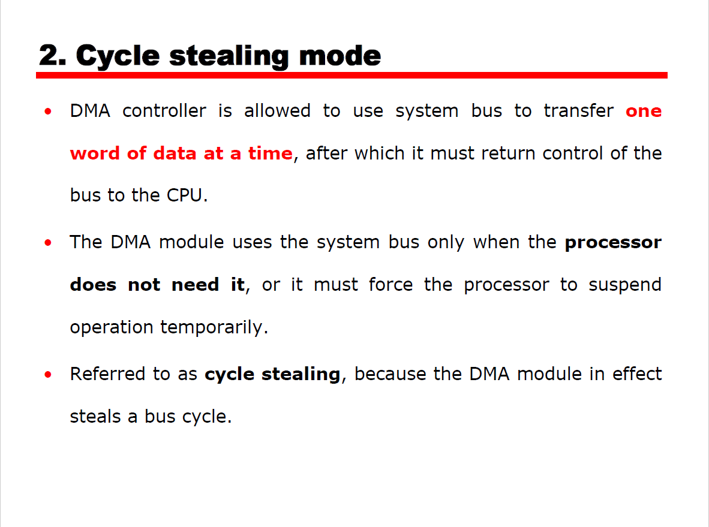

Slide 31
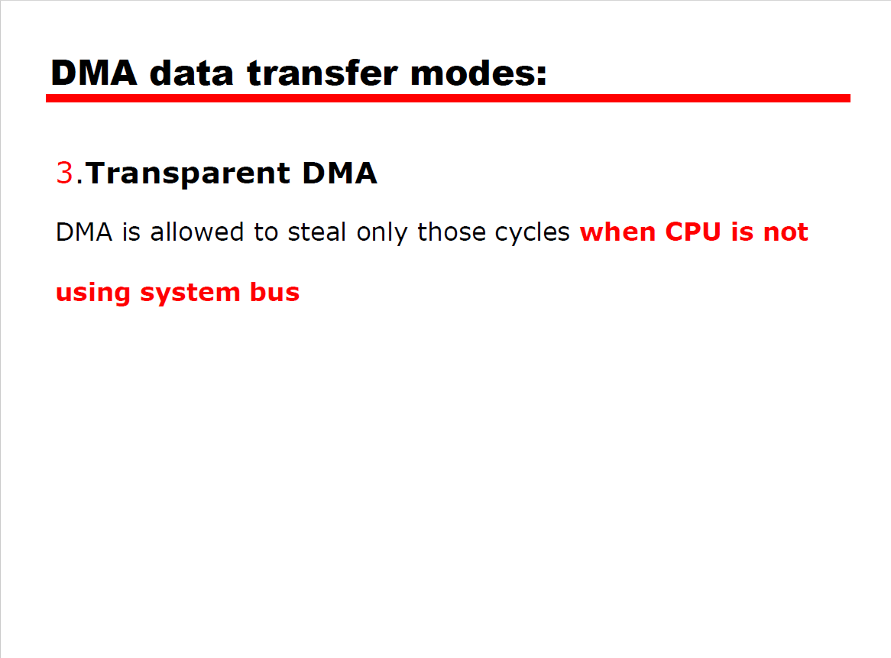

Slide 32
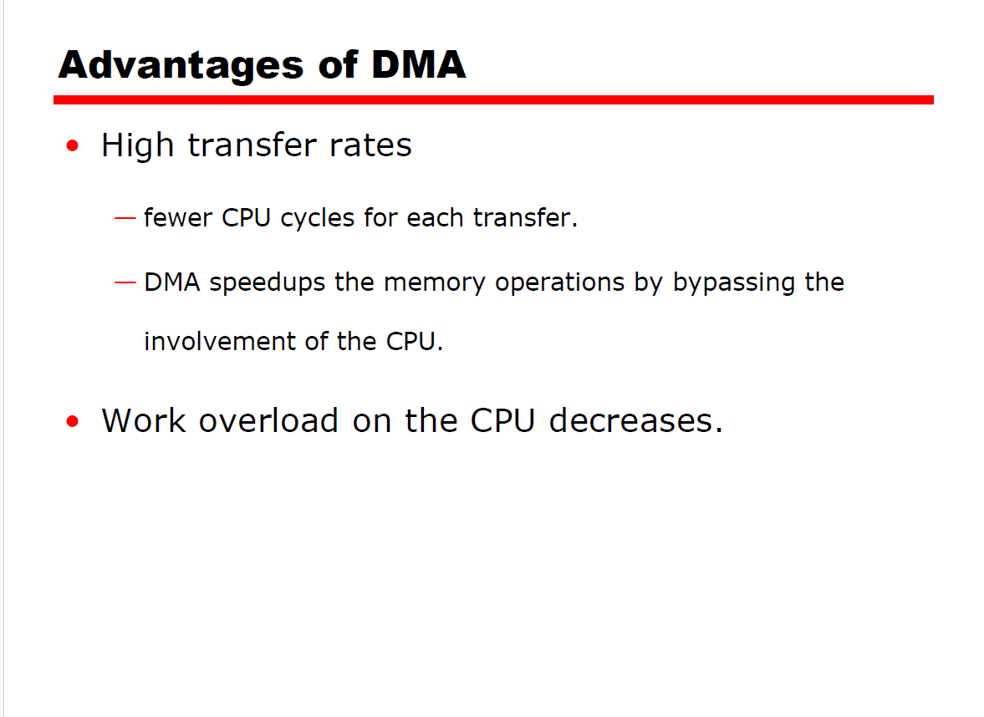

Slide 33
