Slide 1
Stacks

Slide 2
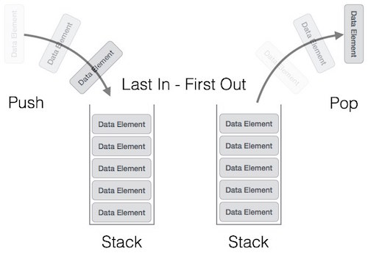
Stacks
Stack is a linear data structure which follows a particular order in which the operations are performed.
The order may be LIFO(Last In First Out) or FILO(First In Last Out).

Slide 3
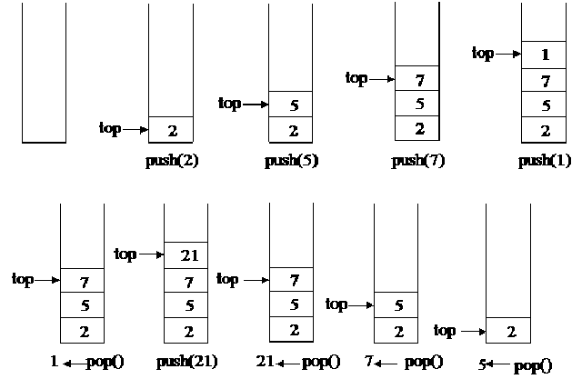
Operation on Stacks
Push operation-The insertion of an element into stack
Pop operation - Deletion of an element from the stack
In stack we always keep track of the last element present in the list with a pointer called top.

Slide 4
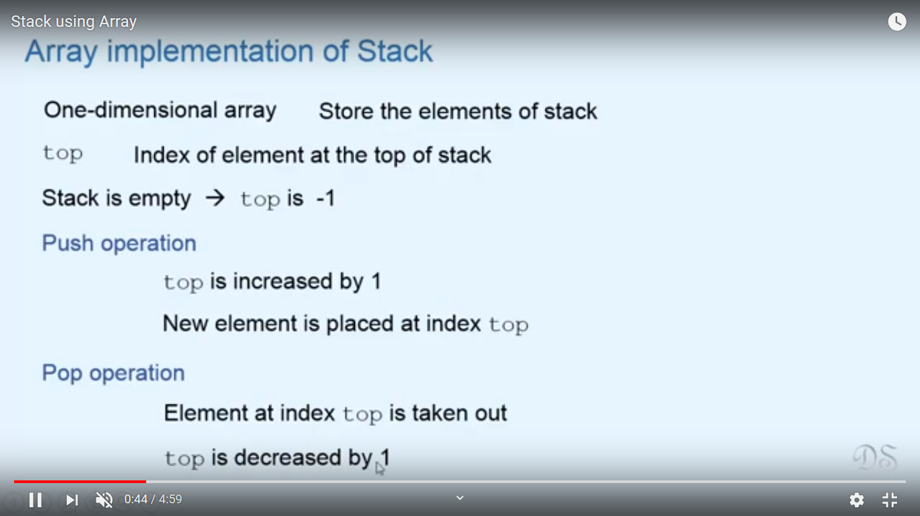
Array Implementation of Stack

Slide 5
Array Implementation of Stack

Slide 6
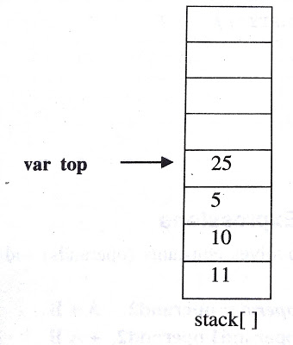
Array Implementation of Stack
Push element one by one onto stack from 0th position to n-1 th position.
Variable top=position of the top element in the array
If there is no element in the stack, value of top will be -1

Slide 7
Stack Overflow /FullCondition
If(top==MAX-1)
Then print stack is full or overflowing

Slide 8
Stack Underflow /Empty Condition
If(top== -1)
Then print stack is empty or underflowing

Slide 9
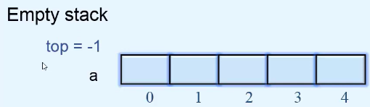
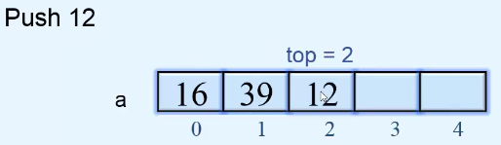
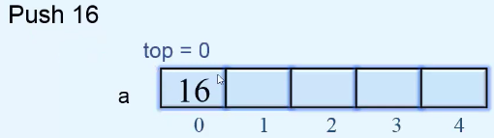
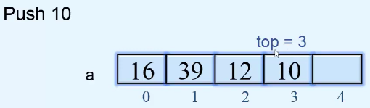
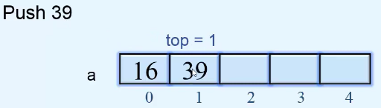
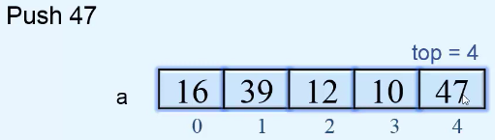
PUSH Operation on Stack

Slide 10
Algorithm for PUSH Operation
Check Stack Full condition
If(top==MAX-1)
Then print stack is full or overflow
Otherwise increase the top value by 1
top=top+1
Input the value
Assign the item at top position stack_arr[top]=pushed_item

Slide 11
Try writing the code for Push Operation function

Slide 12
PUSH Operation
push()
{
int pushed_item;
if(top == (MAX-1))
printf("Stack Overflow\n");
else
{
printf("Enter the item to be pushed in stack : ");
scanf("%d",&pushed_item);
top=top+1;
stack_arr[top] = pushed_item;
}
}/*End of push()*/

Slide 13
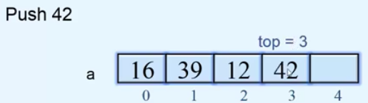
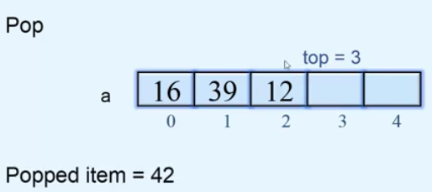
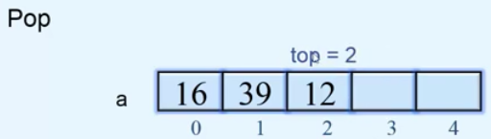
POP Operation on Stack
Stack Underflow condition
If(top== -1)

Slide 14
Algorithm for POP Operation
Check Stack Underflow condition
If(top== -1)
Then print stack is underflow
Otherwise, delete the top position element
Popped_item=stack_arr[top]
Decrease the position of top
top=top-1
Print the popped_item

Slide 15
Try writing the code for Pop Operation function

Slide 16
POP Operation
pop()
{
if(top == -1)
printf("Stack Underflow\n");
else
{
printf("Popped element is : %d\n",stack_arr[top]);
top=top-1;
}
}/*End of pop()*/

Slide 17
Try writing the code for Display Operation function

Slide 18
Display fn
display()
{
int i;
if(top == -1)
printf("Stack is empty\n");
else
{
printf("Stack elements :\n");
for(i = top; i >=0; i--)
printf("%d\n", stack_arr[i] );
}
}/*End of display()*/

Slide 19
Peek Operation
An operation on certain abstract data types, specifically sequential collections such as stacks and queues,
which returns the value of the top ("front") of the collection
without removing the element from the collection.
It thus returns the same value as operations such as "pop" or "dequeue", but does not modify the data.

Slide 20
Peek Operation
The name "peek"
the name for this operation varies depending on data type and language.
Peek is generally considered an inessential operation,
not included in the basic definition of these data types.

Slide 21
Peek Operation
Sequential types for which peek is often implemented include:
Stack
Queue
Priority queue (such as a heap)
Double-ended queue (deque)
Double-ended priority queue (DEPQ)

Slide 22
Peek Operation
Single-ended types, such as stack,
generally only admit a single peek, at the end that is modified.
Double-ended types, such as deques,
admit two peeks, one at each end.
Names for peek vary.
For queues "front" is common.
Dequeues have varied names, often "front" and "back" or "first" and "last".
The name "peak" is also occasionally found

Slide 23
Linked List Representationof Stack

Slide 24
Linked List Representation of Stack
The info field of the node holds the elements of the stack
Link fields hold pointers to the neighbouring element in the stack
The start pointer behaves as the TOP pointer variable of the stack
Null pointer of the last node in the linked list signals the bottom of the stack

Slide 25
Linked List Representation of Stack
struct node
{
int info;
struct node *link;
} *top=NULL;

Slide 26
Push Operation
Inserting a node into the front or start of the list. i.e. at the top of the stack
Stack after Before Push Operation,
Stack after Push Operation, Push www into stack, inserted at Top
Bottom of Stack
Top
XXX
YYY
ZZZ
Bottom of Stack
Top
WWW
XXX
YYY
ZZZ

Slide 27
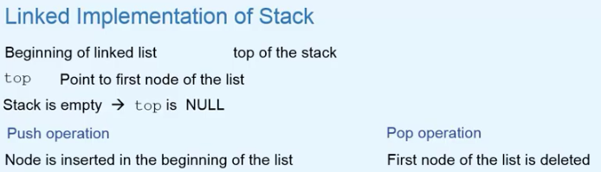
Linked List Representation of Stack

Slide 28
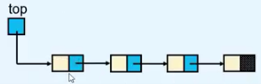
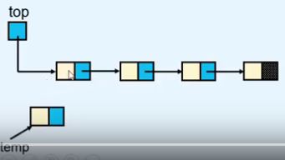
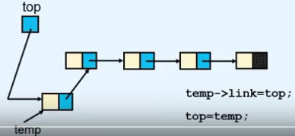
PUSH Operation on Stack
tmp = (struct node *)malloc(sizeof(struct node));
tmp->link=top;
top=tmp;

Slide 29
Push Operation
push()
{
struct node *tmp;
int pushed_item;
tmp = (struct node *)malloc(sizeof(struct node));
printf("Input the new value to be pushed on the stack : ");
scanf("%d",&pushed_item);
tmp->info=pushed_item;
tmp->link=top;
top=tmp;
}/*End of push()*/

Slide 30
Pop Operation
Deleting a node pointed to by start pointer of the list. i.e. at the top of the stack
Stack after Before Pop Operation
Stack after Pop Operation, element at top deleted
Top
XXX
YYY
ZZZ
Bottom of Stack
Top
YYY
ZZZ
Bottom of Stack

Slide 31
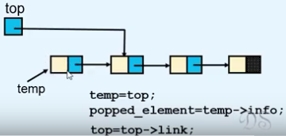
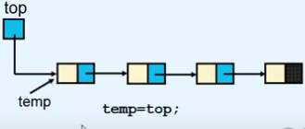
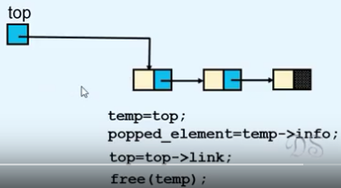
POP Operation on Stack

Slide 32
POP Operation
pop()
{
struct node *tmp;
if(top == NULL)
printf("Stack is empty\n");
else
{
tmp=top;
printf("Popped item is %d\n",tmp->info);
top=top->link;
free(tmp);
}
}/*End of pop()*/

Slide 33
Display Operation
display()
{ struct node *ptr;
ptr=top;
if(top==NULL)
printf("Stack is empty\n");
else
{
printf("Stack elements :\n");
while(ptr!= NULL)
{
printf("%d\n",ptr->info);
ptr = ptr->link;
}/*End of while */
}/*End of else*/
}/*End of display()*/

Slide 34
Application of Stack

Slide 35
Application of Stack –Reversal of a String
Push each character of the string on the stack.
When whole string is pushed on the stack
Pop the characters from the stack to get the reversed string

Slide 36
Application of Stack –Reversal of a String
Try Writing the Code snippet for it……..

Slide 37
Application of Stack –Polish Notation
Polish notation (PN), also known as
normal Polish notation (NPN)
Łukasiewicz notation
Warsaw notation,
Polish prefix notation or
simply prefix notation,

Slide 38
Polish Notation-Prefix Notation
Is a mathematical notation in which operators precede their operands,
The description "Polish" refers to the nationality of logician Jan Łukasiewicz who invented Polish notation in 1924.

Slide 39
Reverse Polish Notation-Postfix Notation
Reverse Polish notation (RPN), in which operators follow their operands.
The term Polish notation is sometimes taken (as the opposite of infix notation) to also include reverse Polish notation.

Slide 40
Expression Representation
An expression is defined as a number of operands or data items combined using several operators.
3 popular methods for representation:
Infix Notation
Prefix Notation
Postfix Notation

Slide 41
Infix Notation
Used in General Mathematics
Operator is written in between the operands
Eg- a+b, x+y*z
Called infix because of the position of the operator in expression.
Evaluation-
Evaluated left to right but operator precedence must be taken into consideration
Not used inside computer, due to additional complexity of handling of precedence

Slide 42
Prefix Notation
Operator is written before the operands
Also called Polish Notation
Eg- +ab, +x*yz

Slide 43
Postfix Notation
Operator is written after the operands
Also called Reverse Polish or Suffix Notation
Eg- ab+, xyz*+

Slide 44
Polish Notation
Prefix and Postfix are free from any precedence
Computers use postfix form

Slide 45
Notation Conversion
Scan the expression from left to right
Operator Precedence-
Paranthesis evaluated first
After that evaluation is on the basis of operator precedence
Logical Not
Exponential Operator
Multiplication/division/modulus
Addition/Subtraction
Left shift,Right Shift
Relational
Logical And
Logical Or

Slide 46
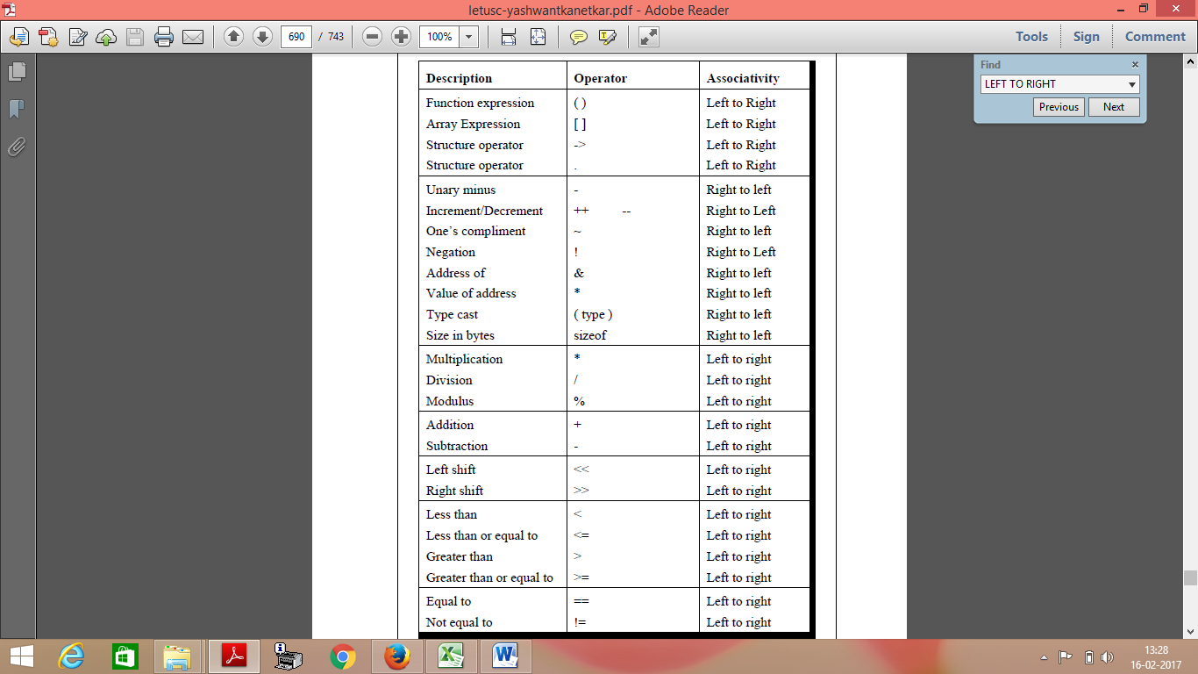
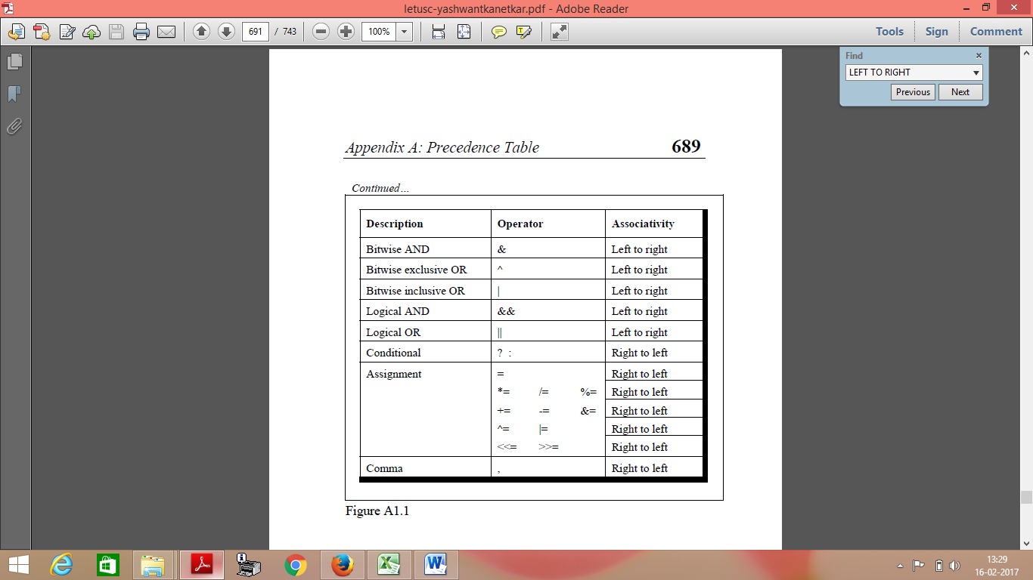
Operator Precedence Table

Slide 47
Manual Conversion -Infix to Postfix
A+ B * C Given infix form
Left to right scan, Brackets first then Operator Precedence
A + B C * Convert the multiplication
A B C * + Convert the addition

Slide 48
Manual Conversion -Infix to Postfix
A+[(B+C)+(D+E)*F]/G

Slide 49
Manual Conversion -Infix to Postfix
A+[(B+C)+(D+E)*F]/G
Left to right scan, Brackets first then Operator Precedence
A+[(BC+)+(D+E)*F]/G
A+[(BC+)+(DE+)*F]/G
A+[(BC+)+(DE+)F*]/G
A+[(BC+)(DE+)F*+]/G
A+[(BC+)(DE+)F*+]G/
A[(BC+)(DE+)F*+]G/+
ABC+DE+F*+G/+

Slide 50
Manual Conversion -Infix to Postfix
Convert the following expressions from Infix to Postfix;
A + B + C + D
(A + B) / (C – D)
(A + B) * C - (D - E) * (F + G)
( (A+B) — C * (D/E ) ) + F
( (A + B) * (C– D) + E ) / (F + G)

Slide 51
Manual Conversion -Infix to Postfix
Convert the following expressions from Infix to Postfix;
A + B + C + D
=AB+ +C +D
=AB+C+ +D
=AB+C+D+

Slide 52
Manual Conversion -Infix to Postfix
Convert the following expressions from Infix to Postfix;
A + B + C + D=A B + C + D +
(A + B) / (C – D) =A B + C D - /

Slide 53
Manual Conversion -Infix to Postfix
Convert the following expressions from Infix to Postfix;
A + B + C + D=A B + C + D +
(A + B) / (C – D) =A B + C D - /
(A + B) * C - (D - E) * (F + G)=AB+C*DE-FG+*-

Slide 54
Manual Conversion -Infix to Postfix
Convert the following expressions from Infix to Postfix;
A + B + C + D=A B + C + D +
(A + B) / (C – D) =A B + C D - /
(A + B) * C - (D - E) * (F + G)=AB+C*DE-FG+*-
( (A+B) — C * (D/E ) ) + F=A B + C D E / * - F +

Slide 55
Manual Conversion -Infix to Postfix
Convert the following expressions from Infix to Postfix;
A + B + C + D=A B + C + D +
(A + B) / (C – D) =A B + C D - /
(A + B) * C - (D - E) * (F + G)=AB+C*DE-FG+*-
( (A+B) — C * (D/E ) ) + F=A B + C D E / * - F +
( (A + B) * (C– D) + E ) / (F + G)=A B + C D - * E + F G + /

Slide 56
Manual Conversion -Infix to Prefix
A/B^C+D

Slide 57
Manual Conversion -Infix to Prefix
A/B^C+D
Left to right scan, Brackets fist then Operator Precedence
A/^BC+D
/A^BC+D
+/A^BCD

Slide 58
Manual Conversion -Infix to Prefix
Convert the following expressions from Infix to Prefix;
(P*Q^R+S)
(A-B/C)*(D*E-F)
(A*B+(C/D))-F
A+B*C-(D/E^F)*G*H
(A+B)*C/D+E^F/G

Slide 59
Manual Conversion -Infix to Prefix
Convert the following expressions from Infix to Prefix;
(P*Q^R+S)=+*P^QRS

Slide 60
Manual Conversion -Infix to Prefix
Convert the following expressions from Infix to Prefix;
(P*Q^R+S)=+*P^QRS
(A-B/C)*(D*E-F)=*(-A/BC)(-*DEF)

Slide 61
Manual Conversion -Infix to Prefix
Convert the following expressions from Infix to Prefix;
(P*Q^R+S)=+*P^QRS
(A-B/C)*(D*E-F)=*(-A/BC)(-*DEF)
(A*B+(C/D))-F=-+*AB/CDF

Slide 62
Manual Conversion -Infix to Prefix
Convert the following expressions from Infix to Prefix;
(P*Q^R+S)=+*P^QRS
(A-B/C)*(D*E-F)=*-A/BC-*DEF)
(A*B+(C/D))-F=-+*AB/CDF
A+B*C-(D/E^F)*G*H
=A+*BC-(/D^EF)*G*H
=A+*BC-*/D^EFG*H
=A+*BC-**/D^EFGH
=+A*BC-**/D^EFGH
=-+A*BC**/D ^EFGH

Slide 63
Manual Conversion -Infix to Prefix
Convert the following expressions from Infix to Prefix;
(P*Q^R+S)=+*P^QRS
(A-B/C)*(D*E-F)=*(-A/BC)(-*DEF)
(A*B+(C/D))-F=-+*AB/CDF
A+B*C-(D/E^F)*G*H
=A+*BC-(/D^EF)*G*H
=A+*BC-*/D^EFG*H
=A+*BC-**/D^EFGH
=+A*BC-**/D^EFGH
=-+A*BC**/D ^EFGH
(A+B)*C/D+E^F/G
=+AB*C/D+E^F/G
=+AB*C/D+^EF/G
=*+ABC/D+^EF/G
=/*+ABCD+^EF/G
=/*+ABCD+/^EFG
=+/*+ABCD/^EFG

Slide 64
Algorithm for Infix to Postfix using stack
Step 1-Put the opening bracket ‘(‘ on the start of the expression and add the closing bracket ‘)’ at the end of the input expression ‘P’
Step 2-Scan the Expression P from left to right and repeat steps 3 to 6 for each element of P until the stack is empty
Step 3-If an operand is encountered, add it to the output expression ‘Q’
Step 4-If a left bracket is encountered push it onto the stack

Slide 65
Algorithm for Infix to Postfix using stack
Step 5-If an operator is encountered then
5a)Repatedly pop from the stack and add to the output expression Q, each operator which has the same or higher priority compared to the operator just scanned.
5b) then Add the operator just scanned to the stack
Step 6-Ifa right bracket ‘)’ is encountered then repeatedly pop from the stack and add to the output expression Q until a left bracket is encountered.
Pop the left bracket also

Slide 66
Infix to Postfix Conversion using stack
Eg- P=(A+B)*C

Slide 67
Infix to Postfix Conversion using stack
Eg- P=(A+B)*C
P=( (A+B) * C )
Scan | Stack | Expression Q
( | (
( | ((
A | (( | A
+ | ((+ | A
B | ((+ | AB
) | ( | AB+
* | (* | AB+
C | (* | AB+C
) | NULL | AB+C*

Slide 68
Infix to Postfix Conversion using stack
Convert P/(Q-R)*S+T

Slide 69
Infix to Postfix Conversion using stack
Convert P/(Q-R)*S+T=(P/(Q-R)*S+T)
Scan | Stack | Expression Q
( | (
P | ( | P
/ | ( / | P
( | ( / ( | P
Q | ( / ( | PQ
- | ( / (- | PQ
R | ( / (- | PQR
) | ( / Rule 5a) | PQR-
* | ( * | PQR-/
S | ( * | PQR-/S
+ | ( + | PQR-/S*
T | ( + | PQR-/S*T
) | NULL | PQR-/S*T+

Slide 70
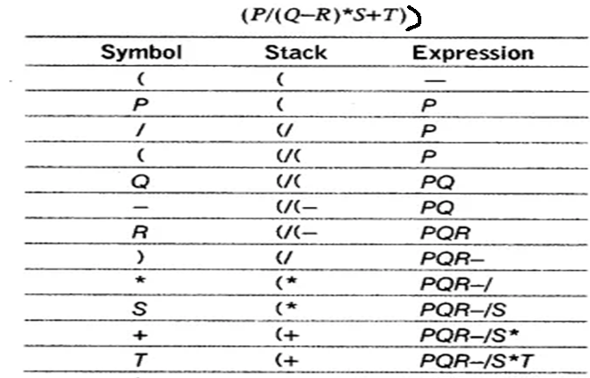
Infix to Postfix Conversion using stack
Convert (P/(Q-R)*S+T)
null
PQR-/S*T+

Slide 71
Infix to Postfix Conversion using stack
Convert P=a && b||c || ! ( e > f )

Slide 72
Notation Conversion
Scan the expression from left to right
Operator Precedence-
Paranthesis evaluated first
After that evaluation is on the basis of operator precedence
Logical Not
Exponential Operator
Multiplication/division/modulus
Addition/Subtraction
Left shift,Right Shift
Relational
Logical And
Logical Or

Slide 73
Infix to Postfix Conversion using stack
Convert P=(a && b||c || ! ( e > f ) )
Operator Precedence
Logical Not
Exponential Operator
Multiplication/division/modulus
Addition/Subtraction
Left shift,Right Shift
Relational
Logical And &&
Logical Or ||
Scan | Stack | Expression Q
( | (
a | ( | a
&& | (&& | a
b | (&& Rule 5a | ab
|| | (|| | ab&&
c | (|| | ab&&c
|| | (|| Rule 5a | ab&&c||
! | (||! | ab&&c||
( | (||!( | ab&&c||
e | (||!( | ab&&c||e
> | (||!(> | ab&&c||e
f | (||!(> | ab&&c||ef
) | (||! | ab&&c||ef>
) | NULL | ab&&c||ef>!||

Slide 74
Infix to Postfix Conversion using stack
Convert P=A+(B*C-(D/E^F)*G*H )

Slide 75
Infix to Postfix Conversion using stack
Convert P=(A+(B*C-(D/E^F)*G*H ))
Scan | Stack | Expression Q
( | (
A | ( | A
+ | (+ | A
( | (+( | AB
B | (+( | AB
* | (+(* | AB
C | (+(* | ABC
- | (+(- | ABC*
( | (+(-( | ABC*
D | (+(-( | ABC*D
/ | (+(-( / | ABC*D
E | (+(-( / | ABC*DE
^ | (+(-( / ^ | ABC*DE
F | (+(-(/^ | ABC*DEF
) | (+(- | ABC*DEF^/
* | (+(-* | ABC*DEF^/
G | (+(-* | ABC*DEF^/G
* | (+(-* | ABC*DEF^/G*
H | (+(-* | ABC*DEF^/G*H
) | (+ | ABC*DEF^/G*H*-
) | null | ABC*DEF^/G*H*-+

Slide 76
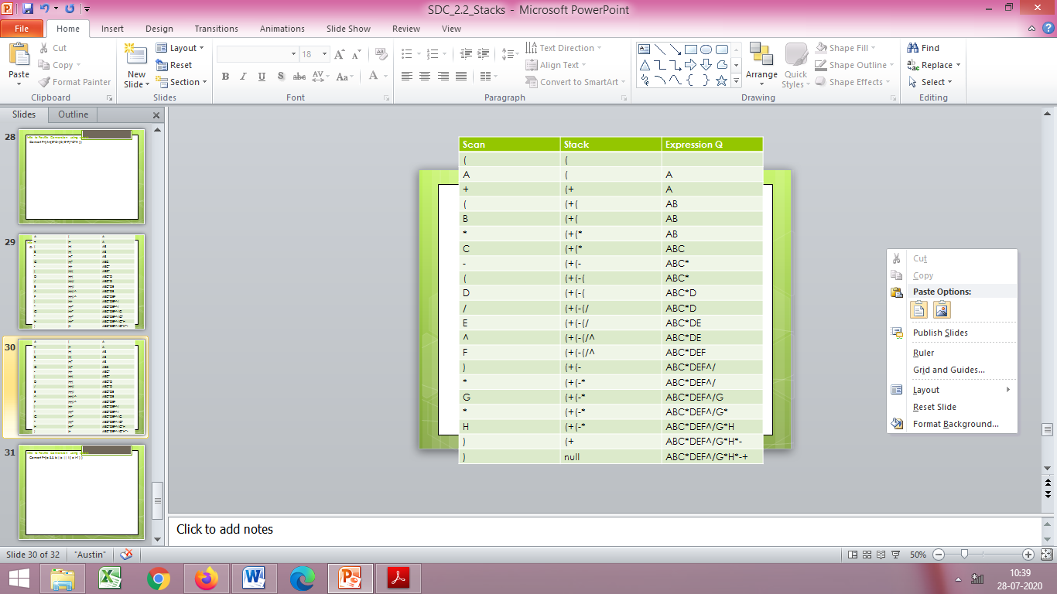
Convert P=(A+(B*C-(D/E^F)*G*H ))

Slide 77
Manual Evaluation of a Prefix notation
+5*32

Slide 78
Manual Evaluation of a Prefix notation
Lets take an eg: +5*32
Find an operator from left to right having 2 operands after it
Multiplication of 3 and 2 is carried out
Expression becomes +56
Now + has two operands so evaluated
Exp=11

Slide 79
Manual Evaluation of a Postfix notation
532*+

Slide 80
Manual Evaluation of a Postfix notation
Lets take an eg: 532*+
Find first operator from left to right having 2 operands before it
perform the operation
Multiplication of 3 and 2 is carried out
Expression becomes 56+
Now + is evaluated
Exp=11

Slide 81
Manual Evaluation
Evaluate the following expression-
P=653+9*+

Slide 82
Algorithm for Evaluation of Postfix using stack
Step 1-Scan the Expression P from left to right and repeat steps 2 and 3 for each element of ‘P’ until the last element
Step 2- If an operand is encountered, push it on the stack
1st operand say ‘a’ is pushed
2nd operand say ‘b’ is pushed
Step 3-If an operator is encountered then
3a) Remove the top two elements of stack and perform
a operator b
(where b is the top element and a is the next element to top element)
3b)Push the result onto the stack
Stack
b
a

Slide 83
Algorithm for Evaluation of Postfix using stack
Evaluate the following expression-
P=653+9*+

Slide 84
Algorithm for Evaluation of Postfix using stack
Stack
Stack
8
6
Stack
72
6
P=653+9*+
P=53+9*+
P=3+9*+
P=+9*+
Evaluate 5+3=8
Push 8
P=9*+
P=*+
Evaluate
8*9=72
Push 72
P=+
Evaluate 6+72=78
Ans=78
Stack
6
Stack
9
8
6
Stack
5
6
Stack
3
5
6

Slide 85
Algorithm for Evaluation of Postfix using stack
Evaluate the following expression-
432*+5-
532*+4-5+
53+82-*
Evaluate 562+*(12)4/- taking 12 as a single number

Slide 86
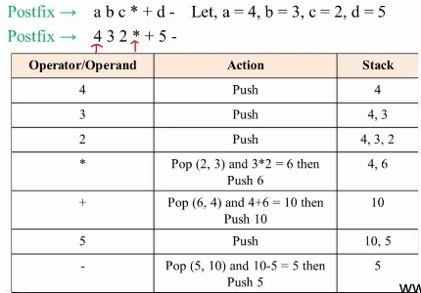
Evaluate 432*+5-

Slide 87
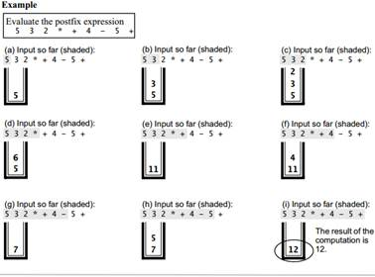

Slide 88
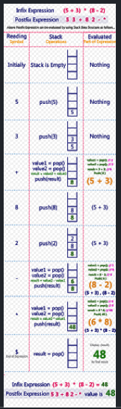
Courtesy:http://btechsmartclass.com/data_structures/postfix-evaluation.html

Slide 89
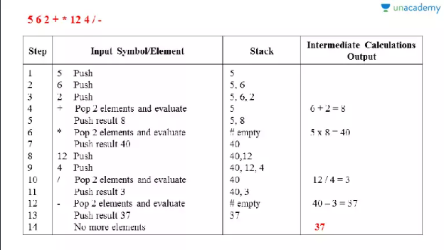
Evaluate 562+*(12)4/- taking 12 as a single number
Courtesy:https://unacademy.com/lesson/evaluation-of-a-postfix-expression-in-tabular-form/8Z5PDFL5

Slide 90
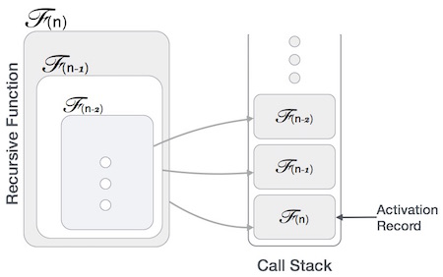
Application of Stack –Recursion

Slide 91
Application of Stack –Recursion
Many programming languages implement recursion by means of stacks.
A function (caller) calls another function (callee) or itself as callee,
The caller function transfers execution control to the callee.
This transfer process may also involve some data to be passed from the caller to the callee.

Slide 92
Application of Stack –Recursion
The caller function has
to suspend its execution temporarily and
resume later
when the execution control returns from the callee function.

Slide 93
Application of Stack –Recursion
Here, the caller function needs to start exactly from the point of execution where it puts itself on hold.
It also needs the exact same data values it was working on.
So, an activation record (or stack frame) is created for the caller function.
Activation record keeps the information about
local variables,
formal parameters,
return address and
all information passed to the callee function.

Slide 94
Application of Stack –Recursion
A recursive function to find the factorial of a positive whole number
int factorial(n)
{ if (n == 1)
{
// base case return 1; }
else
{ return n * factorial(n - 1);
// function calls itself } }

Slide 95
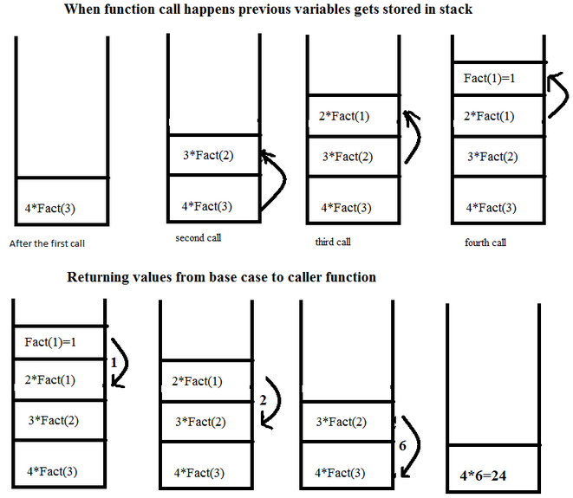
Application of Stack –Recursion

Slide 96
Application of Stack –Recursion
Functions calls are ‘stacked’ one on top of the other,
This is called the call stack (or execution stack)
The call stack operates on a “Last In, First Out” basis. An item is “pushed” onto a stack on function call, and an item is “popped” off the stack when that function returns a value.

Slide 97
extra

Slide 98
Application of Stack –Recursion
Time Complexity
In iterations,
we take number of iterations to count the time complexity.
In recursion,
assuming everything is constant,
count the number of times a recursive call is being made.
Space Complexity
Space complexity is counted as
what amount of extra space is required for a module to execute.
In iterations,
the compiler hardly requires any extra space.
The compiler keeps updating the values of variables used in the iterations.

Slide 99
Application of Stack –Recursion
Time Complexity
A call made to a function is Ο(1),
hence the (n) number of times a recursive call is made
makes the recursive function Ο(n).
Space Complexity
In recursion,
the system needs to store activation record each time a recursive call is made.
Thus, space complexity of recursive function
may go higher than that of a function with iteration.

