Slide 1
Non- Linear Data Structures-MAP
Module 4.1

Slide 2
MAP
A map is any data structure that groups a dynamic number of key-value pairs together,
Map allows us to
retrieve values by key,
to insert new key-value pairs, and
to update the values associated with keys.
Courtesy: https://noncombatant.org/2014/03/02/maps-and-their-applications/

Slide 3
MAP
A Map is a type of fast key lookup data structure that offers a flexible means of indexing into its individual elements.
Unlike most array data structures that
only allow access to the elements by means of integer indices,
the indices for a Map can be nearly any scalar numeric value or a character vector.
Courtesy: https://in.mathworks.com/help/matlab/matlab_prog/overview-of-the-map-data-structure.html

Slide 4
MAP
Indices into the elements of a Map are called keys.
These keys, along with the data values associated with them, are stored within the Map.
Each entry of a Map contains exactly one unique key and its corresponding value.
No two mapped values can have same key values.
A map cannot contain duplicate keys

Slide 5
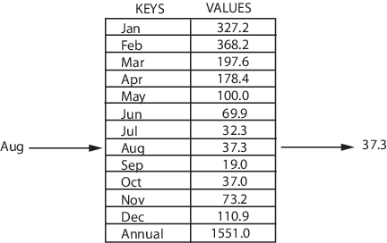
MAP-Example
Indexing into the Map of rainfall statistics shown below with a character vector representing the month of August yields the value internally associated with that month, 37.3.
Mean monthly rainfall statistics (mm)

Slide 6
MAP
Keys are not restricted to integers as they are with other arrays.
Specifically, a key may be any of the following types:
1-by-N character array
Scalar real double or single
Signed or unsigned scalar integer

Slide 7
MAP
The values stored in a Map can be of any type.
This includes
arrays of numeric values,
structures,
cells,
character arrays,
objects, or
other Maps.

Slide 8
MAP ADT Functions
Some basic functions associated with Map:
begin() – Returns an iterator to the first element in the map
end() – Returns an iterator to the theoretical element that follows last element in the map
size() – Returns the number of elements in the map
max_size() – Returns the maximum number of elements that the map can hold
empty() – Returns whether the map is empty
pair insert(keyvalue, mapvalue) – Adds a new element to the map
erase(iterator position) – Removes the element at the position pointed by the iterator
clear() – Removes all the elements from the map
Courtesy:https://www.geeksforgeeks.org/map-associative-containers-the-c-standard-template-library-stl/

Slide 9
begin() function
Used to return an iterator pointing to the first element of the map container.
begin() function returns a bidirectional iterator to the first element of the container.
Syntax :
mapname.begin()
Parameters : No parameters are passed.
Returns : This function returns a bidirectional iterator pointing to the first element.

Slide 10
Demonstrates begin() and end()
#include <iostream>
#include <map>
using namespace std;
int main()
{
// declaration of map container
map<char, int> mymap;
mymap['a'] = 1;
mymap['b'] = 2;
mymap['c'] = 3;
// using begin() to print map
for (auto it = mymap.begin(); it != mymap.end(); ++it)
cout << it->first << " = "
<< it->second << '\n';
return 0;
}
Output:
a = 1
b = 2
c = 3

Slide 11
What is a map in C++?
A C++ map is a way to store a key-value pair.
Maps are part of the C++ STL (Standard Template Library).

Slide 12
The Standard Template Library (STL) is a set of C++ template classes to provide common programming data structures and functions such as lists, stacks, arrays, etc.
It is a library of container classes, algorithms, and iterators.
https://www.geeksforgeeks.org/the-c-standard-template-library-stl/

Slide 13
Standard Containers
A container is a holder object that stores a collection of other objects (its elements). The container manages the storage space for its elements and provides member functions to access them, either directly or through iterators (reference objects with similar properties to pointers).
https://cplusplus.com/reference/iolibrary/

Slide 14
end() function
end() function is used to return an iterator pointing to past the last element of the map container.
Since it does not refer to a valid element, it cannot de-referenced end() function returns a bidirectional iterator.
Syntax :
mapname.end()
Parameters : No parameters are passed.
Returns : This function returns a bidirectional iterator pointing to the next of last element.

Slide 15
insert()
A built-in function in C++ STL which is used to insert elements with a particular key in the map container.
Syntax:
iterator map_name.insert({key, element})
Parameters:
The function accepts a pair that consists of a key and element which is to be inserted into the map container.
The function does not insert the key and element in the map if the key already exists in the map.
Return Value:
The function returns an iterator pointing to the new element in the container.

Slide 16
insert()
// C++ program to illustrate
// map::insert({key, element})
#include <bits/stdc++.h>
using namespace std;
int main()
{
// initialize container
map<int, int> mp;
// insert elements in random order
mp.insert({ 2, 30 });
mp.insert({ 1, 40 });
mp.insert({ 3, 60 });
// does not inserts key 2 with element 20
mp.insert({ 2, 20 });
mp.insert({ 5, 50 });
// prints the elements
cout << "KEY\tELEMENT\n";
for (auto itr = mp.begin(); itr != mp.end(); ++itr) {
cout << itr->first
<< '\t' << itr->second << '\n';
}
return 0;
}
OUTPUT-
KEY ELEMENT
1 40
2 30
3 60
5 50

Slide 17
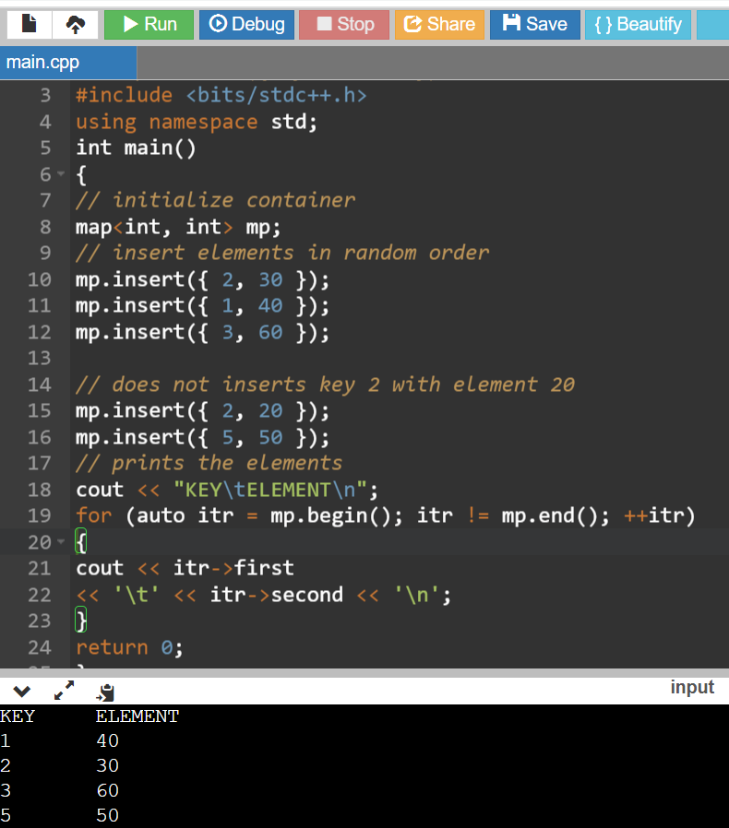

Slide 18
bits/stdc++.h
It is basically a header file that includes every standard library. In programming contests, Using this file is a good idea, when you want to reduce the time wasted in doing chores; especially when your rank is time sensitive.
In programming contests, people do focus more on finding the algorithm to solve a problem than on software engineering.
From, software engineering perspective, it is a good idea to minimize the include.
If you use it actually includes a lot of files, which your program may not need, thus increases both compile time and program size unnecessarily.

Slide 19
size() function
In C++, size() function is used to return the total number of elements present in the map.
Syntax:
map_name.size()
Return Value: It returns the number of elements present in the map.

Slide 20
size() function
Input : map1 = {
{1, "India"},
{2, "Nepal"},
{3, "Sri Lanka"},
{4, "Myanmar"}
}
map1.size();
Output: 4
Input : map2 = {};
map2.size();
Output: 0

Slide 21
clear()
clear() function is used to remove all the elements from the map container and thus leaving it’s size 0.
Syntax:
map1.clear() where map1 is the name of the map.
Parameters:
No parameters are passed.
Return Value:
None

Slide 22
clear()
Input : map1 = {
{1, "India"},
{2, "Nepal"},
{3, "Sri Lanka"},
{4, "Myanmar"}
}
map1.clear();
Output: map1 = {}

Slide 23
clear()
#include <bits/stdc++.h>
using namespace std;
int main()
{
// Take any two maps
map<int, string> map1, map2;
// Inserting values
map1[1] = "India";
map1[2] = "Nepal";
map1[3] = "Sri Lanka";
map1[4] = "Myanmar";
// Print the size of map
cout<< "Map size before running function: \n";
cout << "map1 size = " << map1.size() << endl;
cout << "map2 size = " << map2.size() << endl;;
// Deleting the map elements
map1.clear();
map2.clear();
// Print the size of map
cout<< "Map size after running function: \n";
cout << "map1 size = " << map1.size() << endl;
cout << "map2 size = " << map2.size();
return 0;
}
Output:
Map size before running function:
map1 size = 4
map2 size = 0
Map size after running function:
map1 size = 0
map2 size = 0

Slide 24
erase()
A built-in function in C++ STL which is used to erase element from the container.
It can be used to erase keys, elements at any specified position or a given range.
Syntax :
map_name.erase(key)
Parameters:
The function accepts one mandatory parameter key which specifies the key to be erased in the map container.
Return Value:
The function returns 1 if the key element is found in the map else returns 0.

Slide 25
erase()
#include <bits/stdc++.h>
using namespace std;
int main()
{
// initialize container
map<int, int> mp;
// insert elements in random order
mp.insert({ 2, 30 });
mp.insert({ 1, 40 });
mp.insert({ 3, 60 });
mp.insert({ 5, 50 });
// prints the elements
cout << "The map before using erase() is : \n";
cout << "KEY\tELEMENT\n";
for (auto itr = mp.begin(); itr != mp.end(); ++itr) {
cout << itr->first
<< '\t' << itr->second << '\n';
}
// function to erase given keys
mp.erase(1);
mp.erase(2);
// prints the elements
cout << "\nThe map after applying erase() is : \n";
cout << "KEY\tELEMENT\n";
for (auto itr = mp.begin(); itr != mp.end(); ++itr) {
cout << itr->first
<< '\t' << itr->second << '\n';
}
return 0;
}

Slide 26
erase()
The map before using erase() is :
KEY ELEMENT
1 40
2 30
3 60
5 50
The map after applying erase() is :
KEY ELEMENT
3 60
5 50

Slide 27
empty()
Used to check if the map container is empty or not.
Syntax :
mapname.empty()
Parameters :
No parameters are passed.
Returns :
True, if map is empty
False, Otherwise

Slide 28
empty()
Examples:
Input : map
mymap['a']=10;
mymap['b']=20;
mymap.empty();
Output : False

