Slide 1
Sets, Maps and Dictionary
Ref: Data Structures and Algorithms in C++ 2e By Michael Goodrich, Roberto Tamassia and David Mount

Slide 2
Sets
A set is defined as a collection that contains no duplicates
Basic Operations we perform with sets are
Set Union(S1 U S2)
Set Intersection(S1 ∩ S2)
Set Difference(S1 - S2)

Slide 3
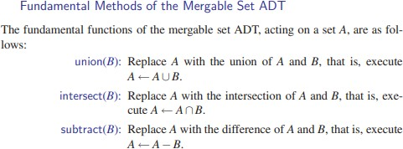
Sets

Slide 4
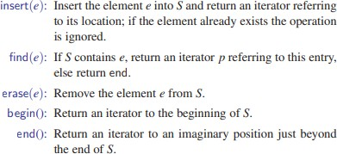
Sets ADT
Set ADT provides number of methods.

Slide 5
basic functions associated with Set:
Set in C++ Standard Template Library (STL)
begin() – Returns an iterator to the first element in the set.
end() – Returns an iterator to the theoretical element that follows last element in the set.
size() – Returns the number of elements in the set.
max_size() – Returns the maximum number of elements that the set can hold.
empty() – Returns whether the set is empty.

Slide 6
Reading assignment: Set in C++ Standard Template Library (STL)
rbegin()– Returns a reverse iterator pointing to the last element in the container.
rend()– Returns a reverse iterator pointing to the theoretical element right before the first element in the set container.
crbegin()– Returns a constant iterator pointing to the last element in the container.
crend() – Returns a constant iterator pointing to the position just before the first element in the container.

Slide 7
Reading assignment: Set in C++ Standard Template Library (STL)
cbegin()– Returns a constant iterator pointing to the first element in the container.
cend() – Returns a constant iterator pointing to the position past the last element in the container.
size() – Returns the number of elements in the set.
max_size() – Returns the maximum number of elements that the set can hold.
empty() – Returns whether the set is empty.

Slide 8
Reading assignment: Set in C++ Standard Template Library (STL)
insert(const g) – Adds a new element ‘g’ to the set.
iterator insert (iterator position, const g) – Adds a new element ‘g’ at the position pointed by iterator.
erase(iterator position) – Removes the element at the position pointed by the iterator.
erase(const g)– Removes the value ‘g’ from the set.
clear() – Removes all the elements from the set.

Slide 9
Reading assignment: Set in C++ Standard Template Library (STL)
key_comp() / value_comp() – Returns the object that determines how the elements in the set are ordered (‘<‘ by default).
find(const g) – Returns an iterator to the element ‘g’ in the set if found, else returns the iterator to end.
count(const g) – Returns 1 or 0 based on the element ‘g’ is present in the set or not.
lower_bound(const g) – Returns an iterator to the first element that is equivalent to ‘g’ or definitely will not go before the element ‘g’ in the set.

Slide 10
Reading assignment: Set in C++ Standard Template Library (STL)
upper_bound(const g) – Returns an iterator to the first element that will go after the element ‘g’ in the set.
equal_range()– The function returns an iterator of pairs. (key_comp). The pair refers to the range that includes all the elements in the container which have a key equivalent to k.
emplace()– This function is used to insert a new element into the set container, only if the element to be inserted is unique and does not already exists in the set.

Slide 11
Reading assignment: Set in C++ Standard Template Library (STL)
emplace_hint()– Returns an iterator pointing to the position where the insertion is done. If the element passed in the parameter already exists, then it returns an iterator pointing to the position where the existing element is.
swap()– This function is used to exchange the contents of two sets but the sets must be of same type, although sizes may differ.
operator= – The ‘=’ is an operator in C++ STL which copies (or moves) a set to another set and set::operator= is the corresponding operator function.
get_allocator()– Returns the copy of the allocator object associated with the set.

Slide 12
Reading assignment
Refer: https://www.geeksforgeeks.org/set-in-cpp-stl/

Slide 13
Disjoint sets and partitions
A1 and A2 are called disjoint partitions of A iff
A1 U A2 = A
A1 ∩ A2 = Φ
E.g. A1={1,2,3,4,5} and A2= {2,4,6}, A3= {6,7} and A= {1,2,3,4,5,6,7}
A1 and A2 are not disjoint partitions of A
A1 and A3 are disjoint partitions of A

Slide 14
Set partition using union- find operation
Union: creates disjoint subsets
Find: checks connectivity

Slide 15

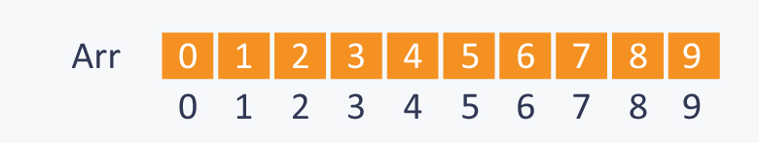
Example
Example:
S = {0, 1, 2, 3, 4, 5, 6, 7, 8, 9}.
N = 10
Initially there are 10 subsets and each subset has single element in it.
When each subset contains only single element, the array Arr is:
Ref: https://www.hackerearth.com/practice/notes/disjoint-set-union-union-find/

Slide 16
Example
Perform the following operations on the set:
1) Union(2, 1)=(1st element=>child,2nd element=parent)
2) Union(4, 3)
3) Union(8, 4)
4) Union(9, 3)
5) Union(6, 5)
6) Union(5, 2)
Find(6,1), find(8,9) find(7,1)

Slide 17
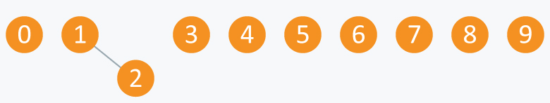
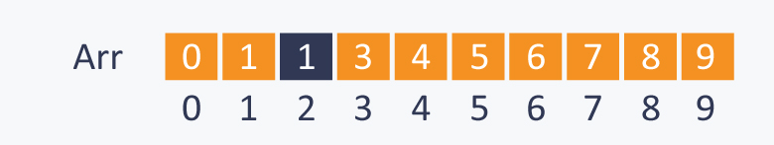
1) Union(2, 1)
Ref: https://www.hackerearth.com/practice/notes/disjoint-set-union-union-find/

Slide 18
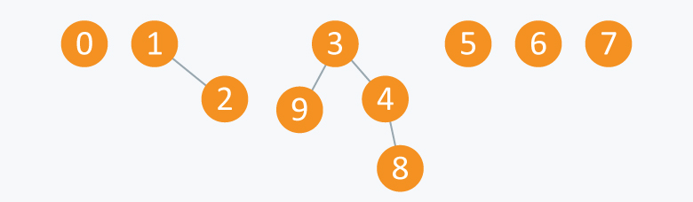
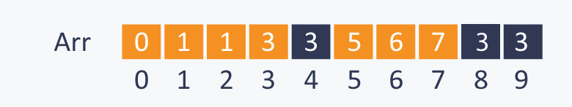
2) Union(4, 3) 3) Union(8, 4) 4) Union(9, 3)
Ref: https://www.hackerearth.com/practice/notes/disjoint-set-union-union-find/

Slide 19
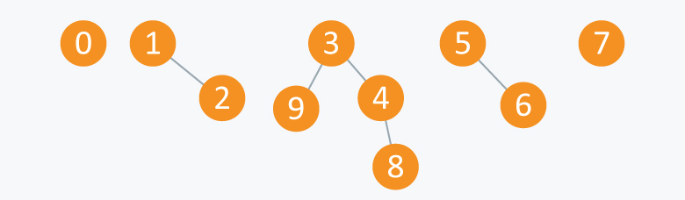
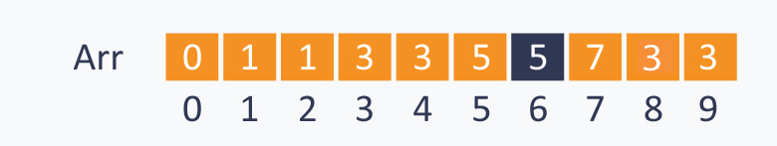
5) Union(6, 5)
➔5 subsets.
A1= {3, 4, 8, 9},
A2= {1, 2},
A3= {5, 6}
A4= {0}
A5 = {7}.
All these subsets are said to be Connected Components.

Slide 20
Find (0, 7) = False as 0 and 7 are disconnected
Find (8, 9) = True as 8 and 9 are connected directly or indirectly
Ref: https://www.hackerearth.com/practice/notes/disjoint-set-union-union-find/

Slide 21
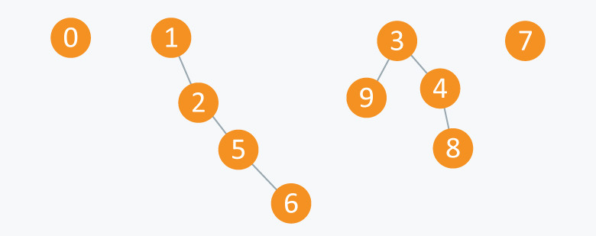
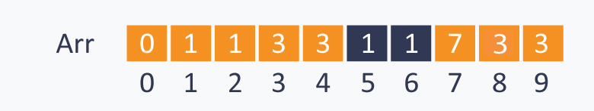
6) Union(5, 2)
Ref: https://www.hackerearth.com/practice/notes/disjoint-set-union-union-find/

Slide 22
Applications of set partitioning
Elections
Divide and conquer
Classification
Pattern matching
Mutually exclusive processes in OS
Combinatorial explosion problem where repetition is not allowed

Slide 23
Maps
Also known as:
table, search table, associative array, or associative container
A data structure optimized for a very specific kind of search / access
with a bag we access by asking "is X present"
with a list we access by asking "give me item number X"
with a queue we access by asking "give me the item
that has been in the collection the longest."
In a Map we access by asking "give me the value
associated with this key."

Slide 24
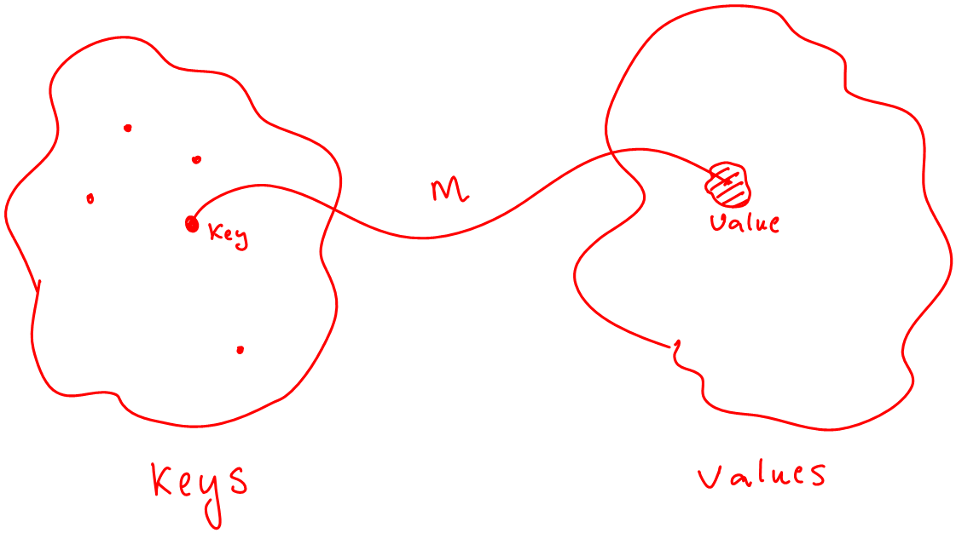
Maps
A Map models a searchable collection of key-value entries
The main operations of a map are for searching,
inserting, and deleting items
Multiple entries with the same key are not allowed
Applications:
address book
student-record database

Slide 25
Maps
A map allows to store elements so they can be located quickly using keys.
key as a unique identifier
A map stores key-value pairs (k,v), called entries,
each key is unique, so the association of keys to values defines a mapping.
E.g. In a map storing student records (such as the student’s name, address, and course grades), the key might be the student’s ID number.
Sometimes referred to as associative stores or associative containers, as the key associated with an object determines its “location” in the data structure

Slide 26
Maps
Used where each key is to be viewed as a kind of unique index address for its value, that is,
E.g. if we wish to store student records, we would probably want to use student ID objects as keys (and disallow two students having the same student ID).
In other words, the key associated with an object can be viewed as an “address” for that object.

Slide 27
Map ADT
Value definition: Map is a collection of key value entries, with each value associated with a distinct key.
Assumption: map provides a special pointer object, which permits us to reference entries of the map, called position.
Iterator references entries and navigate around the map.
Given a map iterator p, the associated entry may be accessed by dereferencing the iterator, *p.
The individual key and value can be accessed using p->key() and p->value(), respectively.
Can be implemented using associative arrays

Slide 28
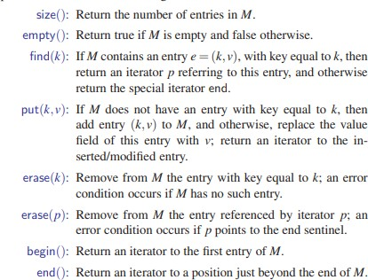
Map ADT

Slide 29
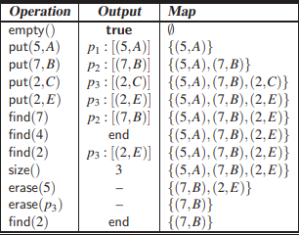
Example
C
C
C
C
C
C
C
C

Slide 30
Reading Assignment
https://www.geeksforgeeks.org/map-associative-containers-the-c-standard-template-library-stl/

Slide 31
Some basic functions associated with Map: begin() – Returns an iterator to the first element in the map end() – Returns an iterator to the theoretical element that follows last element in the map size() – Returns the number of elements in the map max_size() – Returns the maximum number of elements that the map can hold empty() – Returns whether the map is empty

Slide 32
pair insert(keyvalue, mapvalue) – Adds a new element to the map erase(iterator position) – Removes the element at the position pointed by the iterator erase(const g)– Removes the key value ‘g’ from the map clear() – Removes all the elements from the map

Slide 33
Map implementation
Arrays
A simple linked list of pairs
Slow (O(n)),
insufficient for general use.
A hash table.
This is generally very fast (roughly O(1)),
Requires a good hash function for the key type.
A binary search tree.
Fast (O(lg n)).
Unlike in a hash table, the keys will be ordered.
A skip list.

Slide 34
A Simple List-Based Map
We can efficiently implement a map using an unsorted list
We store the items of the map in a list S (based on
a doubly-linked list), in arbitrary order
header
nodes/positions
trailer
9 c
6 c
5 c
8 c
entries

Slide 35
Hash-Based Map implementation
Hash Map uses a hash table as its internal storage container.
Keys stored based on hash codes and size of hash tables internal array

Slide 36
Tree-Based Map implementation
Uses Height Balanced Binary Search Trees
In java a Red - Black tree is used to implement a Map
Somewhat slower than the HashMap

Slide 37
Dictionary
A dictionary allows for keys and values to be of any
object type.
Unlike Map, a dictionary allows for multiple entries to have the same key
Map=(2,e) &(2,c), duplicate keys not allowed
Dictionary both will exist, all 2 records will be together
Same words together
.

Slide 38
Dictionary
For example
an English dictionary, which allows for multiple definitions for the same word.
we might want to store records for computer science
authors indexed by their first and last names.
a multi-user computer game involving players visiting
various rooms in a large castle might need a
mapping from rooms to players. It is natural in this application to allow users to be in the same room simultaneously, however, to engage in battles.

Slide 39
Reading assignment:
Similarities and differences in set, map and dictionary

Slide 40
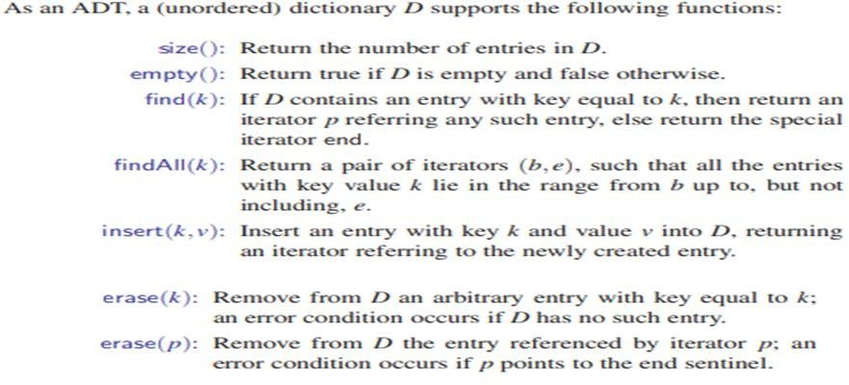

The Dictionary ADT

Slide 41
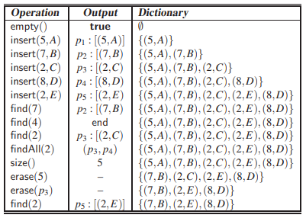
Example
p5)

Slide 42
Dictionary Implementations
Unordered list: In an unordered list, L, implementing a dictionary, we can maintain the location variable of each entry e to point to e’s position in the underlying linked list for L.
Hash table with separate chaining: Consider a hash table, with bucket array A and hash function h, that uses separate chaining for handling collisions. We use the location variable of each entry e to point to e’s position in the list L implementing the list A[h(k)].
Ordered search table: In an ordered table, T, implementing a dictionary, we should maintain the location variable of each entry e to be e’s index in T.

Slide 43
Example
Problem statement:
Given names and phone numbers, assemble a phone book that maps friends' names to their respective phone numbers. You will then be given an unknown number of names to query your phone book for. For each query, print the associated entry from your phone book on a new line in the form name=phoneNumber; if an entry for it is not found, print Not found instead.

Slide 44
Example.. contd
Input Format
The first line contains an integer, , denoting the number of entries in the phone book. Each of the subsequent lines describes an entry in the form of space-separated values on a single line. The first value is a friend's name, and the second value is an -digit phone number.
After the lines of phone book entries, there are an unknown number of lines of queries. Each line (query) contains a name to look up, and you must continue reading lines until there is no more input.
Output Format
On a new line for each query, print Not found if the name has no corresponding entry in the phone book; otherwise, print the full and in the format name=phoneNumber.

Slide 45
Solution?
Sample dictionary entries?
Sample queries?
Output?

Slide 46
Example 2
You have a weather forecast data having temperature details of few cities for few days for the year 2018
Build data structure to answer the following queries
What is Temperature in Delhi on 9-11-2018
What is max temperature recorded in Chennai in 2018
Displaying the number of entries of 2018
Deleting the entry of Mumbai on 9-11-2018
Deleting all entries of Mumbai

Slide 47
City | Date | Temperature
Delhi | 9-11-2018 | 45
Bangalore | 9-11-2018 | 24
Ranchi | 9-12-2018 | 28
Chennai | 9-01-2018 | 38

