Slide 1
Hashing

Slide 2
Searching
To retrieve a record with a particular value.

Slide 3
Searching
Searching is a very common operation in most computer applications.
If we browse the Internet there is virtually no page where we will not find a search button!

Slide 4
Searching
The Google search -search facility helps Internet users.
Windows operating systems also have search facility to find files and folders.

Slide 5
Searching
Different types of Searching :-
The different types of searching techniques are
Linear (Sequential) Search
Binary Search

Slide 6
Linear Search
Linear (Sequential Search) :-
Also called as sequential search,
Simple method used for searching an array for a particular value.

Slide 7
Linear Search
Linear (Sequential Search) :-
The search begins at one end of the list,
Scans the elements of the list , one by one
until the desired record is found or the end of the array/list is reached.
If Search is successful then it will return the location of element
otherwise it will return the failure notification

Slide 8
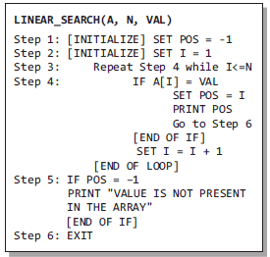
Linear Search

Slide 9
Linear Search
Linear (Sequential Search) :-
Linear search is mostly used to search an unordered list of elements (array in which data elements are not sorted).

Slide 10
Binary Search :-
Binary search is a searching algorithm that works efficiently with a sorted list.

Slide 11
Binary Search :-
How do we find words in a dictionary?
We first open the dictionary somewhere in the middle.
Then, we compare the first word on that page with the desired word whose meaning we are looking for.
If the desired word comes before the word on the page, we look in the first half of the dictionary, else we look in the second half.
Again, we open a page in the first half of the dictionary and compare the first word on that page with the desired word and repeat the same procedure until we finally get the word.
The same mechanism is applied in the binary search.

Slide 12
Binary Search :-
In Binary Search, the entire sorted list is divided into two parts.
We first compare our input item with the mid element of the list and
Restrict our attention to only the first or second half of the list depending on whether the input item comes before or after the mid-element.
In this way we reduce the length of the list at each step until we are getting a single element in a list.

Slide 13
Binary Search :-
Now, let us consider how this mechanism is applied to search for a value in a sorted array.
Consider an array A[] that is declared and initialized as
int A[] = {0, 1, 2, 3, 4, 5, 6, 7, 8, 9, 10};
The value to be searched is VAL = 9.

Slide 14
Binary Search :-
int A[] = {0, 1, 2, 3, 4, 5, 6, 7, 8, 9, 10};
The value to be searched is VAL = 9.
BEG = 0,
END = 10,
MID = (0 + 10)/2 = 5
Now, VAL = 9 and A[MID] = A[5] = 5
A[5] is less than VAL,
therefore, we now search for the value in the second half of the array.

Slide 15
Binary Search :-
So, we change the values of BEG and MID.
Now, BEG = MID + 1 = 6,
END = 10,
MID = (6 + 10)/2 =16/2 = 8
VAL = 9 and A[MID] = A[8] = 8
int A[] = {0, 1, 2, 3, 4, 5, 6, 7, 8, 9, 10};
A[8] is less than VAL,
therefore, we now search for the value in the second half of the segment.
So, again we change the values of BEG and MID.
Now, BEG = MID + 1 = 9,
END = 10,
MID = (9 + 10)/2 = 9
Now, VAL = 9 and A[MID] = 9.

Slide 16
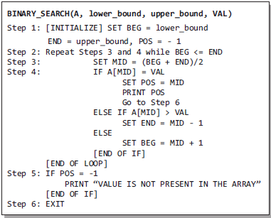
Binary Search :-
Algorithm-

Slide 17
Hashing
Various search algorithms allows us to search data in linear time complexity
[O(n)] =>Linear Search
logarithmic time complexity [O(log n)]=>Binary Search
To search a data in constant time complexity i.e. in O (1) time ??

Slide 18
Hashing
To search a data in constant time complexity i.e. in O (1) time ??
Hash tables
Allows the storage and retrieval of data in an average time of O (1).

Slide 19
Hashing
Hash is an important Data Structure which is designed to use a special function called the Hash function which is used to map a given value with a particular key for faster access of elements.

Slide 20
Hashing
The efficiency of mapping depends of the efficiency of the hash function used.
It is a technique whereby items are placed into a structure based on a key to-address transformation.

Slide 21
Hashing
For storing record
Key
Generate array index
Store the record on that array index

Slide 22
Hashing
For accessing record
Key
Generate array index
Get the record from that array index

Slide 23
Hashing
Hash Table :-
A hash table is a data structure that uses a random access data structure, such as an array, and a mapping function, called a hash function, to allow average constant time O(1) searches.

Slide 24
Hashing
Hash Function :-
A hash function is a mapping between a set of input values and a set of integers, known as hash values.
Denoted by H.
H(K)->A

Slide 25
Hashing
Good Hash Function :-
Should have following properties
1) Efficiently computable. 2) Should uniformly distribute the keys (Each table position equally likely for each key)
3) Should generate unique addresses or addresses with minimum collision

Slide 26
Hashing
Hash Function :-
For eg - A function that converts a given big phone number to a small practical integer value. The mapped integer value is used as an index in hash table.
In simple terms, a hash function maps a big number or string to a small integer that can be used as index in hash table.

Slide 27
Hashing
Hash Function :-
Array Index | Keys
0
1
2 | 011 Delhi
3
4 | 022 Kolkata
5
6 | 033 Mumbai
7
8 | 044 Chennai
9

Slide 28
Hash Function :-
STD codes of the cities are keys
Hash function maps that into address by just adding the digits of the key
Array Index | Keys
0
1
2 | 011 Delhi
3
4 | 022 Kolkata
5
6 | 033 Mumbai
7
8 | 044 Chennai
9

Slide 29
Hashing
Hash of key :-
Let h be a hash function & K is a key,
H (K) is called hash-of-key.
The hash-of-key is the index at which a record with the key value K must be kept.

Slide 30
Hashing
If each key is mapped on a unique hash table address then this situation is ideal situation
If the hash function is generating same hash table address for different keys, the situation is called collision
A good hash function should generate minimum collision

Slide 31
Hashing
2 things-
Choosing a hash function which ensures minimum collision
Resolving collision

Slide 32
Hashing
Some techniques for choosing hash functions are
Truncation Method

Slide 33
Hashing
Truncation Method
Easiest method
A part of the key as address
Can be rightmost or leftmost digit
Eg-
82394561, 87139465, 83567271, 85943228
Suppose table size is 100 then take the 2 rightmost digits for getting the addresses.
Address will be 61, 65, 71 and 28

Slide 34
Hashing
Mid Square Method
Square the key
After getting the number, we take some digits from the middle of that no as address
Eg-
1337 , 1273, 1391, 1026
Square=1787569, 1620529, 1934881, 1052676
Lets take 3rd, 4th digit from each number as address
Let the table size be 100
Address=75, 05,48, 26

Slide 35
Hashing
Folding Method
Break the key into pieces, add them and get the hash address
Eg-Lets take some 8 bit address
82394561, 87139465, 83567271, 85943228
Chop them in pieces 3,2 and 3 digits and them
Address will be->
82394561 = 823+94+561 =1478
87139465= 871+39+465 =1375
83567271= 835+67+271 = 1173
85943228 =859+43+228=1130

Slide 36
Hashing
Folding Method
Suppose the size of Hash table=1000,
Hash address will be from 0 to 999
Truncate the higher digits of the number
Address will be->
H(82394561) = 478
H(87139465) = 375
H(83567271) = 173
H(85943228) = 130

Slide 37
Hashing
Modular Method
Best way
Perform Modulus operation, Remainder is address of hash table
Ensure address will be in range of hash table
Take table size as a prime number
Table size should not be in Power of 2, else collisions increase

Slide 38
Hashing
Modular Method
Let us take some keys
82394561, 87139465, 83567271, 85943228
Table size=97
Address=
82394561%97=45
87139465%%97=0
83567271%97=25
859432285%97=64

Slide 39
Hashing
Hashing
Closed Hashing
Open hashing

Slide 40
Hashing
Closed Hashing( Open addressing)
Uses array
Techniques used in Closed Hashing are-
Linear Probing
Quadratic Probing
Double Hashing
Rehashing

Slide 41
Hashing
Open hashing:-
Uses linked list for resolving collision resolution which has its own disadvantage

Slide 42
Linear Probing
Map the key on a particular address using Modular method
If 2 keys have the same hash address, then it will find the next empty position in the hash table
Hash table is used as circular array
If table size is N then after N-1 position, value is entered in 0th position

Slide 43
Hashing
Linear Probing
Elements=29,18,43,10,36,25,46
Table size=11

Slide 44
Hashing
Linear Probing
Elements=29,18,43,10,36,25,46
Table size=11
H(29)=29%11=7
H(18)=18%11=7
H(43)=43%11=10
H(10)=10%11=10
H(36)=36%11=3
H(25)=25%11=3
H(46)=46%11=2

Slide 45
Hashing
Linear Probing-Insertion
H(29)=29%11=7
H(18)=18%11=7
H(18)=7+1=8
H(43)=43%11=10
H(10)=10%11=10
H(10)=10+1=11%11=0
H(36)=36%11=3
H(25)=25%11=3
H(25)=3+1=4
H(46)=46%11=2
For 18, hash address 7 is already occupied, so next free position is 8th
43 and 10 has same hash address, so 10 will be inserted at 0th position in the table
0 | 10
1
2 | 46
3 | 36
4 | 25
5
6
7 | 29
8 | 18
9
10 | 43

Slide 46
Hashing
Linear Probing
For Searching the element
First we check the hash address position in the table
If element is not available at that position,
Sequentially search the element after that hash address position
0 | 10
1
2 | 46
3 | 36
4 | 25
5
6
7 | 29
8 | 18
9
10 | 43

Slide 47
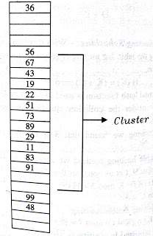
Hashing
Disadvantage of Linear Probing
Clustering Problem
When filled sequence in a hash table becomes longer.
It means that positions are occupied by elements and we have to search a longer period of time to get an empty cell.
Searching also becomes slow

Slide 48
Hashing
Linear Probing
If Hash address is h
In case of collision, linear probing searches the location h,h+1,h+2……….(%SIZE)

Slide 49
Hashing
Linear Probing
If slot hash(x) % S is full, then we try (hash(x) + 1) % S
If (hash(x) + 1) % S is also full, then we try (hash(x) + 2) % S
If (hash(x) + 2) % S is also full, then we try (hash(x) + 3) % S
S=size of hash table

Slide 50
Example
A simple hash function as “key mod 7” and sequence of keys as 50, 700, 76, 85, 92, 73, 101

Slide 51
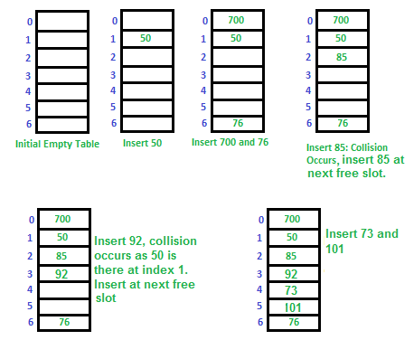
Example
A simple hash function as “key mod 7” and sequence of keys as 50, 700, 76, 85, 92, 73, 101

Slide 52
Example
A simple hash function as “key mod 7” and sequence of keys as 50, 700, 76, 85, 92, 73, 101

Slide 53
Hashing
Quadratic Probing
If Hash address is h
In case of collision, quadratic probing searches the location h+i²%SIZE
For i=1,2,3….it searches for location h+1, h+4, h+9…..
Decreases the clustering problem
Cannot search all the locations
If hash table size is prime, it will search atleast half of the locations of the hash table

Slide 54
Hashing
Quadratic Probing
How Quadratic Probing is done? Let hash(x) be the slot index computed using the hash function.
If the slot hash(x) % S is full, then we try (hash(x) + 1*1) % S.
If (hash(x) + 1*1) % S is also full, then we try (hash(x) + 2*2) % S.
If (hash(x) + 2*2) % S is also full, then we try (hash(x) + 3*3) % S.
This process is repeated for all the values of i until an empty slot is found.
S=size of the table

Slide 55
Hashing
Quadratic Probing
Elements=29,18,43,10,46,54
Table size=11

Slide 56
Hashing
Quadratic Probing
Elements=29,18,43,10,46,54
Table size=11
H(29)=29%11=7
H(18)=18%11=7, collision h+1*1=8
0
1
2
3
4
5
6
7 | 29
8 | 18
9
10

Slide 57
Hashing
Quadratic Probing
Elements=29,18,43,10,46,54
Table size=11
H(29)=29%11=7
H(18)=18%11=7, collision h+1*1=8
H(43)=43%11=10
H(10)=10%11=10, collision h+ 1*1=11%size=11%11=0
0 | 10
1
2
3
4
5
6
7 | 29
8 | 18
9
10 | 43

Slide 58
Hashing
Quadratic Probing
Elements=29,18,43,10,46,54
Table size=11
H(29)=29%11=7
H(18)=18%11=7, collision h+1*1=8
H(43)=43%11=10
H(10)=10%11=10, collision h+ 1*1=11%size=11%11=0
H(46)=46%11=2
H(54)=54%11=10, collision h + 2*2=h+4=14%11=3
0 | 10
1
2 | 46
3 | 54
4
5
6
7 | 29
8 | 18
9
10 | 43

Slide 59
Hashing
Quadratic Probing
Elements=29,18,43,10,46,54
Table size=11
0 | 10
1
2 | 46
3 | 54
4
5
6
7 | 29
8 | 18
9
10 | 43

Slide 60
Example
Let us consider a simple hash function as “key mod 7” and sequence of keys as 50, 700, 76, 85, 92, 73, 101.

Slide 61
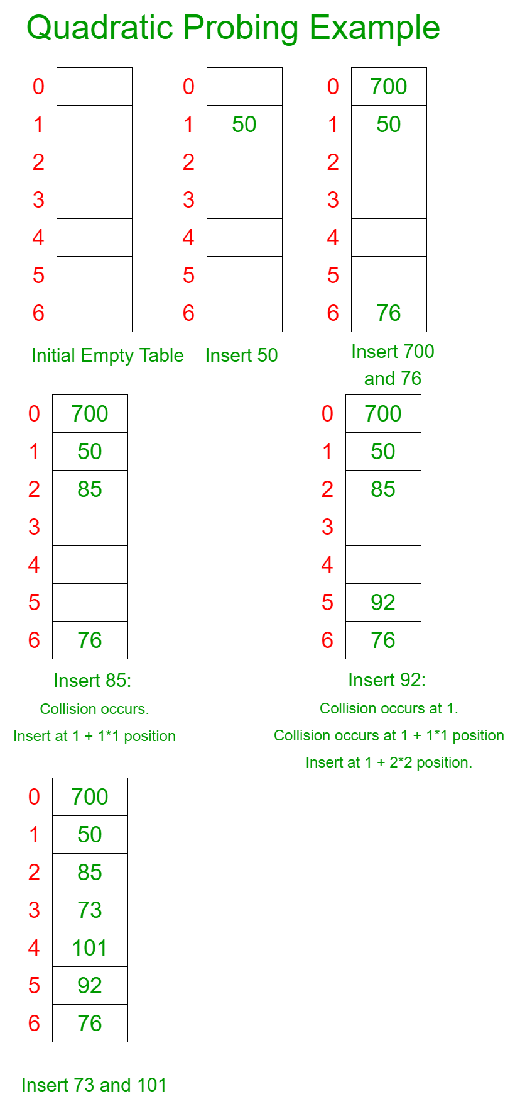
Example
Let us consider a simple hash function as “key mod 7” and sequence of keys as 50, 700, 76, 85, 92, 73, 101.
H(50)=50%7=1
H(700)=700%7=0
H(76)=76%7=6

Slide 62
Example
Let us consider a simple hash function as “key mod 7” and sequence of keys as 50, 700, 76, 85, 92, 73, 101.
H(50)=50%7=1 H(85)=85%7=1, Collision (h+1)=2
H(700)=700%7=0 H(92)=92%7=1 , Collision again (h+4)=5
H(76)=76%7=6

Slide 63

Example
Let us consider a simple hash function as “key mod 7” and sequence of keys as 50, 700, 76, 85, 92, 73, 101.
H(73)=73%7=3
H(101)=101%7=3, collision (h+1)=4

Slide 64
Hashing
Double Hashing
Choose 2nd Hash function
Hashing 2nd time in case of Collision
h =hash value from 1st function
h’=hash value from 2nd function
In case of collision , Search the hash key location h, h+h’, h+2h’, h+3h’,………..

Slide 65
Hashing
Double Hashing
h=key%prime1
h’=prime2-(key%prime2)
In case of collision:-
(h+h’)%prime1,(h+2h’)%prime1……..

Slide 66
Hashing
Double Hashing
First hash function is typically
hash1(key) = key % TABLE_SIZE
A popular second hash function is :
hash2(key) = PRIME – (key % PRIME)
where PRIME is a prime smaller than the TABLE_SIZE.

Slide 67
Hashing
Double Hashing
2 times calculation of hash function which creates it complex
Searching is slower than linear and quadratic probing
Very careful in choosing 2nd Hash function

Slide 68
Hashing
Double Hashing
h=key%13
h’=11-(key%11)
At the time collision, the next probe will be-
=(h+h’)mod13
=((key%13) + (11-(key%11)))mod13

Slide 69
Hashing
0
1
2
3 | 55
4
5
6
7
8 | 8
9 | 48
10
11
12 | 68
Double Hashing
Elements=8, 55, 48, 68
Table size=13
h=key%13
h’=11-(key%11)

Slide 70
Hashing
0
1
2
3 | 55
4
5
6
7
8 | 8
9 | 48
10
11
12
Double Hashing
Elements=8, 55, 48, 68
Table size=13
H(8)=8%13=8
H(55)=55%13=3
H(43)=48%13=9
No collision till now

Slide 71
Hashing
0
1
2
3 | 55
4
5
6
7
8 | 8
9 | 48
10
11
12 | 68
Double Hashing
Elements=8, 55, 48, 68
Table size=13
H(8)=8%13=8
H(55)=55%13=3
H(43)=48%13=9
H(10)=68%13=3, collision
Next address=
=(68%13)+(11-(68%11))%13
=(3+(11-2))%13
=(3+9)%13
=12%13
=12
Position for 68=12

Slide 72
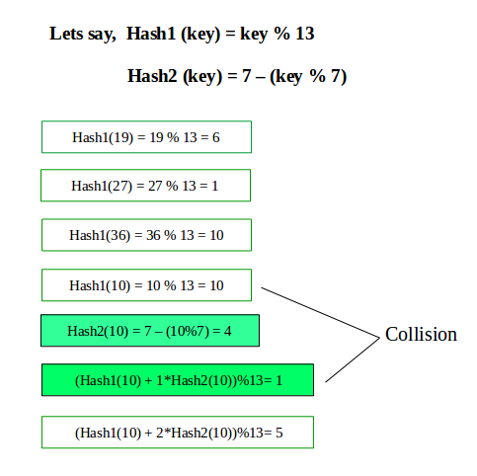
Let us take elements 19, 27,36,10
Perform Double Hashing using the following functions

Slide 73
h
h’
(h+h’)mod 13
(h+2h’)mod 13

Slide 74
Hashing
ReHashing
Chances of Insertion Failure when table is full
Soln=>
Create a new hash table with double size of previous hash table
Use the new hash function and Insert all the elements of the previous hash table in the new table

Slide 75
Hashing
ReHashing
Scan the elements of the previous hash table one by one
Calculate the hash key with new hash function
Insert them in new hash table

Slide 76
Hashing
0 | 10
1
2
3 | 36
4 | 25
5
6
7 | 7
8 | 18
9
10 | 43
Rehashing
Elements=7,18,43,10,36,25
Table size=11
H(7)=7%11=7
H(18)=18%7=7, collision
H(43)=43%11=10
H(36)=36%11=3
H(10)=10%11=10, collision
H(25)=25%11=3

Slide 77
Hashing
0 | 10
1
2 | 46
3 | 36
4 | 25
5
6
7 | 7
8 | 18
9
10 | 43
Rehashing
Elements=7,18,43,10,36,25
Table size=11
Now insert 46
H(46)=46%11=2

Slide 78
Hashing
0 | 10
1
2 | 46
3 | 36
4 | 25
5
6
7 | 7
8 | 18
9
10 | 43
Rehashing
Now to perform Rehashing
Create a new table
For Size of New Hash table, We choose the nearest bigger prime number to double the size of the original hash table

Slide 79
Hashing
0 | 10
1
2 | 46
3 | 36
4 | 25
5
6
7 | 7
8 | 18
9
10 | 43
Rehashing
Original Size=11
Double Size=22
Nearest Bigger prime no=23
New Hash function:-
H(K)=K mod 23

Slide 80
Hashing
0 | 46
1
2 | 25
3
4
5
6
7 | 7
8
9
10 | 10
11
12
13 | 36
14
15
16
17
18 | 18
19
20 | 43
21
22
Rehashing
New Hash Table-
H(K)=K mod 23
H(7)=7%23=7
H(18)=18%23=18
H(43)=43%23=20
H(36)=36%23=13
H(25)=25%23=2
Now insert 46
H(46)=46%23=23%SIZE=23%23=0

Slide 81
Hashing
ReHashing
Bit more expensive technique but it happens very few times
Decision of rehashing can be taken on different conditions like
Table is occupied more than half,
Insertion of new element failure or on any given case

Slide 82
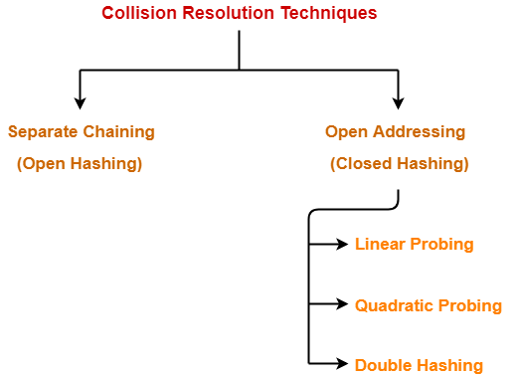
Hashing

Slide 83
Open Hashing
Separate Chaining
Maintain chain of elements which have same hash address

Slide 84
Open Hashing
Separate Chaining
Hash table is an array of pointers which point to the linked list
Maintain Linked list in sorted order and the elements which have same hash address will be in this linked list

Slide 85
Hashing
Separate Chaining
For inserting one element, we have to get the hash value through the hash function
Hash value will be mapped in the hash table position then that element will be inserted in the Linked list
Searching is also same

Slide 86
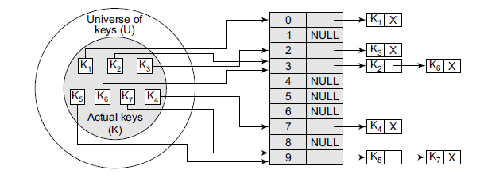
Hashing
Separate Chaining

Slide 87
Separate Chaining
Insert the keys 7, 24, 18, 52, 36, 54, 11, and 23 in a chained hash table of 9 memory locations. Use h(k) = k mod m.
In this case, m=9

Slide 88

Separate Chaining
Insert the keys 7, 24, 18, 52, 36, 54, 11, and 23 in a chained hash table of 9 memory locations. Use h(k) = k mod m.
In this case, m=9
Initially, the hash table can be given as

Slide 89
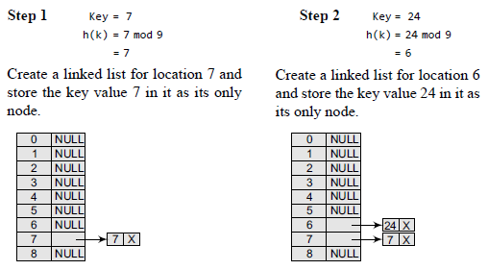
Separate Chaining

Slide 90
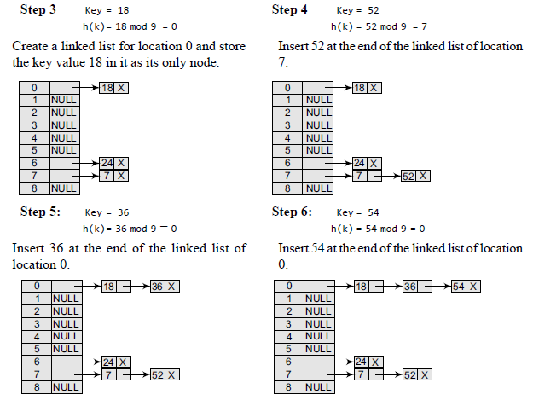
Separate Chaining

Slide 91
Separate Chaining

Slide 92
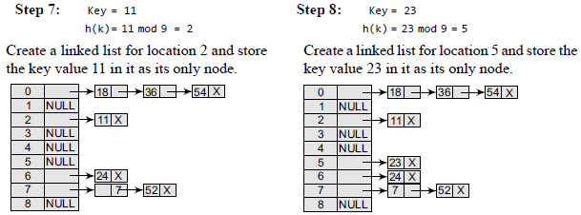
Separate Chaining

Slide 93
Hashing
Advantage of Separate Chaining
Simple to implement.
Hash table never fills up, we can always add more elements to the chain.
Less sensitive to the hash function
It is mostly used when it is unknown how many and how frequently keys may be inserted or deleted.

Slide 94
Hashing
Disadvantages of Separate Chaining
Cache performance of chaining is not good as keys are stored using a linked list. Open addressing provides better cache performance as everything is stored in the same table.
Wastage of Space (Some Parts of hash table are never used)
If the chain becomes long, then search time can become O(n) in the worst case.
Uses extra space for links.

Slide 95
