Slide 1
Inheritance
Kaustubh Kulkarni

Slide 2
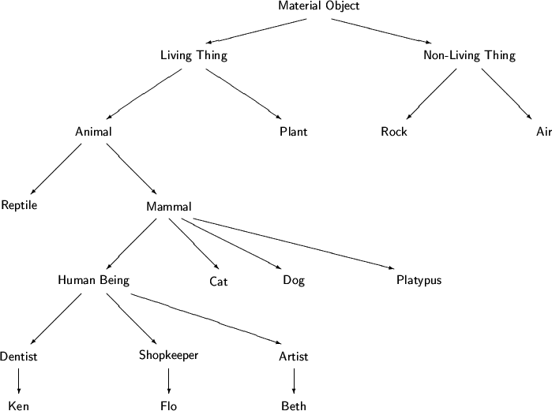

Slide 3
The is-a Rule
Simple rule-of-thumb: Try forming the English sentences “ X is-a Y”.
If it ``sounds right'' to your ear, then X can be made a subclass of Y.
A dog is-a mammal, and therefore a dog inherits from mammal
A car is-a engine sounds wrong, and therefore inheritance is not natural.
Instead a car has-a engine.

Slide 4
Inheritance
Inheritance is the act of deriving a new class from an existing class.
Inheritance allows us to extend the functionality of the object.
The new class automatically contains some or all methods and variables of the original class.
The new derived class is called a child class, or subclass.
The original class is called parent class, or superclass, or base class.
Since the derived class is always more specific, the relation between these classes is called is-a relation.

Slide 5
Purpose
Class extension can be used for a number of purposes.
The most common use is specialization - where the extended class defines new behaviors and thus becomes a specialized version of its superclass.
Consider two classes Book and Dictionary.
Which one is more general?
Book, since a dictionary is a specific kind of a book.
Therefore, we say that Dictionary extends Book.
public class Dictionary extends Book
{
}

Slide 6
Reuse of Code, Reuse of Concept
Reuse of code
Methods defined in the parent can be made available to the child without rewriting.
Reuse of concept.
Methods described in the parent can be redefined and overridden in the child.
Although no code is shared between parent and child, the concept embodied in the definition is shared.

Slide 7
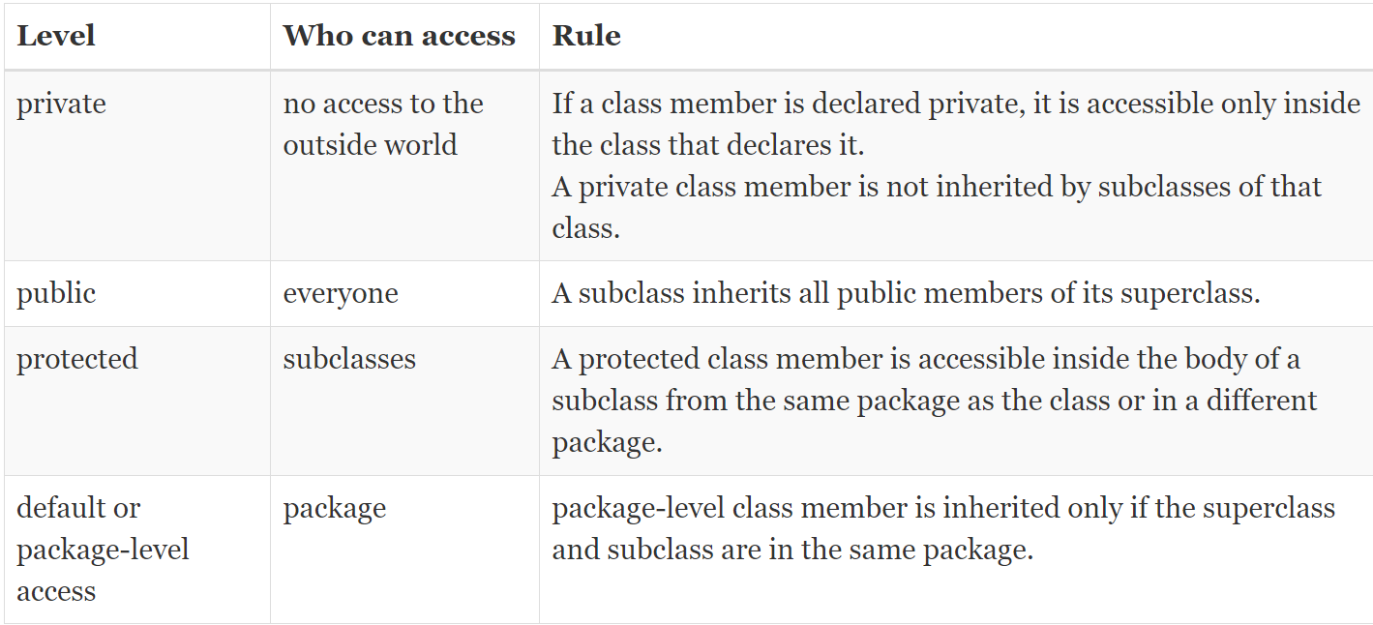
Member Access and Inheritance

Slide 8
class Employee {
private String name = "Unknown";
public void setName(String name) {
this.name = name;
}
public String getName() {
return name;
}
}
class Manager extends Employee {
}

Slide 9
public class Main {
public static void main(String[] args) {
// Create an object of the Manager class
Manager mgr = new Manager();
// Set the name of the manager
mgr.setName("Mary");
// Get the name of the manager
String mgrName = mgr.getName();
// Display the manager name
System.out.println("Manager Name: " + mgrName);
Employee emp = new Employee();
emp.setName("Tom");
String empName = emp.getName();
System.out.println("Employee Name: " + empName);
}
}

Slide 10
public class BankAccount{
protected double balance;
BankAccount(double initialBalance){
balance = initialBalance;
}
public void deposit(double amount){
balance += amount;
}
public void withdraw(double amount){
if (amount > 0 && balance >= amount){
balance -= amount;
}
}
protected void applyInterestRate(){} // This method can be overridden by subclasses to implement specific interest calculations. }

Slide 11
public class SavingsAccount extends BankAccount{
double interestRate;
SavingsAccount(double initialBalance,double interestRate){ super(initialBalance);
this.interestRate = interestRate;
}
void applyInterestRate(){
balance += balance * interestRate;
}
}

