Slide 1
Logical Agents
Chapter 7

Slide 2
Outline
Knowledge-based agents
Wumpus world
Logic in general - models and entailment
Propositional (Boolean) logic
Equivalence, validity, satisfiability
Inference rules and theorem proving
  forward chaining
  backward chaining
  resolution

Slide 3
??
It is a crime for an American to sell weapons to hostile nations. A country Nono, an enemy of America, has all its missiles sold to it by colonel West, who is an American.
Is colonel west a criminal?

Slide 4
Marcus was a man. Marcus was a Pompeian. All Pompeians were Romans. Caesar was a ruler. All Romans were either loyal to Caesar or hated him. Everyone is loyal to someone. People only try to assassinate rulers they aren't loyal to. Marcus tried to assassinate Caesar.
Was Marcus loyal to Caesar?

Slide 5
John likes all kinds of food.
Apples are food.
Dosa is food.
Anything anyone eats and isn’t killed-by is a food.
Bill eats peanuts and is still alive.
Sue eats everything Bill eats.
John Like Peanuts?

Slide 6
Marcus was a Pompeian. 2. All Pompeians died when the volcano erupted in 79 A.D. 3. It is now 2022 A.D.
Is Marcus alive?

Slide 7
If the maid stole the jewelry, then the butler wasn't guilty. Either the maid stole the jewelry or she milked the cows. If the maid milked the cows, then the butler got his cream. The butler was guilty.
Did he get the cream?

Slide 8
Logical Agents
Designing agents that -
can form representations of the world,
use a process of inference to derive new representations about the world, and
use these new representations to deduce what to do.

Slide 9
Key points
Representation of knowledge
Reasoning process that brings knowledge to life

Slide 10
Why Knowledge and reasoning
Enables successful behavior of agents
Play a crucial role in partially observable environments
Help in understanding natural language
Flexible enough to accept new tasks in the form of explicitly described goals

Slide 11
What do you mean by following statement?
"John threw the brick through the window and broke it”

Slide 12
Properties of knowledge
Voluminous
Constantly changing
Hard to characterise

Slide 13

Knowledge bases
Knowledge base = set of sentences in a formal language
Declarative approach to building an agent (or other system):
  Tell it what it needs to know
  Then it can Ask itself what to do - answers should follow from the KB
  Both tasks involve inference- deriving new statements from old ones.

Slide 14

A simple knowledge-based agent
The agent must be able to:
  Represent states, actions, etc.
  Incorporate new percepts
  Update internal representations of the world
  Deduce hidden properties of the world
  Deduce appropriate actions

Slide 15
Knowledge based agents
Agents can be viewed at the knowledge level
  what they know,
  what are its goals,
  regardless of how it is implemented
  Fixes agent behavior
Or at the implementation level
  Data structures in KB and
  algorithms that manipulate the data structures

Slide 16
Knowledge Vs Implementation
Knowledge level:
  A taxi driver is supposed to drive from Dadar to Panvel knows Vashi Creek bridge is the only closest connecting road between two places. we can expect it to cross the Bridge because it knows that that will achieve its goal.
Implementation level:
  its geographical knowledge is implemented as linked lists or pixel maps, or whether it reasons by manipulating strings of symbols stored in registers or by propagating noisy signals in a network of neurons.

Slide 17
Procedural Vs declarative knowledge
Declarative- The agent's initial program, is built by adding one by one the sentences that represent the designer's knowledge of the environment.
  Tells –WHAT.
procedural - Encodes desired behaviors directly as program code; minimizing the role of explicit representation and reasoning can result in a much more efficient system.
  Tells- EXACTLY HOW.
a successful agent must combine both elements in its design.

Slide 18
Wumpus World Problem
The wumpus world is a cave consisting of rooms connected by passageways. Lurking somewhere in the cave is the wumpus, a beast that eats anyone who enters its room. The wumpus can be shot by an agent, but the agent has only one arrow. Some rooms contain bottomless pits that will trap anyone who wanders into these rooms (except for the wumpus, which is too big to fall in). The only mitigating feature of living in this environment is the possibility of finding a heap of gold.
Although the wumpus world is rather tame by modern computer game standards, it makes an excellent testbed environment for intelligent agents.

Slide 19
History of “Hunt the Wumpus”
WUMPUS /wuhm'p*s/ n. The central monster (and, in many versions, the name) of a famous family of very early computer games called “Hunt The Wumpus,” dating back at least to 1972 (several years before ADVENT) on the Dartmouth Time-Sharing System. The wumpus lived somewhere in a cave with the topology of a dodecahedron's edge/vertex graph (later versions supported other topologies, including an icosahedron and Mobius strip). The player started somewhere at random in the cave with five “crooked arrows”; these could be shot through up to three connected rooms, and would kill the wumpus on a hit (later versions introduced the wounded wumpus, which got very angry). Unfortunately for players, the movement necessary to map the maze was made hazardous not merely by the wumpus (which would eat you if you stepped on him) but also by bottomless pits and colonies of super bats that would pick you up and drop you at a random location (later versions added “anaerobic termites” that ate arrows, bat migrations, and earthquakes that randomly changed pit locations).
This game appears to have been the first to use a non-random graph-structured map (as opposed to a rectangular grid like the even older Star Trek games). In this respect, as in the dungeon-like setting and its terse, amusing messages, it prefigured ADVENT and Zork and was directly ancestral to both. (Zork acknowledged this heritage by including a super-bat colony.) Today, a port is distributed with SunOS and as freeware for the Mac. A C emulation of the original Basic game is in circulation as freeware on the net.

Slide 20

Wumpus World PEAS description
Performance measure
  gold +1000, death -1000
  -1 per step, -10 for using the arrow
Environment
  4 X 4 grid of rooms
  Agent always starts in square [1,1], facing to right
  Squares adjacent to wumpus are smelly
  Squares adjacent to pit are breezy
  Glitter iff gold is in the same square
  Shooting kills wumpus if you are facing it
  Shooting uses up the only arrow
  Grabbing picks up gold if in same square
  Releasing drops the gold in same square
Sensors: Stench, Breeze, Glitter, Bump, Scream
Actions: Left turn, Right turn, Forward, Grab, Release, Shoot
Actuators : wheel/feet, arm

Slide 21
Wumpus world characterization
Fully Observable No – only local perception
Deterministic Yes – outcomes exactly specified
Episodic No – sequential at the level of actions
Static Yes – Wumpus and Pits do not move
Discrete Yes
Single-agent? Yes – Wumpus is essentially a natural feature

Slide 22

Exploring a wumpus world

Slide 23

Exploring a wumpus world

Slide 24

Exploring a wumpus world

Slide 25

Exploring a wumpus world

Slide 26

Exploring a wumpus world

Slide 27

Exploring a wumpus world

Slide 28

Exploring a wumpus world

Slide 29

Exploring a wumpus world

Slide 30
Logic in general
Logics are formal languages for information representation so that conclusions can be drawn
Syntax defines the sentences in the language
Semantics define the "meaning" of sentences;
  i.e., define truth of a sentence in a world
E.g., arithmetic language
  x+2 ≥ y is a sentence; x2+y > {} is not a sentence
  x+2 ≥ y is true iff the number x+2 is no less than the number y
  x+2 ≥ y is true in a world where x = 7, y = 1
  x+2 ≥ y is false in a world where x = 0, y = 6

Slide 31
Entailment
Entailment means that one statement logically follows another:
KB ╞ α
Knowledge base KB entails sentence α if and only if, in every model where KB is true α is also true.
  E.g., the KB containing “the Giants won” and “the Reds won” entails “Either the Giants won or the Reds won”
  E.g., x+y = 4 entails 4 = x+y
  Entailment is a relationship between sentences (i.e., syntax) that is based on semantics

Slide 32

Entailment in the wumpus world
Situation after detecting nothing in [1,1], moving right, breeze in [2,1]
Consider possible models for KB assuming only pits
3 Boolean choices ⇒
8 possible models

Slide 33

Wumpus models

Slide 34

Wumpus models
KB = wumpus-world rules + observations

Slide 35

Wumpus models
KB = wumpus-world rules + observations
α₁ = "[1,2] is safe", KB ╞ α₁, proved by model checking

Slide 36
Wumpus models
KB = wumpus-world rules + observations

Slide 37

Wumpus models
KB = wumpus-world rules + observations
α₂ = "[2,2] is safe", KB ╞ α₂

Slide 38
Inference
KB ├_{i} α = sentence α can be derived from KB by procedure i
Soundness (Truth preserving): An inference algorithm that derives only entailed sentences is called sound.
i is sound if whenever KB ├_{i} α, it is also true that KB╞ α
Completeness: An inference algorithm is complete if it can derive every sentence that is entailed.
i is complete if whenever KB╞ α, it is also true that KB ├_{i} α

Slide 39
Think-Pair-share
Marcus is a man
Marcus is a Pompeian
All Pompeian were romans
All Pompeians died in the volcano irrupted in 79AD
All men are mortal
No mortal can live for more than 150 years
Marcus was born in 40AD
Caesar was a ruler
All romans were either loyal to Caesar or hated him
Everyone is loyal to someone
People only try to assassinate the rulers they are not loyal to
Marcus tried to assassinate Caesar

Slide 40
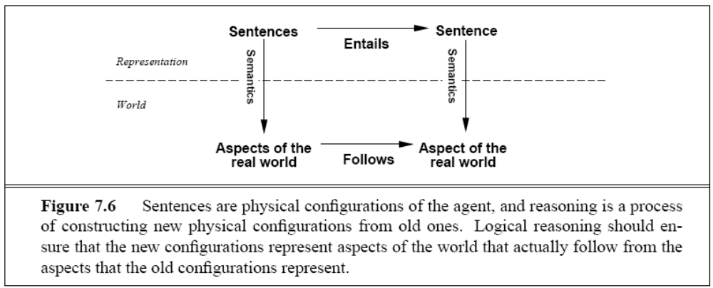
World and its representation
If KB is true in real world, then any sentence α derived from KB by a sound inference procedure is also true in the real world.

Slide 41
Inference
Preview: we will define a logic (first-order logic) which is expressive enough to say almost anything of interest, and for which there exists a sound and complete inference procedure.
That is, the procedure will answer any question whose answer follows from what is known by the KB.

Slide 42
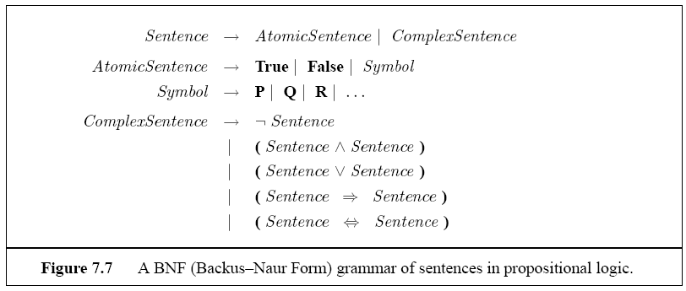
Propositional Logic

Slide 43
Some keywords
Literal- atomic sentence
  Positive literal
  Negative literal
Conjunction- sentence whose connective is ^.
Conjuncts- parts of conjunction statement
Disjunction and disjuncts

Slide 44
Propositional logic: Syntax
Propositional logic is the simplest logic – illustrates basic ideas
The proposition symbols P₁, P₂ etc are sentences
  If S is a sentence, ¬S is a sentence (negation)
  If S₁ and S₂ are sentences, S₁ ∧ S₂ is a sentence (conjunction)
  If S₁ and S₂ are sentences, S₁ ∨ S₂ is a sentence (disjunction)
  If S₁ and S₂ are sentences, S₁ ⇒ S₂ is a sentence (implication)
  If S₁ and S₂ are sentences, S₁ ⇔ S₂ is a sentence (biconditional)

Slide 45
Propositional logic: Semantics
Each model specifies true/false for each proposition symbol
  E.g. P_{1,2} P_{2,2} P_{3,1}
  false true false
With these symbols, 8 possible models, can be enumerated automatically.
Rules for evaluating truth with respect to a model m:
¬S is true iff S is false
S₁ ∧ S₂ is true iff S₁ is true and S₂ is true
S₁ ∨ S₂ is true iff S₁is true or S₂ is true
S₁ ⇒ S₂ is true iff S₁ is false or S₂ is true
i.e., is false iff S₁ is true and S₂ is false
S₁ ⇔ S₂ is true iff S₁⇒S₂ is true andS₂⇒S₁ is true
Simple recursive process evaluates an arbitrary sentence, e.g.,
¬P_{1,2} ∧ (P_{2,2} ∨ P_{3,1}) = true ∧ (true ∨ false) = true ∧ true = true

Slide 46

Truth tables for connectives

Slide 47
Wumpus world sentences
Let P_{i,j} be true if there is a pit in [i, j].
Let B_{i,j} be true if there is a breeze in [i, j].
  ¬ P_{1,1}
  ¬B_{1,1}
  B_{2,1}
"Pits cause breezes in adjacent squares"
  B_{1,1} ⇔ (P_{1,2} ∨ P_{2,1})
  B_{2,1} ⇔ (P_{1,1} ∨ P_{2,2} ∨ P_{3,1})

Slide 48

Truth tables for inference

Slide 49

Logical equivalence
Two sentences are logically equivalent iff true in same models: α ≡ ß iff α╞ β and β╞ α

Slide 50
Validity and satisfiability
A sentence is valid if it is true in all models,
  e.g., True, A ∨¬A, A ⇒ A, (A ∧ (A ⇒ B)) ⇒ B
Validity is connected to inference via the Deduction Theorem:
  KB ╞ α if and only if (KB ⇒ α) is valid
A sentence is satisfiable if it is true in some model
  e.g., A∨ B, C
A sentence is unsatisfiable if it is true in no models
  e.g., A∧¬A
Satisfiability is connected to inference via the following:
  KB ╞ α if and only if (KB ∧¬α) is unsatisfiable

Slide 51
Proof methods
Proof methods divide into (roughly) two kinds:
  Application of inference rules
    Legitimate (sound) generation of new sentences from old
    Proof = a sequence of inference rule applications
    Can use inference rules as operators in a standard search algorithm
    Typically require transformation of sentences into a normal form
  Model checking
    truth table enumeration (always exponential in n)
    improved backtracking, e.g., Davis--Putnam-Logemann-Loveland (DPLL)
    heuristic search in model space (sound but incomplete)
    e.g., min-conflicts-like hill-climbing algorithms

Slide 52
Reasoning patterns in PL
Modus ponens
And elimination
Bidirectional elimination

Slide 53

Modus ponens
The notation means that, whenever any sentences of the form a + P and a are given, then the sentence Beta can be inferred.
Rule- if ( WumpusAhead ANDWumpusAlive) ➔ Shoot
Given - ( WumpusAhead A WumpusAlive)
then Shoot can be inferred.

Slide 54

And elimination
from a conjunction, any of the conjuncts can be inferred
E.g ( WumpusAhead AND WumpusAlive), WumpusAlive can be inferred.

Slide 55

Bidirectional elimination
Equivalence for biconditional elimination yields the two inference rules
Not all inference rules work in both directions like this.

Slide 56
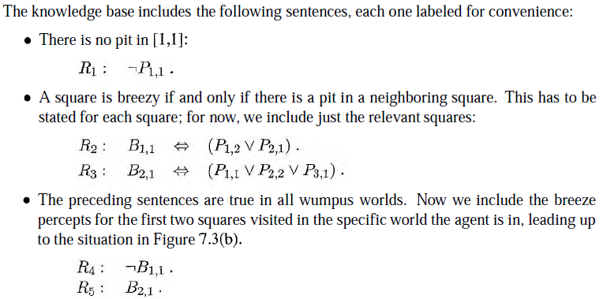

Slide 57
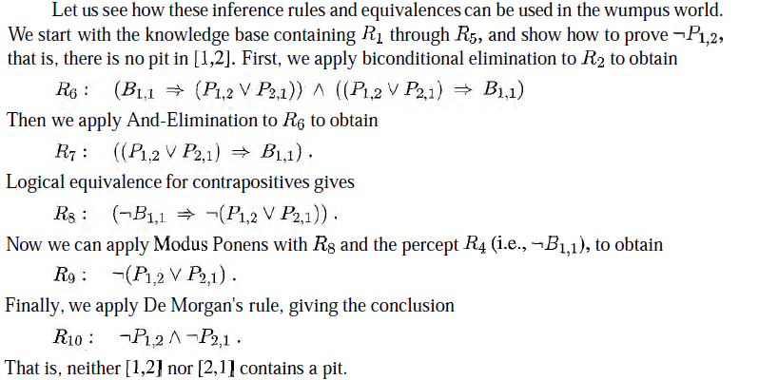

Slide 58
Example 1
Represent in PL and prove Raja is angry
1. Rimi is hungry
2. if Rimi is hungry, she barks.
3. if Rimi is barking then Raja is angry.

Slide 59
Solution
Knowledge Representation-
A - Rimi is hungry
B - Rimi barks.
C - Raja is angry
Given:-
A
A ➔ B
B ➔ C
Solution-
A (Given)
Using Modus Ponens and (1) &(2),
4. B is true
Using Modus Ponens, 4 & (3),
C is true

Slide 60

And-Or Graph
Own a TV
Steal TV
Earn Money
Buy TV

Slide 61
AND-OR Graph: Dog Barking problem
C
Modus Ponens
B
Modus Ponens
A
Given

Slide 62
Example 2
If maid stole the jewelry, then butler was not guilty
Either maid stole the jewelry or she milked the cow.
If maid milked the cow, then butler got the cream.
Therefore if butler was guilty, then prove that he got the cream

Slide 63
PL Representation
P - Maid stole the jewelry
Q - Butler was guilty
R - Maid milked the cow.
S - Butler got the cream.
Given:-
P➔ ~Q
P V R
R➔ S
Q
Prove : S is true
Proof :
Law of contrapositivity & (1)
5. Q ➔ ~P
Modus Ponens & (5)
6. ~p
Satisfiability property and (2), (6)
7. R
Modus Ponens, (7) & (3)
8. S

Slide 64
Forward and backward chaining
Horn Form (restricted)
  KB = conjunction of Horn clauses
  Horn clause = proposition symbol; or
    (conjunction of symbols) ⇒ symbol
  E.g., C ∧ (B ⇒ A) ∧ (C ∧ D ⇒ B)
A Horn clause is a disjunction of literals of which at most one is positive
Modus Ponens (for Horn Form): complete for Horn KBs
α₁, … ,α_{n}, α₁ ∧ … ∧ α_{n} ⇒ β
β
Can be used with forward chaining or backward chaining.
These algorithms are very natural and run in linear time

Slide 65
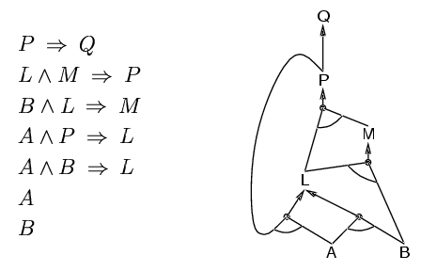
Forward chaining
Idea: fire any rule whose premises are satisfied in the KB,
  add its conclusion to the KB, until query is found

Slide 66
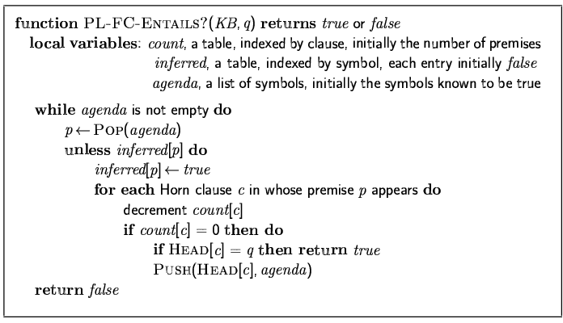
Forward chaining algorithm
Forward chaining is sound and complete for Horn KB

Slide 67
And-Or Graph, PL & FR
  Assume A , B, are true.
  Prove Q is true

Slide 68
Backward chaining
Idea:
works backwards from the query.
If the query q is known to be true, then no work is needed.
Otherwise, the algorithm finds those implications in the knowledge base that conclude q.
If all the premises of one of those implications can be proved true (by backward chaining), then q is true.

Slide 69
Backward chaining

Slide 70
Resolution
Conjunctive Normal Form (CNF)
  conjunction of disjunctions of literals clauses
  E.g., (A ∨ ¬B) ∧ (B ∨ ¬C ∨ ¬D)
Resolution inference rule (for CNF):
where l_{i} and m_{j} are complementary literals.
E.g., P_{1,3} ∨ P_{2,2}, ¬P_{2,2}
P_{1,3}
Resolution is sound and complete for propositional logic
li …  lk, m1  …  mn
li  …  li-1  li+1  …  lk  m1  …  mj-1  mj+1 ...  mn

Slide 71
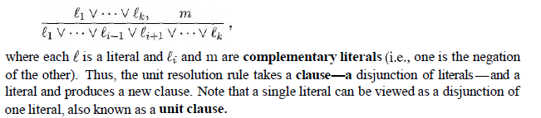
Unit Resolution

Slide 72
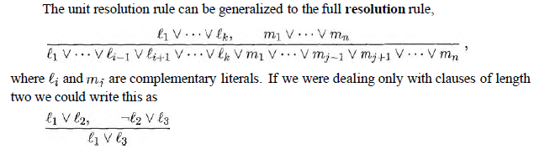
Full Resolution

Slide 73
Conversion to CNF
1. B_{1,1} ⇔ (P_{1,2} ∨ P_{2,1})
Eliminate , replacing α  β with (α  β)(β  α).
2. (B1,1  (P1,2  P2,1))  ((P1,2  P2,1)  B1,1)
Eliminate , replacing α  β with ➢α β.
3. (➢B1,1  P1,2  P2,1)  (➢(P1,2  P2,1)  B1,1)
Move ➢ inwards using de Morgan's rules and double-negation:
4. (➢B1,1  P1,2  P2,1)  ((➢P1,2  ➢P2,1)  B1,1)
Apply distributive law ( over ) and flatten:
5. (➢B1,1  P1,2  P2,1)  (➢P1,2  B1,1)  (➢P2,1  B1,1)

Slide 74
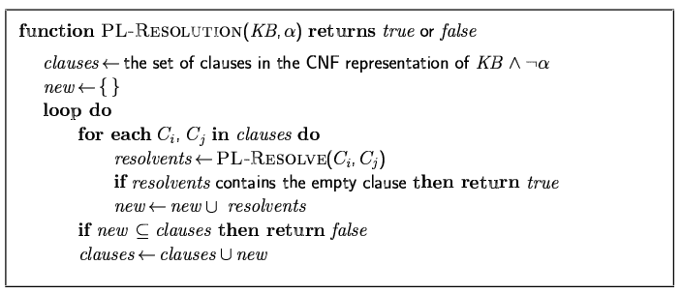
Resolution algorithm
Proof by contradiction, i.e., show KB∧¬α unsatisfiable

Slide 75
Example
If maid stole the jewelry, then butler was not guilty
Either maid stole the jewelry or she milked the cow.
If maid milked the cow, then butler got the cream.
Therefore if butler was guilty, then prove that he got the cream

Slide 76
CNF:-
1. P➔ ~Q
~P V ~Q
2. P V R
3. R➔ S
~R V S
4. Q
Prove: ~S is contradiction
P - Maid stole the jewelry
Q - Butler was guilty
R - Maid milked the cow.
S - Butler got the cream.
Given:-
P➔ ~Q
P V R
R➔ S
Q
Prove: S is true

Slide 77
Butler Got the cream
~S ~R V S (3)
  ~R P V R (2)
  P ~P V ~Q (1)
  ~Q Q (4)
  Contradiction

Slide 78
Solve

Slide 79
Proof By Resolution
Propositional Logic
CNF
1. ~P V Q
2. ~ (L Ո M ) V P
~ L V ~M V P
3. ~ (B Ո L ) V M
~B V ~L V M
4. ~ (A Ո P ) V L
~A V ~P V L
5. ~ (A Ո B) V L
~A V ~B V L
6. A
7. B
P➔ Q
L Ո M ➔ P
B Ո L ➔ M
A Ո P ➔ L
A Ո B ➔ L
A
B

Slide 80

Resolution example
KB = (B_{1,1} ⇔ (P_{1,2}∨ P_{2,1})) ∧¬ B_{1,1} α = ¬P_{1,2}

Slide 81
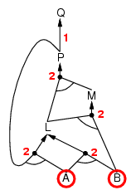
Forward chaining example

Slide 82
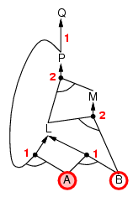
Forward chaining example

Slide 83
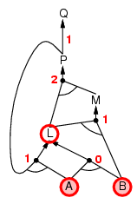
Forward chaining example

Slide 84
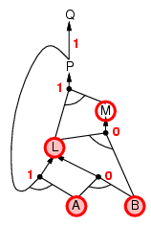
Forward chaining example

Slide 85
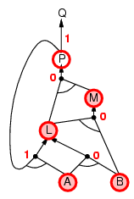
Forward chaining example

Slide 86
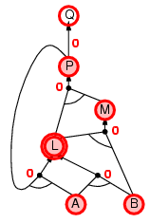
Forward chaining example

Slide 87
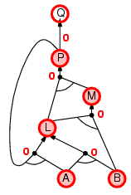
Forward chaining example

Slide 88

Forward chaining example

Slide 89
Proof of completeness
FC derives every atomic sentence that is entailed by KB
  FC reaches a fixed point where no new atomic sentences are derived
  Consider the final state as a model m, assigning true/false to symbols
  Every clause in the original KB is true in m
  a1  …  ak  b
  Hence m is a model of KB
  If KB╞ q, q is true in every model of KB, including m

Slide 90
Backward chaining
Idea: work backwards from the query q:
    check if q is known already, or
    prove by BC all premises of some rule concluding q
Avoid loops: check if new subgoal is already on the goal stack
  has already been proved true, or
  has already failed
Avoid repeated work: check if new subgoal
to prove q by BC,

Slide 91
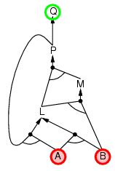
Backward chaining example

Slide 92
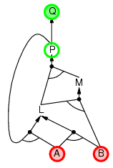
Backward chaining example

Slide 93
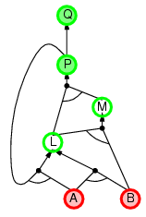
Backward chaining example

Slide 94
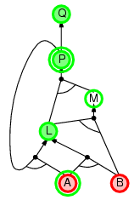
Backward chaining example

Slide 95
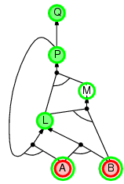
Backward chaining example

Slide 96
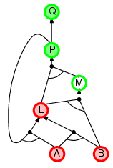
Backward chaining example

Slide 97
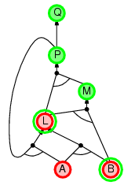
Backward chaining example

Slide 98
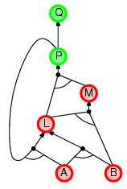
Backward chaining example

Slide 99
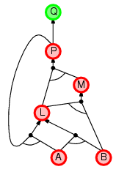
Backward chaining example

Slide 100
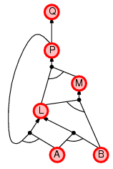
Backward chaining example

Slide 101
Forward vs. backward chaining
FC is data-driven, automatic, unconscious processing,
  e.g., object recognition, routine decisions
May do lots of work that is irrelevant to the goal
BC is goal-driven, appropriate for problem-solving,
  e.g., Where are my keys? How do I get into a PhD program?
Complexity of BC can be much less than linear in size of KB

Slide 102
Efficient propositional inference
Two families of efficient algorithms for propositional inference:
DPLL algorithm (Davis, Putnam, Logemann, Loveland)
  WalkSAT algorithm
Incomplete local search algorithms
Complete backtracking search algorithms

Slide 103
Inference-based agents in the wumpus world
A wumpus-world agent using propositional logic:
  ¬W_{1,1}
  B_{x,y} ⇔ (P_{x,y+1} ∨ P_{x,y-1} ∨ P_{x+1,y} ∨ P_{x-1,y})
  S_{x,y} ⇔ (W_{x,y+1} ∨ W_{x,y-1} ∨ W_{x+1,y} ∨ W_{x-1,y})
  W_{1,1} ∨ W_{1,2} ∨ … ∨ W_{4,4}
  ¬W_{1,1} ∨ ¬W_{1,2}
  ¬W_{1,1} ∨ ¬W_{1,3}
  …
⇒ 64 distinct proposition symbols, 155 sentences
➢P1,1

Slide 104
Expressiveness limitation of propositional logic
KB contains "physics" sentences for every single square
For every time t and every location [x,y],L_{x,y} ∧ FacingRight^{t} ∧ Forward^{t} ⇒ L_{x+1,y}
Rapid proliferation of clauses
t

Slide 105
Summary
Logical agents apply inference to a knowledge base to derive new information and make decisions
Basic concepts of logic:
  syntax: formal structure of sentences
  semantics: truth of sentences wrt models
  entailment: necessary truth of one sentence given another
  inference: deriving sentences from other sentences
  soundness: derivations produce only entailed sentences
  completeness: derivations can produce all entailed sentences
Wumpus world requires the ability to represent partial and negated information, reason by cases, etc.
Resolution is complete for propositional logic
Forward, backward chaining are linear-time, complete for Horn clauses
Propositional logic lacks expressive power

