Slide 1

Planning
Ms. Swati Mali

Slide 2
Why not searching?
Overwhelmed by irrelevant actions
Difficult to find a good heuristic function
Lacks autonomy
Can’t exploit problem decomposition

Slide 3
Why planning?
Can use domain-independent heuristic
Can work on sub-goals independently
Can work out own plans
Can be autonomous
Synthesize goal directed behaviors
Can handle causal dependencies

Slide 4
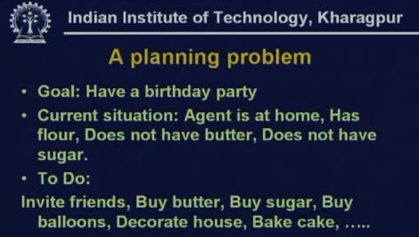
Ref: Prof Sarkar’s slides, IIT KGP

Slide 5
Possible actions
invite friends,
go out and buy butter,
go out and buy sugar,
buy balloons,
decorate the house,
bake the cake and so on.

Slide 6
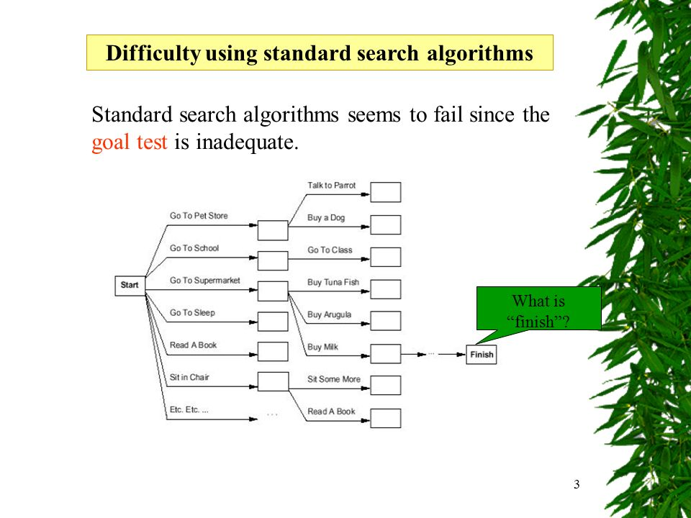
Courtesy: http://images.slideplayer.com/34/8320104/slides/slide_3.jpg

Slide 7
Language for planning problem
STRIPS - STanford Research Institute’s Problem Solver, Stanford, 1971
ADL – Action Description Language, IBM 1987
PDDL
Developed for AI planning competitions (late 1990s).
Inspired by STRIPS & ADL, but standardized for multiple planners.
Expressive enough to describe a wide variety of problems, but restrictive enough to allow efficient algorithms to operate over it

Slide 8
STRIPS (Stanford Research Institute Problem Solver)
One of the earliest AI planning languages (1971).
Uses preconditions, actions, and effects to describe planning problems.
Example Syntax:
Action: MOVE(A, B)
Preconditions: AT(A)
Effects: ¬AT(A), AT(B)
Limitations: Cannot handle conditional effects or numeric values
Cannot express conditional effects or quantification.
Limited expressiveness compared to modern languages.

Slide 9
ADL (Action Description Language)
Enhancement of STRIPS with richer expressiveness.
Introduced conditional effects, disjunctions, and quantified variables in preconditions/effects.
Example Syntax:
Action: PICK_UP(x)
Preconditions: CLEAR(x) ∧ ON_TABLE(x)
Effects: HOLDING(x) ∧ ¬ON_TABLE(x)
Benefit: Supports more complex AI planning tasks.

Slide 10
Reading: Other planning languages
Language | Features & Use Cases
HTN (Hierarchical Task Networks) | Decomposes tasks into subtasks (e.g., SHOP, SHOP2). Used in robotics & gaming.
Golog | Based on situation calculus; great for reasoning over dynamic environments.
RDDL (Relational Dynamic Influence Diagram Language) | Extends PDDL with probabilistic effects. Used in MDP & POMDP planning.
PPDDL (Probabilistic PDDL) | Variant of PDDL that includes uncertainty & probabilistic actions.
ANML (Action Notation Modeling Language) | Used in NASA’s planning tools; supports concurrency & time windows.
NDDL (New Domain Definition Language) | Used in NASA’s EUROPA planner for space missions.
XSB Prolog | Logic programming-based planning, useful in AI reasoning.
Planning with TDL (Task Description Language) | Used in robotics & multi-agent systems.
ASP (Answer Set Programming) | Logic-based planning used in constraint-solving and knowledge-based AI.

Slide 11
Strips vs ADL
1. Only positive literals in states:
e.g. Poor ∩ Unknown
2. Closed World Assumption:
Unmentioned literals are false.
3. Effect P ∩ Q means add P and delete Q.
4. Only ground literals in goals:
e.g. Rich ∩ Famous
1. Positive and negative literals in states:
e.g. ~Rich ∩ ~Famous
2. Open World Assumption:
Unmentioned literals are unknown
3. Effect P ∩ ~Q means add P and ~Q and delete ~P and Q.
4. Quantified variables in goals:
e.g.3x At (PI,x ) ∩ At(P2,x )

Slide 12
Strips vs ADL
5. Goals are conjunctions:
e.g. Rich A Famous
6. Effects are conjunctions.
7. No support for equality.
8. No support for types.
9. No support for numerical data
5. Goals allow conjunction and disjunction:
~Poor A (Famous V Smart)
6. Conditional effects allowed:
when P: E means E is an effect only if P is satisfied.
7. Equality predicate (x = y) is built in.
8. Variables can have types, as in (p:plane)

Slide 13
Problem description
Representation of states
Representation of goals
Representation of actions

Slide 14
Representation of states
Decompose the world into logical conditions
Represent a state as a conjunction of positive literals.
E.g., Poor ∩ Unknown
E.g. At(Plane1, Melbourne) ∩ At(Plane2, Sydney)
Literals in first-order state descriptions must be ground and function-free.
i.e. At(x, y) or At(Father(Fred), Sydney) not allowed.

Slide 15
Representation of goals
A goal is a partially specified state, represented as a conjunction of positive ground literals.
E.g.Rich ∩ Famous or At(P2, Tahiti).
A propositional state s satisfies a goal g if s contains all the atoms in g (and possibly others).
e.g. the state (Rich ∩ Famous ∩ Miserable) satisfies the goal (Rich ∩ Famous).

Slide 16
Representation of actions
An action is specified in terms of the preconditions
The action name and parameter list-
e.g. Fly(p, from, to)-serves to identify the action.
The precondition is a conjunction of function-free positive literals
Any variables in the precondition must also appear in the action's parameter list.
The effect is a conjunction of function-free literals

Slide 17
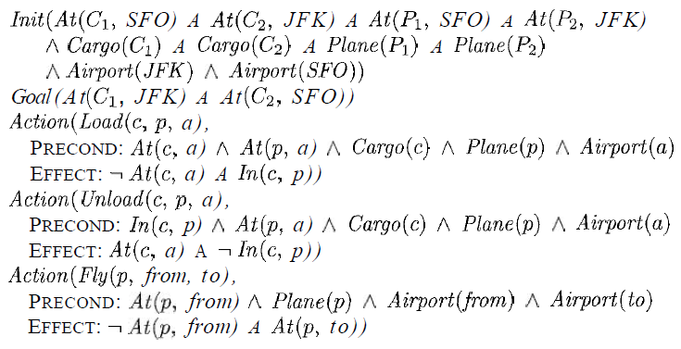
STRIPS solution for transportation of air cargo between airports.

Slide 18
ADL : Air Cargo Problem
Init(At(C1,SFO) ∩ At(C2,JFK) ∩ At(P1,SFO) ∩ At(P2, JFK) ∩ (P1: plane) ∩ (p2: plane) ∩ (C1: Cargo) ∩ (c2: Cargo) ∩ SFO:Airport ∩ JFK: Airport)
Goal(At(C1, JFK) ∩ At(C2,SFO))
Action((Load(c:cargo,p:plane,a:airport)
Precondition: At(c,a) ∩ at(p,a)
Effect: ~At(c,a) ∩ in(c,p))
Action(Fly(p : Plane, from : Airport, to : Airport),
PRECOND: At(p,from)
EFFECT : ~At(p,from) ∩ At(p,to))
Action(UnLoad(c:cargo,p:plane,a:airport)
Precondition: In(c,p) ∩ at(p,a)
Effect: At(c,a) ∩ ~in(c,p))

Slide 19
Problem of cooking chapati and veggies
Init(Have(flour) A Have(Water) A Have(UncutVeggies))
Goal(Have(Baked_Chapati) A Have(Cooked_Veggies)
Action(Knead(f:flour, w:water)
Precondition: Have(f) A Have(W)
Postcondition: Have(dough) A ~Have(f))
Action(Cut(v:UncutVeggies)
Pre: Have(v)
Post: Have(Cut_Veggies) A ~Have(v))

Slide 20
Action(Cook(u:uncooked_Food)
Precondition: Have(u)
Post: Have(cooked_Food))
Action(Roll(d:dough)
Pre: Have(d)
Post: ~Have(d)A Have(unbaked_chapati))

Slide 21
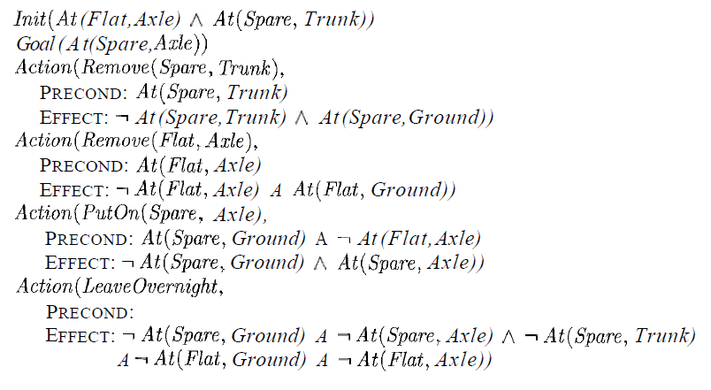
The simple spare tire problem

Slide 22
Partial order planning
Any planning algorithm that can place two actions into a plan without specifying which comes first is called a partial-order planner
solution is represented as a graph of actions, not a sequence
Dummy states- Start & Finish
The partial-order solution corresponds to possible total-order plans; each of these is called a linearization of the partial-order plan.

Slide 23
What POP needs?
Set of actions
Set of ordering constraints
Set of causal links
Set of open preconditions

Slide 24
1. Set of actions
Taken from
set of actions in the planning problem
"empty" plan contains just the Start and Finish actions
Start state
no preconditions
Effect contains all the literals in the initial state
Finish state
has no effects
Preconditions contain the goal literals of the planning problem.

Slide 25
2. Set of ordering constraints
Each ordering constraint is of the form A « B, which is read as "A before B“
Means that action A must be executed sometime before action B, but not necessarily immediately before.
Any cycle-such as A « B and B « A-represents a contradiction, so an ordering constraint cannot be added to the plan if it creates a cycle.

Slide 26
3. Set of causal links
A causal link between two actions A and B in the plan is written as
A ^{p} B and is read as "A achieves p for B."
For example, the causal link
RightSock RightsockOn RightShoe
asserts that RightSockOn is an effect of the RightSock action and a precondition of RightShoe.
It also asserts that RightSockOn must remain true from the time of action RightSock to the time of action RightShoe.
the plan may not be extended by adding a new action C that conflicts with the causal link.
An action C conflicts with A B if C has the effect ~p if C could (according to the ordering constraints) come after A and before B.

Slide 27
4. Set of open preconditions
A precondition is open if it is not achieved by some action in the plan.
ordering constraints that put every other action after Start and before Finish):
Actions: { Rightsock, RightShoe, Leftsock, LeftShoe, Start, Finish}
Orderings:{RightSock « RightShoe, Leftsock « LeftShoe}
Links:{RightSock RightSockOn RightShoe,
Leftsock LeftSockk0n LeftShoe,
RightShoe RightShoeOn Finish,
Leftshoe LeftShoe0n Finish}
Open Preconditions:{} .

Slide 28
consistent plan
Definition- a plan in which there are no cycles in the ordering constraints and no conflicts with the causal links.
solution - A consistent plan with no open preconditions
Total order plan- Every linearization of a partial-order solution is a total-order solution whose execution from the initial state will reach a goal state.
A partial-order plan is executed by repeatedly choosing any of the possible next actions.
The flexible ordering also makes it easier to combine smaller plans into larger ones, as each of the small plans can reorder its actions to avoid conflict with the other plans.

Slide 29
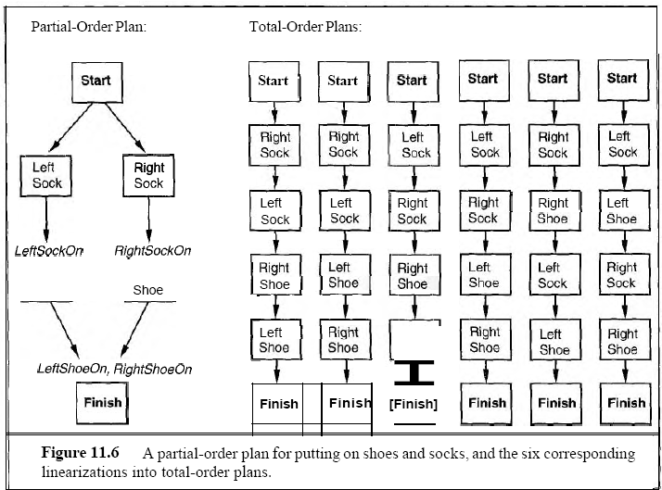

Slide 30
PARTIAL ORDER PLANNING ALGORITHM
Step 1: The initial plan contains Start and Finish, the ordering constraint Start « Finish, and no causal links and has all the preconditions in Finish as open preconditions.
Step 2: The successor function arbitrarily picks one open precondition p on an action B and generates a successor plan for every possible consistent way of choosing an action A that achieves p.
Consistency is enforced as follows:
1. The causal link A P B and the ordering constraint A « B are added to the plan.
Action A may be an existing action in the plan or a new one. If it is new, add it to the plan and also add Start « A and A « Finish.
2. We resolve conflicts between the new causal link and all existing actions and between the action A (if it is new) and all existing causal links.
A conflict between A « B and C is resolved by making C occur at some time outside the protection interval, either by adding B « C or C « A. We add successor states for either or both if they result in consistent plans.
Step 3: The goal test checks whether a plan is a solution to the original planning problem. Because only consistent plans are generated, the goal test just needs to check that there are no open preconditions.

Slide 31
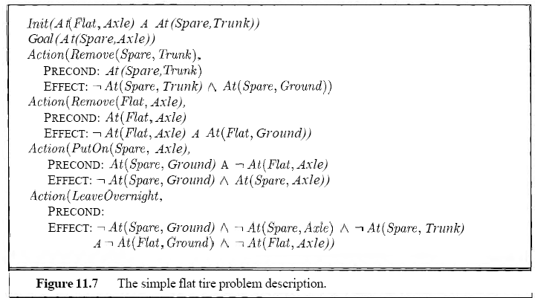
A POP example

Slide 32
POP solution
Initialization:
Initial plan= { Start, Finish}
Causal links={ }
Open preconditions={At(Spare,axle)}
Ordering constraints={Start «Finish }
Pick the only open precondition, At(Spare, Axle) of Finish. Choose the only applicable action, PutOn(Spare, Axle).
Plan= { Start, Finish, PutOn(Spare,Axle)}
Causal links={PutOn(Spare,Axle) At(Spare,axle) Finish}
Open preconditions={At (Spare, Ground), ~At(flat,Axle)}
Ordering constraints={Start «Finish , Start « PutOn(Spare,Axle), PutOn(Spare,Axle) « Finish }

Slide 33
Pick the At (Spare, Ground) precondition of PutOn(Spare, Axle). Choose the only applicable action, Remove(Spare,Trunk) to achieve it.
Plan= { Start, Finish, PutOn(Spare,Axle), Remove(Spare, Trunk),}
Causal links={PutOn(Spare,Axle) At(Spare,axle) Finish,
Remove(Spare,Trunk) At (Spare,Ground)PutOn(Spare,Axle) }
Open preconditions={At(spare,trunk),~At(flat,Axle)}
Ordering constraints={Start «Finish , PutOn(Spare,Axle) « Finish, Remove(Spare,Trunk) « PutOn(Spare,Axle) }

Slide 34
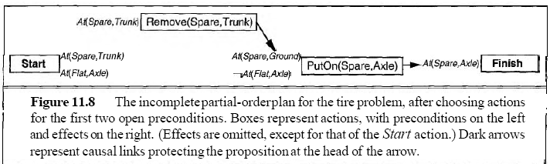
Remove(spare,trunk)

Slide 35
Pick the ~At(Flat, Axle) precondition of PutOn(Spare, Axle). If you choose LeaveOvernight action then it has the effect ~At(Spare, Ground), which means it conflicts with the causal link
Remove(Spare,Trunk) At (Spare,Ground)PutOn(Spare,Axle)
So, To resolve the conflict we add an ordering constraint putting LeaveOvernight before Remove(Spare, Trunk).

Slide 36
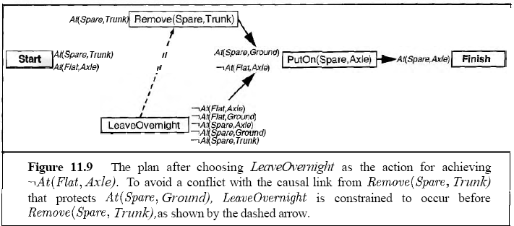
Ordering Conflicting actions

Slide 37
Pick the Remove(Flat,Axle) precondition of ~At(Flat, Axle).
Plan= { Start,Finish,PutOn(Spare,Axle), Remove(Spare,Trunk), Remove(Flat,Axle)}
Causal links={PutOn(Spare,Axle) At(Spare,axle) Finish,
Remove(Spare,Trunk) At (Spare,Ground)PutOn(Spare,Axle)
Remove(Flat,Axle) ~At(Flat,Axle) PutOn(Spare,Axle) }
Open preconditions={At(spare,trunk),At(flat,Axle)}
Ordering constraints={Start«Finish,
PutOn(Spare,Axle)«Finish, Remove(Spare,Trunk)«PutOn(Spare,Axle),
Remove(Flat,Axle) )«PutOn(Spare,Axle)}

Slide 38
FinalPlan
Plan= { Start,Finish,PutOn(Spare,Axle), Remove(Spare,Trunk), Remove(Flat,Axle)}
Causal links={PutOn(Spare,Axle) At(Spare,axle) Finish,
Remove(Spare,Trunk) At(Spare,Ground)PutOn(Spare,Axle)
Remove(Flat,Axle) ~At(Flat,Axle) PutOn(Spare,Axle)
start At(Flat,Axle) Remove(Flat,Axle)
Start At(Spare,Trunk) Remove(Spare,Trunk)}
Open preconditions={}
Ordering constraints={Start«Finish,
PutOn(Spare,Axle)«Finish, Remove(Spare,Trunk)«PutOn(Spare,Axle),
Remove(Flat,Axle) )«PutOn(Spare,Axle)
Start «Remove(Spare,Trunk)
Start «Remove(Flat,Axle)}

Slide 39
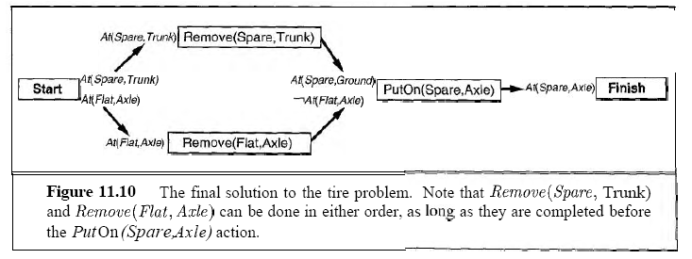
Final plan

Slide 40
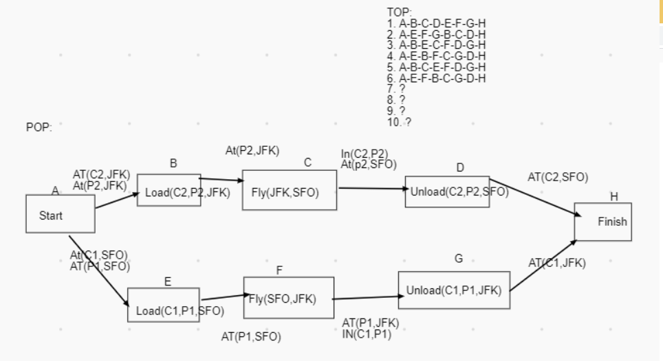
Pop GRAPH FOR CARGO TRANSFER

Slide 41


Slide 42
HIERCHICAL TASK PLANNING(HTN)
Follows planning in real world approach
Follows Hierarchy of actions concept
major action or minor action
Lower level activities would detail more precise steps for accomplishing the higher level tasks.

Slide 43
Planning for ”birthday party”
Major Steps :
Invite friends
Decorations
Bake a cake
Party food, snacks and beverages
Cleaning after party
Minor Steps :
Procuring cake ingridients
House cleaning before decorations
Take photos
Plan on assorted party food, cosidering food preferences of attendees
Arranging for sleepover if someone is staying back

Slide 44
General Property
Postpone attempts to solve mere details, until major steps are in place.
Higher level plan may run into difficulties at a lower level, causing the need to return to higher level again to produce appropriately ordered sequence.
Notes:
44

Slide 45
Planner
Identify a hierarchy of conditions
Construct a plan in levels, postponing details to the next level
Patch higher levels as details become visible

Slide 46
Example
Actions required for “Travelling to Goa”:
Opening makemytrip.com (1)
Finding flight (2)
Buy Ticket (3)
Get taxi(2)
Reach airport(3)
Pay-driver(1)
Check in(1)
Boarding plane(2)
Reach Goa(3)

Slide 47
Example
1st level Plan :
Buy Ticket (3), Reach airport(3), Reach Goa(3)
2nd level Plan :
Finding flight (2), Buy Ticket (3), Get taxi(2), Reach airport(3), Boarding plane(2), Reach Goa(3)
3rd level Plan (final) :
Opening makemytrip.com (1), Finding flight (2), Buy Ticket (3), Get taxi(2), Reach airport(3), Pay-driver(1), Check in(1), Boarding plane(2), Reach Goa(3)

Slide 48
Hierarchical Task Network
Hierarchy abstraction achieved through methods.
A method is a pair (α, d) , where
α is the non-primitive task, and
d is the task network to achieve the task α

Slide 49
Top-down synergy
Plans at higher level of hierarchy achieves more effects than at a lower level.
A part of the plan can be pruned if its post-conditions do not overlap with any other plan’s post-condition.

Slide 50
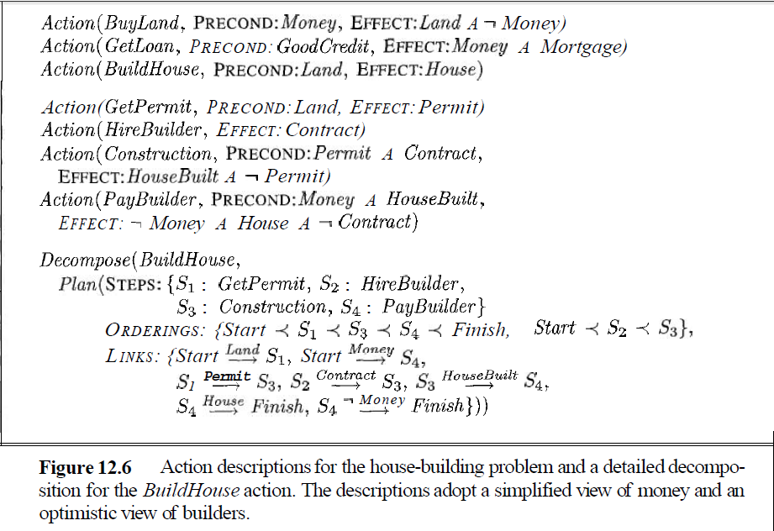
Example: Build a house

Slide 51
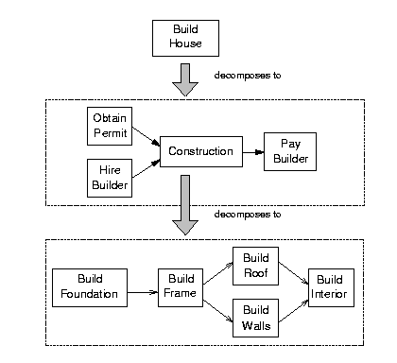
HTN planning: example

Slide 52
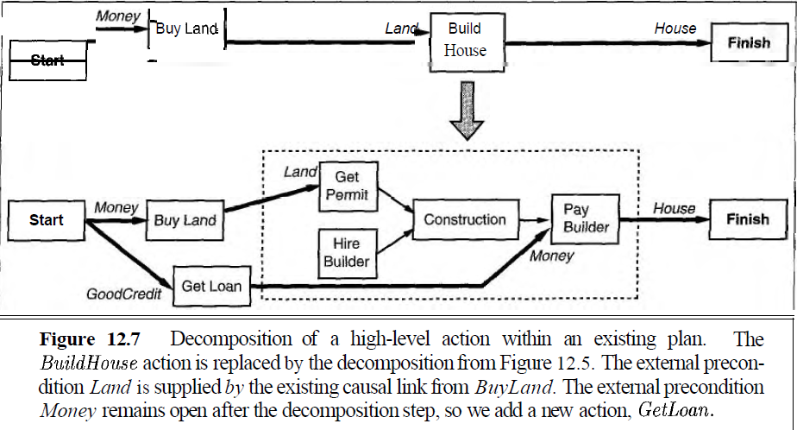

Slide 53
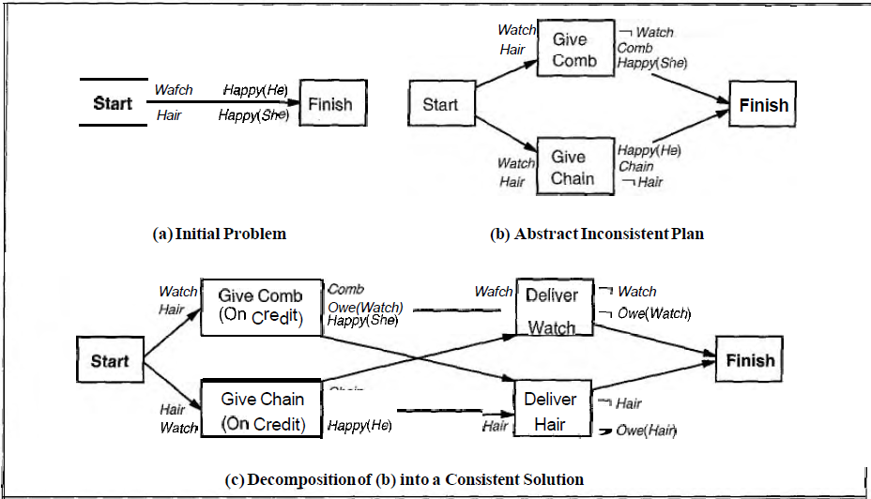
Gift of Maggi by o’henry

Slide 54
Conclusion
For complex problems hierarchical planning is much more efficient than single level planning.
Improves performance as number of operator in the problem increases.
HTN planning gives more expressivity
Merging opens door to accomplish a complete plan from incomplete individual plans
Integration with ontology opens door for automatic planning
Reduces man machine gap.

Slide 55
reference
“AIMA”, Russel & Norving, Pearson education
Lecture slides, Prof. Sarkar, IIT KGP

Slide 56
Thank you

