Slide 1
Natural Language Processing

Slide 2
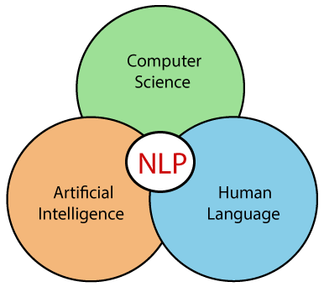

Slide 3
Natural Language Processing (NLP)
NLP refers to AI method of communicating with an intelligent systems using a natural language such as English.
Used in →Intelligent system like robot to perform as per your instructions, when you want to hear decision from a dialogue based clinical expert system, etc.
Involves making computers to perform useful tasks with the natural languages humans use.
The input and output of an NLP system can be −
Speech
Written Text

Slide 4
Components of NLP
1. Natural Language Understanding (NLU)
Helps the machine to understand and analyse human language by extracting the metadata from content such as concepts, entities, keywords, emotion, relations, and semantic roles.
Used in Business applications to understand the customer's problem in both spoken and written language.
NLU involves the following tasks -
Maps the given input into useful representation.
Analyzes different aspects of the language.

Slide 5
2. Natural Language Generation (NLG)
Natural Language Generation (NLG) acts as a translator that converts the computerized data into natural language representation.
It mainly involves Text planning, Sentence planning, and Text Realization.

Slide 6
Steps to build an NLP
Step1: Sentence Segmentation- Paragraph→ Sentences
Step2: Word Tokenization- Sentences → Words/Tokens
Step3: Stemming-Normalize words[intelligence, intelligent,& intelligently→root word "intelligen.“]
Step 4: Lemmatization-Grouping [Stemming]
Step 5: Identifying Stop Words- removing is , and , a , the…
Step 6: Dependency Parsing- relation of words in the sentence
Step 7: POS tags-Noun, verb, adverb, and Adjective
Step 8: Named Entity Recognition (NER)-detecting the named entity such as person name, movie name, organization name, or location.; Steve Jobs introduced I phones
Step 9: Chunking-collect the individual piece of information and grouping them into bigger pieces of sentences.

Slide 7
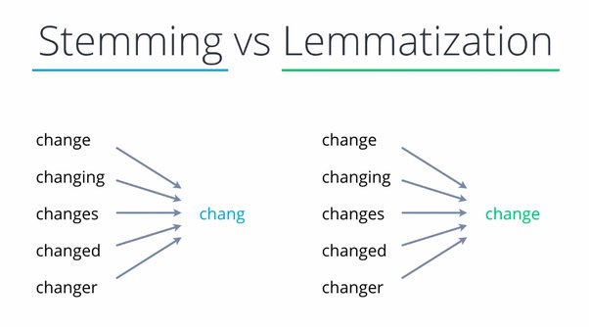

Slide 8
Applications of NLP
Question Answering
Question Answering focuses on building systems that automatically answer the questions asked by humans in a natural language.
Spam Detection
Spam detection is used to detect unwanted e-mails getting to a user's inbox.
Sentiment Analysis
Sentiment Analysis is also known as opinion mining
Analyse the attitude, behaviour, and emotional state of the sender.
Google Translator, Spelling correction, Speech Recognition , ChatBot,etc…..

Slide 9
Reading assignment
Challenges in NLP
Limitations of NLP

