Slide 1
Agent-Based Multistage Application Partitioning in Mobile Cloud Computing
Presented by:
Riddhi Patil (16010122138)
Kashish Mamania (16010122104)
Department of Computer Engineering
K. J. Somaiya School of Engineering
Somaiya Vidyavihar University

Slide 2
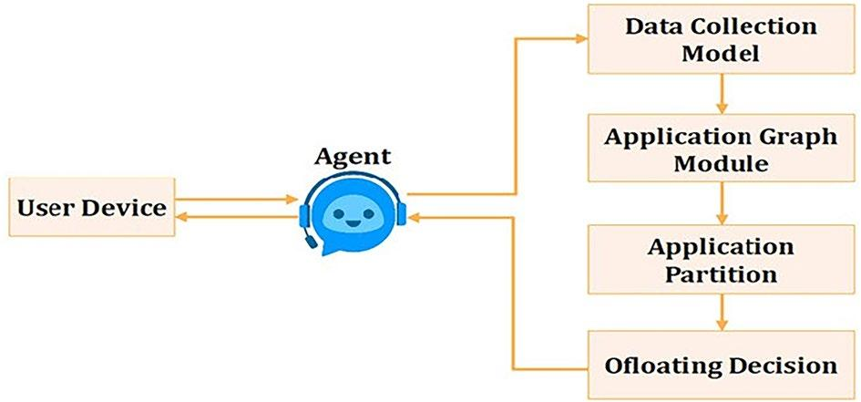
Introduction
With the growing complexity of mobile applications such as facial recognition, augmented reality, and gaming, there is a corresponding rise in computational and energy demands on mobile devices.
Mobile Cloud Computing (MCC) offers a way to offload these heavy tasks to cloud servers, enhancing performance and battery life.
However, the key challenge lies in identifying which parts of an application should be executed locally and which should be offloaded.
This presentation introduces a framework that combines multistage graph partitioning and intelligent agents to make dynamic offloading decisions for optimal performance.

Slide 3
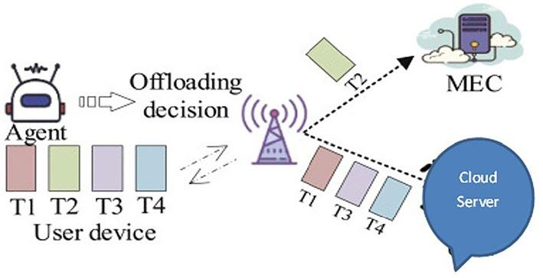
Motivation
Most mobile devices have limited processing power and battery life.
Running complex tasks locally can quickly drain the battery and slow down performance.
Offloading tasks to cloud servers seems like an ideal solution but introduces its own challenges, such as communication latency and resource availability.
A fine-grained, context-aware system that can decide in real-time whether a task should be run locally, at the edge, or in the cloud is needed.
The motivation behind this research is to design such a system to reduce both energy consumption and execution delay.

Slide 4
Scope
The Agent-Based Multistage Partitioning (ABMP) framework is designed for mobile devices running resource-intensive applications that require real-time decisions about offloading computation. It is especially useful in areas like augmented reality, smart health monitoring, autonomous vehicles, mobile gaming, and industrial IoT, where fast processing and battery efficiency are crucial. ABMP supports dynamic partitioning and intelligent offloading across mobile, edge, and cloud layers, adapting to changing resource and network conditions.
However, the framework assumes stable edge and cloud infrastructure. Its current design is for single-user scenarios, and efficiency may decrease with network issues or high user density. Future work will address multi-user support and predictive offloading using machine learning.

Slide 5
Objective
The primary objective of this project is to develop an intelligent, agent-based framework that enhances application partitioning and task offloading in mobile cloud computing environments. Specifically, the goals are:
To minimize energy consumption and execution time for mobile applications by intelligently distributing computational tasks.
To design a multistage graph partitioning mechanism that allows fine-grained control over application workflows.
To implement a three-tier architecture-involving mobile devices, edge cloudlets, and centralized cloud servers—each coordinated by an active software agent.
To enable real-time, context-aware decision-making based on parameters like bandwidth, CPU load, and task urgency.
To validate the proposed model through comparative experiments against existing methods and demonstrate its performance improvements.

Slide 6
Related Work
Many earlier frameworks attempted to address the offloading and partitioning problem using static methods, which don’t adapt well to changing environments.
Some leveraged machine learning models to predict the best offloading strategy.
Others proposed DAG-based approaches for modeling app workflows.
However, these methods often suffer from high latency, limited contextual awareness, and lack of coordination between offloading agents.
Our work builds on these insights to propose a more dynamic and responsive model.

Slide 7
Key Contributions
This research makes four major contributions:
1. Multistage graph partitioning strategy to divide workflows.
2. Three-tier architecture involving mobile, edge cloudlets, and cloud, each supported by an active agent.
3. Real-time offloading decision algorithm based on execution time, energy use, and queue times.
4. Experimental validation showing performance improvements.

Slide 8
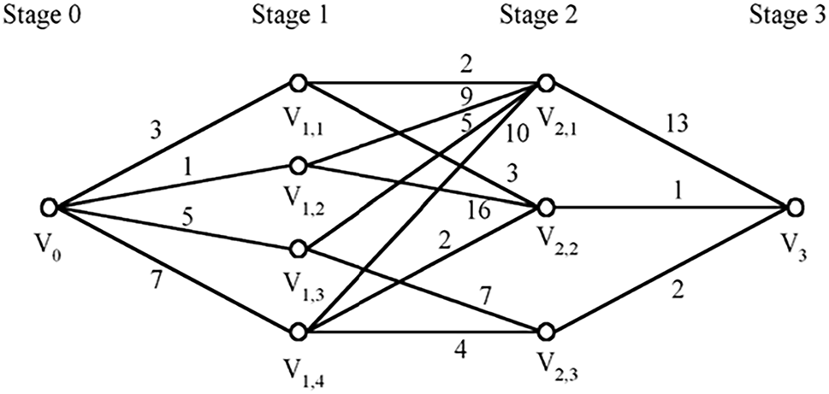
System Architecture
The proposed system follows a three-tier architecture involving mobile devices, edge servers (cloudlets), and centralized cloud servers. Each tier hosts a smart software agent that monitors system resources and coordinates with the others. When a user initiates a task, the mobile agent consults with cloudlet and cloud agents to decide the best execution path. The system dynamically distributes tasks across these three tiers, aiming to minimize energy use and task execution time.

Slide 9
Mobile Agent Architecture
The agent on the mobile device is composed of four modules.
The Data Collection Module gathers contextual data such as available memory, battery level, and bandwidth.
The Graph Module converts application tasks into a multistage graph.
The Partitioning Module classifies tasks as offloadable, must-offload, or unoffloadable.
Lastly, the Offloading Module makes final decisions on task execution locations, checking for waiting times and system loads on cloudlet and cloud resources.

Slide 10
Application Workflow Modeling
Each mobile application is represented as a Directed Acyclic Graph (DAG), where nodes represent tasks and edges represent dependencies.
Tasks are classified into three types:
unoffloadable (must be run on the mobile device),
offloadable (can run anywhere),
and must-offload (require cloud or edge data).
This classification guides the partitioning and offloading decisions, enabling parallel and context-aware execution of tasks.

Slide 11
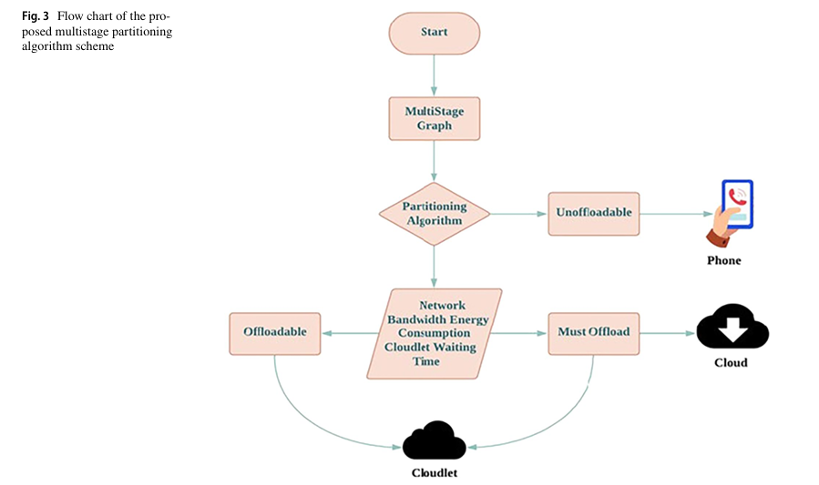

Slide 12
Cost Modeling
Execution time and energy cost are the two main considerations. The framework uses different formulas to compute these costs based on whether a task is executed locally, at the edge, or in the cloud. It considers device CPU speed, bandwidth, data size, and power usage in active and idle modes. The objective is to minimize total energy consumption and execution time while maintaining service quality and meeting application deadlines.

Slide 13

Problem Formulation
The core problem is modeled as an optimization problem. The goal is to minimize energy consumption (Eₖ) for each user while ensuring that the total execution time (Tₖ) remains under a specified deadline (Dₖ). This requires finding the best combination of execution locations for all tasks in the application workflow graph.

Slide 14
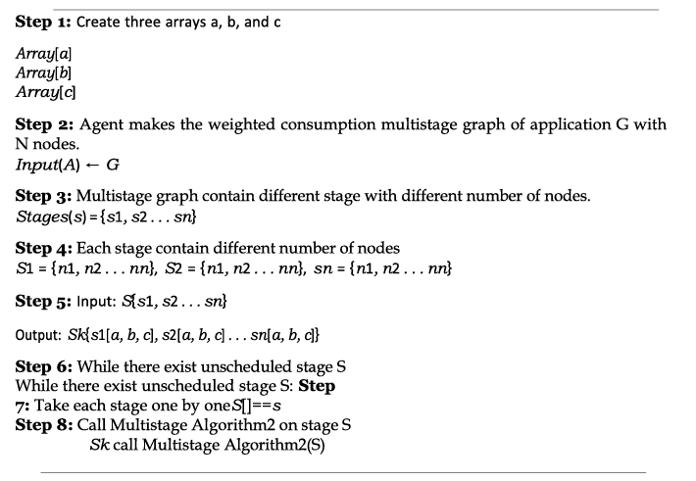
Proposed ABMP Scheme Overview
The Agent-Based Multistage Partitioning (ABMP) scheme works in two phases: partitioning and offloading. The application is first transformed into a multistage graph. At each stage, tasks are sorted into arrays based on their offloading feasibility. The agent then uses this classification, along with real-time environmental data, to decide where to offload tasks. This allows for responsive and efficient task management across mobile, edge, and cloud resources.

Slide 15
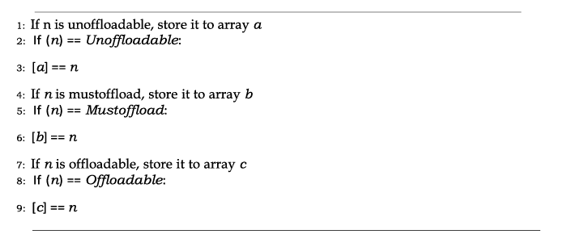
Multistage Graph Partitioning
Unlike previous approaches that made global decisions for the entire task graph, the multistage approach makes decisions at each level of the graph. This allows better control and granularity. Tasks at each stage are grouped and assessed together, which is faster than evaluating each node separately and more accurate than aggregating all nodes into one decision. This ensures efficient and context-aware task distribution.

Slide 16
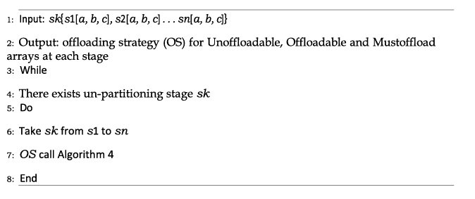
Offloading Algorithm
The offloading algorithm evaluates each task group by considering resource availability, bandwidth, and task urgency. It attempts to offload tasks to the cloudlet first, since it offers lower latency. If resources are insufficient, tasks are either compressed, retried, or offloaded to the cloud. This flexible approach ensures optimal performance in dynamic network and resource conditions.

Slide 17
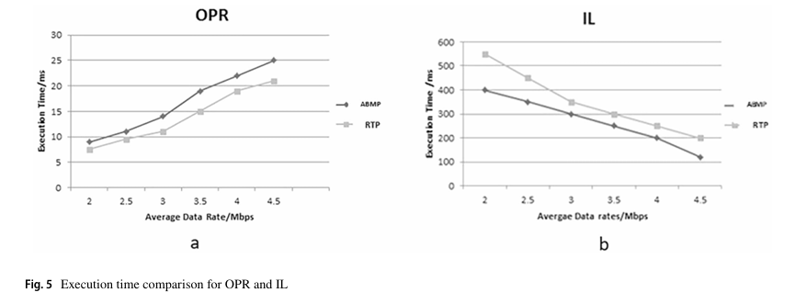
Experimental Setup
The framework was tested using three real-world applications: Object and Pose Recognition (OPR), Indoor Localization (IL), and Optical Character Recognition (OCR). Simulations were conducted using CloudSim and SOOT, on systems with varying CPU and RAM capacities. The same parameters and app structures as in prior studies were used to allow fair comparison.

Slide 18
Results
Results show that the ABMP algorithm consistently achieves lower execution time than both D2-RTP and UMEC+Agent methods, especially under low bandwidth conditions. Execution time improves as available bandwidth increases, but ABMP always maintains a lead, demonstrating its efficiency in both constrained and favorable environments.
In terms of energy efficiency, ABMP outperforms the other methods significantly. For both IL and OPR applications, ABMP uses less energy due to smarter, stage-wise partitioning and effective load distribution. This confirms the effectiveness of agents in decision-making and the utility of multistage processing.

Slide 19
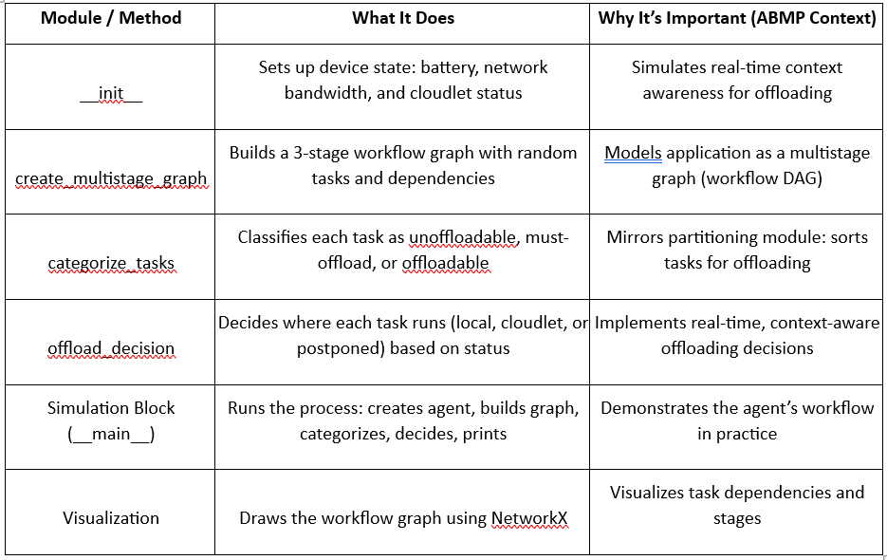
Our Implementation
Here is a tabular summary of the code modules and their functions, explained simply and mapped to the ABMP framework concepts:

Slide 20
Future Work
Future enhancements will focus on expanding the framework to support multi-user environments and ad hoc virtual cloud networks. This could involve integrating additional agents and developing more complex decision-making algorithms to handle shared resources and user competition in real-time.

Slide 21
Conclusion
The proposed ABMP framework introduces a dynamic, context-aware partitioning and offloading mechanism using software agents and multistage graph analysis. It successfully addresses the limitations of prior methods by making granular, stage-level decisions and adapting to real-time conditions. Experimental results validate its superiority in reducing energy consumption and task execution time.

Slide 22
References
Framework for Agent‑Based Multistage Application Partitioning
Algorithm in Mobile Cloud Computing
Asia Kanwal1 · Tehmina Amjad1 · Humaira Ashraf1
Received: 17 October 2023 / Accepted: 30 December 2023 / Published online: 23 March 2024
© The Author(s), under the exclusive license to Springer Nature Singapore Pte Ltd. 2024, corrected publication 2024
Link: https://www.researchgate.net/publication/379225384_Framework_for_Agent-Based_Multistage_Application_Partitioning_Algorithm_in_Mobile_Cloud_Computing

