Slide 1
INTRODUCTION TO MORPHOLOGY AND IMAGE COMPRESSION DR. BHAKTI PALKAR

Slide 2
5.1
Morphological operations:
Dilation
Erosion
Opening
Closing
Hit or Miss Transform
Boundary extraction

Slide 3

DILATION
The dilation process the structuring element is reflected and shifted from left to right and from top to bottom, at each shift; the process will look for any overlapping similar pixels between the structuring element and that of the binary image.
If there exists an overlapping then the pixels under the centre position of the structuring element will be turned to 1 or black.

Slide 4
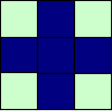
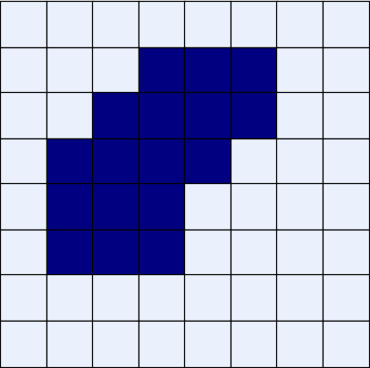






















Original Image
Processed Image With Dilated Pixels
Structuring Element

Slide 5

DILATION EXAMPLE
Dilation by 3*3 square structuring element
Dilation by 5*5 square structuring element
Original image
Watch out: In these examples a 1 refers to a black pixel!

Slide 6
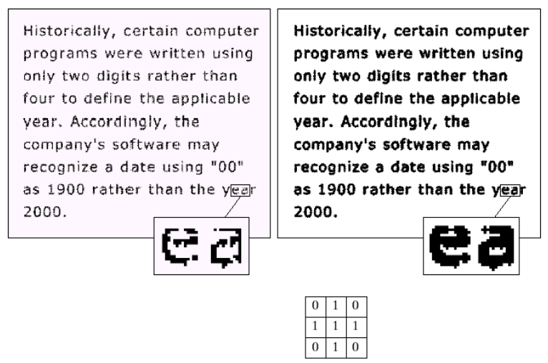
DILATION EXAMPLE
Original image
After dilation
Structuring element

Slide 7


WHAT IS DILATION FOR?
Dilation can repair breaks
Dilation can repair intrusions
Watch out: Dilation enlarges objects

Slide 8
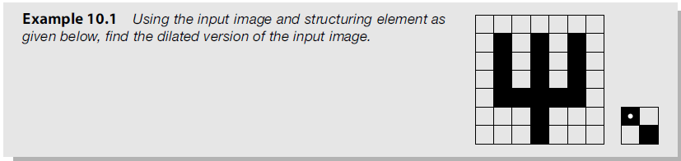

Slide 9
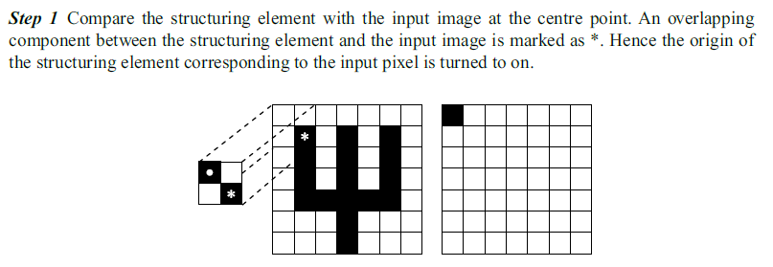

Slide 10
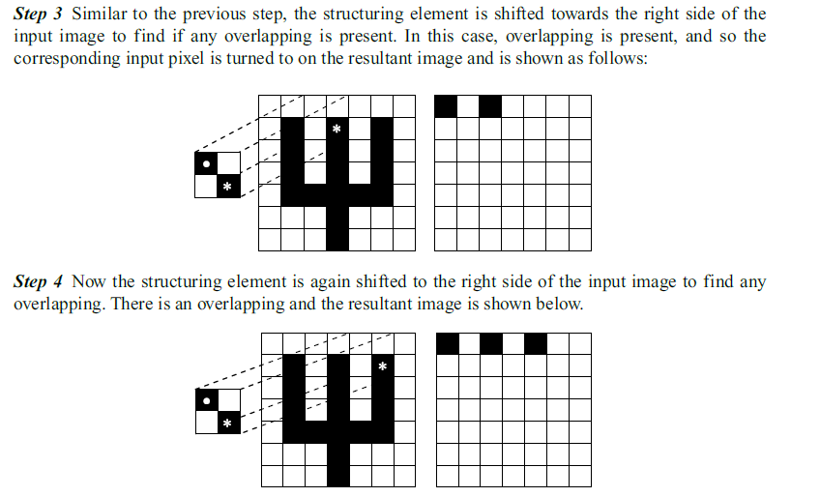

Slide 11
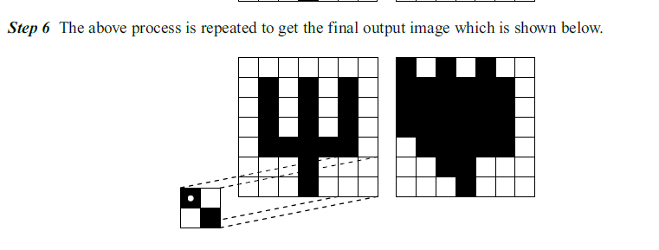

Slide 12
EROSION
Erosion is the counter-process of dilation. If dilation enlarges an image then erosion shrinks the image.
The process will look for whether there is a complete overlap with the structuring element or not.
If there is no complete overlapping then the centre pixel indicated by the centre of the structuring element will be set white or 0

Slide 13
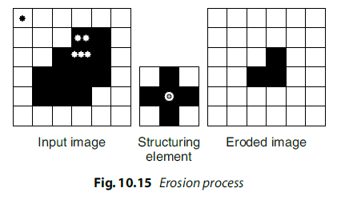

Slide 14
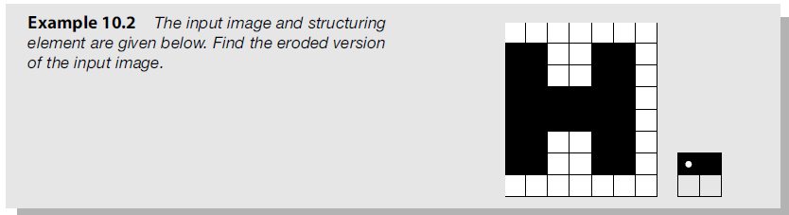

Slide 15
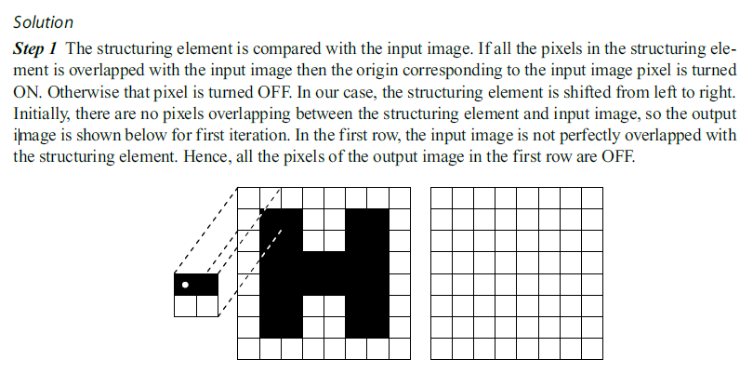

Slide 16
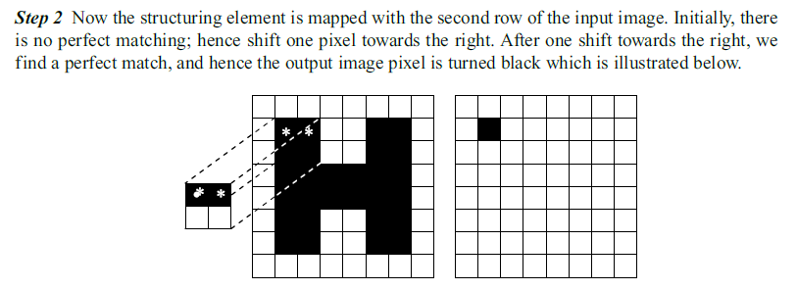

Slide 17
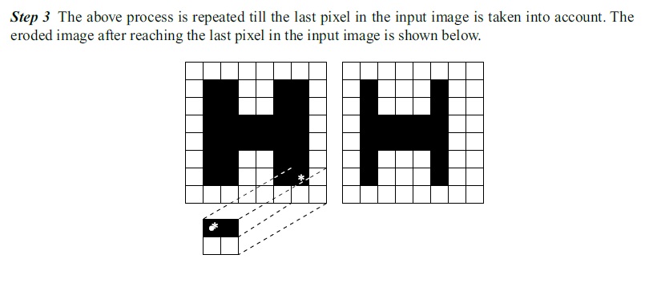

Slide 18
COMPOUND OPERATIONS
More interesting morphological operations can be performed by performing combinations of erosions and dilations
The most widely used of these compound operations are:
Opening
Closing

Slide 19
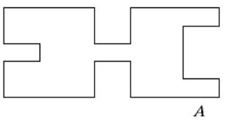
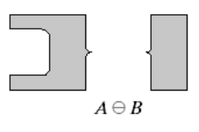
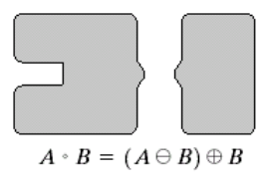
OPENING
The opening of image f by structuring element s, denoted f ○ s is simply an erosion followed by a dilation
f ○ s = (f s) s
Images taken from Gonzalez & Woods, Digital Image Processing (2002)
Original shape
After erosion
After dilation (opening)
Note a disc shaped structuring element is used

Slide 20


OPENING EXAMPLE
Original Image
Image After Opening
Images taken from Gonzalez & Woods, Digital Image Processing (2002)

Slide 21


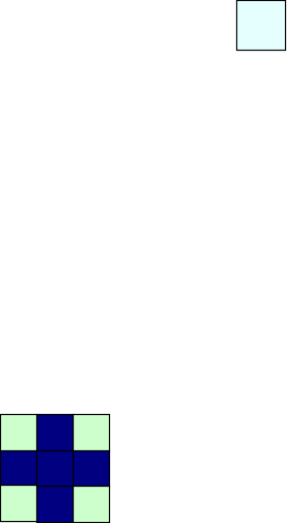





















OPENING EXAMPLE
Original Image
Processed Image
Structuring Element

Slide 22
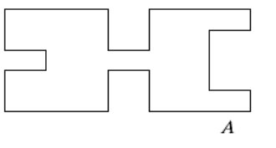
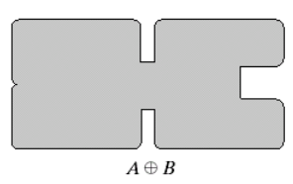
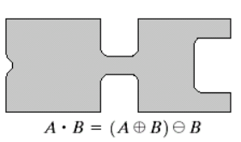
CLOSING
The closing of image f by structuring element s, denoted f • s is simply a dilation followed by an erosion
f • s = (f s)s
Original shape
After dilation
After erosion (closing)
Note a disc shaped structuring element is used
Images taken from Gonzalez & Woods, Digital Image Processing (2002)

Slide 23

CLOSING EXAMPLE
Original Image
Image After Closing
Images taken from Gonzalez & Woods, Digital Image Processing (2002)

Slide 24
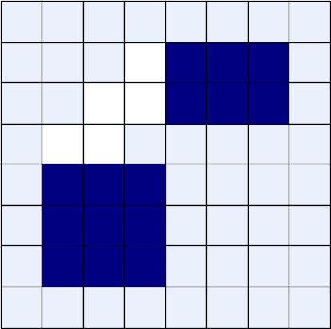
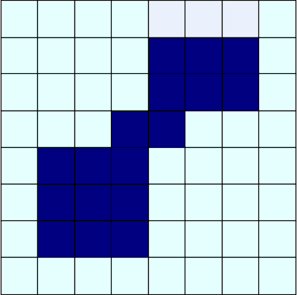
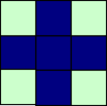
CLOSING EXAMPLE
Original Image
Processed Image
Structuring Element

Slide 25
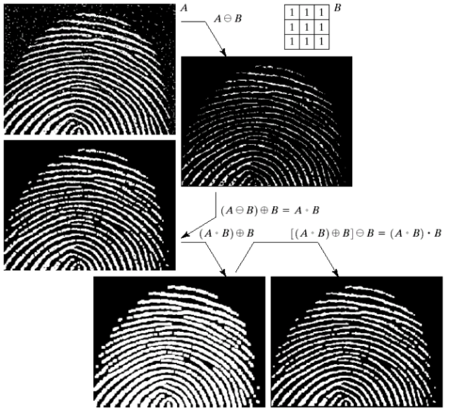
MORPHOLOGICAL PROCESSING EXAMPLE
Images taken from Gonzalez & Woods, Digital Image Processing (2002)

Slide 26
MORPHOLOGICAL ALGORITHMS
Using the simple technique we have looked at so far we can begin to consider some more interesting morphological algorithms
We will look at:
Boundary extraction
Region filling
Extraction of connected components
Thinning/thickening
Skeletonization
Convex Hull
Pruning

Slide 27
HIT AND MISS TRANSFORM
The hit-or-miss transform is a transformation which is used for template matching.
The transformation involves two template sets, B and (W−B), which are disjoint.
Template B is used to match the foreground image, while (W−B) is used to match the background of the image.
The hit-or-miss transformation is the intersection of the erosion of the foreground with B and the erosion of the background with (W−B).

Slide 28


Slide 29
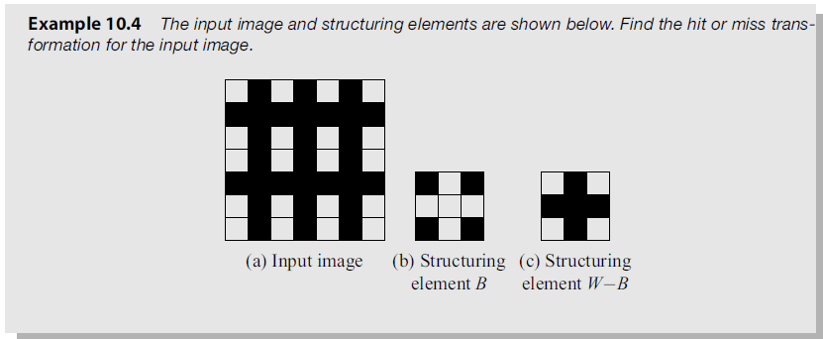

Slide 30
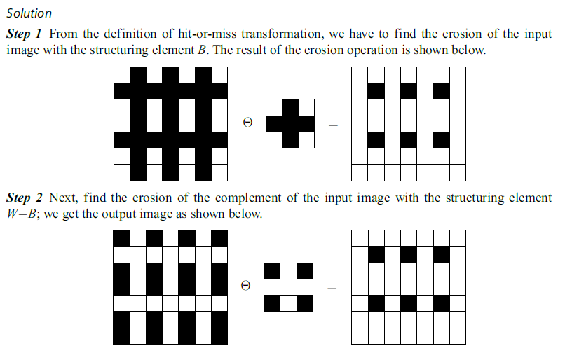

Slide 31
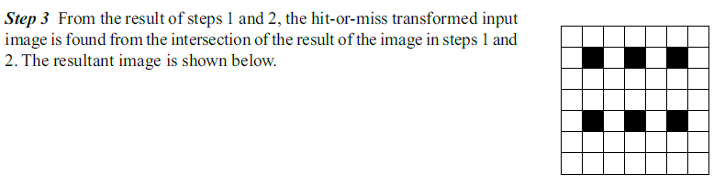

Slide 32
5.2
Introduction, redundancies: coding, inter-pixel, psycho-visual, compression ratio, fidelity criteria
Lossless compression techniques: Run length coding, Arithmetic coding, Huffman coding, Differential PCM
5.3
Lossy Compression techniques: Improved grey scale quantization, Vector quantization, Transform coding, JPEG.

Slide 33
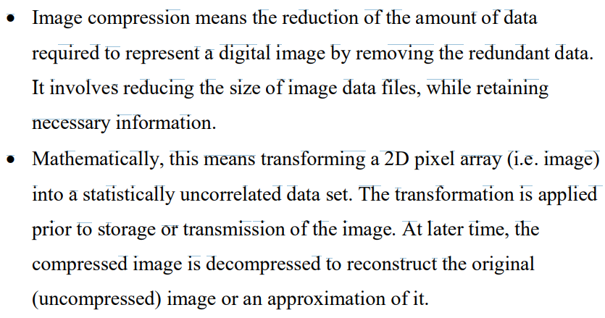
IMAGE COMPRESSION

Slide 34
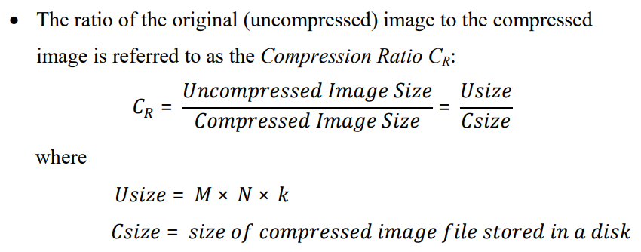
COMPRESSION RATIO

Slide 35
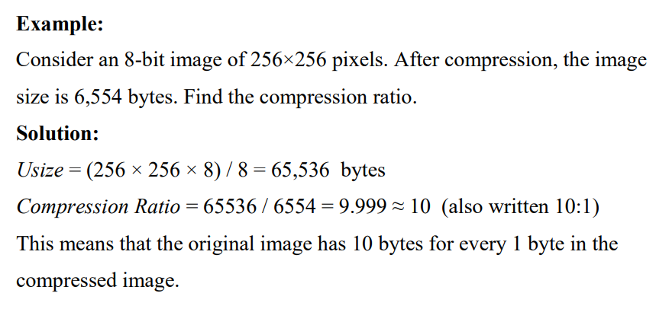
COMPRESSION RATIO

Slide 36
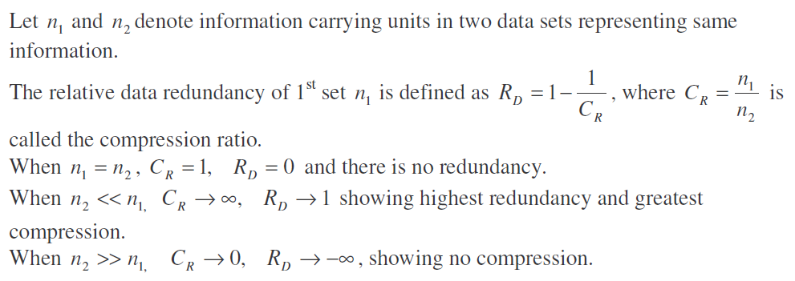
REDUNDANCY AND COMPRESSION RATIO

Slide 37
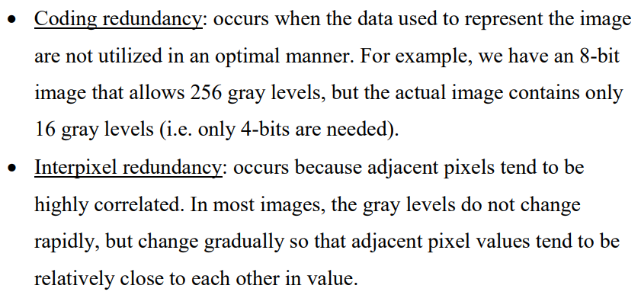
IMAGE DATA REDUNDANCIES

Slide 38
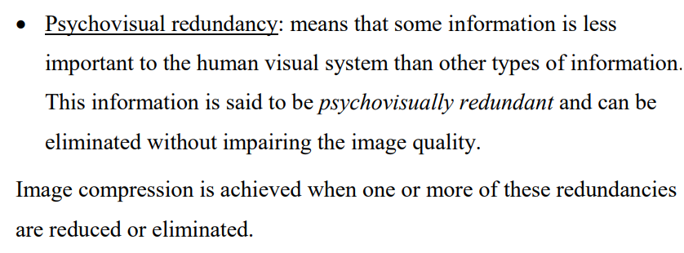
IMAGE DATA REDUNDANCIES

Slide 39
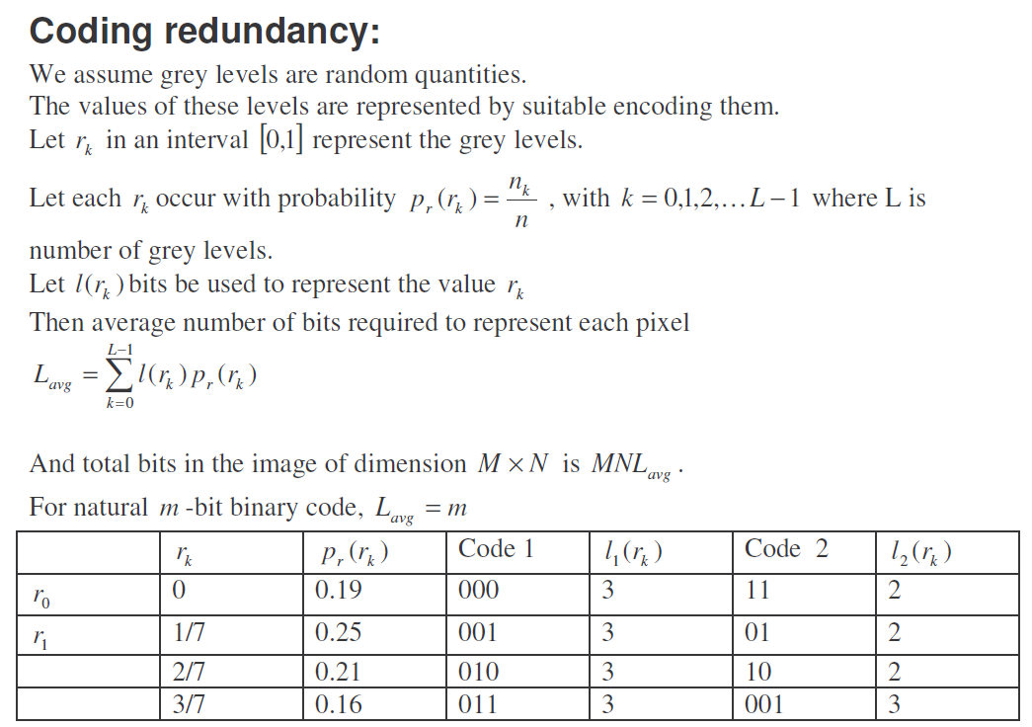
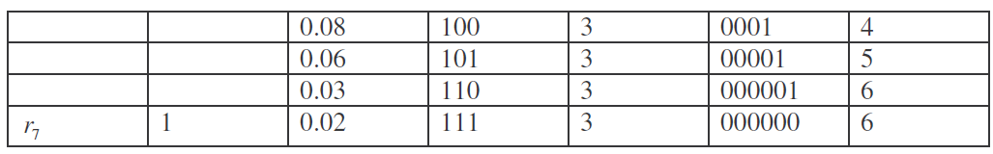

Slide 40
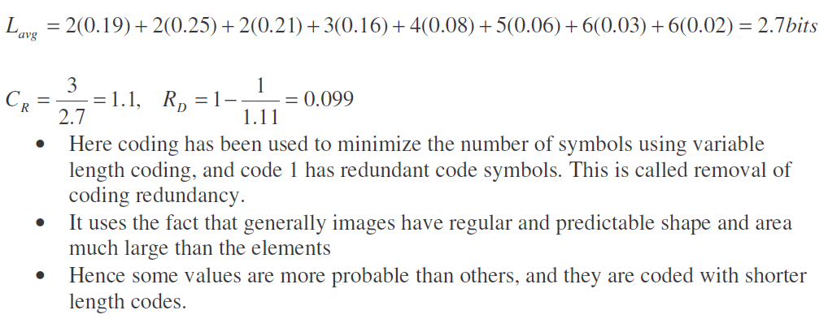
The relative data redundancy

Slide 41
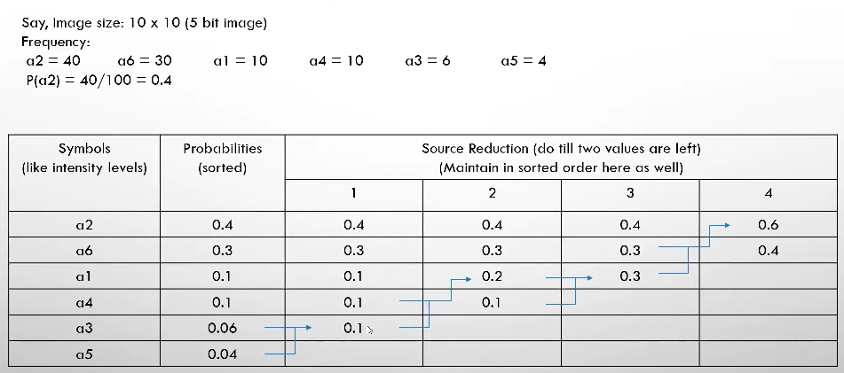
HUFFMAN CODING

Slide 42
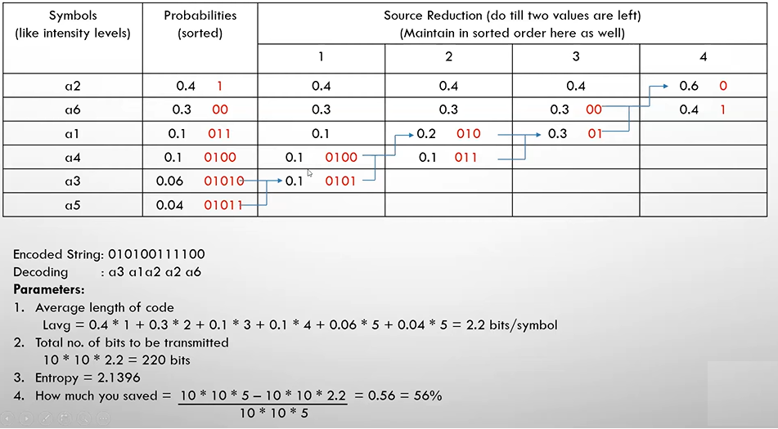

Slide 43
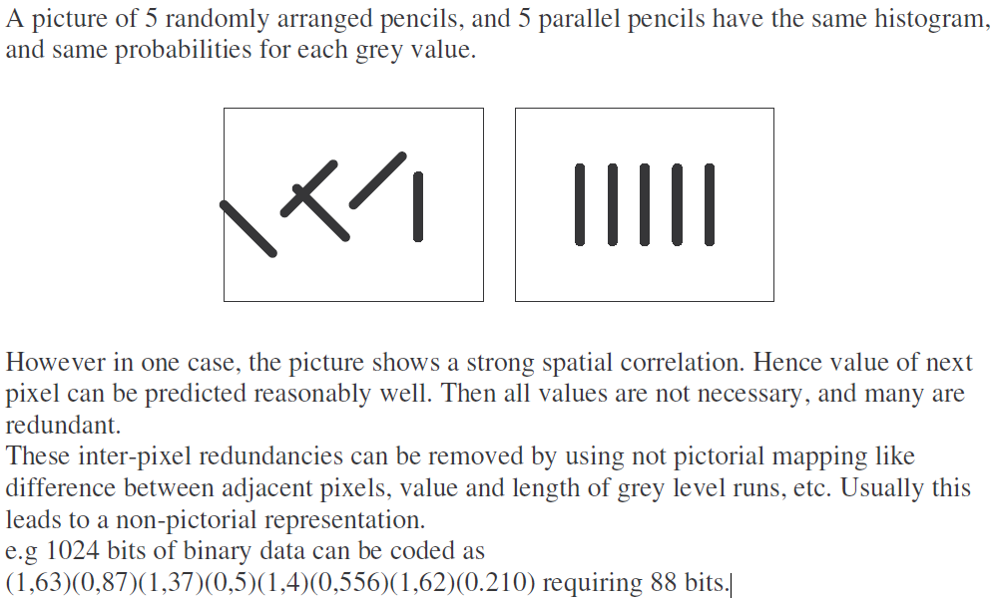
INTERPIXEL REDUNDANCY

Slide 44
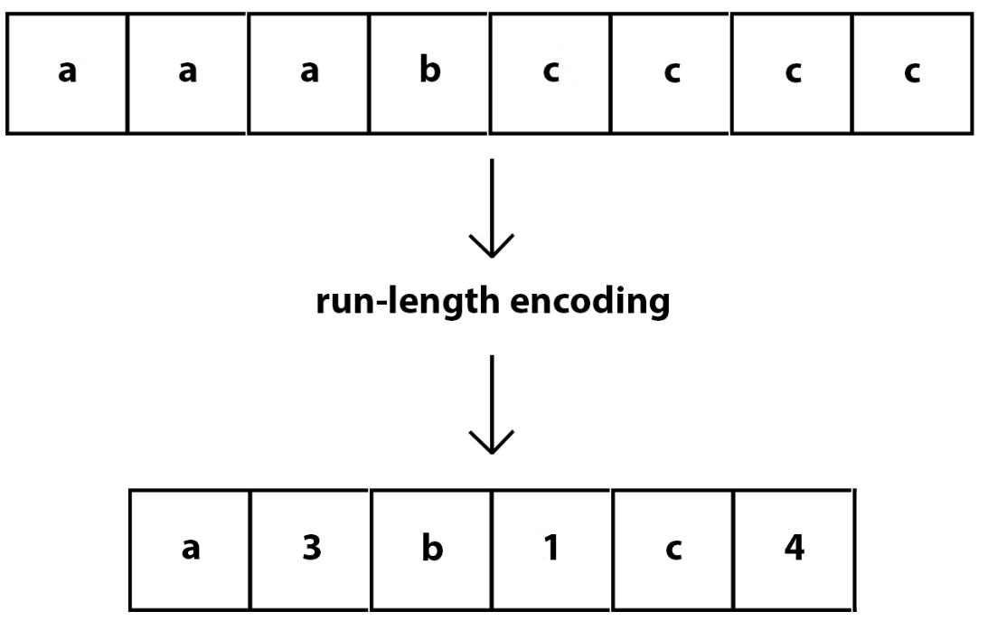
RUN LENGTH ENCODING

Slide 45
WHAT IS RUN-LENGTH ENCODING?
Run-length encoding (RLE) is a lossless compression method where sequences that display redundant data are stored as a single data value representing the repeated block and how many times it appears in the image.
Later, during decompression, the image can be reconstructed exactly from this information.
This type of compression works best with simple images and animations that have a lot of redundant pixels. It's useful for black and white images in particular.
For complex images and animations, if there aren't many redundant sections, RLE can make the file size bigger rather than smaller. Thus it's important to understand the content and whether this algorithm will help or hinder.

Slide 46
PSYCHO VISUAL REDUNDANCY
The eye and the brain do not respond to all visual information with same sensitivity.
Some information is neglected during the processing by the brain. Elimination of this information does not affect the interpretation of the image by the brain.
Edges and textural regions are interpreted as important features and the brain groups and correlates such grouping to produce its perception of an object.
Psycho visual redundancy is distinctly vision related, and its elimination does result in loss of information. Quantization is an example.
When 256 levels are reduced by grouping to 16 levels, objects are still recognizable. The compression is 2:1, but an objectionable graininess and contouring effect results.

Slide 47
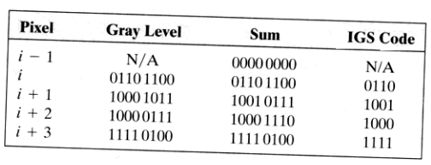
IGS QUANTIZATION
The graininess from quantization can be reduced by Improved Grey Scale quantization which breaks up the edges and contours and makes them less apparent. IGS adds a pseudo random number generated from low order bits of neighboring pixels to each pixel before quantizing them. If most significant bits are all 1, the 0s are added. The msbs become the coded value.

Slide 48
FIDELITY CRITERIA
The removal of psychovisually redundant data results in a loss of real or quantitative visual information. Because information of interest may be lost, a repeatable or reproducible means of quantifying the nature and extent of information loss is highly desirable. Two general classes of criteria are used as the basis for such an assessment:
A) Objective fidelity criteria
B) Subjective fidelity criteria.

Slide 49
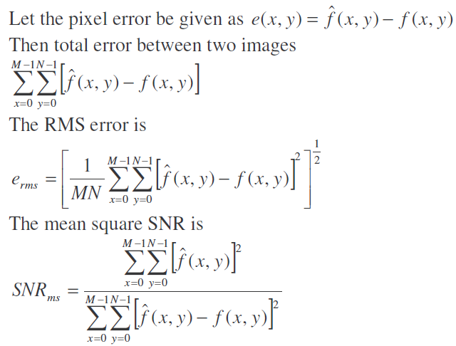
OBJECTIVE FIDELITY CRITERION
When the level of information loss can be expressed as a function of the original or input image and the compressed and subsequently decompressed output image, it is said to be based on an objective fidelity criterion
The rms value of the signal-to-noise ratio, denoted SNRrms, is obtained by taking the square root of Eq. above.

Slide 50
SUBJECTIVE FIDELITY CRITERION
Although objective fidelity criteria offer a simple and convenient mechanism for evaluating information loss, most decompressed images ultimately are viewed by humans. Consequently, measuring image quality by the subjective evaluations of a human observer often is more appropriate. This can be accomplished by showing a "typical" decompressed image to an appropriate cross section of viewers and averaging their evaluations. The evaluations may be made using an absolute rating scale or by means of side-by-side comparisons of f(x, y) and f^(x, y).

Slide 51
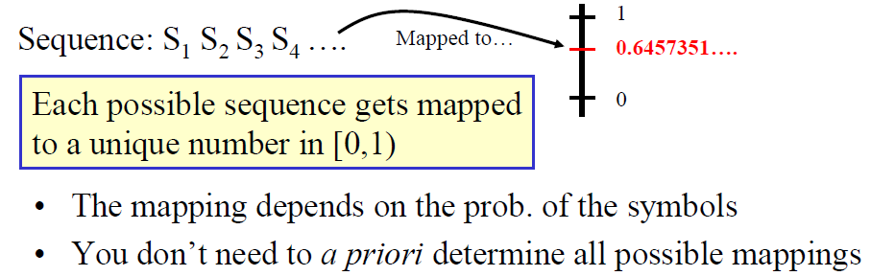
ARITHMETIC CODING
Main Idea of Arithmetic Coding

Slide 52
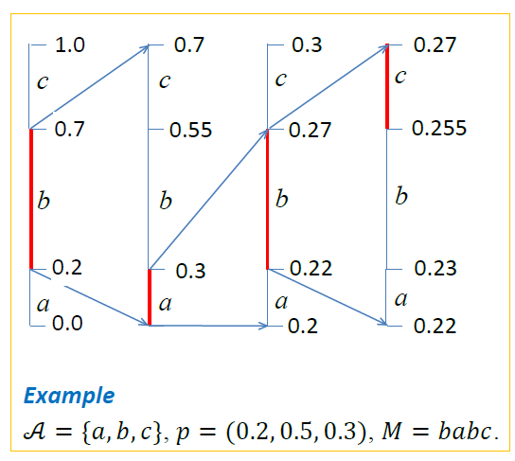
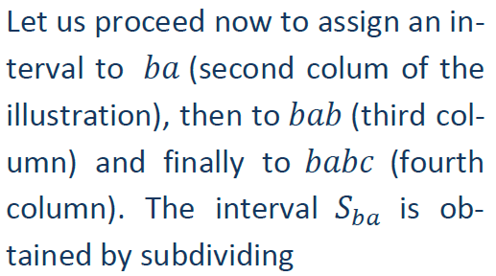

how to obtain the segment 𝑆𝑀 for the message 𝑏abc produced by the source {′𝑎′:0.2,′𝑏′:0.5,′𝑐′:0.3}.

Slide 53
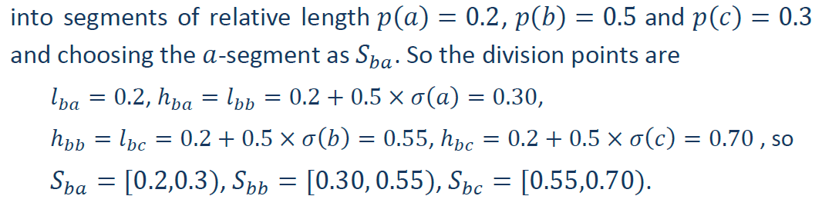
ARITHMETIC CODING

Slide 54
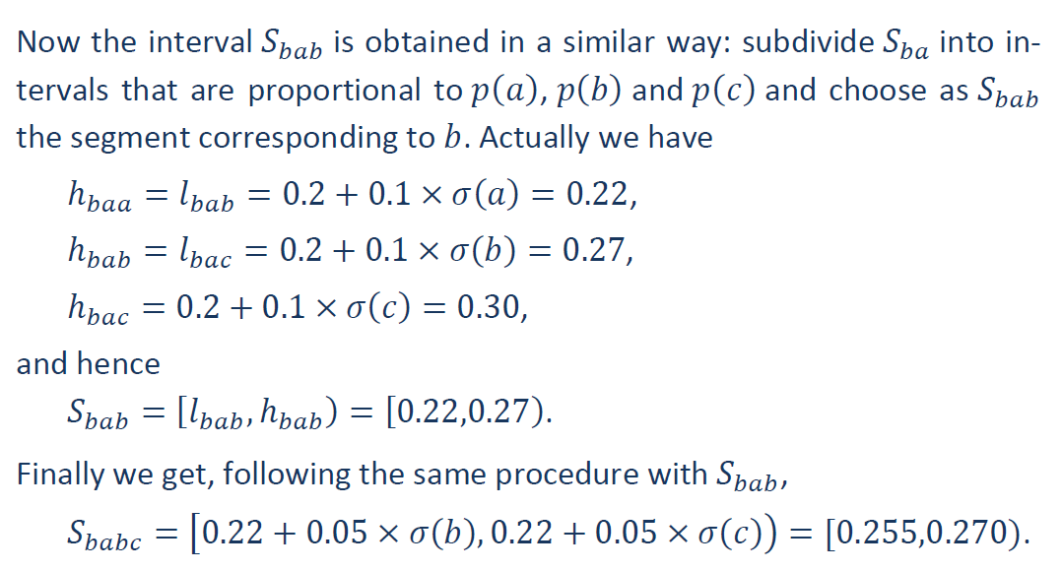
ARITHMETIC CODING

Slide 55
ARITHMETIC CODING
Interval | Subinterval |  |  | Symbol
[0,1] | [0.0-0.2] | [0.2-0.7] | [0.7-1.0]
[0.2-0.7] | [0.2-0.3] | [0.3-0.55] | [0.55-0.7] | b
[0.2-0.3] | [0.2-0.22] | [0.22-0.27] | [0.27-0.3] | a
[0.22-0.27] | [0.22-0.23] | [0.23-0.255] | [0.255-0.27] | b
[0.255-0.27] |  |  |  | c

Slide 57
VECTOR QUANTIZATION
Vector quantization (VQ) is the process of mapping a vector that can have many values to a vector that has a smaller (quantized) number of values
For image compression, the vector corresponds to a small subimage, or block

Slide 58
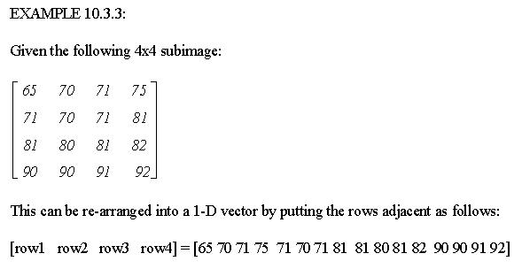
VECTOR QUANTIZATION

Slide 59
VECTOR QUANTIZATION
VQ can be applied in both the spectral or spatial domains
Information theory tells us that better compression can be achieved with vector quantization than with scalar quantization (rounding or truncating individual values)

Slide 60
VECTOR QUANTIZATION
Vector quantization treats the entire subimage (vector) as a single entity and quantizes it by reducing the total number of bits required to represent the subimage
This is done by utilizing a codebook, which stores a fixed set of vectors, and then coding the subimage by using the index (address) into the codebook

Slide 61
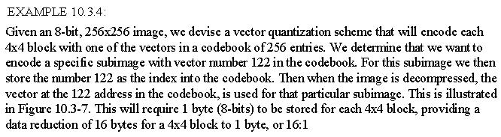
VECTOR QUANTIZATION
In the example we achieved a 16:1 compression, but note that this assumes that the codebook is not stored with the compressed file

Slide 62
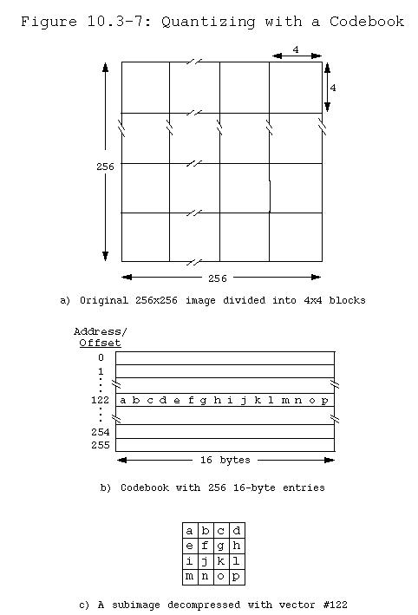

Slide 63
VECTOR QUANTIZATION
However, the codebook will need to be stored unless a generic codebook is devised which could be used for a particular type of image, in that case we need only store the name of that particular codebook file
In the general case, better results will be obtained with a codebook that is designed for a particular image

Slide 64
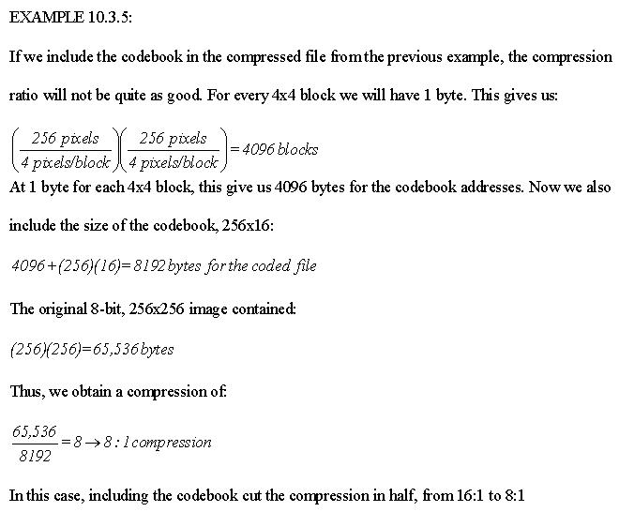

Slide 65
VECTOR QUANTIZATION
A training algorithm determines which vectors will be stored in the codebook by finding a set of vectors that best represent the blocks in the image
This set of vectors is determined by optimizing some error criterion, where the error is defined as the sum of the vector distances between the original subimages and the resulting decompressed subimages

Slide 66
WHY JPEG IMAGE COMPRESSION?
The compression ratio of lossless methods (e.g., Huffman, Arithmetic, LZW) is not high enough for image and video compression.
JPEG uses transform coding, it is largely based on the following observations:
Observation 1: A large majority of useful image contents change relatively slowly across images, i.e., it is unusual for intensity values to alter up and down several times in a small area, for example, within an 8 x 8 image block. A translation of this fact into the spatial frequency domain, implies, generally, lower spatial frequency components contain more information than the high frequency components which often correspond to less useful details and noises.
Observation 2: Experiments suggest that humans are more immune to loss of higher spatial frequency components than loss of lower frequency components.

Slide 67
JPEG CODING
C_{r}
C_{b}
F(u, v)
Fq(u, v)
Steps Involved:
Discrete Cosine Transform of each 8x8 pixel array f(x,y) 🡪_{T} F(u,v)
Quantization using a table or using a constant
Zig-Zag scan to exploit redundancy
Differential Pulse Code Modulation(DPCM) on the DC component and Run length Coding of the AC components
Entropy coding (Huffman) of the final output
Y
f(i, j)
DCT
Quantization
8 x 8
8 x 8
Quant…
Tables
Coding
Tables
Zig Zag
Scan
Header
Tables
Data
Entropy
Coding
DPCM
RLC

Slide 68



DCT : DISCRETE COSINE TRANSFORM
DCT converts the information contained in a block(8x8) of pixels from spatial domain to the frequency domain.
A simple analogy: Consider a unsorted list of 12 numbers between 0 and 3 -> (2, 3, 1, 2, 2, 0, 1, 1, 0, 1, 0, 0). Consider a transformation of the list involving two steps (1.) sort the list (2.) Count the frequency of occurrence of each of the numbers ->(4,4,3,1 ). : Through this transformation we lost the spatial information but captured the frequency information.
There are other transformations which retain the spatial information. E.g., Fourier transform, DCT etc. Therefore allowing us to move back and forth between spatial and frequency domains.
1-D DCT: 1-D Inverese DCT:

Slide 69



EXAMPLE AND COMPARISON
DCT
FFT
100 | -52 | 0 | -5 | 0 | -2 | 0 | 0.4
36 | 10 | 10 | 6 | 6 | 4 | 4 | 4
100 | -52 | 0 | -5 | 0 | -2 | 0 | 0.4
36 | 10 | 10 | 6 | 6 | 4 | 4 | 4
Inverse DCT
Inverse FFT
8 | 15 | 24 | 32 | 40 | 48 | 57 | 63
24 | 12 | 20 | 32 | 40 | 51 | 59 | 48
Example Description:
f(n) is given from n = 0 to 7; (N=8)
Using DCT(FFT) we compute F(ω) for ω = 0 to 7
We truncate and use Inverse Transform to compute f’(n)

Slide 70


2-D DCT
Images are two-dimensional; How do you perform 2-D DCT?
Two series of 1-D transforms result in a 2-D transform as demonstrated in the figure below
1-D
Row-
wise
1-D
Column-
wise
8x8
8x8
8x8
F(0,0) includes the lowest frequency in both directions is called DC coefficient Determines fundamental color of the block
F(0,1) …. F(7,7) are called AC coefficients Their frequency is non-zero in one or both directions

Slide 71


2-D TRANSFORM EXAMPLE
The following example will demonstrate the idea behind a 2-D transform by using our own cooked up transform: The transform computes a running cumulative sum.
1
1
1
1
1
1
1
1
1
1
1
1
1
1
1
1
My Transform:
1
1
1
1
1
1
1
1
1
1
1
1
1
1
1
1
1
1
1
1
1
1
1
1
8
7
6
5
4
3
2
1
1
1
1
1
1
1
1
1
8
7
6
5
4
3
2
1
1
1
1
1
1
1
1
1
8
7
6
5
4
3
2
1
1
1
1
1
1
1
1
1
1-D
Row-
wise
8
7
6
5
4
3
2
1
8x8
8
7
6
5
4
3
2
1
8
7
6
5
4
3
2
1
64
56
48
40
32
24
16
8
8
7
6
5
4
3
2
1
1-D
Column-
wise
56
49
42
35
28
21
14
7
8
7
6
5
4
3
2
1
48
42
36
30
24
18
12
6
8x8
40
35
30
25
20
15
10
5
32
28
24
20
16
12
8
4
24
21
18
15
12
9
6
3
Note that this is only a hypothetical transform. Do not confuse this with DCT
16
14
12
10
8
6
4
2
8
7
6
5
4
3
2
1
8x8

Slide 72
QUANTIZATION
Why? -- To reduce number of bits per sample
F’(u,v) = round(F(u,v)/q(u,v))
Example: 101101 = 45 (6 bits). Truncate to 4 bits: 1011 = 11. (Compare 11 x 4 =44 against 45) Truncate to 3 bits: 101 = 5. (Compare 8 x 5 =40 against 45) Note, that the more bits we truncate the more precision we lose
Quantization error is the main source of the Lossy Compression.
Uniform Quantization:
q(u,v) is a constant.
Non-uniform Quantization -- Quantization Tables
Eye is most sensitive to low frequencies (upper left corner in frequency matrix), less sensitive to high frequencies (lower right corner)
Custom quantization tables can be put in image/scan header.
JPEG Standard defines two default quantization tables, one each for luminance and chrominance.

Slide 73
ZIG-ZAG SCAN
Why? -- to group low frequency coefficients in top of vector and high frequency coefficients at the bottom
Maps 8 x 8 matrix to a 1 x 64 vector
8x8
. . .
1x64

Slide 74
DPCM ON DC COMPONENTS
The DC component value in each 8x8 block is large and varies across blocks, but is often close to that in the previous block.
Differential Pulse Code Modulation (DPCM): Encode the difference between the current and previous 8x8 block. Remember, smaller number -> fewer bits
45
45
1x64
1x64
54
9
1x64
1x64
48
-6
.
.
.
1x64
.
.
.
1x64
32
12
1x64
1x64
36
4
1x64
1x64

Slide 75
RLE ON AC COMPONENTS
The 1x64 vectors have a lot of zeros in them, more so towards the end of the vector.
Higher up entries in the vector capture higher frequency (DCT) components which tend to be capture less of the content.
Could have been as a result of using a quantization table
Encode a series of 0s as a (skip,value) pair, where skip is the number of zeros and value is the next non-zero component.
Send (0,0) as end-of-block sentinel value.
. . .
0
0
0
0
0
1
1
0
0
0
0
0
0
0
0
2
. . .
1x64
5,1
7,2

Slide 76
ENTROPY CODING: DC COMPONENTS
DC components are differentially coded as (SIZE,Value)
The code for a Value is derived from the following table
SIZE | Value | Code
0 | 0 | ---
1 | -1,1 | 0,1
2 | -3, -2, 2,3 | 00,01,10,11
3 | -7,…, -4, 4,…, 7 | 000,…, 011, 100,…111
4 | -15,…, -8, 8,…, 15 | 0000,…, 0111, 1000,…, 1111
. |  | .
. |  | .
11 | -2047,…, -1024, 1024,… 2047 | …
Size_and_Value Table

Slide 77
ENTROPY CODING: DC COMPONENTS (CONTD..)
DC components are differentially coded as (SIZE,Value)
The code for a SIZE is derived from the following table
SIZE | Code Length | Code
0 | 2 | 00
1 | 3 | 010
2 | 3 | 011
3 | 3 | 100
4 | 3 | 101
5 | 3 | 110
6 | 4 | 1110
7 | 5 | 11110
8 | 6 | 111110
9 | 7 | 1111110
10 | 8 | 11111110
11 | 9 | 111111110
Example: If a DC component is 40 and the previous DC component is 48. The difference is -8. Therefore it is coded as:
1010111
0111: The value for representing –8
(see Size_and_Value table)
101: The size from the same table reads 4. The corresponding code from the table at left is 101.
Huffman Table for DC component SIZE field

Slide 78
ENTROPY CODING: AC COMPONENTS
AC components (range –1023..1023) are coded as (S1,S2 pairs):
S1: (RunLength/SIZE)
RunLength: The length of the consecutive zero values [0..15]
SIZE: The number of bits needed to code the next nonzero AC component’s value. [0-A]
(0,0) is the End_Of_Block for the 8x8 block.
S1 is Huffman coded (see AC code table below)
S2: (Value)
Value: Is the value of the AC component.(refer to size_and_value table)
Run/ SIZE | Code Length | Code
0/0 | 4 | 1010
0/1 | 2 | 00
0/2 | 2 | 01
0/3 | 3 | 100
0/4 | 4 | 1011
0/5 | 5 | 11010
0/6 | 7 | 1111000
0/7 | 8 | 11111000
0/8 | 10 | 1111110110
0/9 | 16 | 1111111110000010
0/A | 16 | 1111111110000011
Run/ SIZE | Code Length | Code
1/1 | 4 | 1100
1/2 | 5 | 11011
1/3 | 7 | 1111001
1/4 | 9 | 111110110
1/5 | 11 | 11111110110
1/6 | 16 | 1111111110000100
1/7 | 16 | 1111111110000101
1/8 | 16 | 1111111110000110
1/9 | 16 | 1111111110000111
1/A | 16 | 1111111110001000
… 15/A | More | Such rows
Partial Huffman Table for AC Run/Size Pairs

Slide 79
ENTROPY CODING: EXAMPLE
Example: Consider encoding the AC components by arranging them in a zig-zag order -> 12,10, 1, -7 2 0s, -4, 56 zeros
12: read as zero 0s,12: (0/4)12 🡪 10111100
1011: The code for (0/4 from AC code table)
1100: The code for 12 from the Size_and_Value table.
10: (0/4)10 🡪 10111010
1: (0/1)1 🡪 001
-7: (0/3)-7 🡪 100000
2 0s, -4: (2/3)-4 🡪 1111110111011
1111110111: The 10-bit code for 2/3
011: representation of –4 from Size_and_Value table.
56 0s: (0,0) 🡪 1010 (Rest of the components are zeros therefore we simply put the EOB to signify this fact)
40
12
0
0
0
0
0
0
10
-7
-4
0
0
0
0
0
1
0
0
0
0
0
0
0
0
0
0
0
0
0
0
0
0
0
0
0
0
0
0
0
0
0
0
0
0
0
0
0
0
0
0
0
0
0
0
0
0
0
0
0
0
0
0
0

Slide 80
JPEG MODES
Sequential Mode:
Each image is encoded in a single left-to-right, top-to-bottom scan.
The technique we have been discussing so far is an example of such a mode, also referred to as the Baseline Sequential Mode.
It supports only 8-bit images as opposed to 12-bit images as described before.

Slide 81

IMAGE COMPRESSION METHODS

Slide 82



