Slide 1
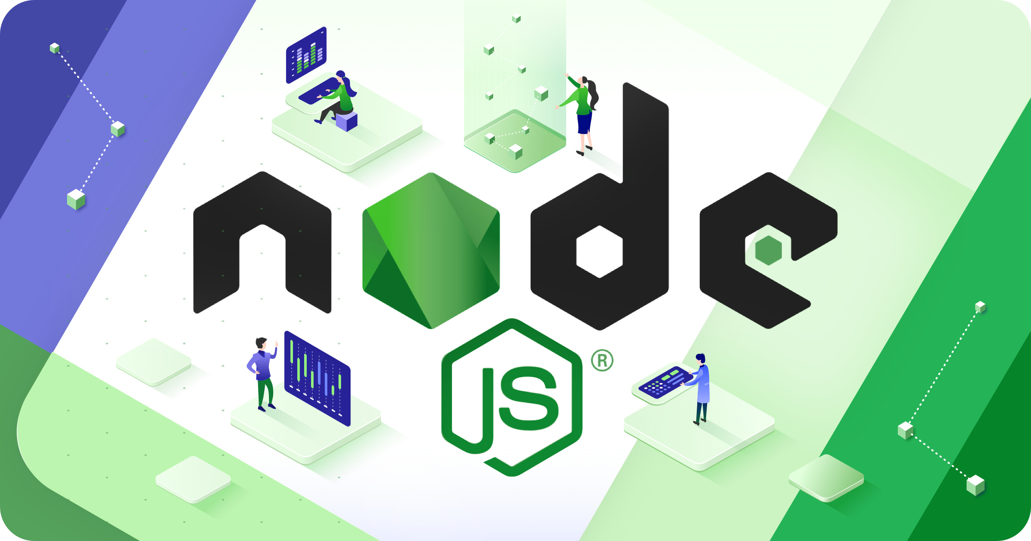
Node.JS Architecture
Presented by: Divya Gupta

Slide 2
Table of Content
Q. How Node.JS is Asynchronous, Event-Driven, & Single-Threaded at the same time.
Introduction to Node.JS
3 key Concepts:
Asynchronous Programming
Event-Driven Architecture
Single-Threaded Execution
Node.JS Server Architecture
Components of NodeJS Architecture

Slide 3

Introduction to Node.JS
Node.js (Node js) is an open-source and cross-platform JavaScript runtime environment.
It runs on Chrome’s V8 JavaScript engine. It allows developers to run JavaScript code on the server.
Node.js enables developers to get into the server-side world.

Slide 4
Event-Driven
Asynchronous & Non-Blocking
Single-Threaded
3 Key Concepts

Slide 5
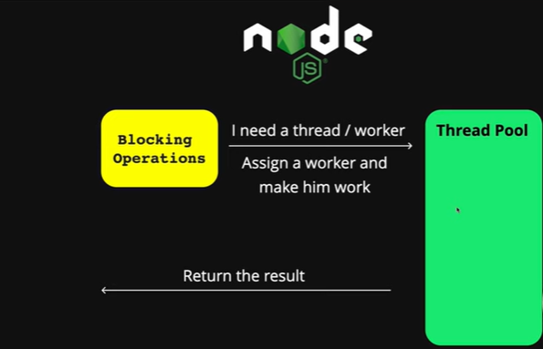
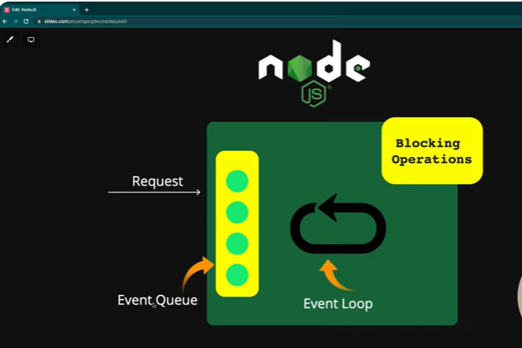
Asynchronous & Non-Blocking
Asynchronous Operations:
Node.js doesn't wait for a task to complete before moving on to the next. Instead, it registers a callback function to be executed when the operation finishes.
Non-Blocking I/O:
Node.js uses asynchronous I/O operations, meaning it doesn't block the main thread while waiting for data from a file or network connection.

Slide 6
2. Event-Driven
Event Loop
Event Queue
Event Loop Processing
Node.js uses an event loop to process events and callbacks.
When an asynchronous operation completes, it adds a callback to the event queue.
The event loop continuously checks the event queue and executes callbacks.

Slide 7
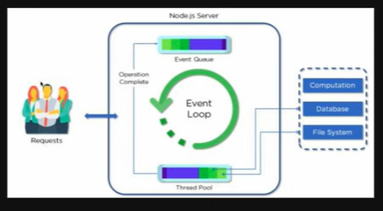

Slide 8
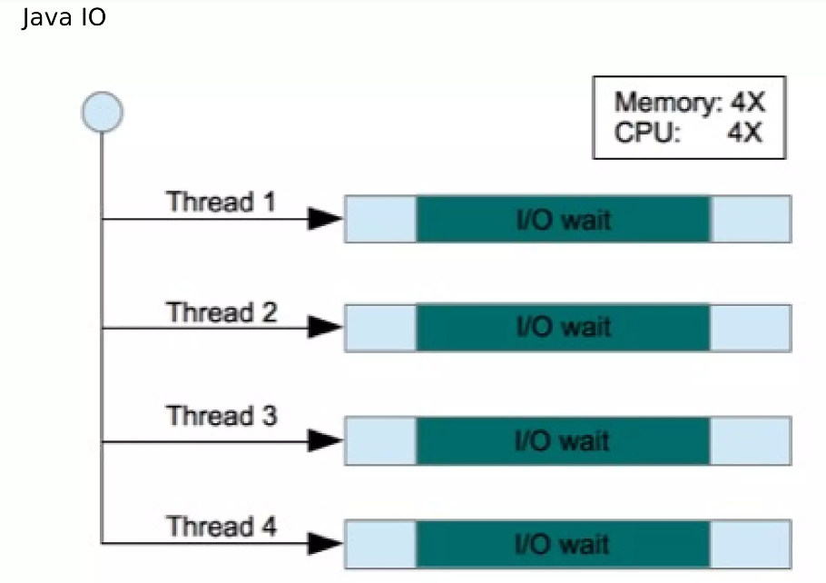
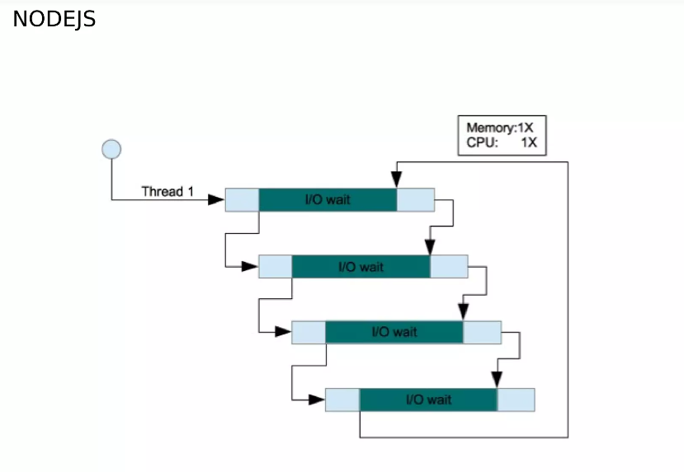
3. Single-Threaded Execution
Single Thread:
Node.js runs on a single thread of execution.
Non-blocking I/O:
The asynchronous nature of Node.js allows it to handle multiple concurrent requests efficiently without blocking the main thread.

Slide 9
Node JS Architecture
To manage several concurrent clients, Node.js employs a “Single Threaded Event Loop” design. The JavaScript event-based model and the JavaScript callback mechanism are employed in the Node.js Processing Model.
It employs two fundamental concepts:
1) Asynchronous model
2) Non-blocking of I/O operations
These features enhance the scalability, performance, and throughput of Node.js web applications.

Slide 10
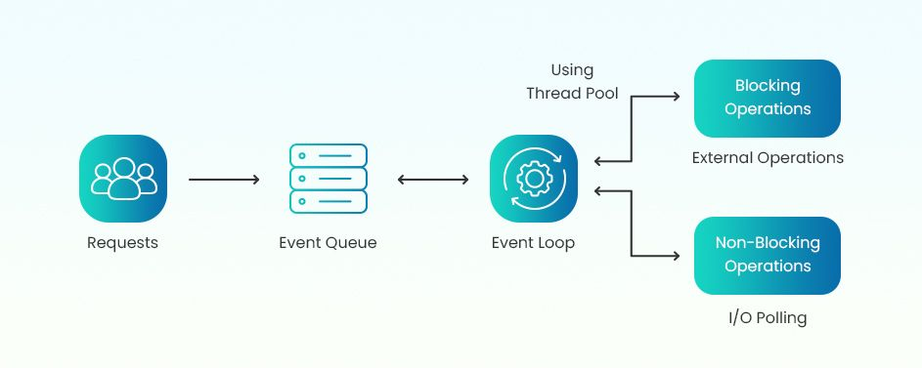

Slide 11
Components of Node.JS Architecture
Components of Node.JS Architecture
Requests
Node.js Server
Event Queue
Thread Pool
Event Loop
External Resources

Slide 12
BIBLIOGRAPHY
https://radixweb.com/nodejs-architecture
https://www.geeksforgeeks.org/node-js-web-application-architecture/
https://www.scaler.com/topics/nodejs/node-js-architecture/
https://nodejs.org/docs/latest/api/

Slide 13
THANK YOU

