Slide 1


APPLIED DATA SCIENCE AND BLOCKCHAIN FUNDAMENTALS AND APPLICATIONS
GROUP ASSIGNMENT – BITCOIN PRICE PREDICTION (GROUP-3)
S.NO. | STUDENT NAME | STUDENT ROLL NO
1 | KARTHIK NAMBIAR | 2204107025
2 | KASHISH NIGAM | 2204107026
3 | SUDEEP NIGAM | 2204107047
4 | VAIBHAV KHANNA | 2204107050

Slide 2
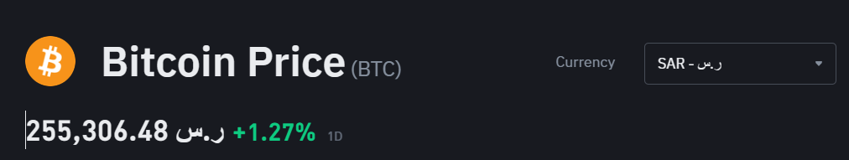

INTRODUCTION
The emergence of digital currencies has led to an increased interest in understanding and predicting their trading patterns. Blockchain technology has revolutionized the digital currency ecosystem by providing decentralized and transparent transaction records
In this context, time series analysis techniques such as Long Short-Term Memory (LSTM) have been widely employed to forecast digital currency prices
We aim to analyze the efficiency of the market with reference to predictability of future prices of digital currency on the basis of historical prices for the digital currency (BTC) traded on the Saudi market (SAR/Sudi Riyal)

Slide 3
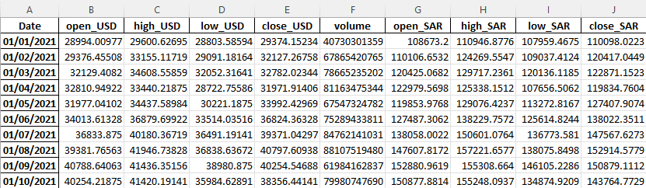
DATA COLLECTION AND PREPARATION
Historical trade details such as Open Price, High Price, Low Price, Close Price and Traded volume for the digital currency (BTC) traded on the Saudi market in both USD and SAR is taken from Yahoo Finance from 1 January 2021 to 31 December 2023
Since the Yahoo Finance only contains the ticker BTC-USD (Bitcoin USD (BTC-USD) Price History & Historical Data - Yahoo Finance), we have used foreign exchange rate between USD and SAR to convert USD to SAR
This foreign exchange rate is taken also from Yahoo Finance via the ticker SAR/USD (SAR/USD (SARUSD=X) Live Rate, Chart & News - Yahoo Finance)
This is done for all the prices such as Open Price, High Price, Low Price and Close Price
This functionality is implemented via GetDigitalCurrencyData

Slide 4
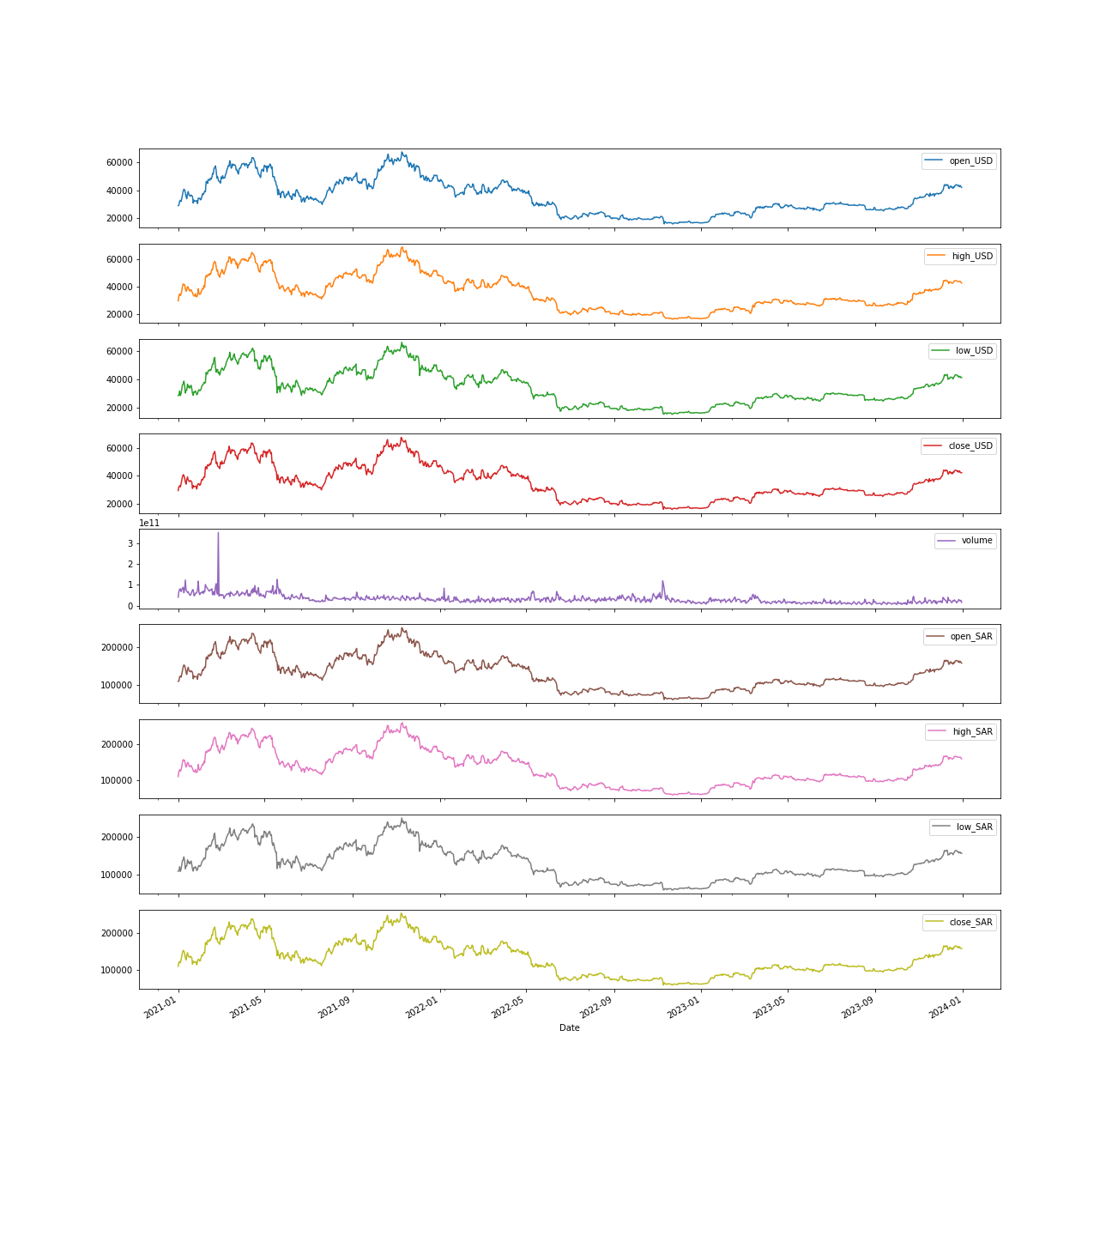
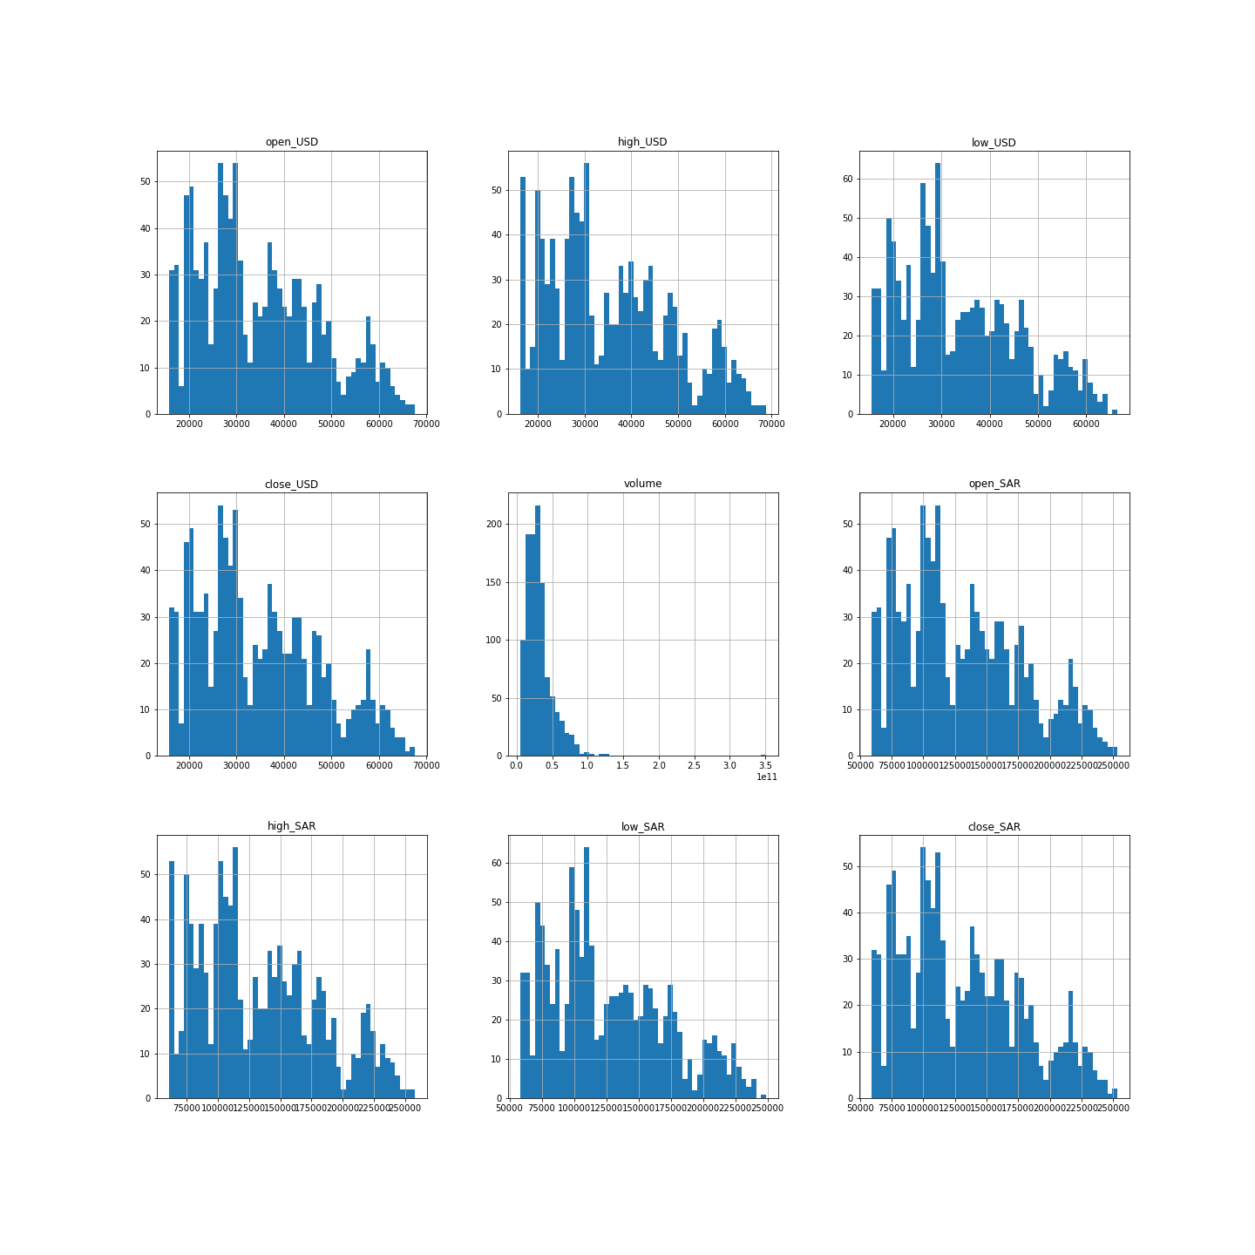
DIGITAL CURRENCY SUBPLOTS

Slide 5
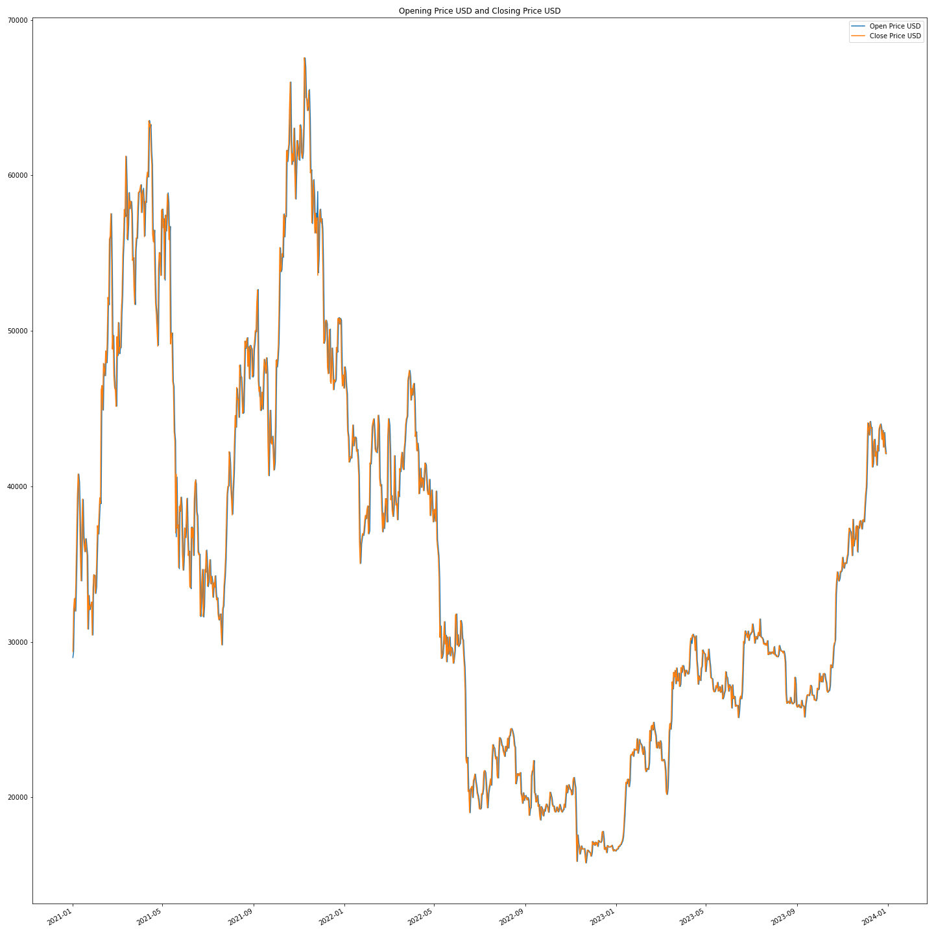
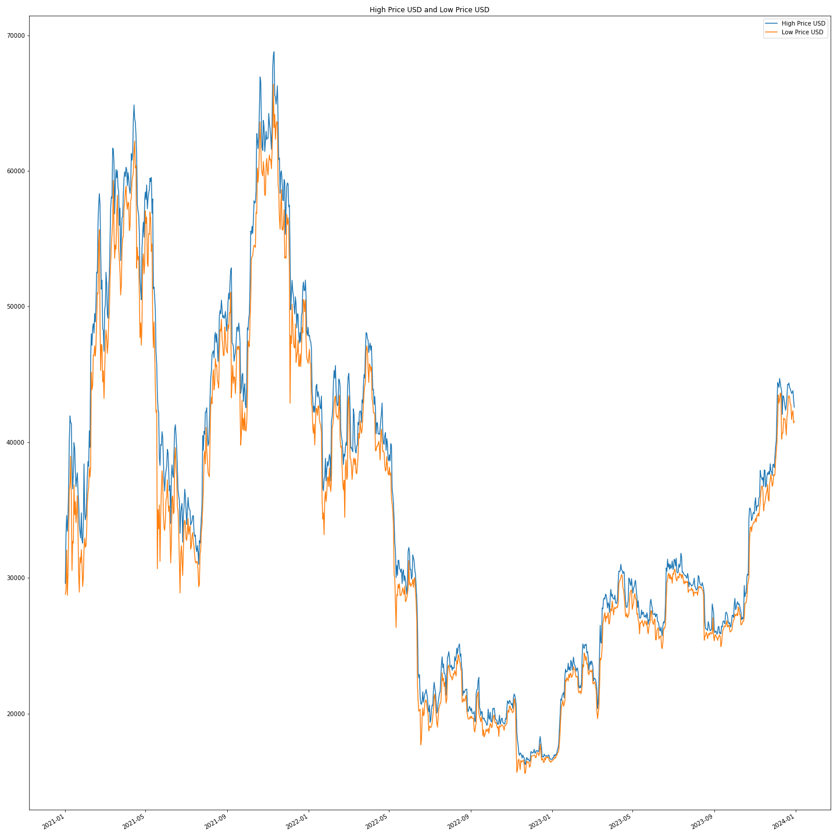
OPEN USD vs CLOSE USD AND HIGH USD vs LOW USD
Significant volatility, with the price showing sharp rises and falls
Volatility is because of highly speculative market
Plot seems to show cycles of ups and downs, which might be indicative of typical market behavior
Periods where the gap between the high and low prices is quite wide

Slide 6
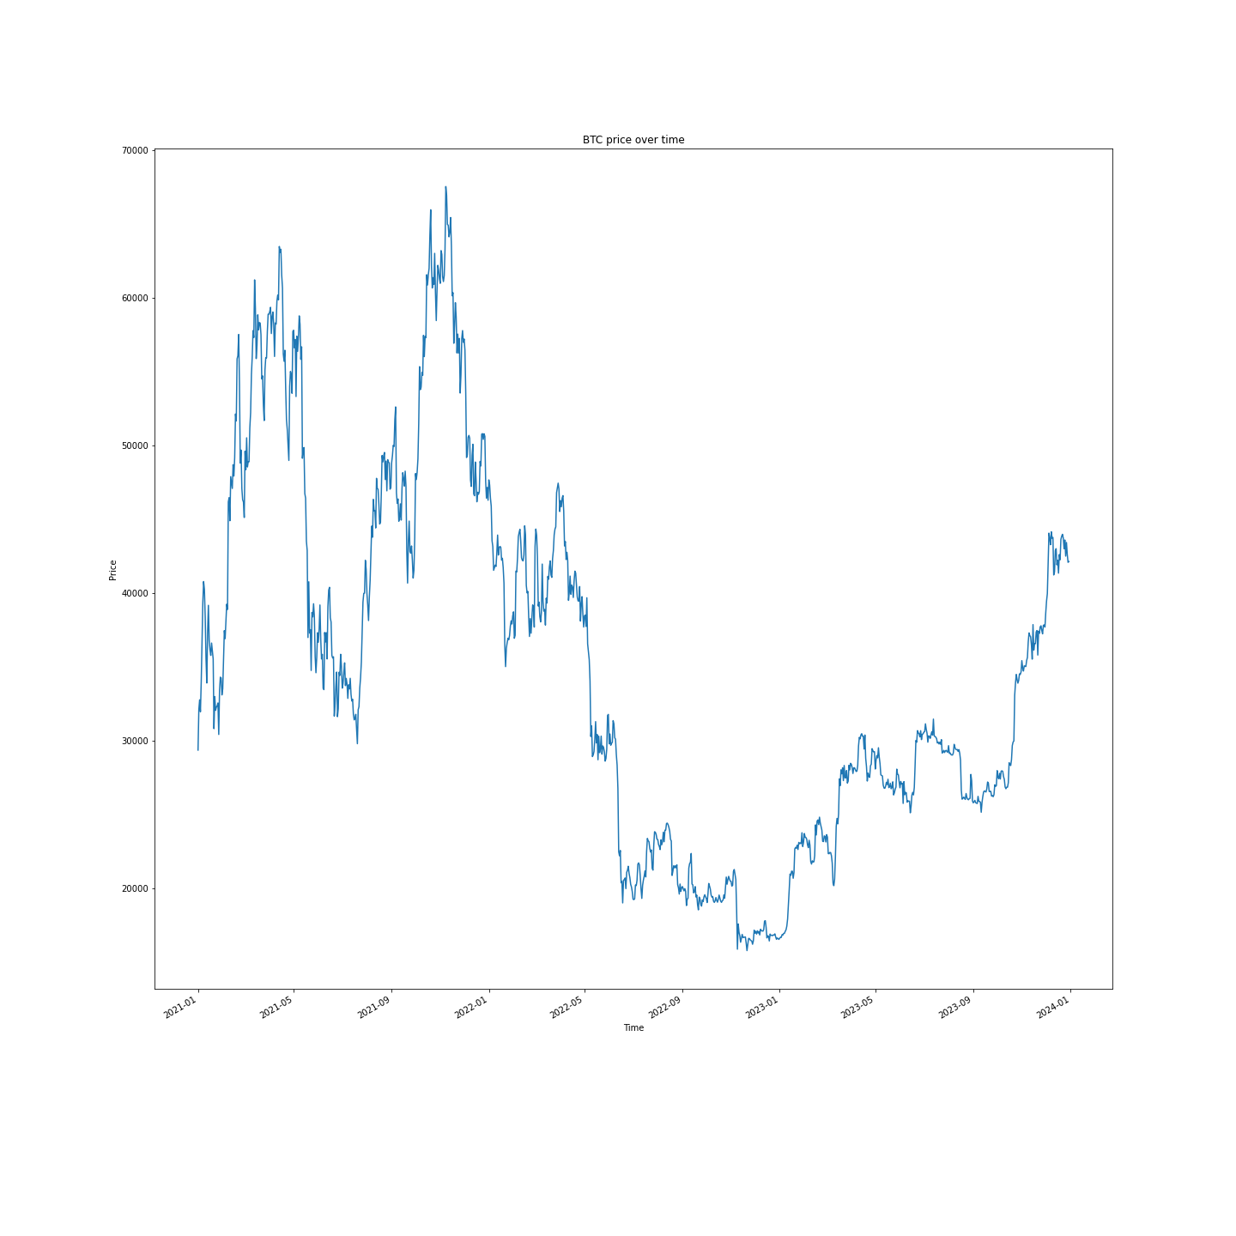
BTC PRICE OVER TIME
There appear to be periods of both uptrend and downtrend.
Sharp increases and decreases in value over time.
The right-most part of the chart shows an uptrend, indicating an increase in price leading up to the 31 December 2023

Slide 7
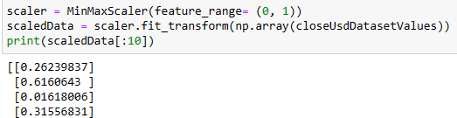
DATA PREPROCESSING
Extracts the close_USD values and applies MinMaxScaler to scale the data.
The MinMaxScaler specifically transforms features by scaling each feature to a given range, typically 0 to 1.
This is done by subtracting the min value and dividing by the maximum minus the minimum. It ensures that each input parameter contributes approximately proportionately to the final decision.
The entire dataset is divided into training and testing sets. 75% of the data is used for training the model and the rest 25% is for testing it.
SLIDING WINDOW TECHNIQUE
Now we are using sliding window approach to create input-output pairs for training the model.
Extracting Training Data: Utilizing a subset of the scaled dataset for training
Creating Input-Output Pairs: Initializing empty lists to store input sequences and corresponding output values
Defining Parameters: (Length of the input sequences= TimeSteps) and (Number of features= No of Columns) in each input-output pair
Iterating over Training Data:
Using a for loop to iterate over the training data.
Constructing input-output pairs by sliding a window of length timeSteps over the training data.
Each iteration of the loop represents a time step in the dataset.
The window slides along the dataset one step at a time, creating multiple input-output pairs for training
The window of historical data (input sequence) is used to predict the subsequent value (output).
It Enables the LSTM model to learn patterns from historical data
Facilitates the prediction of future values based on learned patterns.

Slide 8
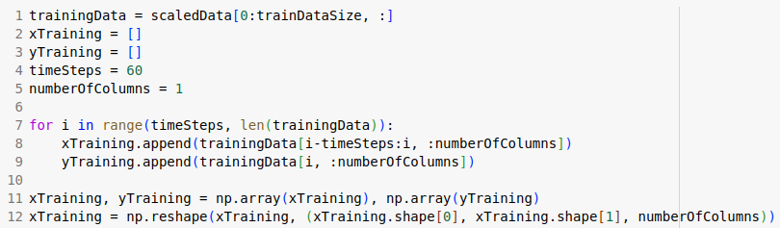
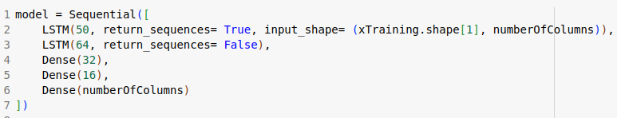
LSTM MODEL AND TRAINING
>> Converting the lists of input-output pairs (xTraining and yTraining) into NumPy arrays.
>> The reshaping step transforms the input sequences which are typically in 2D into 3D array with dimensions [Samples, time_steps, features].
>> Now we will made a Sequential model using the Keras library.

Slide 9
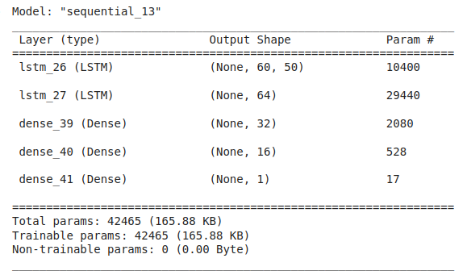
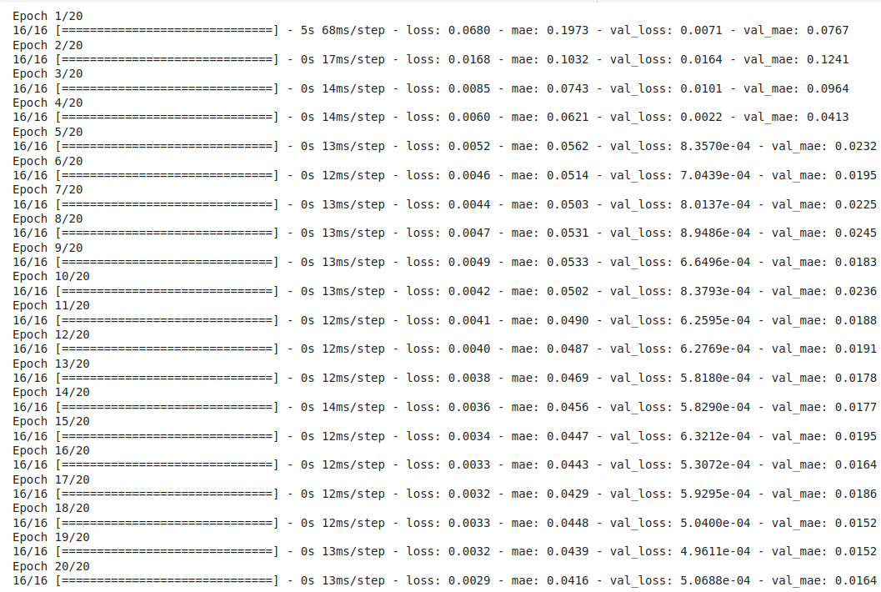
LSTM MODEL AND TRAINING
The model consists of the following layers:
An LSTM (Long Short-Term Memory) layer with 50 units, returning sequences. This is the input layer, designed to handle time series data (xTraining) with numberOfColumns features.
A second LSTM layer with 64 units, not returning sequences, to further process the data.
Three Dense (fully connected) layers with 32, 16, and numberOfColumns units respectively. The last Dense layer presumably outputs predictions corresponding to the number of features you're predicting.
The model is compiled with the Adam optimizer and uses mean squared error ('mse') as the loss function, and mean absolute error as a metric for evaluation.
The training data (xTraining and yTraining) are used, with the model set to train for 20 epochs and a batch size of 32. This step is where the model learns from the training data by adjusting its weights to minimize the loss function.

Slide 10
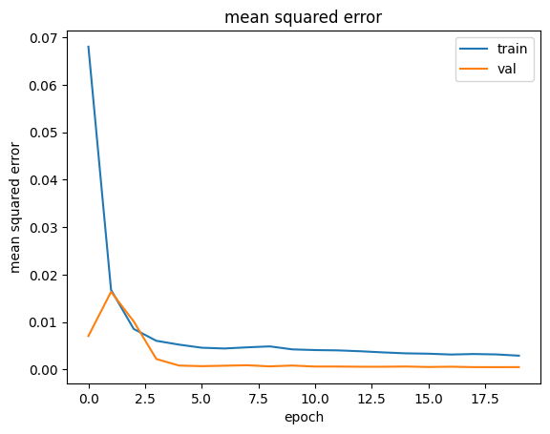
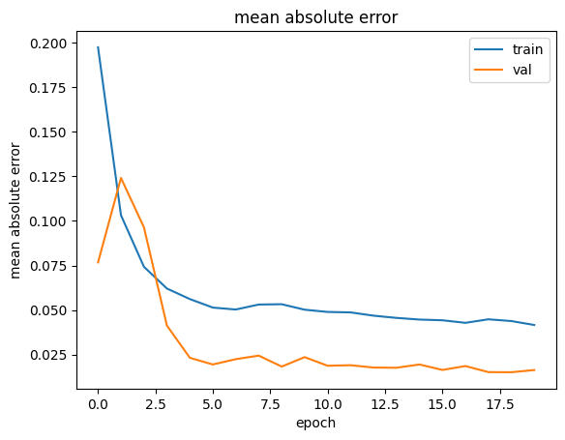
TRAINING CURVE
The graph shown here illustrates the relationship between Losses and Epochs.
The metrics used for training are mean squared error and mean average error.
Here the blue line represents the training loss and the orange line represents the validation loss.
Here Both errors are decreasing as the number of epochs increasing, indicating an improvement in model accuracy over time

Slide 11
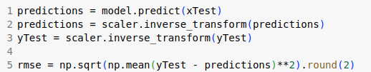
PREDICTION AND EVALUATION
>> For the prediction process we will perform the same steps for test data as we did for the training data 1. Extracting test data from the scaled dataset
2. Generating input sequences for the LSTM model using a sliding windows approach.
>> Making the predictions:
Utilizing the trained LSTM model to predict target values based on the test data (xTest).
>> Invert Scaling Transformations:
Reversing the scaling transformation applied to the predictions to obtain the interpretable results.
RMSE Calculation:
Calculation of the Root Mean Square Error to assess the accuracy of the predictions.
We got RMSE value of 18.12

Slide 12
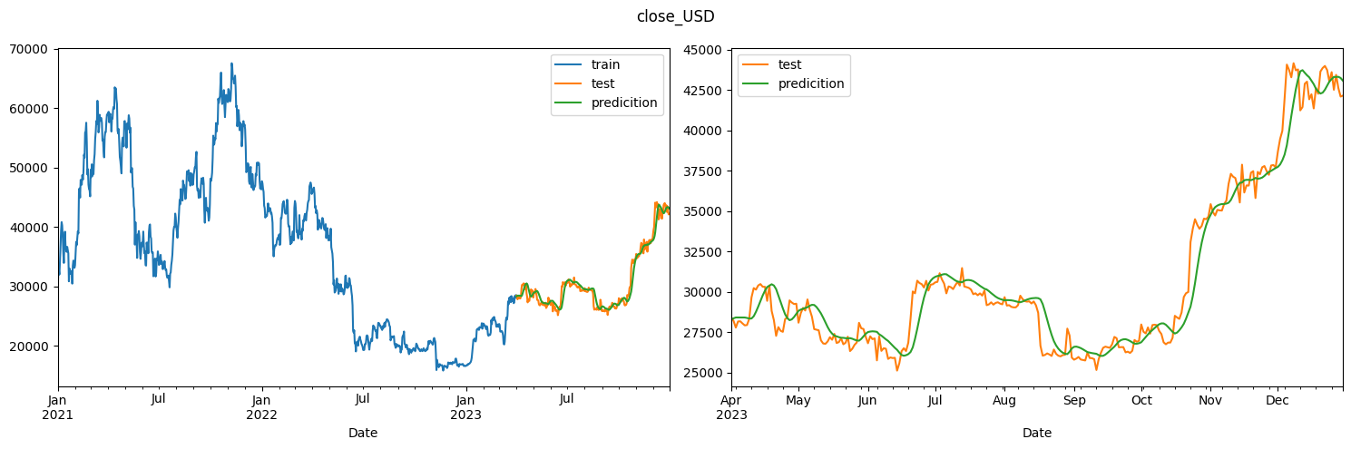
RESULTS
In this section, we'll examine the predictions made by our LSTM model and compare them with the actual values from the test dataset.
Upon examining the DataFrame, we observe that some predictions closely match the actual values, while others deviate to varying degrees.
The comparison between predictions and actuals provides valuable insights into the model's accuracy and effectiveness in forecasting.

Slide 13
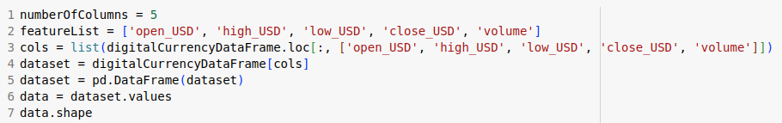
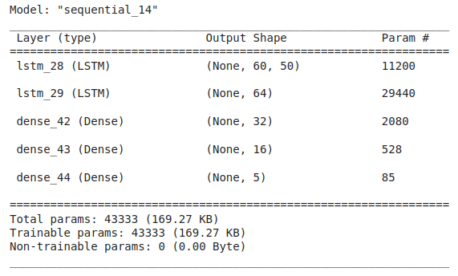
MULTIPLE FEATURES LSTM
In the previous sections, we looked at how LSTM can predict a single variable. Here we train an LSTM for multiple feature prediction.
Similar preprocessing such as MinMaxScaler and Sliding window is performed on the dataset. The LSTM architecture is used is shown below:

Slide 14
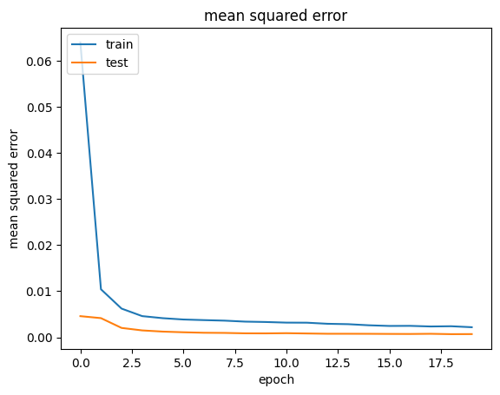
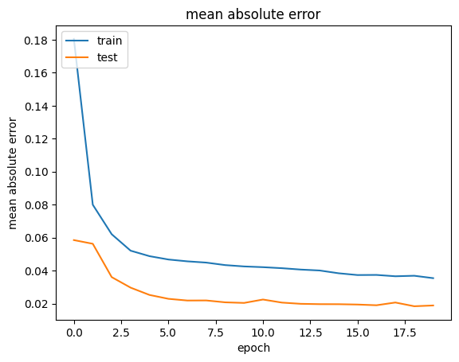
MULTIPLE FEATURES LSTM
The model is fitted for 20 epochs with a 33% validation split with a batch size of 32. The metrics used for training are Mean Squared Error and Mean Absolute Error.
The RMSE for each feature is as follows:
open_USD : 86.34 ; high_USD : 591.27 ; low_USD : 294.64 ; close_USD : 79.31 ; volume : 5830185068.59

Slide 15
