Slide 1


Master of Science in Data Science and Management Jointly offered by Indian Institute of Technology Indore & Indian Institute of Management Indore
DSM 509 – Applied Data Science and Blockchain Fundamentals and Applications
Term-V, MSDSM Batch-2, 2022-2024
Group-6 BERTopic Model Capstone Project
Student Name | Student ID
KARTHIK BABU NAMBIAR | 2204107025
KASHISH NIGAM | 2204107026
VAIBHAV KHANNA | 2204107050

Slide 2
BERTopic Model Project
AIM: Build BERTopic model from the data and point out 5 conclusions on model performance.
Model used: BERTopic
Model accuracy: 0.6177863708985377
5 Reasons:
Clear Topic Identification: The model has successfully identified distinct topics related to the Tokyo 2020 Olympics, including specific events such as hockey, weightlifting and the achievements of athletes like Mirabai Chanu.
Relevant Representative Documents: The representative documents associated with each topic are coherent and relevant, indicating that the model has effectively captured the key themes present in the dataset.
Diverse Topic Coverage: The topics cover a diverse range of subjects, including sports events, athlete achievements, cultural aspects (such as the Olympic flame), and broader concepts like sacrifice and courage, reflecting the multifaceted nature of the Olympics.
Dominant Topics: Certain topics, such as those related to Mirabai Chanu's silver medal win and Tokyo 2020 Olympics hockey events, appear to be more dominant based on their higher topic counts, suggesting their significance within the dataset.
Moderate Coherence Score: The coherence score of 0.6178 indicates a moderate level of topic coherence, suggesting that while the topics are interpretable, there may still be room for improvement in terms of enhancing the semantic coherence and clarity of topics.

Slide 3
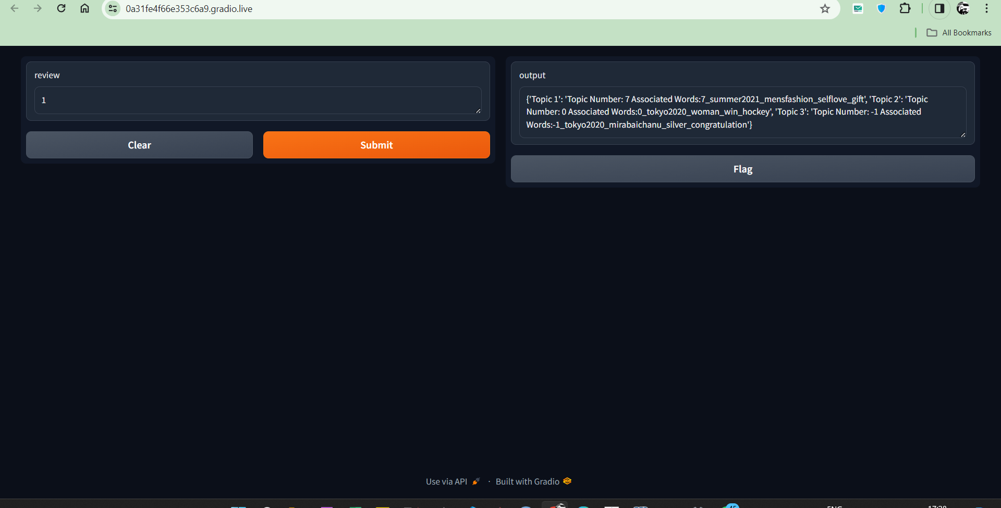
Deploy the model in FastAPI and create a UI using Gradio
(paste a screen short of the UI)

