Slide 1



ENTERTAINMENT BASED TOY [ELEPHANT]
CMR COLLEGE OF ENGINEERING & TECHNOLOGY
(AUTONOMOUS)

Slide 2
TEAM NUMBER: 01
Team Members:05
KARINGULA VENUDHAR 21H51A1203
KASHISH SINGHAL 21H51A1247
BODA HRUSHIKESH REDDY 21H51A1201
JAISHETTI SRI VARSHITH 21H51A1202
KATARAPU BABITHA 21H51A1204

Slide 3
LIST OF CONTENTS:
Need statement
Abstract Requirements
Existing solutions
Advantages and disadvantages of the Existing solutions
Proposed solution
Working mechanism of the proposed model
Advantages and disadvantages of the proposed solution
Conclusion

Slide 4
NEED STATEMENT:
A toy manufacturing industry in the town is interested in designing of toys for entertaining the kids. There is need of designing an elephant model which should be semi-automatic, should move as slow as possible, and serve the purpose of entertainment and attract kids with its appearance

Slide 5
ABSTRACT:
The remote control basically consists of two types, one is the wired and another one is the wireless. The wired component consists of remote control which can easily control the movements and the wireless component consists of receiving and detecting sensors and performing actions accordingly. My project is specially for the small children’s, so that they can play . This smart toy performs walking movement. The goal of this project is to design a toy elephant for entertainment.

Slide 6
REQUIREMENTS:
Arduino UNO
Breadboard
Drive motor
Shafts
Wheels
Ultrasonic sensor
Rechargeable battery
Switch

Slide 7
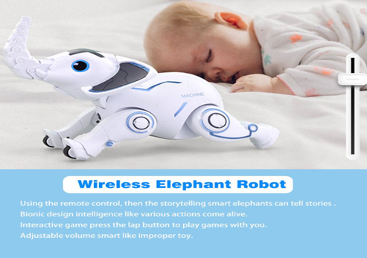
EXISTING SOLUTIONS :
RC PROGRAMMABLE ROBOTIC AI ELEPHANT:
[ Comprehensive Functions]: Voice-activated instructions, walking, crouch down singing, sit down, handstand, say hello, push-ups, nose up and down. You can also control the volume.
[ Programming Function]: You can program the actions on your elephant and it will repeat the actions you programmed.
[ Simple Operation]: All functions are clearly displayed on the remote control, and with voice commands, children can easily play.
[ Fun Interaction]: More interesting is you can throw a ferrule to an elephant and it can catch it with its nose.
[ Best Gift for Kids]: 3.7V 600mAh rechargeable battery can provide more playing time.

Slide 8

2) PATPAT® Electric Elephant Musical Toy:
[Moving with The Floating Ball]--Equipped with universal wheel on the bottom, the elephant-design toy can move freely, automatically turn around when facing a wall. Most interesting part is that the 'acrobatics' performance, floating balls. Through the nose and air pressure theory, turn on the switch, and the elephant will start blow the color ball into air.
[Cute Elephant of Moving Glowing Ear]--Not just the fun performance brought by the toy, the ear part is also can be like a real elephant is fanning their ears. With the music , the glowing devices in the ear start to work, then you get a pair of moving glowing ears.

Slide 9
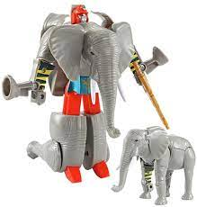
3) TRANSFORMING ACTION FIGURE-ELEPHANT:
TRANSFORMS FROM ELEPHANT TO ROBOT - Manipulate the parts of the elephant and it changes into a robot figure in seconds!
PERFECT FOR PLAYTIME – This transforming toy is perfect for getting your little one excited for playtime and perfectly stimulates their imagination so that they can make creative play sessions when playing with our transforming action figure.
TRANSFORMS WITH EASE – Our robot toy is perfectly simple for children to transform thanks to its easily movable parts as and quality build construction. Then, it can also be easily transformed back into an animal toy when they’re done.
GREAT FOR CHILDREN YOUNG AND OLD – This elephant robot toy has been made to be perfect for children 3 and over to play with. Even older kids will be able to enjoy the unique design and thought provoking transformation mechanisms

Slide 10
Disadvantages of existing solutions:
The main disadvantage of above mentioned existing solution is cost is very high.
It is also much difficult to operate the elephant toy because it has many advanced functions .
It is difficult to remember which button in remote is used to perform particular task.

Slide 11

PROPOSED SOLUTION:
The Entertainment based toy is elephant specially designed for kids. As we all know that kids love to play with toys with entertains them.Here we are making elephant toy which performs walking movement. We are using ultrasonic sensor to detect obstacle. Our toy can work on Bluetooth or manually . We will do this with the help of Arduino UNO.

Slide 12
WORKING MECHANISM:
Firstly a code with required operations including ultrasonic sensor and Bluetooth module with switch operation is uploaded into micro-controller(Arduino).
L293D Motor driver shield is attached to Arduino board and wheels using shafts are attached to the motor driver using wires. Bluetooth module sent the signal to the Arduino board and wheels starts rotating . Hence the elephant toy moves forward.
We can operate it manually by using ultra sonic sensor. If ultrasonic sensor detects any object (obstacle) then it will change toy’s direction.

Slide 13
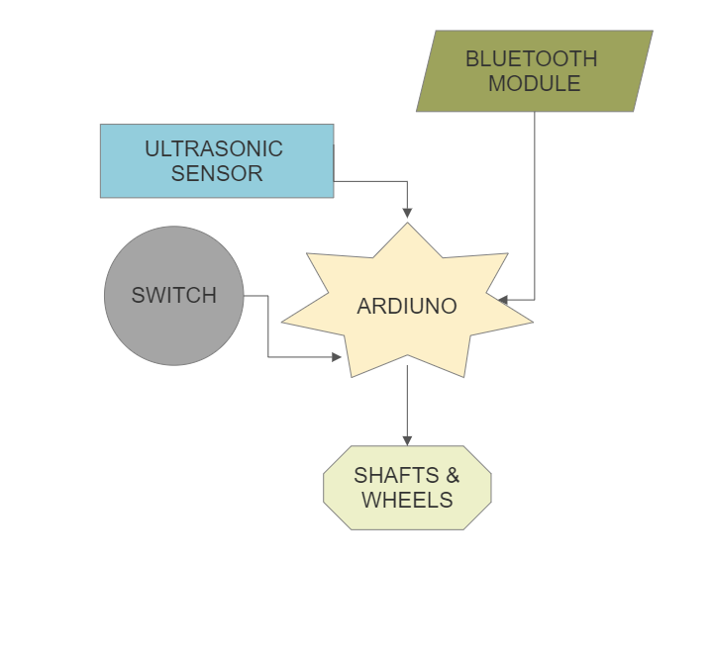
BLOCK DIAGRAM:

Slide 14
Pros and cons:
PROS
CONS
Eco-friendly material.
Cost efficient.
Gets accurate result.
Faces little difficulty to operate.
Requires Bluetooth connection for operating through Bluetooth.

Slide 15
CONCLUSION:
Significance refers to the importance of the system, this project is important and also useful to the small kids and parents for entertaining the child as a toy manufacturing industry in the town is interested in designing of toys for entertaining the kids. The limitation is that the small kids sometimes in anger or while playing even throw their toys. Because of this the system might break down.

