Slide 1
JusticeSync
Case Management System
Prakash Subedi (616468)

Slide 2
Problem Statement
User Authentication: Lawyers should be able to securely log in to the system using their credentials.
Client Management: Lawyers should be able to create, and view, client records. Each client record should include essential details such as name, contact information, person or company type, and any relevant notes.
Case Management: Lawyers should be able to create, and view, case records associated with each client. Each case record should include details such as case type, case number, case status, associated parties and key dates.
Time Entry: Lawyers should be able to log billable hours spent on each case accurately. The system should allow lawyers to enter the date, time spent, description of work done, and associate the time entry with a specific case.

Slide 3
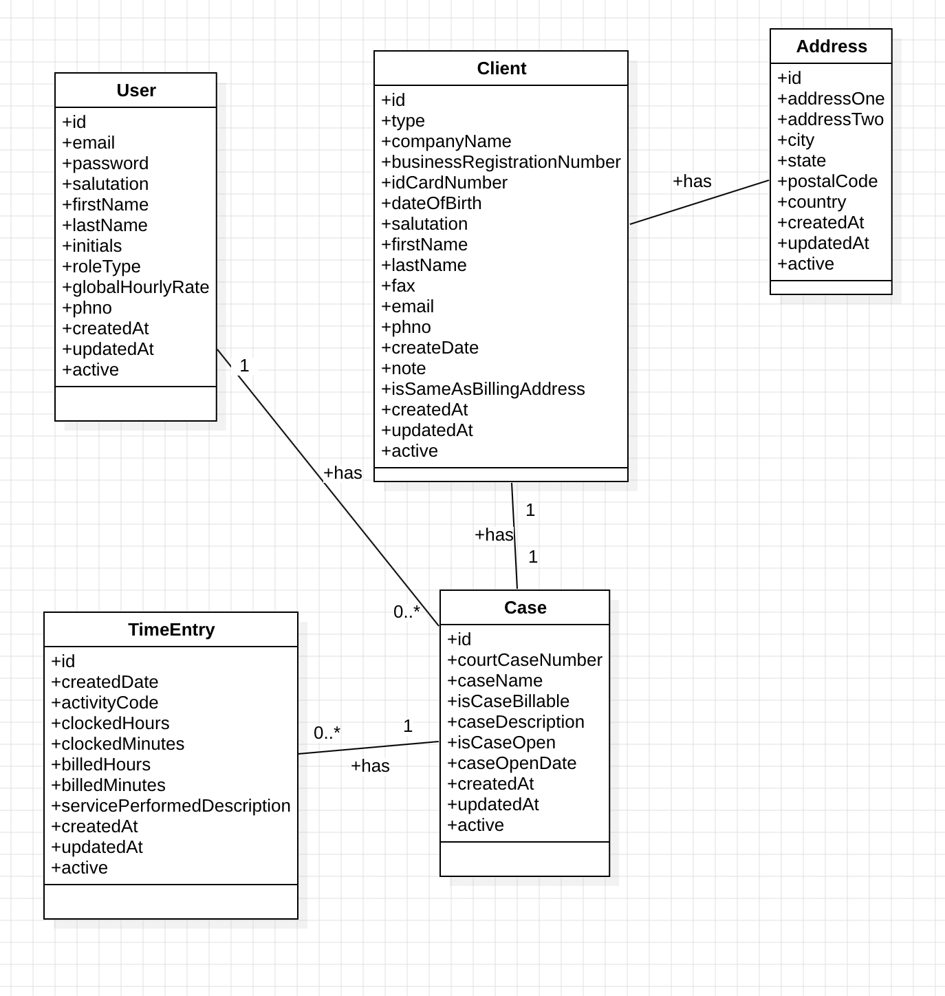
Class Diagram

Slide 4
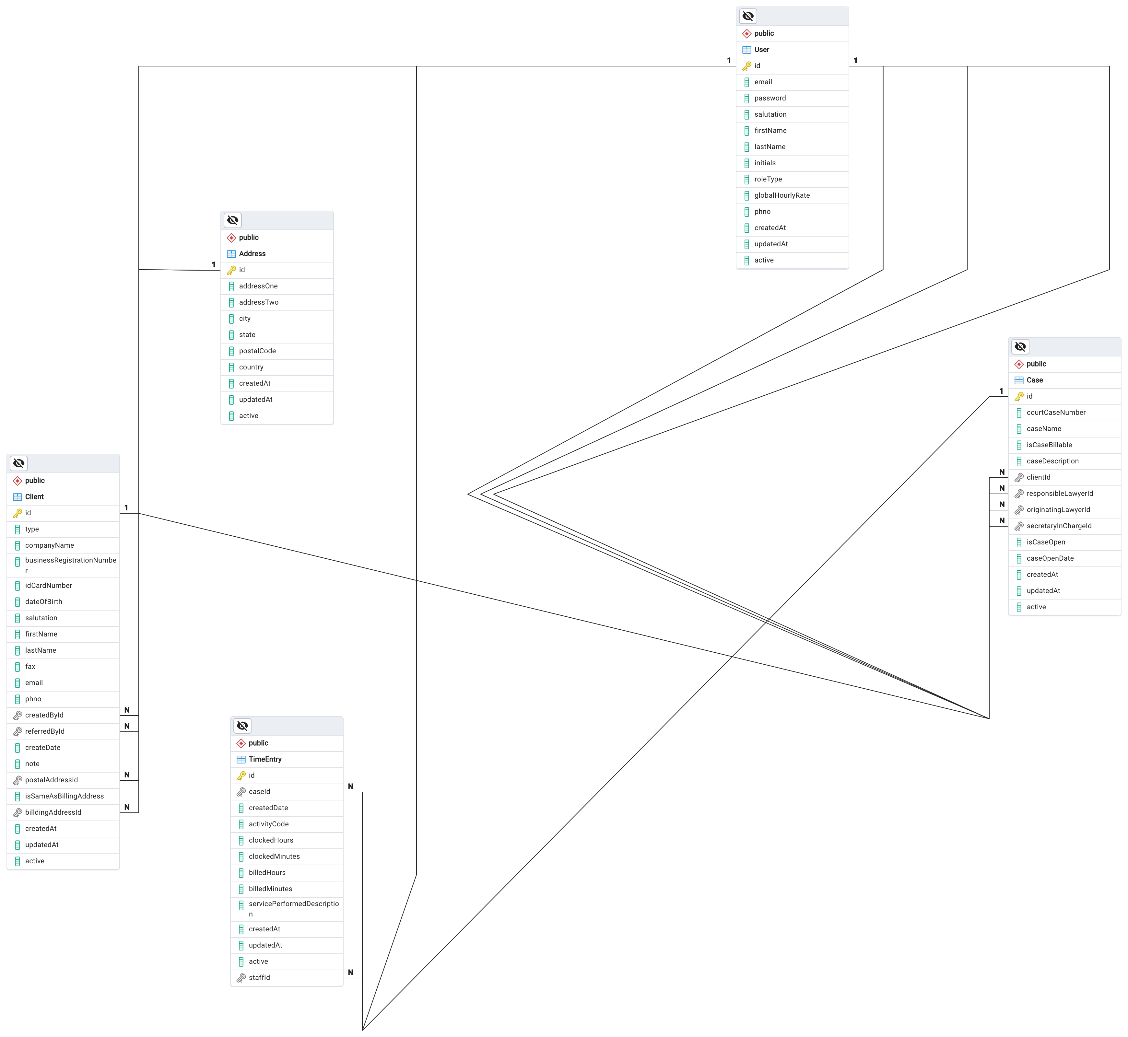
ER Diagram

Slide 5
Tech Stacks
Frontend: React.js, React Query, Material UI
Backend: Express.js, Json Web Token, Postgres, Prisma ORM

Slide 6
Demo Time

