Slide 1
Name: Kashshaf Mahbub
Reg No: 2016331016
Parkinson's Disease Detection

Slide 2
Parkinson’s disease is a brain disorder that leads to stiffness and difficulty in walking, balance and coordination. It gradually gets worse over time and can lead to paralysis.
What is Parkinson’s disease?

Slide 3
Dependencies
Pandas
Sklearn.model_selection-
train_test_split
Sklearn.preprocessing-
StandardScaler
Sklearn - SVM

Slide 4
The dataset for the model is taken from kaggle Parkinson’s disease dataset. The dataset is composed of 31 peoples biomedical voice measurements and 23 of the people has the disease. The dataset has attributes on various aspects of voice onwhich we will train our model.

Slide 5
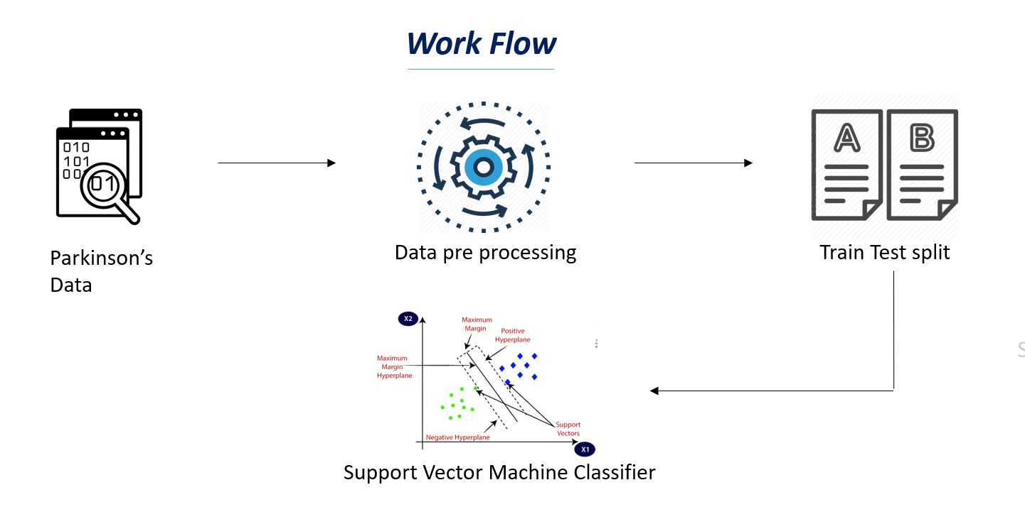

Slide 6
StandardScaler was used to preprocess the training data by standardizing the raw data from dataset without changing the meaning.
Data Preprocessing

Slide 7
Train_test_split was used to split the dataset into %80 training data and %20 test data.
Train test split

Slide 8
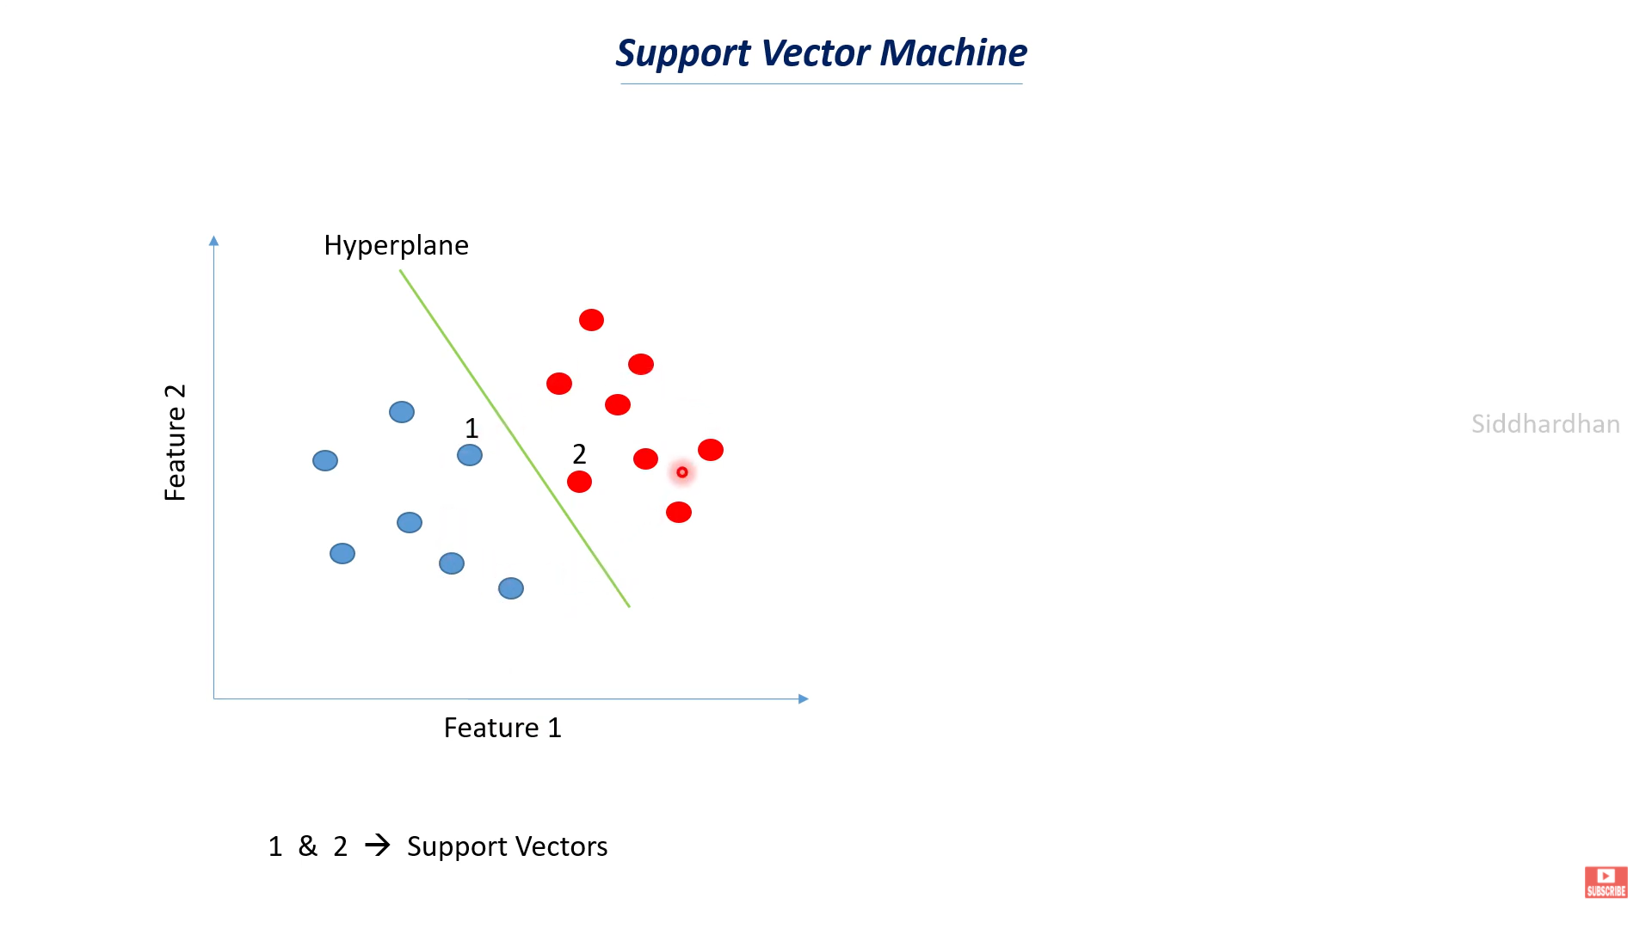

Slide 9
Support vector machine model is used for prediction. It creates a hyperplane between the Diseased people and normal people cluster so when a new data enters if its on the side of the Diseased people model will predict the data collected from the person has Parkinson’s disease otherwise it won’t.
SVM

Slide 10
Thank you.

