Slide 1
Industry Relevant Problem-Telecom
Subscriber ranking based on behaviour
Kashyap R Puranik (CS)
Arjun N Bharadwaj (EE)
Joseph Joseph (EE)

Slide 2
The Problem Statement
Rate and relatively rank subscribers to provide campaigns, bonus, customised care
Behaviour and not just expenditure
Take last month's rank into consideration
Parallelizable approach
An extensive algorithm
Large data available in CDR for all subscribers

Slide 3
Assumptions – The Basic Model
The subscribers and their service usage can be modelled as a network and graph theoretic approaches can be taken
We model it as a weighted non-directed graph
Subscriber → node
Edge between subscribers if cumulative revenue crosses a threshold T (parameter)
Sparse graph
Incidence matrix → bad one

Slide 4
Construction of the graph
T → The minimum threshold that the connection should cross to qualify as an edge
G = (E, V, W)
V → set of vertices |V| =N
E → set of edges = {e|e = (u, v) ^ u, vЄV ^
ConnectionValue(u, v) > T
ConnectionValue is a function E → R which will be defined soon

Slide 5
Assumptions – Graph Creation
A → B calls and B → A calls happen only because A and B are both there in the network
The graph is hence undirected
Pruning of graph is to restrict the number of edges and to ignore accidental and rare calls.

Slide 6
Construction of the graph
High level implementation
Store the list of neighbours for each node
weight of each edge in a graph
Distributed storage in hashtables all in RAM
Data access in constant time using functions
HashVertex(v) → returns location of neighbours of vertex
HashEdge(u,v) or HashEdge(e) → returns location of weights of an edge

Slide 7
Construction of the graph
Algorithm 1
Part1: Scan-stage (Input -> CDR_list)
for each CDR in CDR_list do:
value := getVallue(service, duration, cost)
addNeighbour(caller, callee)
addNeighbour(callee, caller)
addValue(caller, callee, value)

Slide 8
Functions used
AddNeighbour() takes one parameter gets the location using the HashVertex() function and adds the second parameter to the hash table
AddValue() takes an edge as a parameter to get the location of data storage for the edge using the HashEdge() function and adds the second parameter to the current value of the edge

Slide 9
Algorithm is Parallelizable
Iterations order independent
For loops can be executed concurrently
Distributed data storage in RAM

Slide 10
More Assumptions - Call Causality
Call A → B may cause B → C call
Coincidental or frequently occurring pattern
If so connection A → B value is more important than just the revenue generated
If 2 CDRs are as follows
Num | Caller | Callee | Time | Cost
M | A | B | T1 | C1
N | B | C | T2 | C2

Slide 11
Call Causality
(A → B) should benefit by a value given by
V = K * C1 * e^{( s ( T2 – T1 ) )}
V → value of benefit
K → benefit factor that (A → B) should get
S → another constant that determines the importance of the time difference. Can be tuned to make the benefit fall to very low values in a few hours (3 to 6 hours)
Closer the calls, more the benefit
BenefitValue(CDR1,CDR2) gives the above

Slide 12
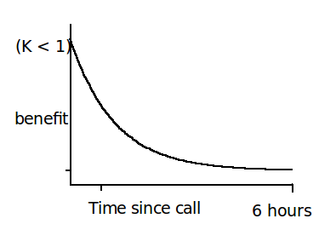
Call causality
Co-incidental occurrence of the phenomenon won't contribute much but frequent occurrences get added up and contribute to the overall benefit a causing connection gives

Slide 13
ConnectionValue
A new definition of weight of an edge in a graph which takes not just the expenditure but also causal relations.
An approximation for the hard problem of calculating exact total benefit ia described in the following slide

Slide 14
ConnectionValue()
Algorithm 2:
Maintain a queue of CDRs consisting of CDRs in the past H hrs → CDR_queue (say 6 hours)
d → diminishingFactor (say 0.25)
Repeat till convergence:
for each CDR in CDR_list
enqueue the CDR_queue with CDR
dequeue old CDRs from the queue
if ∃ (C1 =(A → B) ^ C2 → (B → C))
add d*benefitValue(C1,C2) to (A → B)
d = d*diminishingFactor

Slide 15
Construction of the graph (continued)
Part 2: Prune edges if
(ConnectionValue < Threshold)
For each CDR in CDR_list do:
value := getValue(caller, callee)
if (value < T):
dropEdge(caller, callee)
getValue() function uses HashEdge() function to get the value
dropEdge() function uses HashVertex() to remove a neighbour.
The algorithm is again parallelizable

Slide 16
Graph Clustering
Common clustering algorithms can be used to cluster huge graphs to deal with each cluster independently
Eg. CHAMELEON algorithm
- construct sparse graphs
- partition graphs
- merge closely lying partitions

Slide 17
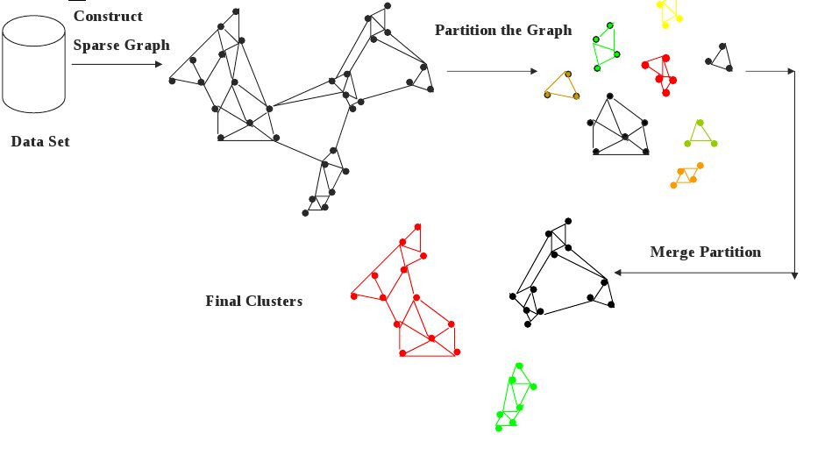
Graph Clustering (CHAMELEON)

Slide 18
Central Nodes
Closest nodes to the centre of a visible cluster
Centrality can be measured as
C(u) = Σ distance(u, v) ∀v ∈ Cluster(u)
Fleury's algorithm

Slide 19
Bridge nodes
They connect two clusters together
Not important monetarily but important because they cause information flow
May cause merging of clusters
They will then be the centres of the new cluster

Slide 20
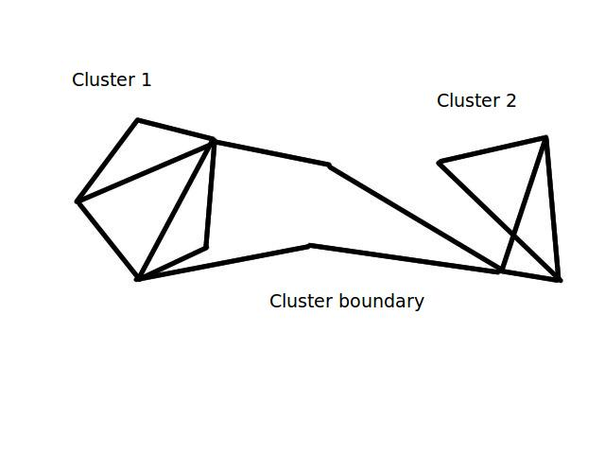
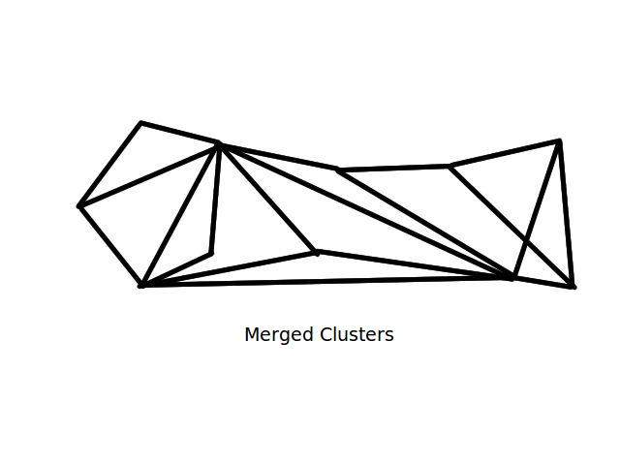
Cluster Merging

Slide 21
Random Walks
Consider a random walk in a cluster
Transition probability is given by
T(u, v) = ConnectionValue(u,v)/ ConnectionValue(u,w),w∈Neighbour(u)
Increment count each time a node is visited
The more the number of neighbours a node has, the more likely is its increment of count
More the value of a connection, more likely it is picked

Slide 22
Random Walk Algorithm
Algorithm 3
start at centre of cluster
Count(u) = 0, ∀u∈V
repeat N times till convergence of values:
Transit to neighbour 'n' with
probability T(u, n)
count(n) = count(n) + I

Slide 23
Ant Algorithms
Ants follow a unique algorithm to find the shortest way to a food source.
They lay pheromones on the path they take
2 paths length l1, l2 l1<l2 take time t1, t2 t1<t2
The pheromone concentration for a node on path of length l1 increases faster than the other
If probability of an ant taking a path depends on the pheromone concentration, ants find the shortest paths

Slide 24
Ant Algorithms
We run the ant algorithm to make the ants find the neighbouring cluster centres from a given cluster centre
The pheromone concentration(count) of the bridge nodes will be high
Hence this is a random walk method to find the most likely path for information flow between clusters and hence identification of the bridge nodes

Slide 25
Overall score in a cluster
By running the algorithms mentioned above, we have the following scores
Centrality Rank R1 (Score S1)
Random walk hit count R2 (Score S2)
Inter Cluster Connectivity Rank R3 (Score S3)
Use the above to get overall rank
a*S1 + b*S2 + cS3
Where a, b, c are tunable parameters
We get the rank of vertex v in cluster C: R(v,C)

Slide 26
Cluster ranking
Now that we have ranked nodes in clusters, we have to rank the clusters as well
Cluster Shinking:
For each cluster in the original graph, add a node in a new graph G'
Add edges between two nodes in G' if pheromone concentration on paths connecting neighbouring clusters exceeds a threshold T'
Value(C) C∈G' = Σ Value(u), u∈C
ConnectionValue(C,D)=Value(C)+Value(D)

Slide 27
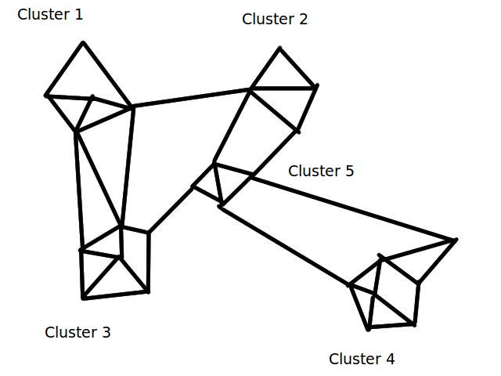
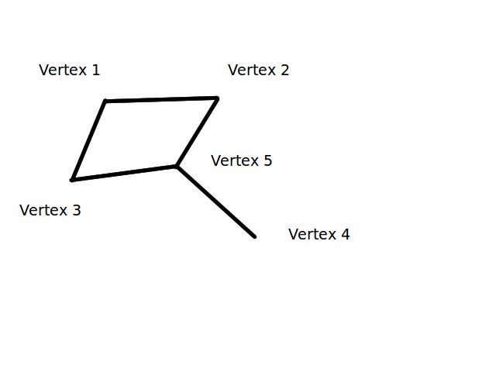
Cluster Shrinking

Slide 28
Cluster Ranking
Now we have a new graph with a limited number of nodes corresponding to clusters from the original graph
Run the above mentioned ranking algorithms to get the rank for each vertex in the new graph R(C), Score = S(C)

Slide 29
Overall ranking
Overall Score(u) = Score(C)*B + score(u) u∈C
B (Base) is a tunable parameter

Slide 30
An Alternate Solution
Page ranking
Expectation Maximization to calculate page-ranking to deal with circularity
Initialise:
Value(u) = Σ connectionValue(u, v)
∀v ∈ Cluster(u)
Expectation:
Pr_{n}(u) = Σd ( Pr_{n – 1}(v)/|Neighbour(v)| )
∀v ∈ Neighbour(u)
Maximization: Assign new PR scores to each node to maximize the probability of the PR scores correctness

Slide 31
Page Ranking
Eg.
A page's PageRank = 0.15 + 0.85 * (a "share" of the PageRank of every page that links to it)
The algorithm is repeated till convergence is observed
Obviously scalable because the EM step for each node can be independently calculated on different machines.

Slide 32
Conclusions
An algorithm to give a relative ranking to subscribers has been developed and has been shown to be parallelizable and scalable to a large extent depending on the number of clusters in the graph.

