Slide 1
Ignobel Prizes
Rigorous methods for bias-free evaluation of the talent of irritation
Kashyap R Puranik

Slide 2
Irritating people
commonly available means of pleasure
Legal in most countries
Top 5 in the list of most pleasurable activities according to a survey involving 12 of my friends
Different types: Sadists, masochists.

Slide 3
The idea
To quantify the irritation aptitude to score people on how well they irritate

Slide 4
Previous works
No documented work on irritation evaluation
Other phenomenon like funniness, geekiness has been quantified using tests and human judges
Facebook quizzes like “How evil are you”, “how happy are you”, “What pokemon are you” attempt some kind of quantification and clustering.
None of the above are bias free

Slide 5
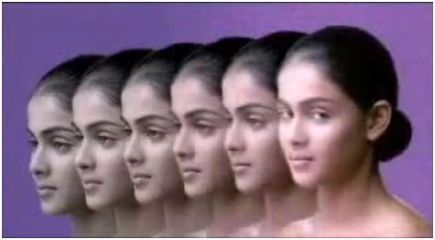
Fairness quantification
Place your face next to one of Genelia's faces that most matches your colour to get your score.

Slide 6
Previous Works
The only method of quantification of irritation talent currently available involves asking the irritator to rate himself on a scale of 10.
Not a scientific method
Designed by IITM arts students

Slide 7
The algorithm
Choose a mode that causes irritation
Select a set of random scenario-unaware audience
Execute the irritation process
Record the text (and video for analysis)
Analyze
Repeat
Don't get stuck in an infinite loop
Finally Give an overall average score

Slide 8
The approach in detail
The audio responses by the victims of irritation are converted to text using software
Scoring:- Sentiment Analysis is performed on the sentences to score the sentences
The average of all the scores obtained by a subject is assigned as his score

Slide 9
Video
Here is a video that shows a set of irritation techniques

Slide 10
Sentiment Analysis in detail
Extract a lexicon
- Create a file of seed words
- Use label propagation algorithm on Wordnet 2.0 to generate the lexicon
Convert a small seed file to a huge lexicon

Slide 11
Sample seed file
Witch -2.56
Fish -7.45
Shoot -0.64
Using the above seed file, we managed to extract a huge lexicon which of bad/swear words includes bi-grams and tri-grams.
A huge corpus was used for the extraction namely American rap songs.
(PS: These are all the bad words, the author knows. Open source contributions are welcome)

Slide 12
A part of the lexicon (N-grams)
what the fish -1.23
fudge off -3.45
sand of a beach -2.41

Slide 13
Experiments
A professional irritator was selected and he executed his actions, he chose the following actions
- Tickling
- spraying ice cold water
Audience :- Scenario unaware resting people
Location :- A nude beach

Slide 14
An Example
Video

Slide 15
Scoring a sentence
With the following lexicon
{ Value('what the fish') = -1.23, Value('sand of a beach') = -2.41, Value('fudge') =-0.63 }
Score(”What the fish! I will fudge you, you sand of a beach”) =
-(1.23 + 2.41 + 0.63) =
-4.27

Slide 16
Don't forget to insert a funny picture here

Slide 17
Sentiment Composition
(Freakin) (Awesome)
-4.50 +3.7
(Adj) (Noun)
+7.87 (and not -1.13)
(Freakin) (Sand of a beach)
(Adj) (Noun)
-4.50 -2.41
-4.91

Slide 18
Evaluation of the technique
People who were resting were abruptly disturbed and their reactions were recorded
Both the actions were performed on all of the victims at different times
They were asked to decide which act was more irritating
The following confusion matrix was obtained from the experiment
The intricate details of the experiment left to imagination (will be published later)

Slide 19
Confusion Matrix
Precision: 88.00%
Recall: 81.48%
 | Value (Method1) > Value (Method2) | Value (Method2) > Value (Method1)
DecisionFor = Irritator1 | 22% | 5%
DecisionFor = Irritator2 | 3% | 70%

Slide 20
Other applications
Schools
- Bad word detection by hidden microphones and analyzers for disciplining
students who can later be beaten up or hung upside down if found guilty
Assigning Scores to people's statements
- Kashyap R Puranik : AverageScore +3.57
- Rahm Emanuel (White house Chief of Staff) :
AverageScore -245.23

Slide 21
Conclusion
A quantification for irritation ability has been made and experiments suggest that the quantification works well and the model agrees well with human judgment

