Slide 1

IILM UNIVERSITY, GREATER NOIDA
INTERNSHIP REPORT PRESENTATION
Partnering with AI
in the Workplace
A Forage Job Simulation | Delivered in partnership with Datacom
Mohammad Kashif Saleem Ansari
Roll No. 2410031358 | B.Tech CSE, Section 2CSE 22
Completed August 2026

Slide 2






A B O U T T H E S T U D E N T
Candidate Profile
Roll Number
2410031358
Institute
Mohammad
Kashif Saleem
IILM University, Greater Noida, U.P.
Programme
B.Tech CSE, Section 2CSE 22, Batch 2025-26
B.Tech – Computer Science & Engineering
Internship Domain
AI Collaboration & Prompt Engineering
Duration
Self-Paced Job Simulation | Completed August 2026
Partnering with AI in the Workplace • Mohammad Kashif Saleem Ansari
02

Slide 3



A B O U T T H E P R O G R A M
Forage & Datacom
Forage hosts free, virtual, industry-designed job simulations built directly with partner companies, allowing students to practise the real tasks an entry-level employee would face before ever applying for a role. For this simulation, Forage partnered with Datacom — a technology services and IT solutions company operating across Australia, New Zealand and the wider Asia-Pacific region — to design a program focused on working alongside AI in a modern technical workplace.
Global Platform
Datacom-Designed
Verified Certification
Used by millions of students worldwide to build practical, resume-worthy workplace skills.
Tasks built with Datacom's own teams to mirror genuine day-to-day AI-collaboration work.
Completion is issued with unique Enrolment and User Verification Codes for authenticity.
Partnering with AI in the Workplace • Mohammad Kashif Saleem Ansari
03

Slide 4




P R O B L E M S T A T E M E N T
Bridging the AI Collaboration Gap
Modern workplaces increasingly rely on AI tools to accelerate research, content creation and software debugging. Yet many early-career professionals have never practised prompting AI effectively, verifying its output, or catching its mistakes — so they either avoid AI altogether or over-trust it without checking. This simulation was built to close exactly that gap.
This internship addressed that gap — practising the full AI-collaboration workflow:
→
→
→
Write Prompt
Generate with AI
Review Output
Refine & Submit
Partnering with AI in the Workplace • Mohammad Kashif Saleem Ansari
04

Slide 5






P R O J E C T O B J E C T I V E S
What the Internship Set Out to Achieve
Effective Prompting
AI-Assisted Research
AI-Powered Debugging
Write clear, specific, context-rich prompts that produce reliable AI output.
Partner with AI to research a topic, structure findings and create a work product.
Use AI to identify, explain and fix code errors without introducing new ones.
Verifying AI Output
Iterative Refinement
Workplace AI Judgement
Judge when AI output can be trusted directly and when it needs correction.
Practise revising a prompt when the first AI response falls short.
Gain realistic exposure to how Datacom expects employees to use AI responsibly.
Partnering with AI in the Workplace • Mohammad Kashif Saleem Ansari
05

Slide 6



S K I L L S & P R A C T I C E S
The Toolkit Behind the Internship
AI Chat Assistants
Prompt Engineering
AI Debugging Tools
Forage Platform
Prompting & drafting
Clarity & context
Diagnose & fix code
Task delivery & grading
Fact Verification
Documentation Tools
Iterative Refinement
Human-in-the-Loop
Checking AI claims
Drafting deliverables
Prompt → review → redo
Accountable review
Partnering with AI in the Workplace • Mohammad Kashif Saleem Ansari
06

Slide 7



T H E I N T E R A C T I O N L O O P
From Prompt to Verified Output
Task Brief
Simulation issues a realistic Datacom scenario and clear deliverable
↓
Prompt Composition
Brief translated into a specific, context-rich AI prompt
↓
AI Generation
AI produces a draft response, suggestion or code fix
↓
Human Review
Output checked for accuracy, relevance and completeness
↓
Refinement
Prompt revised and re-generated where output falls short
↓
Final Submission
Verified deliverable submitted for rubric-based assessment
Partnering with AI in the Workplace • Mohammad Kashif Saleem Ansari
07

Slide 8
M E T H O D O L O G Y
The Three-Module Learning Journey
1
2
3
MODULE
MODULE
MODULE
Writing Effective Prompts
Partnering with AI to Research, Design & Create
Click, Prompt, Fix — AI-Powered Debugging
Studied clarity, context, constraints and iteration; rewrote vague prompts into precise, task-appropriate ones.
Used AI to research and draft a deliverable, independently verifying key facts before finalising the output.
Used targeted prompts to diagnose a bug, evaluate the AI's proposed fix, and validate the corrected code.
Partnering with AI in the Workplace • Mohammad Kashif Saleem Ansari
08

Slide 9

E X P E C T E D O U T C O M E S
Skills & Capabilities Gained
Ability to write focused, context-rich prompts that reliably produce usable AI output
Practical experience combining independent judgement with AI assistance in a research task
A repeatable four-step approach to AI-assisted debugging: diagnose, explain, fix, verify
Greater awareness of AI's limits — knowing when confidence does not guarantee correctness
Comfort iterating on prompts rather than accepting an incomplete first draft
A completed, independently verifiable certificate of completion from Forage and Datacom
Partnering with AI in the Workplace • Mohammad Kashif Saleem Ansari
09

Slide 10
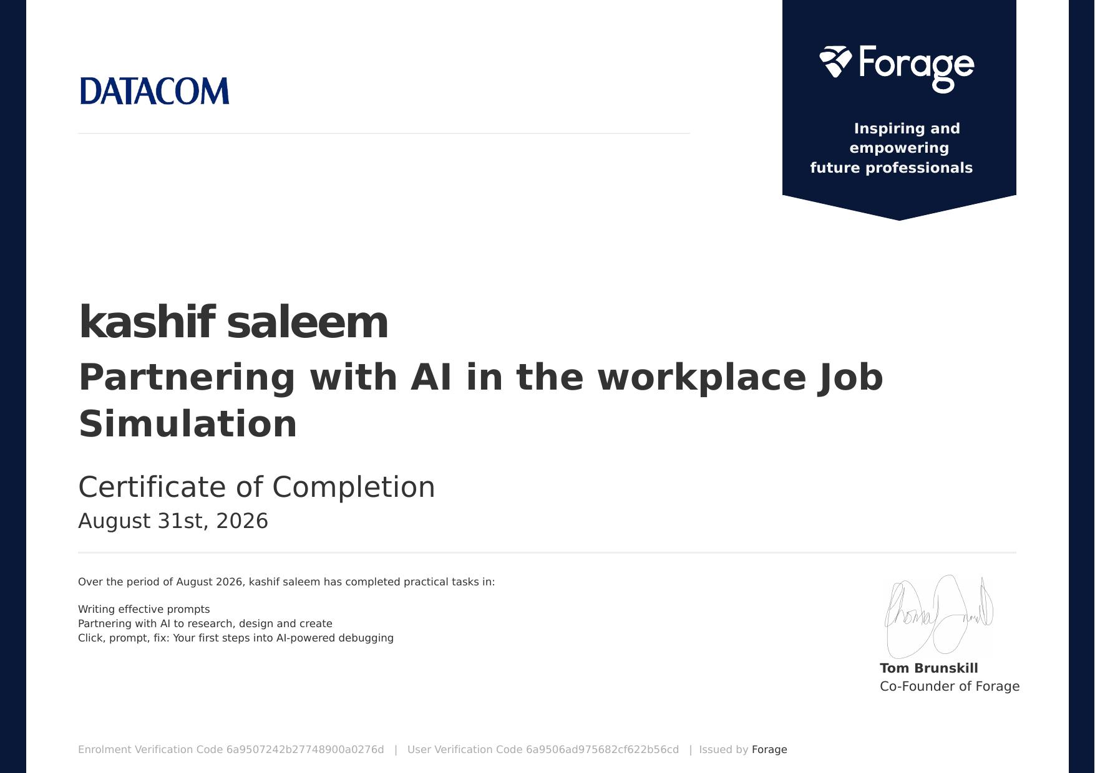

C E R T I F I C A T I O N
Successfully Completed
Status
Certificate of Completion
Enrolment Verification Code
6a9507242b27748900a0276d
User Verification Code
6a9506ad975682cf622b56cd
Issued
31 August 2026, by Forage on behalf of Datacom
Partnering with AI in the Workplace • Mohammad Kashif Saleem Ansari
10

Slide 11
Thank You
Partnering with AI in the Workplace | Forage × Datacom Job Simulation
Mohammad Kashif Saleem Ansari
Roll No. 2410031358 | IILM University, Greater Noida

