Slide 1
Crypto Forecasting
CSE523 Machine Learning Prof Mehul Raval
Mid-Semester Presentation Winter 2022
CryptoPolice
Sameep Vani AU1940049
Kavya Patel AU1940144
Kashvi Gandhi AU1940175
Khushi Shah AU1920171

Slide 2
Introduction
Cryptocurrencies are one of the most popular assets for speculation and investments but they are highly volatile. The fluctuating nature causes both hype and risk.
Crypto Forecasting is a process of utilizing the time- series data of given cypto currencies along with other features to predict the future value of these crypto currencies by analysing the past trends and data.
Through Crypto Forecasting, we intend to forecast
short term return in 14 popular cryptocurencies using Machine Learning.

Slide 3

Problem Statement
The dataset contains trade history of several cryptoassets like Bitcoin, Ethereum, Litecoin etc. Given the time series, the challenge is to predict the future returns on these assets through various regression and time-series models.
It is a classic supervised and regression machine learning problem.

Slide 4

Existing body of work
Time-series forecasting of Bitcoin prices using
high-dimensional features: a machine learning
01
approach
Forecasting and trading cryptocurrencies with
02
machine learning under changing market
conditions
Cryptocurrency price prediction using traditional
03
statistical and machine‐learning techniques: A
survey
Machine Learning Strategies for Time
Series Forecasting
04

Slide 5
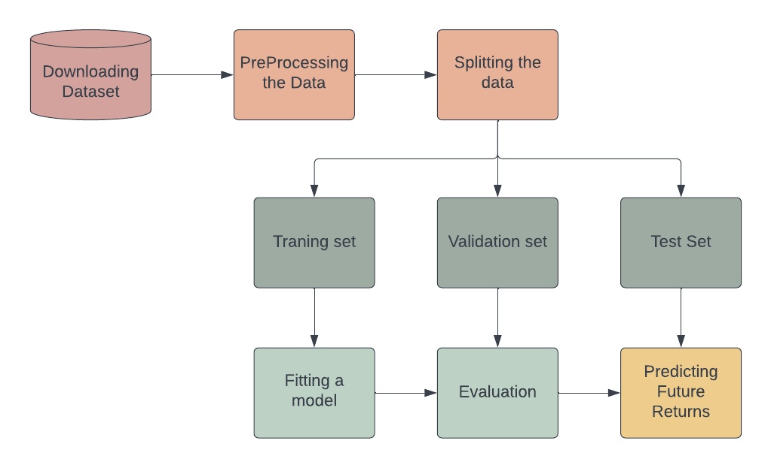
Approach

Slide 6
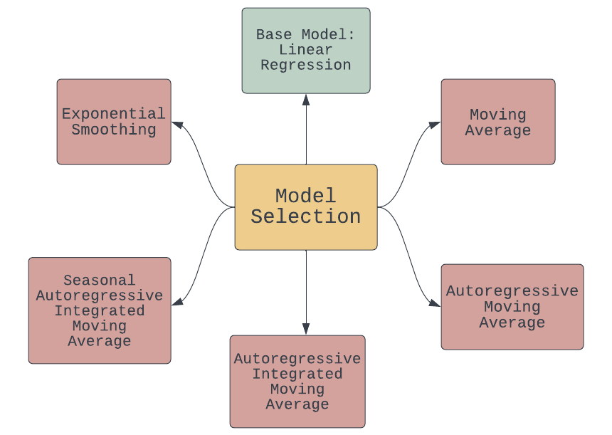
Approach

Slide 7
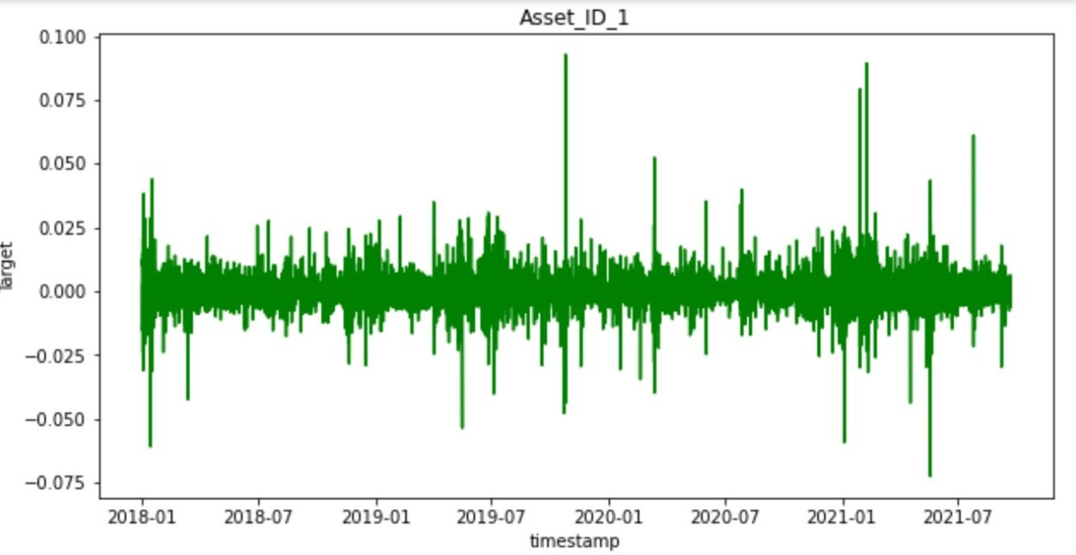
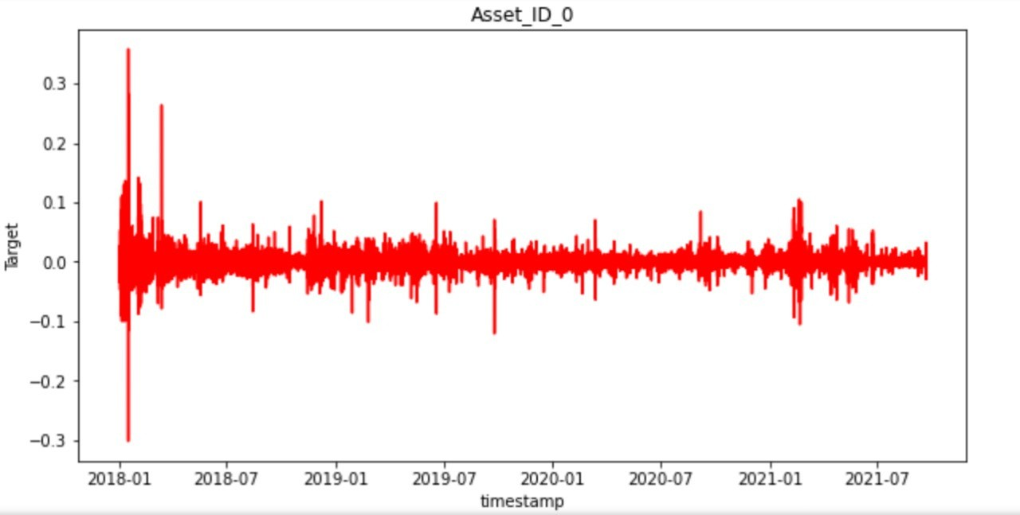
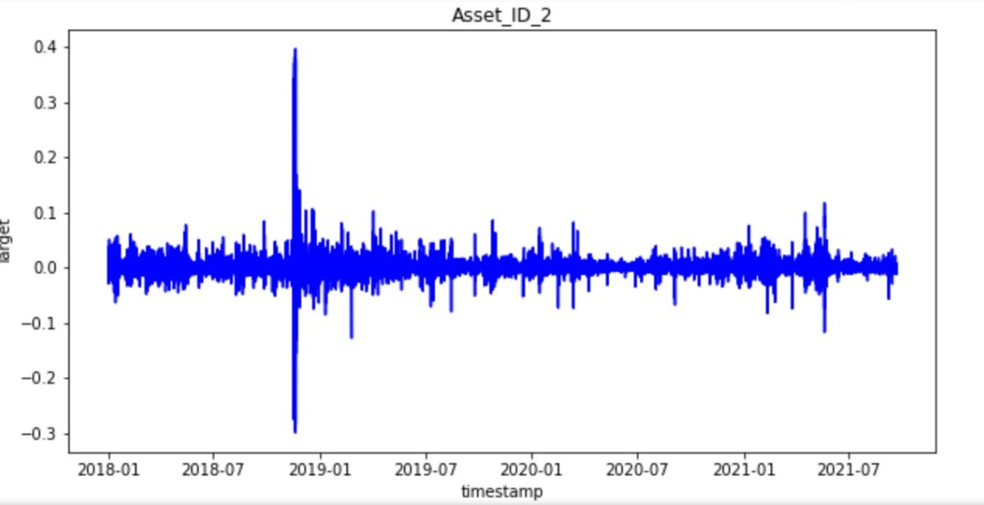
Results
Fig 2. Plot for Bitcoin
Fig 1. Plot for Binance Coin
Fig 3. Plot for Bitcoin cash

Slide 8
Fig 4. Linear Regression
Base Model - Linear Regression Graph - Time vs Target
Conclusion - Linear Regression Model can be a good fit.

Slide 9




Future Goals
Try Multiple Regression
Preprocess the Data
Visualization
Models
EDA for Time Series
Improve Accuracy

Slide 10
References
G-Research Crypto
01
Forecasting
A Comprehensive guide to T ime Series Analysis - Analytics
02
V idhya
03
The Complete Guide to Time
Series Analysis and Forecasting
T ime-Series Forecasting with
S park ML: Part— 1
04
05
Learn Time Series Tutorials

