Slide 1

LIVER DISEASE PREDICTION SYSTEM
A MACHINE LEARNING PROJECT
BY
DHEERAJ KUMAR GUPTA
AVNISH KUMAR KASHYAP
SUDHANSHU RAWAT
RISHABH SINGH
GAURAV KUMAR YADAV

Slide 2

Introduction
In India, delayed diagnosis of diseases is a fundamental problem due to a shortage of medical professionals. A typical scenario, prevalent mostly in rural and somewhat in urban areas are:
A patient going to a doctor with certain symptoms.
The doctor recommending certain tests like blood test, urine test, etc depending on the symptoms.
The patient taking the aforementioned tests in an analysis lab.
The patient taking the reports back to the hospital, where they are examined and the disease is identified.

Slide 3
Aim
The aim of this project is to help the User to identify whether a person needs special liver diagnosis or not.
The idea is to use the historical data of liver patients to predict whether a patient need diagnosis or not.
Problem Statement
Given a dataset containing various attributes of 583 Indian patients, use the features available in the dataset and define a supervised classification algorithm which can identify whether a person is suffering from liver disease or not.

Slide 4
About Dataset
Features:
The data set contains 416 liver patient records and 167 non liver patient records collected from North East of Andhra Pradesh, India. This data set contains 441 male patient records and 142 female patient records.
Any patient whose age exceeded 89 is listed as being of age "90".
Age of the patient
Gender of the patient
Total Bilirubin
Direct Bilirubin
Alkaline Phosphotase
Alamine Aminotransferase
Aspartate Aminotransferase
Total Protiens
Albumin
Albumin and Globulin Ratio
Dataset: field used to split the data into two sets (patient with liver disease, or no disease)

Slide 5
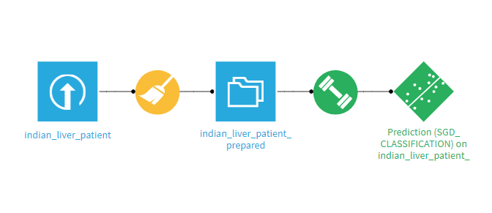
FLOW DIAGRAM

Slide 6
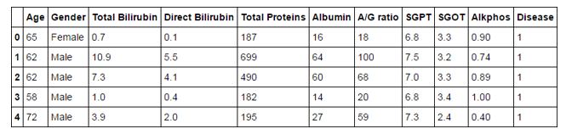
Data Analysis
Snapshot of Dataset :
Total rows = 583
Change Male 🡪 0 and Female 🡪 1 of column Gender.
Four entries of Alkphos are missing so drop the corresponding four rows.
Apply Logistic Regression, Artificial Neural Networks and Stochastic Gradient Descent(SGD) and evaluate different performance matrix.

Slide 7
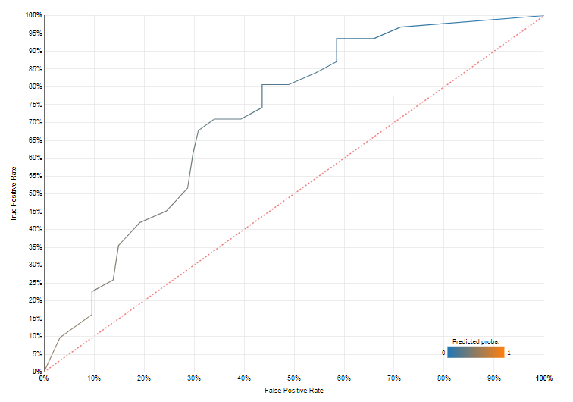
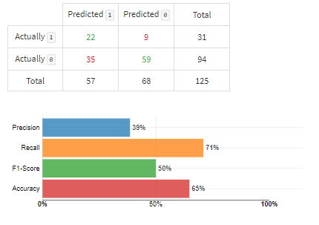
PERFORMANCE MATRIX OF ARTIFICIAL NEURAL NETWORKS
ROC CURVE (AUC = 0.717)
CONFUSION MATRIX

Slide 8
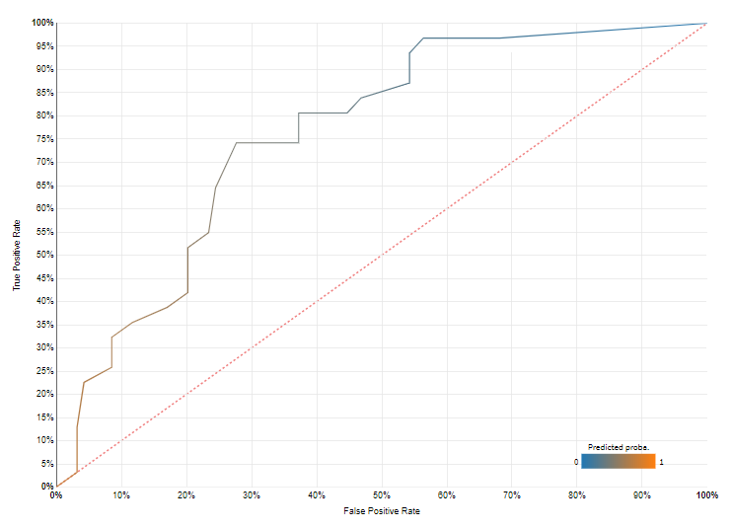
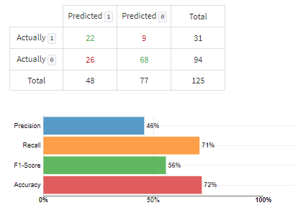
PERFORMANCE MATRIX OF LOGISTIC REGRESSION
ROC CURVE (AUC = 0.766)
CONFUSION MATRIX

Slide 9
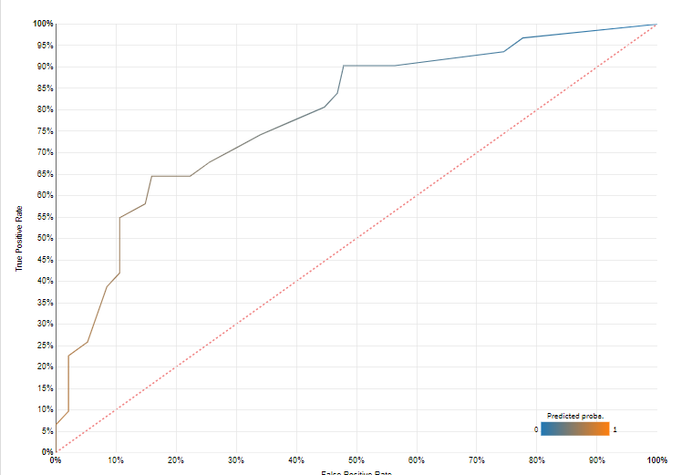
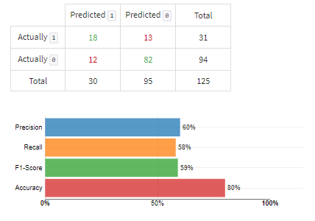
PERFORMANCE MATRIX OF SGD
MODEL SELECTED
ROC CURVE (AUC = 0.793)
CONFUSION MATRIX

Slide 10
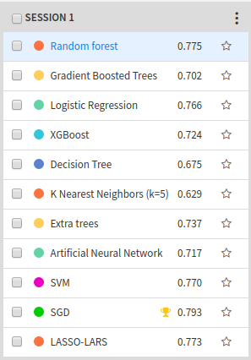
WHY SGD?
Stochastic Gradient Descent (SGD) is a simple yet very efficient approach to discriminative learning of linear classifiers under convex loss functions such as (linear) Support Vector Machines and Logistic Regression. Given that the data is sparse, the classifiers in this module easily scale to problems with more than 10^5 training examples and more than 10^5 features.

Slide 11
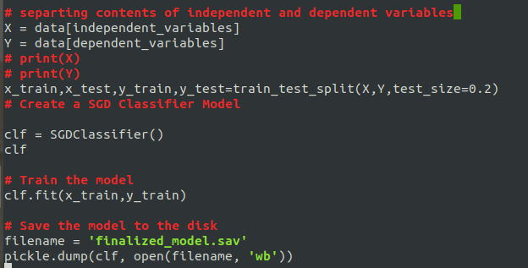
IMPLEMENTING SGDCLASSIFIER MODEL ON DATASET
Train the model

Slide 12

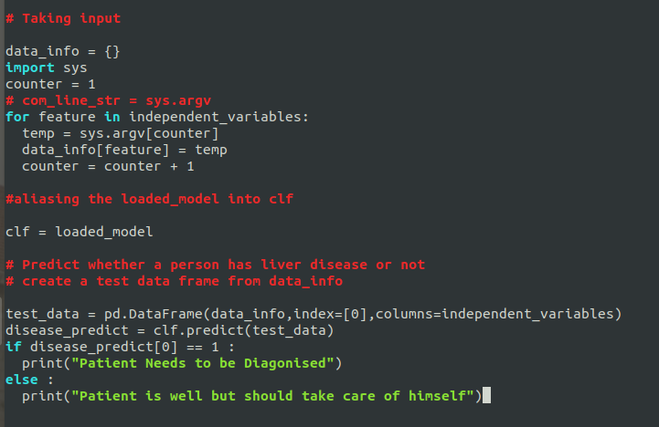
PREDICT THE OUTPUT BASED ON INPUT FROM USER

Slide 13
RESOURCES USED
http://18.221.152.62/
BACKEND:
PHP
Python3
CLIENT
Server:
Apache2
Front End :
HTML
CSS
Javascript

Slide 14

SCREENSHOTS

Slide 15
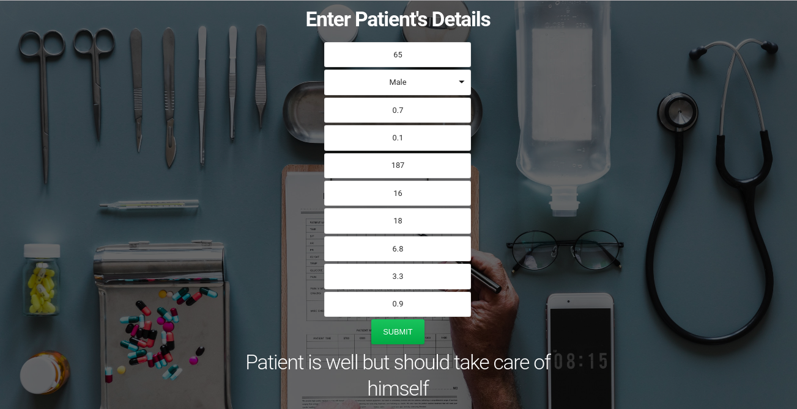

Slide 16
ACKNOWLEDGEMENT
This dataset was downloaded from the UCI ML Repository:
Lichman, M. (2013). UCI Machine Learning Repository [http://archive.ics.uci.edu/ml]. Irvine, CA: University of California, School of Information and Computer Science.
CONCLUSION
A web application of liver disease prediction system using SGD supervised classification has been developed.

Slide 17
THANK YOU !

