Slide 1
Crop Recommendation System
BT21CSE059 - Krishna Kashyap

Slide 2
Overview
By providing personalized recommendations based on soil and environmental factors, the system enables farmers to make informed decisions about which crops to cultivate on their land. This reduces reliance on guesswork and increases the likelihood of successful harvests.
The system takes into account factors such as soil nutrient levels, temperature, humidity, and rainfall to recommend crops that are well-suited to the prevailing conditions. This helps farmers optimize their use of resources such as fertilizers, water, and pesticides, leading to improved efficiency and cost savings.
By selecting crops that are best suited to the specific conditions of their fields, farmers can maximize their crop yields. This not only increases their profitability but also contributes to food security by ensuring a reliable supply of crops.
The system helps farmers mitigate risks associated with crop failure by recommending resilient crops that are better able to withstand adverse conditions such as drought or disease. This reduces the financial and emotional impact of crop loss on farmers and their communities.

Slide 3
Problem Statement
You are tasked with developing a recommendation system for crop cultivation based on various environmental factors.
The system will take several input parameters and provide a recommendation for the type of crop that is most suitable for cultivation.

Slide 4
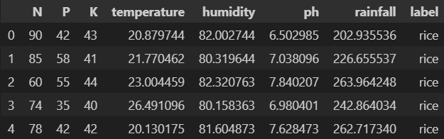
Dataset
Crop Recommendation Dataset (kaggle.com)
2200 rows - 22 classes, each data row classified into rice, wheat etc.

Slide 5
Input Parameters
N: The amount of nitrogen in the soil in kg/ha.
P: The amount of phosphorus in the soil in kg/ha.
K: The amount of potassium in the soil in kg/ha.
temperature: The temperature in Celsius (°C) at the time of crop cultivation.
humidity: The relative humidity in percentage (%) at the time of crop cultivation.
ph: The pH value of the soil.
rainfall: The amount of rainfall in mm during the crop cultivation period.

Slide 6
Output Parameters
Label:
The target variable which indicates the type of crop that is recommended based on the given environmental factors

Slide 7
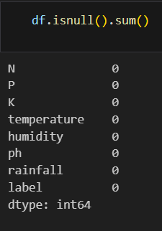
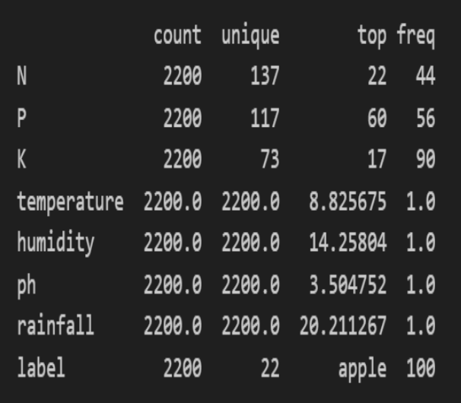
Data Preprocessing
Remove any missing or null attributes from the dataset.
Encode labels to digits

Slide 8
Candidate Algorithms
Logistic Regression
Naïve Bayes
Decision Trees
Support Vector Machines (SVM)
Random Forest

Slide 9
Libraries Used
Pandas: A powerful data manipulation library in Python, widely used for data analysis and manipulation.
NumPy: A fundamental package for scientific computing with Python, providing support for arrays, matrices, and mathematical functions.
seaborn: A Python visualization library based on matplotlib, providing a high-level interface for drawing attractive and informative statistical graphics.
matplotlib.pyplot: A collection of command-style functions that make matplotlib work like MATLAB for creating static, animated, and interactive visualizations in Python.
StandardScaler: A utility class in scikit-learn used for standardizing features by removing the mean and scaling to unit variance.
Scikit-learn: Simple and efficient tools for predictive data analysis

Slide 10
Accuracy Measure
Logistic Regression - 0.9522727272727273
Decision Tree - 0.9
Random Forest - 0.990909090909091
Naive Bayes - 0.990909090909091
SVM - 0.9795454545454545

Slide 11
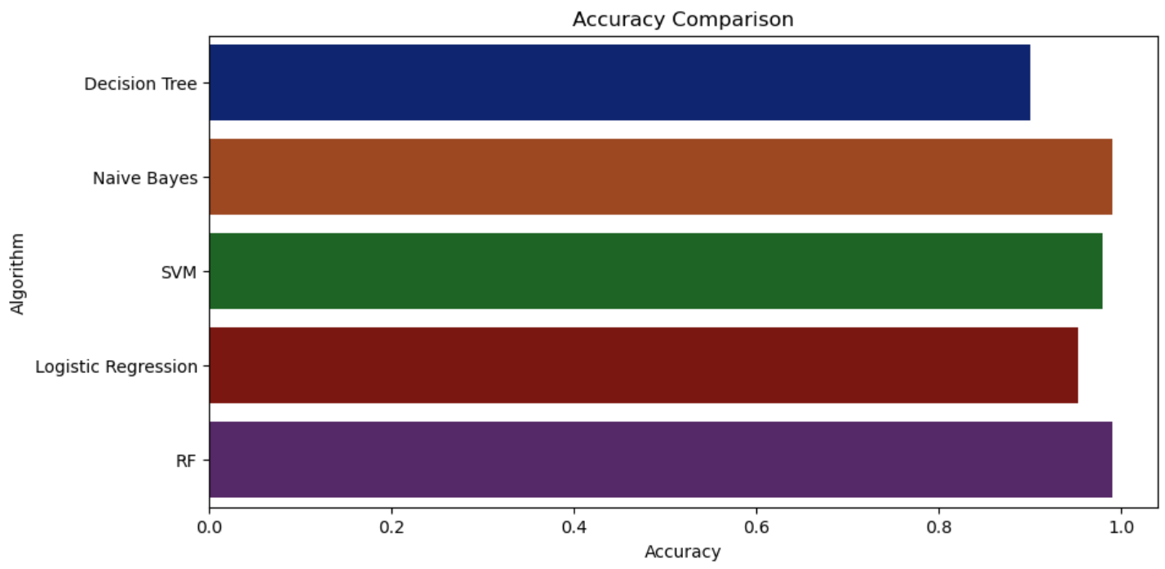
Algorithm v/s Accuracy Score plot
Best Algorithm that can be used: Random Forest Algorithm

Slide 12
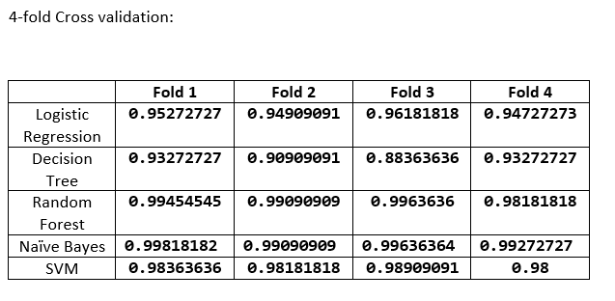
K-Fold Cross Validation The dataset is divided into k parts and then k-1 parts are used for training and the kth part is used for validation.

Slide 13
Advantages of Random Forest Algorithm
High Accuracy: Using several decision trees, each trained on a distinct subset of the data, Random Forest aggregates their predictions. Random Forest lessens the variation associated with individual trees, resulting in predictions that are more accurate, by averaging (for regression) or voting (for classification) the predictions of these trees. When using an ensemble approach instead of a single decision tree model, accuracy is typically higher.
Robustness to Noise: As Random Forest combines the forecasts of several decision trees, it is resilient to noisy data. Because noisy data points are unlikely to alter the forecasts of every tree in the forest, they have a lower chance of affecting the overall performance of the model. Random Forest works well with datasets that contain outliers or intrinsic noise because of its robustness.
Handles Both Numerical and Categorical Data: Without the use of Feature Engineering strategies like one-hot encoding, Random Forest is capable of handling a combination of numerical and categorical characteristics. The method can handle both types of data without bias since it automatically chooses random subsets of features for each decision tree during training.

Slide 14
Disadvantages of Random Forest Algorithm
Memory Usage: Random Forest models have a tendency to use a lot of memory, particularly when working with big datasets or deeply rooted trees. The training data, feature splits, and leaf node predictions must all be stored in each decision tree in the forest. Memory utilization rises with the number of trees or the depth of the trees, which may cause memory limitations on some hardware systems.
Prediction Time: Random Forest models can take longer to make predictions than certain other algorithms, even though they are more effective at training. This is particularly true for large datasets or models with a lot of trees. To get a final forecast, each observation must navigate through several decision trees in the forest. This might lengthen the prediction time, especially for real-time or latency-sensitive applications.

Slide 15
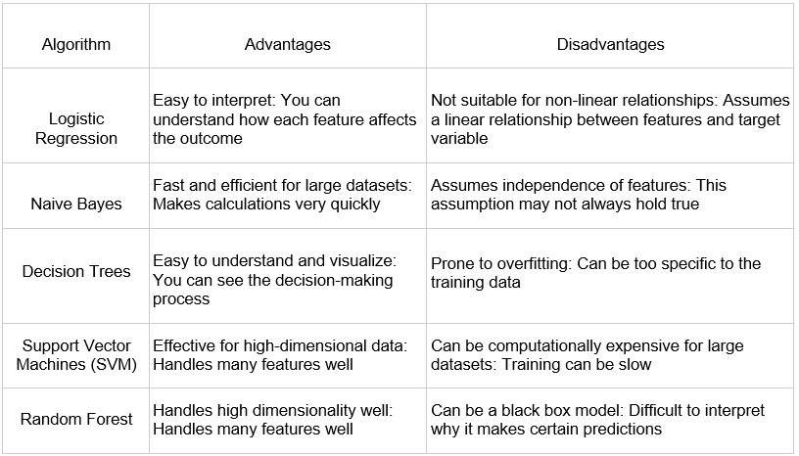
Advantages and Disadvantages

