Slide 1
Research Practice(BITS G540)
Joshi Kashyap Jayantkumar
2022H1030116P

Slide 2
Contents:-
Project Information
Image Dataset
Features Extraction
Image Retrieval Techniques:
k-nearest neighbors (knn)
Support vector machines(svm)
Results
Observations
Conclusion

Slide 3
Project Information:-
Title: Content-Based Image Retrieval
Paper Link: Content-Based Image Retrieval
Project Overview:
CBIR is a technique for retrieving digital images from a large database based on the image content, such as color, texture, shape, and other features, instead of relying on textual information or metadata. The paper provides a detailed explanation of popular feature extraction techniques, including color histogram, Gabor Wavelet, etc. Paper further describes the fundamental image retrieval techniques, the first being k-nearest neighbors (knn) and the second support vector machines(svm)

Slide 4
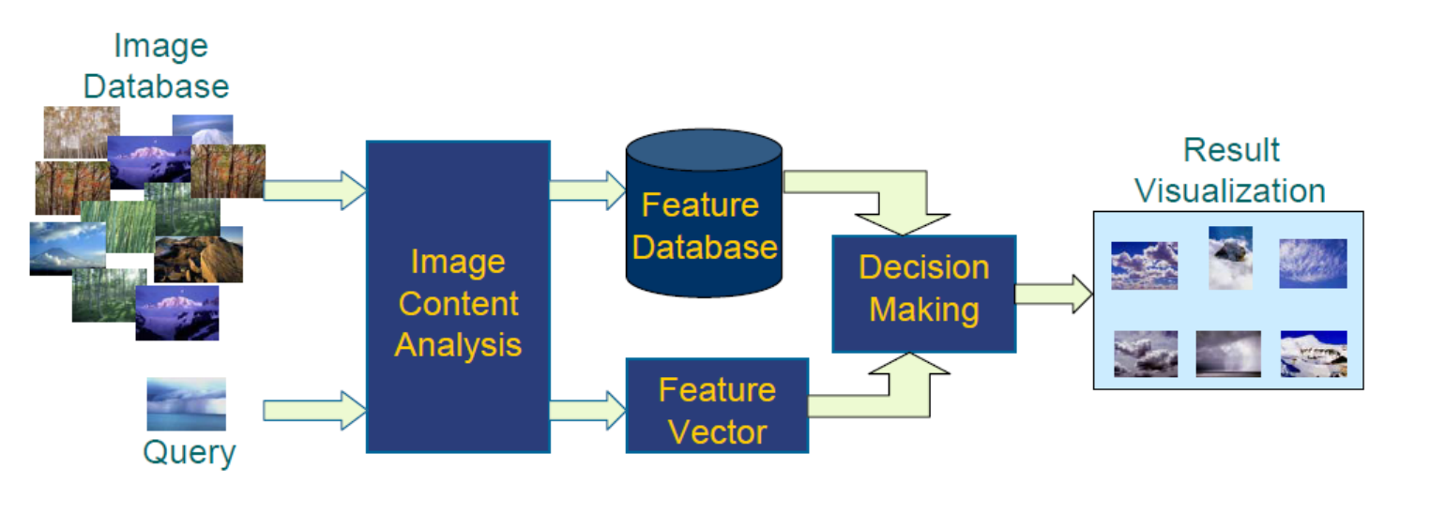
Schematic Overview

Slide 5
Image Data Set 1
Currently dataset of 1000 images has been taken.
Divided the dataset into ten different categories and labeled them.
Dataset : Dataset
Labels List
1.) Humans
2.)Beach
3).Monument
4).Buses
5)Dinosaurs
6)Elephants
7)Flowers
8)Horses
9)Mountains
10)Food

Slide 6
Image Data Set 2
The second dataset contains 1200 images of different celebrity faces
Divided the dataset into ten different categories and labelled them.
Dataset : ImageDataSet2_Faces
Labels
1.)Virat Kohli
2.)Salman Khan
3.)George Bush
4.)Barak Obama
5.)Michelle Obama
6.)Tom Cruise
7.)Jackie Chan
8.)Maria Kondo
9.)Priyanka Chopra
10) Tom Daschle

Slide 7
Feature Extraction
Image feature extraction refers to the process of identifying and extracting relevant information from images, such as colors, shapes, textures, and patterns.
In order to transform the raw pixel image into something meaningful that the prediction algorithm can understand.
These features can be used to train machine learning models for various computer vision applications, including object recognition, image classification, and facial recognition.

Slide 8
Feature Extraction
Color Histogram
In image processing and photography, a color histogram represents the distribution of colors in an image.
Color Histogram provides a simple yet effective, representation of the color distribution in an image. By analyzing the frequency of colors in an image, we can gain insight into its overall appearance
H(Hue),S(Saturation),V(Value) space is chosen here.
Quantized H, S, and V space into 8,2,2 bins, respectively.

Slide 9
Feature Extraction
Color Auto-Correlogram
The color auto-correlogram is a technique that captures the spatial distribution of colors in an image.
It is particularly useful for texture classification and object recognition tasks.
Here, the image is quantized into 4*4*4 colors in RGB space.

Slide 10
Feature Extraction
Color Moments
Taking , mean and standard deviation of R, G, B color channels.
By computing statistical features from the color channels of an image, we can obtain a compact representation of the color distribution that captures important information about the image content.
These statistical features can be used to distinguish between different types of images, such as those containing natural scenes, man-made objects, or specific types of textures.

Slide 11
Feature Extraction
Gabor Wavelet
Gabor Wavelet is able to capture important information about the texture patterns present in an image.
The filters are designed to analyze the image at different scales and orientations and can detect texture patterns that are not easily captured by other techniques.

Slide 12
Feature Extraction
Wavelet Moments
Wavelet moments are used in image feature extraction because they provide a compact and discriminative representation of the image information at multiple scales.
The wavelet moments also capture the texture and shape information present in the image, which can be useful for tasks such as object recognition, texture classification, and image segmentation.
Moreover, wavelet moments are less sensitive to noise and illumination changes than other feature extraction techniques, such as color histograms.

Slide 13
Feature Extraction
- Concatenate the features to form 190-dimensional feature vectors.
Features | Description | Dimensions
Color Histogram | HSV space is chosen, each H, S, V component is uniformly quantized into 8, 2 and 2 bins respectively | 32
Color auto-correlogram | The image is quantized into 4x4x4 = 64 colors in the RGB space | 64
Color moments | The first two moments (mean and standard deviation) from the R, G, B color channels are extracted | 6
Gabor wavelet | Gabor wavelet filters spanning four scales: 0.05, 0.1, 0.2, 0.4 and six orientations: θ0 = 0, θn+1 = θn + 6 π are applied to the image. The mean and standard deviation of the Gabor wavelet coefficients are used to form the feature vector | 48
Wavelet moments | Applying the wavelet transform to the image with a 3-level decomposition, the mean and the standard deviation of the transform coefficients are used to form the feature vector | 40

Slide 14
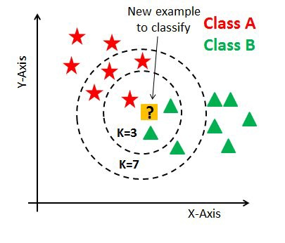
Image Retrieval Techniques
k-NN(K- Nearest Neighbour)
k-NN classification rule is to assign to a test sample the majority category label of its k-nearest training samples.

Slide 15
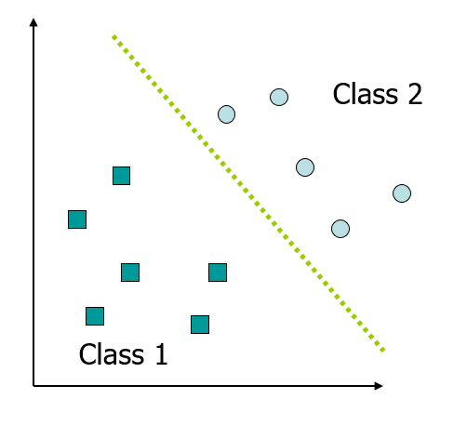
Image Retrieval Techniques
Support Vector Machine (SVM)
It is based on the concept of finding a hyperplane that separates the data into different classes or predicts a target variable.

Slide 16
Results
For Training: 80% Data
For Testing :20% Data
Image Data Set 1
Accuracy:80%
Image Data Set 2
Accuracy:87%

Slide 17
Observations:
Currently using a dataset that contains 1000 & 1200 images, which is not sufficiently large enough to get accurate results.
Features extraction techniques which we are currently using are efficient, but higher resolution images need more features to be included for more accurate results.
One major drawback of KNN is its sensitivity to high-dimensional data, such as images. where the distances between data points become large, and their relative ordering becomes meaningless.
KNN also requires a lot of computational resources to calculate distances between each pair of data points in the training set, which can be prohibitive in large datasets.

Slide 18
Observations:
SVM algorithm can be computationally expensive, especially when dealing with large datasets and high-dimensional feature spaces. In order to perform multi-class classification, multiple SVM classifiers must be trained, which can further increase computational complexity.
SVM can be sensitive to class imbalance, where one class has significantly fewer samples than another, leading to biased results.

Slide 19
Conclusions
The project implemented a system for image classification and similarity retrieval using feature extraction techniques and machine learning algorithms.
The results showed good accuracy in classifying images and retrieving similar ones.
Limitations were encountered due to the dataset.
Overall, the project demonstrates the effectiveness of feature extraction and machine learning techniques for image analysis tasks
For future work, we plan to explore the use of convolutional neural networks (CNNs) to improve the performance of our image classification and similarity retrieval system.

Slide 20
Thank You

