Slide 1


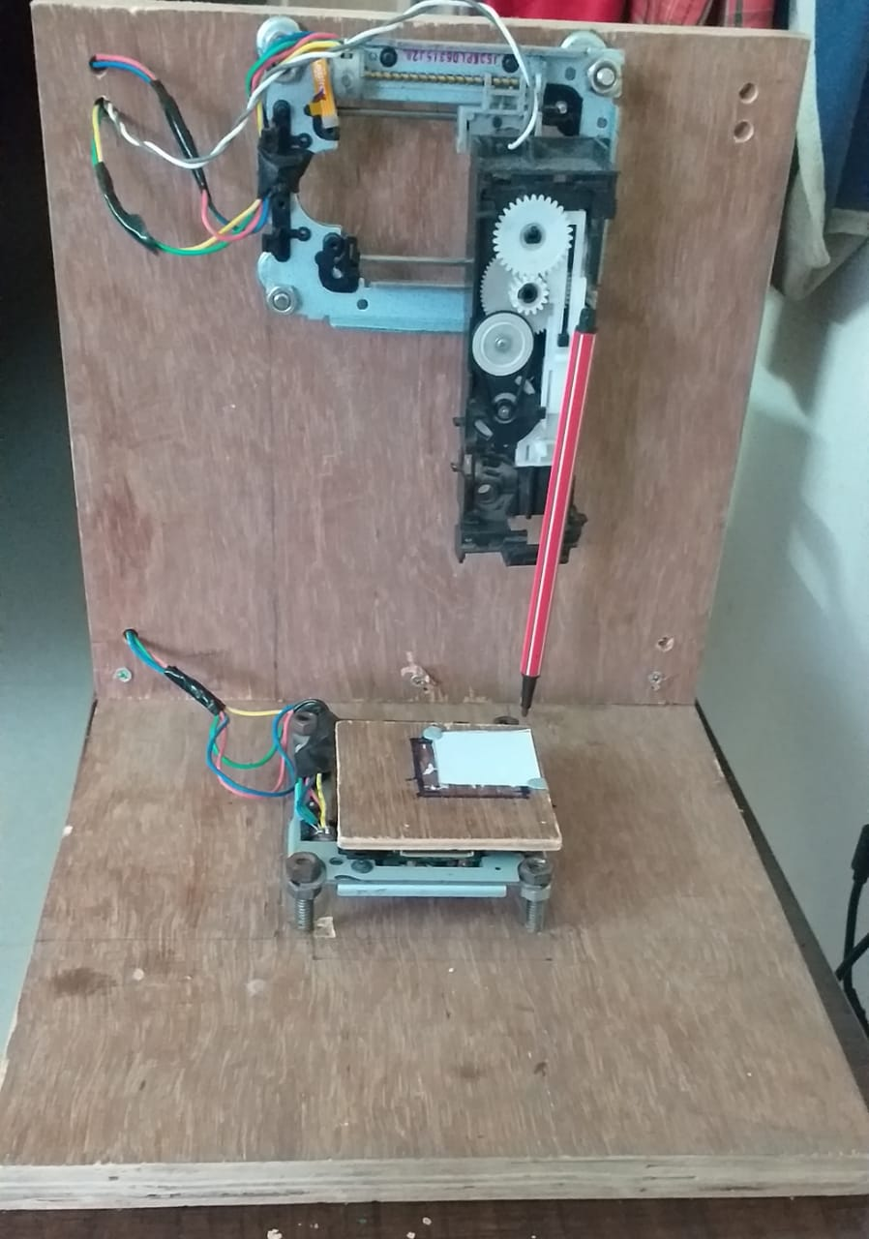
CNC Soldering machine
MENTOR:
Ashiq Rahman anwar batcha
Team Members:
Girinath R
Karthikeyan N
Kasi viswanathan S
Vasanth kumar v

Slide 2
Abstract:
We ECE students spend a lot of time in soldering ICs and other electronic components which is a very trivial task when compared to designing and testing. It would be awesome if we have a machine that does the soldering process after we design. The objective of our project is to build a Computer Controlled Soldering Machine that can solder Through Hole components placed on a PCB. It takes the co-ordinates of soldering points from a file generated by EDA software (Eagle/Altium) which are processed and fed to a micro-controller based device. This in turn controls the actuators and get our work done. This prototype would save a lot of circuit-building time.

Slide 3
LITERATURE SURVEY
S. No. | TITLE OF THE JOURNAL | NAME OF THE AUTHOR | YEAR OF PUBLICATION | INFEREFENCE | URL
1. | How to make Arduino mini CNC plotter machine | Sandeep | 27/09/2019 |  | Click here
2. | Control Stepper Motor with A4988 Driver Module & Arduino | NA | NA |  | Click here

Slide 4
3. | Convert ATX PSU to Bench Supply | NA | NA |  | Click here
4. | Interface L298N DC Motor Driver Module with Arduino | NA | NA |  | Click here
5. | ESP32 / ESP8266 Arduino: Serial communication with Python | Nuno Santos | 02/12/2017 |  | Click here

Slide 5
Designing PCB file
Generating CSV file
Extracting soldering points from CSV file using Python
BLOCK DIAGRAM
ESP32 receives the command wirelessly and controls the actuators
The calculated results are sent to ESP32(via Bluetooth from PC)
Calculating steps needed to traverse from one point to another using Python

Slide 6
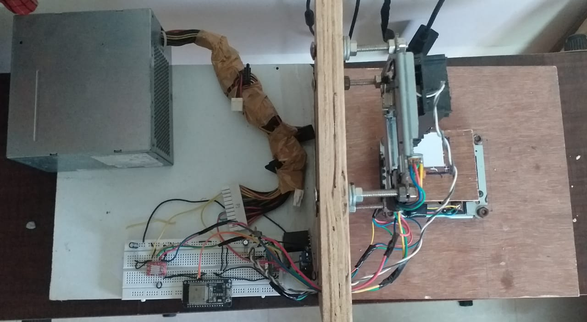
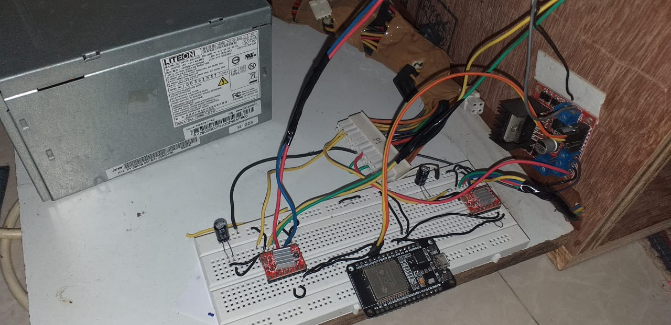
TOP VIEW
CIRCUIT SETUP

Slide 7
WORKING VIDEO:

Slide 8
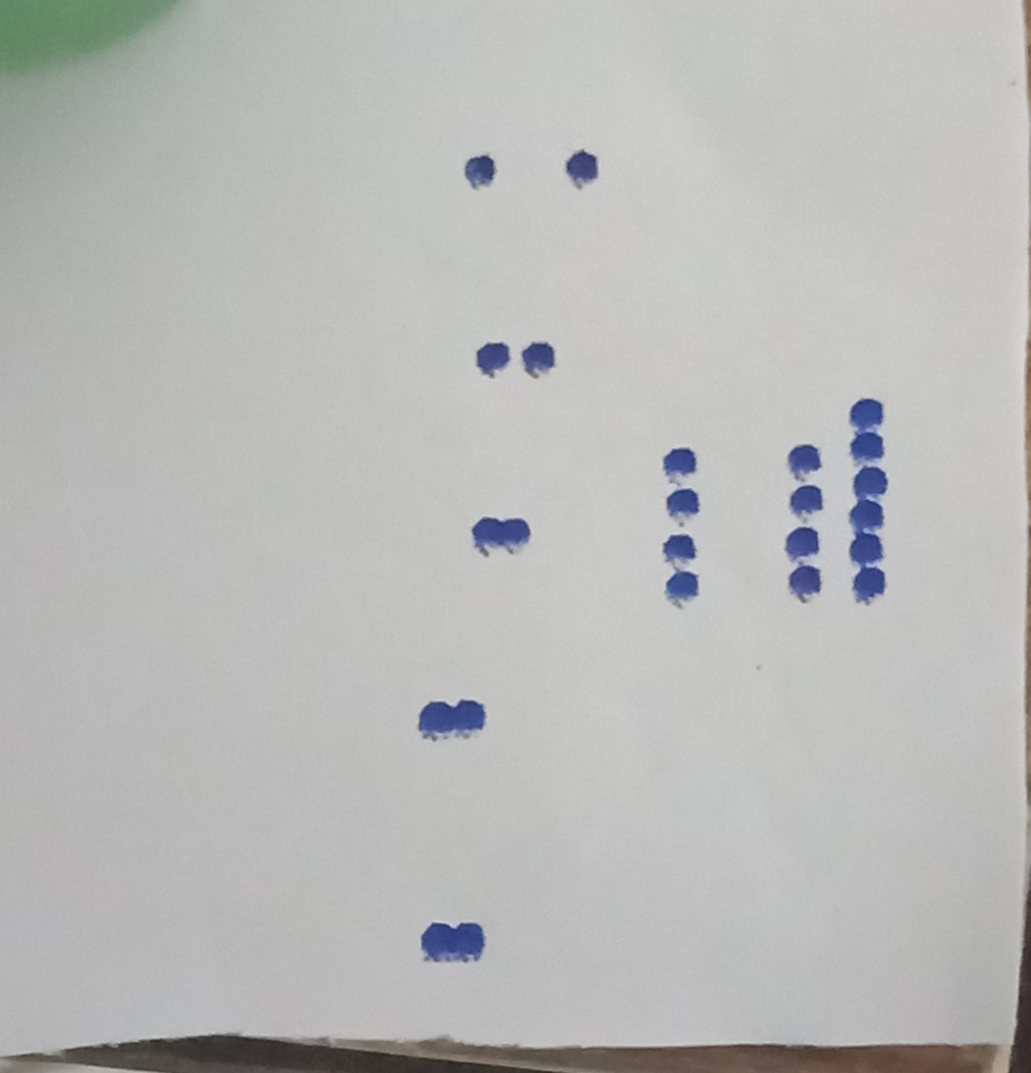
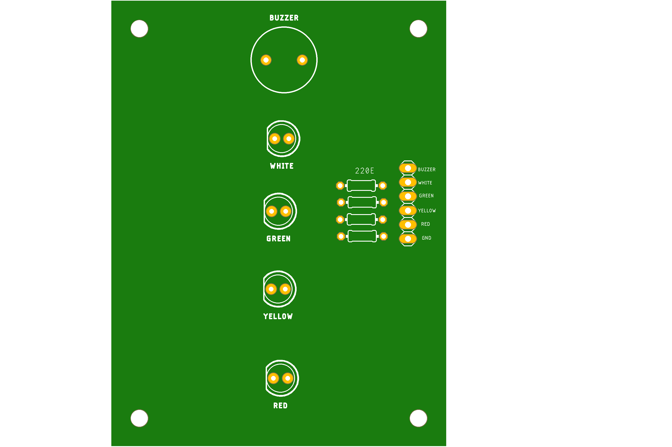
TEST OUTPUTS:

Slide 9
