Slide 1
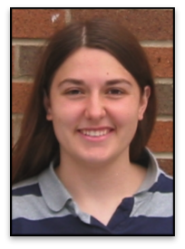
Differential relatedness of African Americans to populations within West Africa
Katarzyna Bryc^{1**}, Amy Williams^{1**}, Nick Patterson², Solomon Musani³, Michele Sale⁴, Wei-Min Chen⁴, Jasmin Divers⁵, Maggie C. Ng⁶, Donald W. Bowden⁶, James G. Wilson³, David Reich¹
1. Harvard Medical School, 2. Broad Institute, 3. University of Mississippi Medical Center, 4. University of Virginia, 5. Wake Forest University, 6. Wake Forest University School of Medicine, ** These authors contributed equally to this work.
Amy Williams

Slide 2
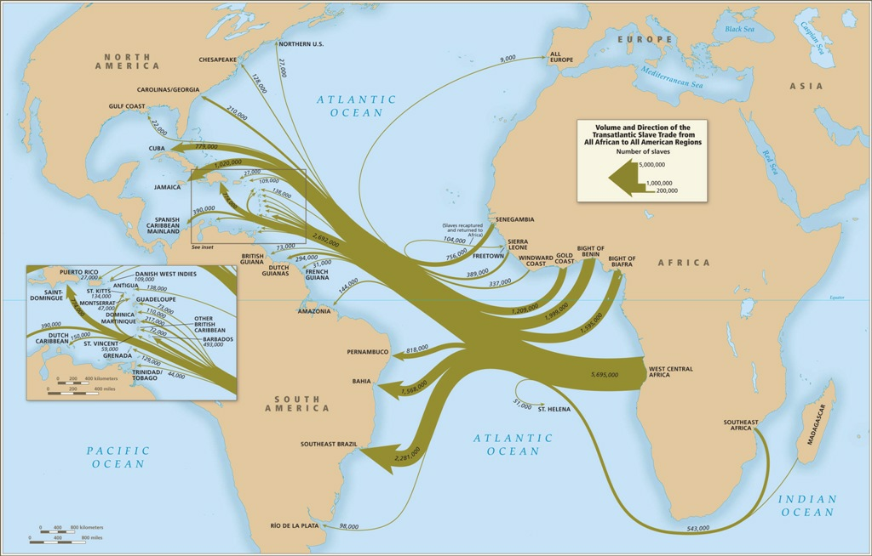
Trans-Atlantic Slave Trade
Regions:
Senegambia
Sierra Leone
Windward Coast
Gold Coast
Bight of Benin
Bight of Biafra
West Central Africa
Southeast Africa
Madagascar
Image from http://www.slavevoyages.org/

Slide 3
African American admixture
Can we learn more using genetic data?
Can we detect differences in ancestral populations among African Americans?
Notes:
Can we learn more about which African populations or groups contributed ancestry to African Americans in the U.S. by studying autosomal, high density, genetic data?
Can we detect differences in proportions of ancestral African populations among Afams from different parts of the U.S.?

Slide 4
Admixture
1
2
3
4
Ancestral populations
G1
G2

Slide 5
Admixture
1
2
3
4
Ancestral populations
G1
•
•
•
•
•
•
Ancestry deconvolution:
20% population 1
18% population 2
32% population 3
30% population 4
G8

Slide 6
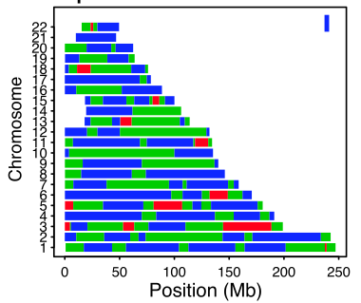
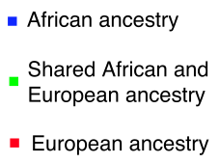
Local ancestry
“Chromosome painting”
African vs European proportions vary
Sex bias in ancestry contributions
mtDNA and Y chromosome haplotypes
Bryc et al. 2010, PNAS
Notes:
Who has seen such a figure before?
Lots of methods for this – LAMP, HapMix, PCADMIX, ChromoPainter. These results, and clustering methods such as FRAPPE, STRUCTURE, ADMIXTURE
But this is only for African/European ancestry – doesn’t tell us proportions of where this individual came from within African;

Slide 7
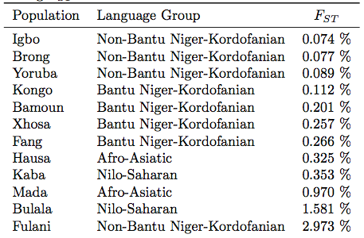
Fst calculations
Bryc et al. 2010, PNAS
Notes:
But this comes with potential biases in using local ancestry. Also, this doesn’t tell you about the proportion of ancestry that could be present within African Americans.
Difficulties: Any African American individual can contain segments from several (unknown) African populations.

Slide 8
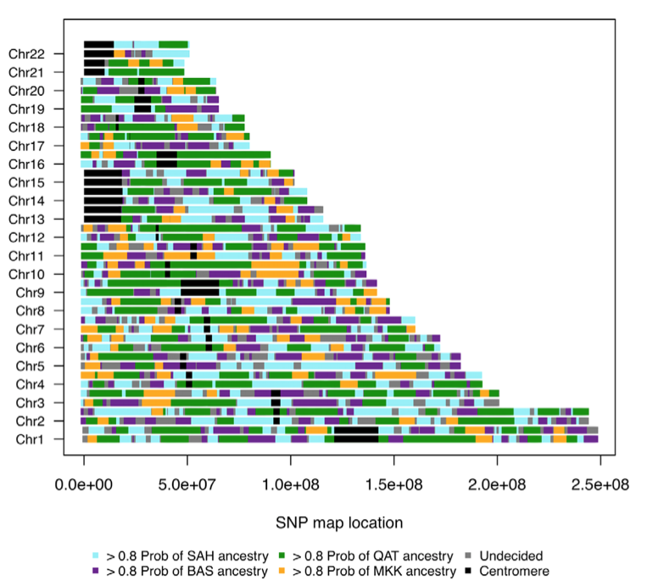
Local ancestry of an Egyptian
Saharawi – North Africa
Maasai – East Africa
Basque – Europe
Arabic Qatari – Middle East
Henn et al. 2012, PLoS Genetics
Notes:
Would love to do this for an African American – could then obtain proportions of ancestry for this individual for Assigning local ancestry of an Egyptian is highly challenging, even more difficult to assign.
One way to improve this would be to use haplotype information which becomes computationally infeasible. Similar allele frequencies among African populations.
[Maghrebi vs Berber ancestry]

Slide 9
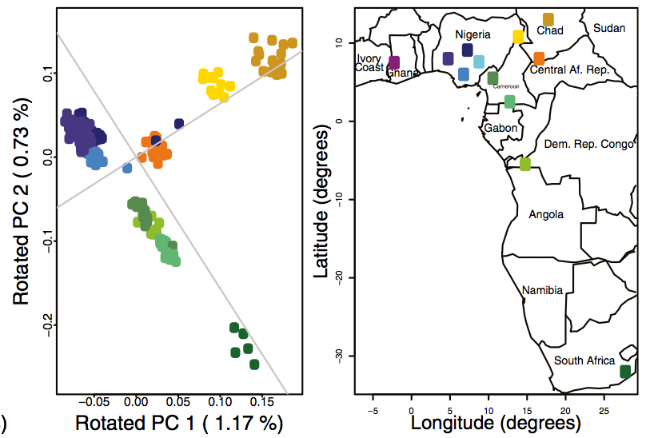


Population Substructure within Africa
Bryc et al. 2010, PNAS

Slide 10
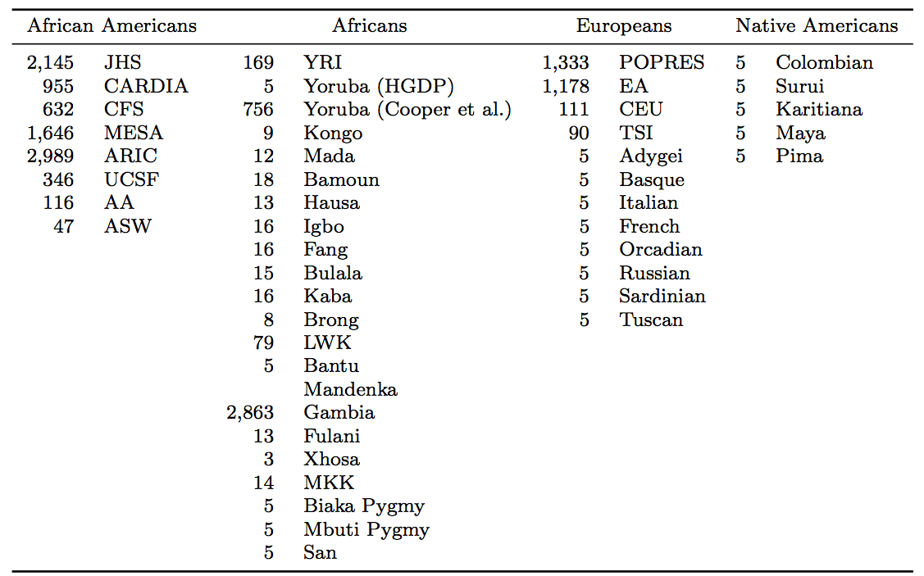
Identifying ancestral populations
Lots of data

Slide 11
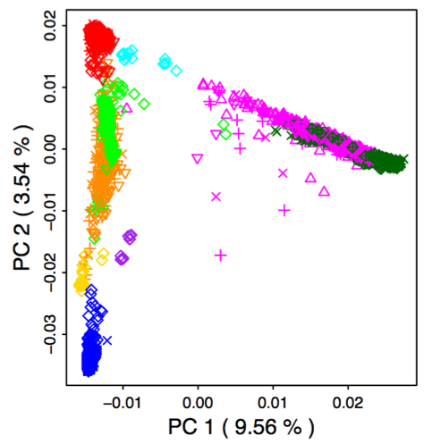
Identifying ancestral populations
Merge many datasets
Europe
Oceania
African American
South Asia
Latino
Africa
America
East Asia
Notes:
Clustering

Slide 12
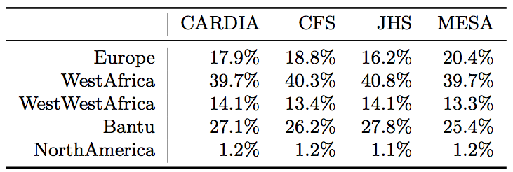
Approach 1: use lots of individuals
QPADMLIN Patterson et al. 2010, Hum Mol Gen
  Model:
  Inferences dependent on choice of populations

Slide 13
Approach 2: IBD
Identity-by-descent (IBD)
  Phasing via Williams et al. (in review, AJHG)
  IBD via GERMLINE (Gusev et al. 2008, Genome Research)
Relative proportions of IBD sharing
 | CARDIA | CFS | JHS | MESA
Sierra Leone | 9.1% | 9.2% | 9.3% | 9.6%
Gambia | 60.7% | 60.2% | 60.8% | 59.1%
Nigeria | 30.2% | 30.7% | 29.9% | 31.3%

Slide 14
Conclusions
Find Bantu, non-Bantu, and Sierra Leone/Gambian ancestry, at appreciable levels
No evidence for ancestry differences among African American cohorts

Slide 15
Future directions
Additional African American populations
  Gullah Sea Islands of South Carolina
Test more detailed models using QPADMLIN
Individual IBD sharing differences

Slide 16
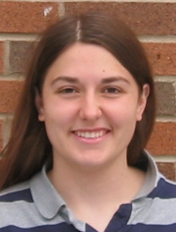
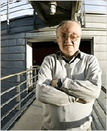

Acknowledgements
Amy Williams
Nick Patterson
David Reich
Collaborators
James G. Wilson
Solomon Musani
Michele Sale
Wei-Min Chen
Jasmin Divers
Maggie C. Ng
Donald W. Bowden
Reich Lab Members
Priya Moorjani
Sriram Sankararaman
Shop Mallick

