Slide 1
Separation of the largest eigenvalues in eigenanalysis of genotype data from discrete populations
Katarzyna Bryc
Postdoctoral Fellow, Reich Lab, Harvard Medical School
Visiting Postdoctoral Fellow, 23andMe
Rosenberg lab meeting, Stanford University
January 22, 2014

Slide 2
Goal: think a lot about PCA
Role in population genetics
  Exploratory data analysis
  Population structure inference
Relationship to other methods
Deepen understanding of the math
  i.e., what is an eigenvalue exactly?
Better interpret, understand, and judge PCA results

Slide 3
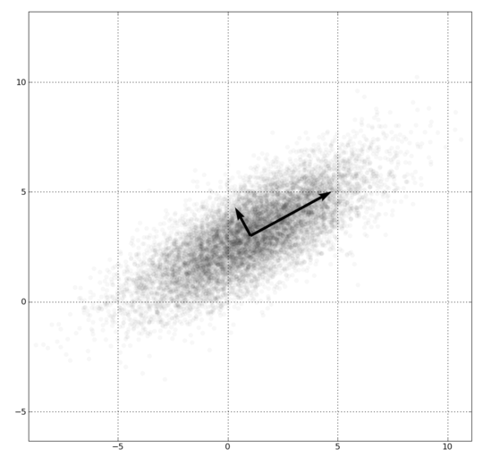
Principal Components Analysis (PCA)
Invented in 1901 by Karl Pearson
Goes by many names; lots of overlap with methods used in other fields
  Singular Value Decomposition (SVD)
  Eigenvalue decomposition of covariance matrix
  Factor analysis
  Spectral decomposition in signal processing
Nothing intrinsic to PCA for genetic data – it’s just a method

Slide 4
Role of PCA
natural selection
genetic drift
mutation
gene flow
recombination
population structure ← PCA
Population genetics
allele
frequency

Slide 5
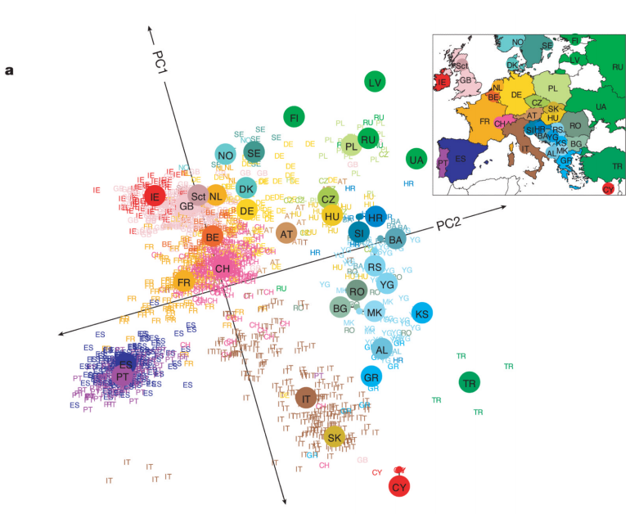
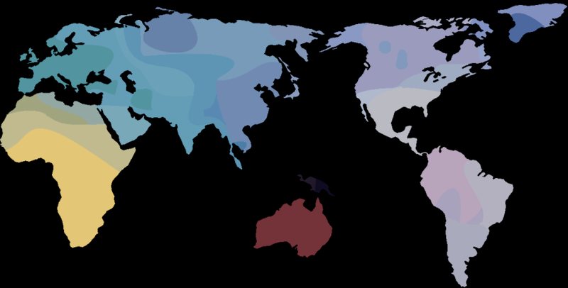
PCA in population genetics
Learning about human history
Visualization
Luigi Luca Cavalli-Sforza The History and Geography of Human Genes (1994)
Genes mirror geography within Europe
Novembre et al. (2008) Nature
Based on 194 blood polymorphisms from 42 populations suggested waves of expansion.
Based on 500K SNPs from 3,000 Europeans

Slide 6
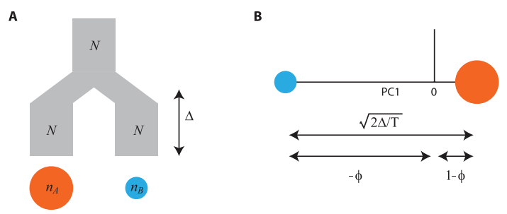
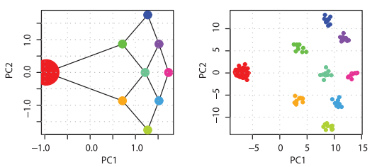
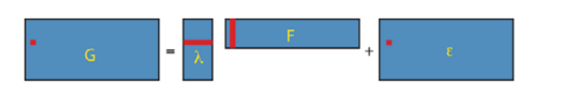
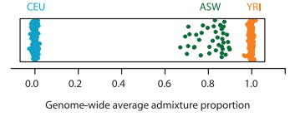
PCA in population genetics
Demography
Sampling
Admixture
View as matrix factorization unifies PCA and ADMIXTURE/STRUCTURE
Engelhart & Stephens (2010) PLoS Gen
McVean (2009) PLoS Gen

Slide 7
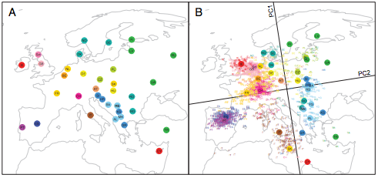

PCA in population genetics
Test for correlation with geography
Eigenanalysis: detecting and quantifying structure
Formal test for structure
Wang et al. (2010) Stat. App. Gen. Mol. Bio.
x is approximately distributed as Tracy-Widom
Procrustes transform of the data; PCA significantly similar to geographic coordinates
Patterson et al. (2006) PLoS Gen

Slide 8


Slide 9
To scale or not to scale
PCA is not scale-invariant
Typically each attribute (SNP) is normalized
  Makes sense if you want each SNP to be “weighted” equally
  But: Normalization by the sample variance (for a SNP) = normalization by a random variable. Eek!
For mathematical tractability, we do not normalize.

