Slide 1
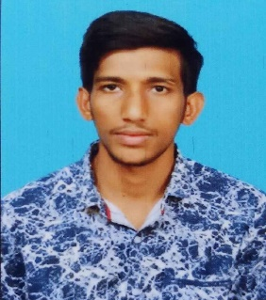

SELECTED EXPERIENCES
Kasi Durgarao
Associate Software Engineer
Done technical process of RO-Pro Product and made demo on it (Geo-fencing with Site tracker application).
Currently Undergoing through Google Associate Certification and AINoF Training.
PROFESSIONAL BACKGROUND
IT Foundation, Cloud Foundation, Java full stack with ReactJs, Azure Fundamentals (AZ-900), Network Services OSS SA L1 and L2, Network Services OSS SF L1 & L2, 5G BA L1, 5G Foundation, IT Enabler Technologies for OSS SA L1,Mobility Android L1
I've gone through the behavioural trainings like Business Com Etiquette, Business Com Written.
Done the installation Mongodb in AWS EC2 Instance and go through it.
EDUCATIONAL BACKGROUND
RAJAMAHENDRI INSTITUTE OF ENGINEERING AND TECHNOLOGY
B. TECH – ELECTRONICS AND COMMUNICATION ENGINEERING
1

