Slide 1


Hadoop Streaming-Based Real-Time Weather Data Analytics System
CSA1522-CLOUD COMPUTING & BIG DATA ANALYTICS
Guided by :
Dr. Rajaram P
Name of the student :
G. Manobhi Ram(192311322)
D. Sindhu prasad(192311271)
M. kasif(192424214)

Slide 2
List Of Content
Introduction
Abstract
Objectives
Literature Review / Background
Methodology
System
Design / Architecture
Module 1 – Cloud-Based Data Acquisition and Storage
Module 2 – Weather Data Analysis and Trend Detection
Module 3 – Cloud-Based Recommendation and Monitoring System
Cloud Computing / Techniques Used
Notes:
Image source: https://pub.mdpi-res.com

Slide 3
List Of Content
Implementation
Results & Discussion
Benefits for India
Challenges & Limitations
Future Scope
Conclusion
References
Notes:
Image source: https://pub.mdpi-res.com

Slide 4
Introduction
Weather forecasting and climate monitoring require the continuous processing of large volumes of weather data generated from sensors, weather stations, satellites, and IoT devices.
Traditional systems face challenges in handling high-speed data streams efficiently.
Hadoop Streaming enables real-time processing of weather information using distributed computing, allowing quick analysis of temperature, humidity, rainfall, wind speed, and atmospheric pressure for accurate forecasting and decision-making.
Notes:
Image source: https://pub.mdpi-res.com

Slide 5
Abstract
Real-time weather monitoring supports agriculture, disaster management, transportation, and environmental studies.
The project uses Hadoop Streaming and MapReduce to process weather data from multiple sources.
It analyzes temperature, humidity, rainfall, wind speed, and atmospheric pressure.
The system detects weather trends and abnormal climatic conditions.
Distributed storage and parallel processing provide scalable, reliable, and efficient analytics.
The system enables real-time insights for smart decision-making.
Notes:
Image source: https://www.mdpi.com

Slide 6
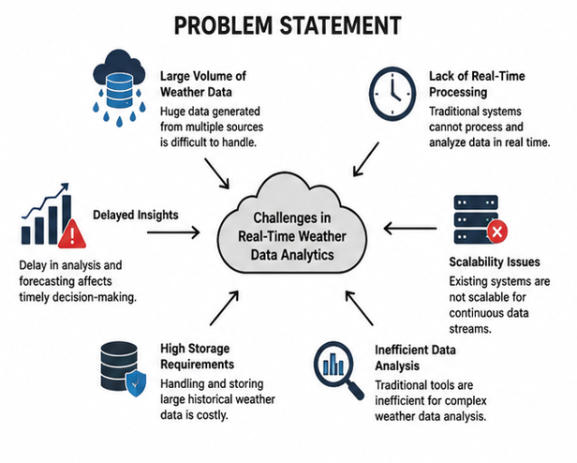
Develop a Hadoop-based weather analytics system.
Process weather data using Hadoop Streaming.
Analyze weather parameters in real time.
Store large-scale weather datasets efficiently.
Generate weather trends and reports.
Improve forecasting accuracy using distributed computing.
Objectives
Notes:
Image source: https://pub.mdpi-res.com

Slide 7
Literature Review / Background
Author / Study | Key Finding
V.K. Jain (2017) | Hadoop and Big Data enable efficient processing of large datasets.
Apache Hadoop Documentation | HDFS provides distributed and fault-tolerant data storage.
IEEE Research Studies | MapReduce supports large-scale distributed data processing.
ACM Research Studies | Hadoop can be applied to distributed computing and weather-data analytics.
Existing Weather Analytics Research | Weather parameters can be analyzed to identify climatic patterns and trends.

Slide 8
Methodology
Weather Sensors / APIs
Key Processing Stages:
Data ingestion
Distributed storage
MapReduce processing
Statistical analysis
Visualization and monitoring
Data Collection
Data Validation & Preprocessing
HDFS Storage
Hadoop Streaming Mapper
Shuffle & Sort
Reducer
Weather Analytics
Reports / Dashboard / Alerts

Slide 9
System Design / Architecture
Weather Sensors / APIs
Major Technologies Used:
Hadoop HDFS
Hadoop Streaming
MapReduce
Distributed Processing
Statistical Analysis
Data Acquisition Layer
HDFS Distributed Storage
Hadoop Streaming: Mapper → Shuffle & Sort → Reducer
Weather Analytics
Dashboard / Reports / Alerts

Slide 10
Module 1 – Cloud-Based Data Acquisition and Storage
Inputs:
Temperature (°C)
Humidity (%)
Rainfall (mm)
Wind Speed (km/h)
Atmospheric Pressure (hPa)
Process:
Collect weather data from sensors/API.
Validate and preprocess data.
Store data in HDFS.
Maintain historical weather records.
Output:
Distributed weather database
Real-time weather data availability
Historical weather repositor
handhoop Concepts Used:
HDFS
Data Ingestion
Distributed Storage
Hadoop Streaming
Notes:
Image source: https://pub.mdpi-res.com

Slide 11
Module 2 – Weather Data Analysis and Trend Detection
Inputs:
Temperature
Humidity
Rainfall
Wind Speed
Pressure
Process:
Read weather data from HDFS.
Execute Mapper using Hadoop Streaming.
Aggregate results using Reducer.
Analyze weather trends.
Output:
Average Temperature
Rainfall Statistics
Humidity Analysis
Weather Trend Report
Techniques Used:
Hadoop Streaming
MapReduce
Statistical Analysis
Notes:
Image source: https://pub.mdpi-res.com

Slide 12
Module 3 – Cloud-Based Recommendation and Monitoring System
Process
Display analyzed weather reports.
Monitor weather continuously.
Generate graphical reports.
Store processed results.
Provide weather alerts.
Outputs
Weather Dashboard
Temperature Trends
Rainfall Analysis
Weather Alerts
Historical Reports
Handhoop Concepts Used
HDFS
Hadoop Streaming
MapReduce
Distributed Processing
Notes:
Image source: https://pub.mdpi-res.com

Slide 13
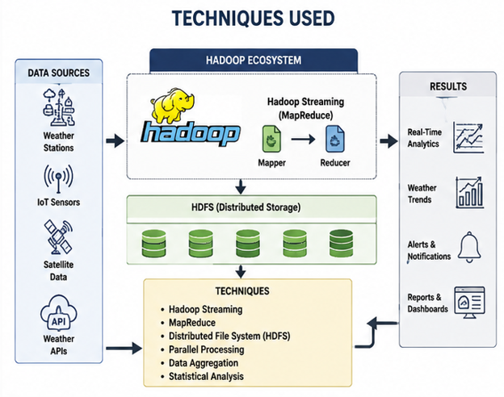
Techniques Used
Cloud Computing
adoop HDFS
Hadoop Streaming
MapReduce
Distributed File System
Big Data Analytics
Statistical Techniques
Mean
Variance
Standard Deviation
Trend Analysis
Data Visualization
Notes:
Image source: https://pub.mdpi-res.com

Slide 14
Implementation
Data Pipeline:
Collect weather data from sensors/APIs.
Validate and preprocess weather records.
Upload datasets to HDFS.
Implement Mapper and Reducer scripts.
Processing & Output:
Execute Hadoop Streaming jobs.
Calculate temperature, rainfall, humidity and other weather statistics.
Store processed results.
Generate reports and visualizations.
Sample Hadoop Streaming command (illustrative syntax):
hadoop jar hadoop-streaming.jar -input /weather/input -output /weather/output -mapper mapper.py -reducer reducer.py

Slide 15
Results & Discussion
Expected Output Analysis:
Average temperature
Rainfall statistics
Humidity analysis
Weather trend reports
Temperature trends
Weather alerts
Historical reports
Distributed processing provides scalable weather-data analysis
Temperature Trends
Rainfall Reports
Humidity Analysis
Weather Alerts
Illustrative report categories — conceptual, not based on measured project data.

Slide 16
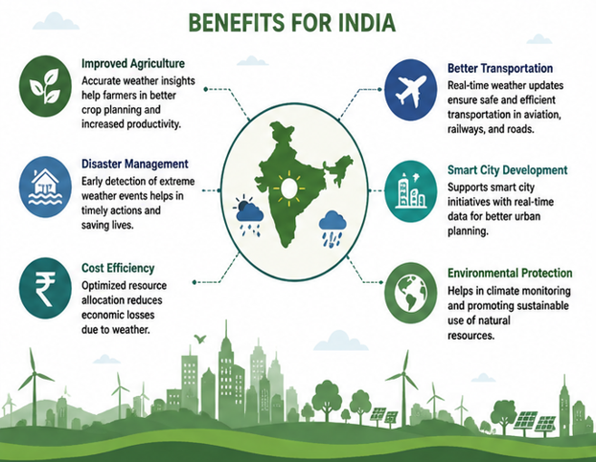
Benefits for India
How will this help India?
Improves weather forecasting accuracy.
Supports precision agriculture.
Helps in flood and cyclone prediction.
Assists disaster management authorities.
Supports smart city applications.
Notes:
Image source: https://www.mdpi.com

Slide 17
Challenges & Limitations
Handling continuous, high-volume weather data from multiple sensors and APIs.
Data validation and preprocessing to remove noisy or missing sensor readings.
Distributed system configuration and management across the Hadoop cluster.
Processing large datasets efficiently within acceptable time limits.
Maintaining reliable, fault-tolerant HDFS storage as data volumes grow.
Real-time monitoring requirements demanding low-latency ingestion and analysis.
Dependence on the availability and quality of external weather data sources.

Slide 18
Future Scope
Integration with live weather APIs and IoT sensors.
More advanced real-time analytics.
Machine-learning-based weather prediction.
Improved graphical dashboards.
Automated weather alerts.
Integration with smart agriculture systems.
Flood, cyclone and extreme-weather prediction.
Cloud-scale deployment for larger datasets.
Current System
Near-Term Enhancements
Long-Term Vision

Slide 19
Conclusion
Provides an efficient and scalable solution for real-time weather data processing.
Uses Hadoop Streaming, HDFS, and MapReduce for distributed storage and fast processing.
Enables accurate weather trend analysis and timely forecasting.
Supports disaster preparedness, agricultural planning, and environmental monitoring.
Improves decision-making through reliable real-time analytics.
Demonstrates the use of cloud computing and big data technologies for weather data.
Notes:
Image source: https://pub.mdpi-res.com

Slide 20
References
V.K. Jain, Big Data and Hadoop, Khanna Publishing House, 2017.
Apache Software Foundation, Apache Hadoop Documentation, Apache Software Foundation.
IEEE Xplore Digital Library – Research articles on Hadoop Streaming, MapReduce, Big Data Analytics, and Real-Time Weather Data Processing.
ACM Digital Library – Research articles on Distributed Computing, Hadoop-Based Weather Forecasting, and Big Data Analytics.
Donald Miner and Adam Shook, MapReduce Design Patterns: Building Effective Algorithms and Analytics for Hadoop and Other Systems, O'Reilly Media, 2012.

Slide 21



