Slide 2
Generic SAN adapter
Nathan
Aug 30th, 2013

Slide 3
Generic San Adapter
It’s effort to address some issues what we have now
Few of SAN models are supported
Only ISCSI connection supported and FC connection not supported
SC is the bottleneck of I/O performance and stability with DAS/Overlay drivers
The target of this generic san adapter
Leverage all existing SAN in customers data centers
Make the SC is out of the data path between VM and storage device.

Slide 4
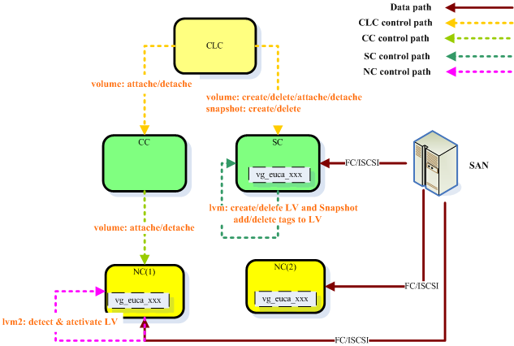
The solution Overview

Slide 5
Solution Overview (cont)
Eucalyptus don’t manage the data connection
Data connection between SAN and NCs/SC are setup as the SC and NCs registered into cloud.
Using LVM2
One big LUN (or multiple) of the SAN attached to all NCs/SC
One VG contains all of these LUNs.
One EBS volume is one LV in this VG
Implement snapshot by using LV snapshotting
SC is responsible for creating/deleting LV/ LV snapshot

Slide 6
Solution Overview (cont 1)
LVM synchronization
LVM information need to sync to NCs after SC change the VG (for example, new LV created)
Using “vgscan” to sync LVM information in NCs
LVM lock
In order to guarantee the metadata consistent, NCs are not allowed to change the VG (create/delete/change LV)
An customized lock is added for LVM2
Operation like Lvcreat/lvdelete/lvchange/vgexten are blocked to VG (name start with “euca-sharedevice-vg”

Slide 7
Solution Overview (cont 2)
LV Access Controlling
LV can be seen by all NCs.
Use host tag & activation filter to control the NC can only activate the LV which are attached to VM running in it.
Host tag is the IP address of the NC
Host tag will be added into LV when SC export the volume

Slide 8
Solution Overview (cont 3)
LV Access Controlling
LV can be seen by all NCs.
Use host tag & activation filter to control the NC can only activate the LV which are attached to VM running in it.
Host tag is the IP address of the NC
Host tag will be added into LV when SC export the volume

Slide 9
Solution Overview (cont 4)
Fencing (not implemented in this version)
To pretend EBS volume be accessed by a NC which identified as failed by SC/CC
Network between NC and SC/CC is broken, and NC is identified by CC as failed, but NC can still access the SAN.
SC force to delete or detach volume from VM running in this NC

Slide 10
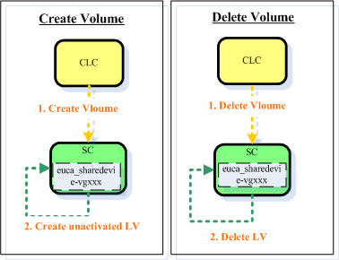
Process Scenarios

Slide 11
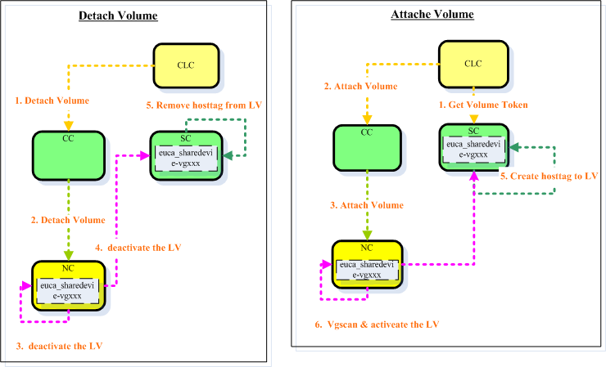
Process Scenarios (CONT 1)

Slide 12
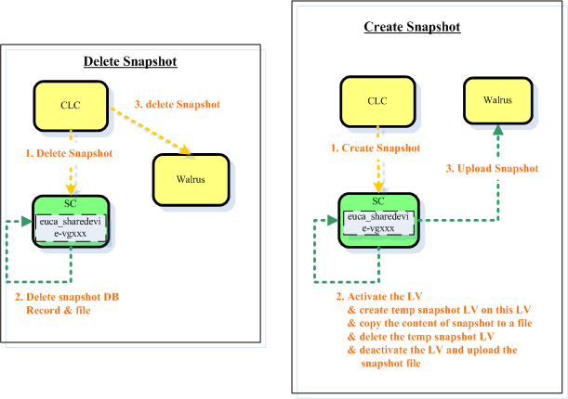
Process Scenarios (CONT 2)

Slide 13
Implementation
The generic SAN adapter include
A new block storage manager “clvm”
A customized LVM2 lock deployed in NC
Patches to iscsi connect and disconnect scripts in NC

Slide 14
Configuration
In SC
Configure the block storage manager
Euca-modify-property –p cluster01.storage.blockstoragemanager =clvm.
Configure the path of lun of san
Euca-modify-property –p cluster01.storage.sharedevice=/dev/sdb

Slide 15
Configuration (CONT 1)
In NC
Configure LVM2 (/etc/lvm/lvm.conf)
Configure the lock type as “2” and set external lock library as liblvm2eucalock.so
Configure host tag
Configure activation filter
Configure IQN (/etc/iscsi/initiatorname.iscsi)
clvm block manager need to get the IP address of NC from IQN
set the initatorname as “iqn.1994-05.com.redhat:xxx.xxx.xxx.xxx” xxx.xxx.xxx.xxx is the ip address of the NC.

Slide 16
HA Consideration (todo)
SC is out of data path between SAN and VM
SC cache the snapshot file
Consideration for HA
The snapshot file directory “$EUCALYPTUS/var/lib/eucalyptus/volumes should be a mount point and created on a shared san disk
When enable the SC, make sure the LVM information is synchronized (call vgscan) and re-mount snapshot file directory (refresh the file system)

Slide 17
Operations
Increase the capacity
Now, use LVM2 CLI to add the new LUN into the VG
Todo: modify the cloud property to add additional LUN to block manager, block manager will automatically create PV and add it into VG
Force to delete volume
Run LVM2 CLI to delete the host tag of LV

Slide 18
Nathan
Nathanxu@eucalyptus.com

