Slide 1


A. G. M. RURAL COLLEGE OF ENGINEERING AND TECHNOLOGY, Varur
Approved By AICTE, New Delhi, Affiliated To VTU, Belagavi and Recognized by State Govt.
DEPARTMENT OF COMPUTER SCIENCE AND ENGINEERING
2023-2024
TECHNICAL SEMINAR
On
FAKE REVIEW DETECTION SYSTEM
Under the guidance of
DR. CHANNAMMA P
PRESENTED BY
HARSHINI SELVARAJ
2AV20CS003

Slide 2
FAKE REVIEW DETECTION SYSTEM

Slide 3
Agenda
Introduction to Review
Classification of Fake Review.
Working of Fake Review detection system.
Phases Of Fake Review Survey Using Machine learning Approach.
Approaches of fake reviews
Fake Review detection Using Naive Bayes algorithm
Fake Review detection Using Random Forest Classifier
Fake Review detection using Decision tree.
Scope of Growth and Advantages
Conclusion

Slide 4
Introduction
Online reviews are comments, tweets, posts, opinions on different online platforms like review sites, news sites, e-commerce sites or any other social networking sites.
Fake or spam review refers to any unsolicited and irrelevant information about the product or service. Spammer writes fake reviews about the competitor’s product and promotes own products.
The reviews written by spammers are known as fake reviews or spam reviews. Thus fake reviews detection has become critical issue for customers to make better decision on products trustworthy as well as the vendors to make their purchase.
Reviews are considered as an individual’s personal thought or experience about products or services . Customer analyzes available reviews and takes decision whether to purchase the product or not . Therefore online reviews are valuable source of information about customer opinions .

Slide 5
The reviews on a product may be positive or negative, the negative reviews will attract the customers more than a positive review. These fake reviews can affect any business which leads to financial loses.
Fake reviews can appear in many websites or an social media platforms. The company owners will intentionally motivate some of the people to write the fake reviews to improve their business towards another product.
The focus of this research is to create an environment of online E-commerce platform where consumers build trust in a platform where the products they purchase are genuine and feedbacks posted on these websites/applications are true.
So our Final aim in this is to implement best approach available for detection of fake reviews using Machine Learning techniques. To let users, know if each individual review is trustworthy or not for efficient use of money from users side.

Slide 6
Classification of Fake Reviews:
The fake reviews are classified in two groups :
Untruthful reviews
Reviews on brands
Untruthful reviews:
These reviews promote or demote the products with positive or negative words respectively and misguide the customers.
Reviews on brands:
These reviews are not related to products, not on the different features of the product or services. Reviewer uses brand name repeatedly to promote a particular brand.

Slide 7
There are three basic approaches for identifying fake reviews:
These three approaches are as follows:
Review Centric Approach.
Reviewer Centric Approach.
Product Centric Approach.
Review Centric Approach:
This approach identifies review as fake review based on the content of reviews written by reviewers. In this method, various features like review content similarity, use of capitals, use of numerals, brand name, similarity between products and reviews, repeated use of good and bad words in review are considered.

Slide 8
Reviewer Centric Approach:
This method depends on the behavior of reviewers. This approach considers information about users and all reviews that are written by them . Features used in this method are account age, profile picture, URL length, IP address, number of written reviews by one reviewer, maximum rating per day etc.
Product Centric Approach:
This method mainly focuses on the product related information. In this method, sales rank of product, price of product etc. are considered as features.These includes products Reviews.

Slide 9
Working of Fake Review detection System
Data Collection
Data Pre-Processing
Feature Extraction
Model Training
Classification

Slide 10
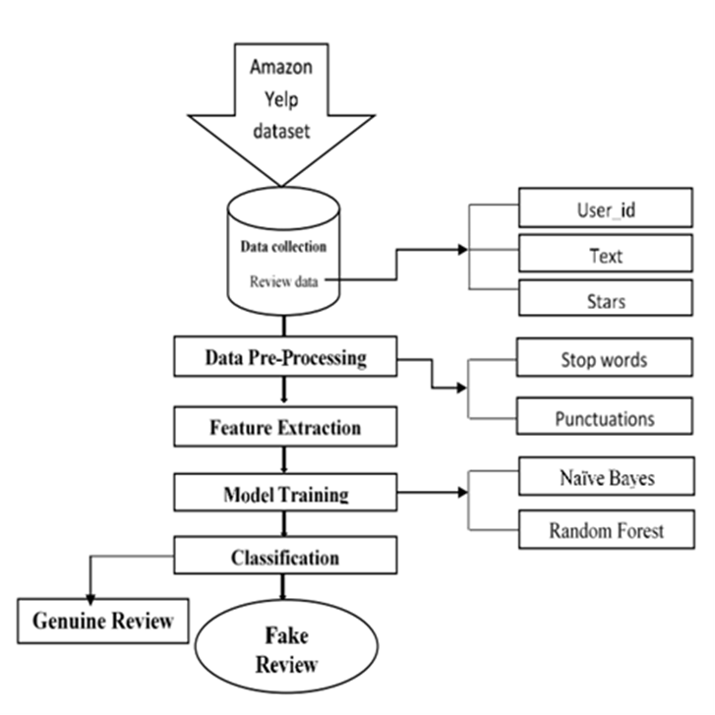
Methodology of Fake Review Detection

Slide 11
Fake Review Detection works as follows:
Data collection:
In this phase, review data will be gathered from various platforms like Amazon. These reviews could be for product or service like hotel reviews.
Data pre-processing:
In next step, data preprocessing is applied like punctuation marks removal, stemming, stop word removal etc. In punctuation marks removal, the whole text is divided into sentences, phrases or paragraphs. In the stemming process, stem will be created from every word in dataset. In stop word removal phase, frequently used group of words like determiners, articles and preposition will be detected and removed. After removing these words, only important words will be retained for the next step.
Feature extraction and selection:
In this step, features are extracted from the preprocessed data. Feature extraction refers to the process of transforming raw data into numerical features that can be processed while preserving the information in the original data set. In the feature selection includes reducing the input variable to the model and using the relevant data to train model.

Slide 12
Classifier model construction and testing:
For training purpose, small set of labeled data is used. In this phase, classification model is generated by using the training review dataset. The reviews used for this purpose are already labeled as fake or genuine review. Once the classifier is trained, it will be tested using test dataset. The different machine learning algorithms which can be used for model construction are naive bayes classification, decision tree ,etc.
The performance of fake review detection method depends on labeled data used for training purpose, correct selection of features and data mining techniques used for detection.
Fake Review Detection can be categorized along two phases:
Training Phase
Testing Phase

Slide 13
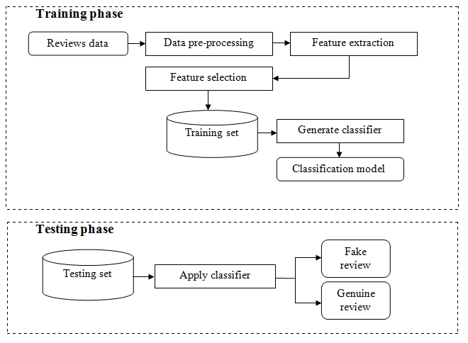
Figure : Machine Learning based Fake Review Detection

Slide 14
APPROACHES TO FAKE REVIEW DETECTION USING MACHINE
LEARNING ALGORITHMS:
Fake Review Detection Using Naive Bayes Algorithm
Fake Review Detection using Decision Tree.
Fake Review Detection Using Random Forest Classifier.

Slide 15
Fake Review Detection Using Naive Bayes Algorithm
A Naive Bayes calculation was employed to create a binary classification model for predicting the sentiment of a survey as either positive or negative.
Naive Bayes classifier assumes that the value of a particular feature is independent of the value of any other feature, given the class variable. The classifier uses the training data to calculate the likelihood of each outcome based on the features.
One significant characteristic is that it makes assumptions about the data, assuming that all features in the dataset are independent and equally significant.

Slide 16
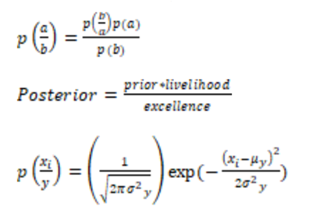
Naive Bias Equations:
Equations (1), (2), and (3) represent the standard form of any Naive Bayes problem and are used to compute probabilities for predicting values within the range (0, 1).
Variables such as p (probability), a, b, xi, y, yi, σ (standard deviation), and μ (mean) are used in these equations to calculate probabilities.

Slide 17
Fake Review Detection using Decision tree
Decision Trees are used to detect fake reviews based on six conditions: star ratings, response, reply, useful profile, profile status, and template.
Reviews are extracted using a web crawler, and potential features are derived for analysis.
The Decision Rule Classifier applies predefined rules to classify reviews.
The goal is to identify the most effective feature for distinguishing fake from genuine reviews.
.

Slide 18
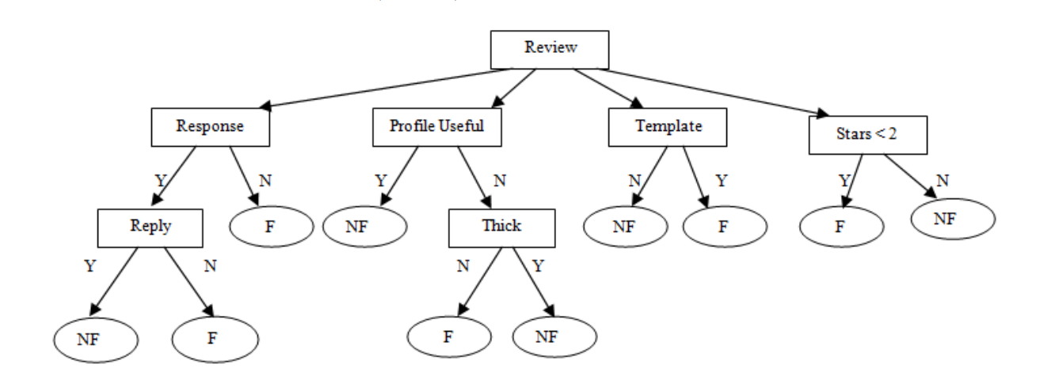
Decision Rule Classifier
Here:
F=Fake,
NF=Not Fake,
Y=Yes, N=No.

Slide 19
Fake Review Detection using Random Forest Algorithm:
It is a supervised learning algorithm utilized for training and testing machine learning models.
The "forest" refers to an ensemble of decision trees trained with the "bagging" method, where decision trees are combined to enhance performance and learning.
The results of the models are evaluated using a confusion matrix, which summarizes the performance of the classifier.
A Random Forest Classifier is suitable for fake product review monitoring and removal.

Slide 20
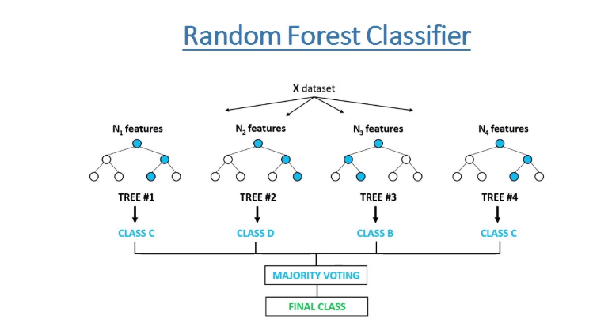
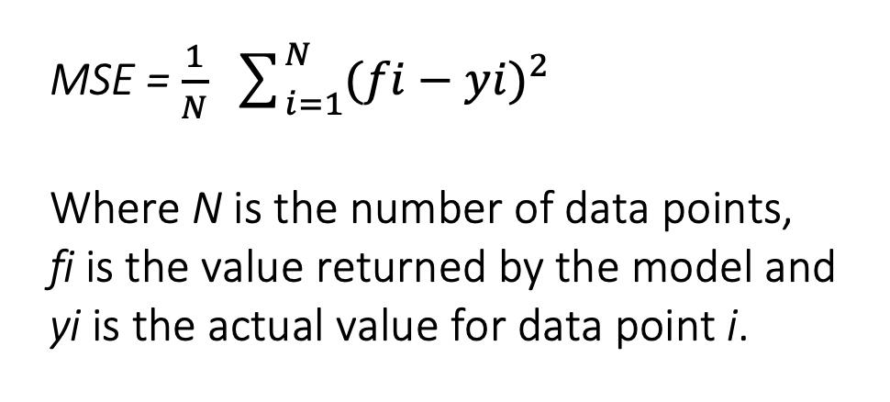

Slide 21
These red flags may indicate a fake review campaign:
A very high percentage of five-star reviews
Lack of detail in reviews and vague praise
Generic review titles like “Nice product” or simply “Awesome”
Mentions of competing products
Wording similar to other reviews
Poor grammar
Multiple reviews on specific dates (especially if there are long gaps between them)
“Customers also bought” section contains unrelated products.
User may not give review from the valid account. Users may contain a spam account through which feedback is provided.
Explaining away cons.

Slide 22

Customer Reviews:

Slide 23
Scope of Growth and Advantages
No fixed algorithm we need to choose a algorithm based on criteria.
For businesses, identifying and removing fake reviews helps preserve their reputation and credibility, ensuring that genuine positive reviews accurately reflect their offerings.
Removing fake reviews improves the overall user experience on online platforms, as consumers can trust the authenticity of the reviews they read, leading to more satisfying interactions with products or services.

Slide 24
Conclusion
Due to rapid development of the internet, the size of the reviews of the items / products increases. These huge amounts of information are generated on Internet; there is no analysis of quality of reviews that are written by consumer. Anyone can write anything which conclusively leads to fake reviews or some companies are hiring people to post reviews.
Identifying fake reviews from a large dataset is challenging enough to become an important research problem. Business organizations, specialists and academics are battling to find the best system for spam review detection.
Some of the fake reviews that have been intentionally fabricated to seem genuine, capability to identify fake online reviews are crucial.
The most important part of an algorithm is its efficiency. Efficiency is not just about execution time. The efficiency of an algorithm is about the time taken for training the model and the time taken for the prediction.

Slide 25
References
Dhairya Patel, Aishwerya Kapoor and Sameet Sonawane “Fake review detection using opinion mining” International Research journal of Engineering and technology (IRJET) , volume 5, issue 12,Dec 2020.
Jitendra kumar Rout, Amiya Kumar Dash and Niranjan Kumar Ray “Framework for Fake Review Detection: Issues and Challenges” IEEE Xplore ISBN:978-1-7281-0259-7/18 2022.
Nidhi A. Patel and Prof. Rakesh Patel “A Survey on Fake Review Detection using Machine Learning Techniques” IEEE Xplore ISBN: 978-1-5386-6947-1/18 2020.
Sanjay K.S and Dr.Ajit Danti “Detection of fake opinions on online products using Decision Tree and Information Gain” IEEE Xplore ISBN: 978-1-5386-7808-4 2021.

Slide 26


