Slide 1


Ajeenkya DY Patil School of Engineering, Pune
Department of Artificial Intelligence & Data Science Engineering
AY: 2025-26
Class: TE SEM-I
A Seminar Presentation
on
Real-time Vendor Tracking System: AI-Driven Solutions for Last-Mile Vegetable Delivery
Guided by:
> Prof. Hemangi Patil
Presented by:
> Kasim Lohar B37

Slide 2

AGenda
Introduction
Problem Statement
Motivation
Literature Survey
System Architecture/Algorithm
Conclusion
Future Scope
References

Slide 3
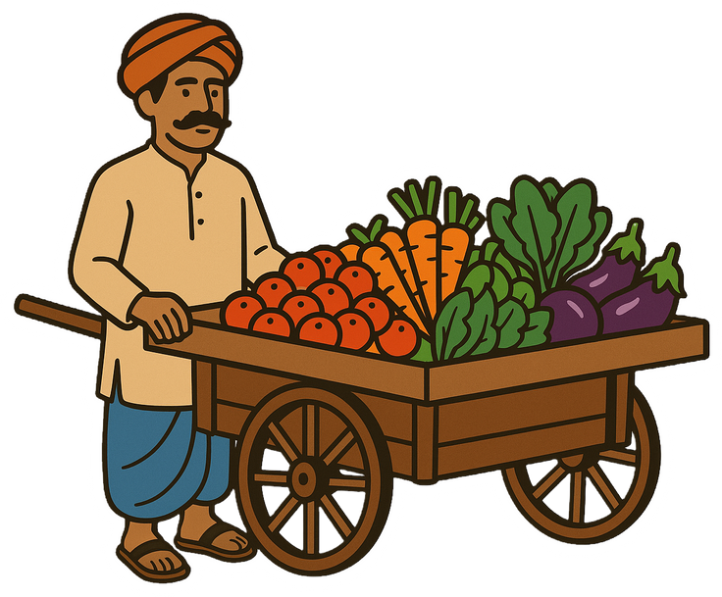

Introduction
The Traditional Vegetable Retail Ecosystem
👥 Customers (Households)
Daily dependency on fresh vegetables
Limited communication channels
Uncertain vendor arrival times
Payment and change issues
🛒 Mobile Vendors (Sabzi Wala)
House-to-house delivery
Fixed routes and timings
Cash-only transactions
Limited inventory visibility

Slide 4





Problem Statement
Key Challenges in Traditional Vegetable Retail
⏰ ARRIVAL UNCERTAINTY
"When will the vendor arrive?"
No predictable timing
Customers wait at home
Missed deliveries
🥕 INVENTORY INVISIBILITY
"What vegetables are available today?"
No advance stock information
Disappointment on arrival
Incomplete shopping
💵 PAYMENT HASSLES
"Change and security issues"
Cash-only transactions
Change unavailability
Theft and safety concerns
💬 COMMUNICATION GAPS
"How to place special requests?"
No direct comm.. channel
Difficulty in custom orders
Lack of updates

Slide 5
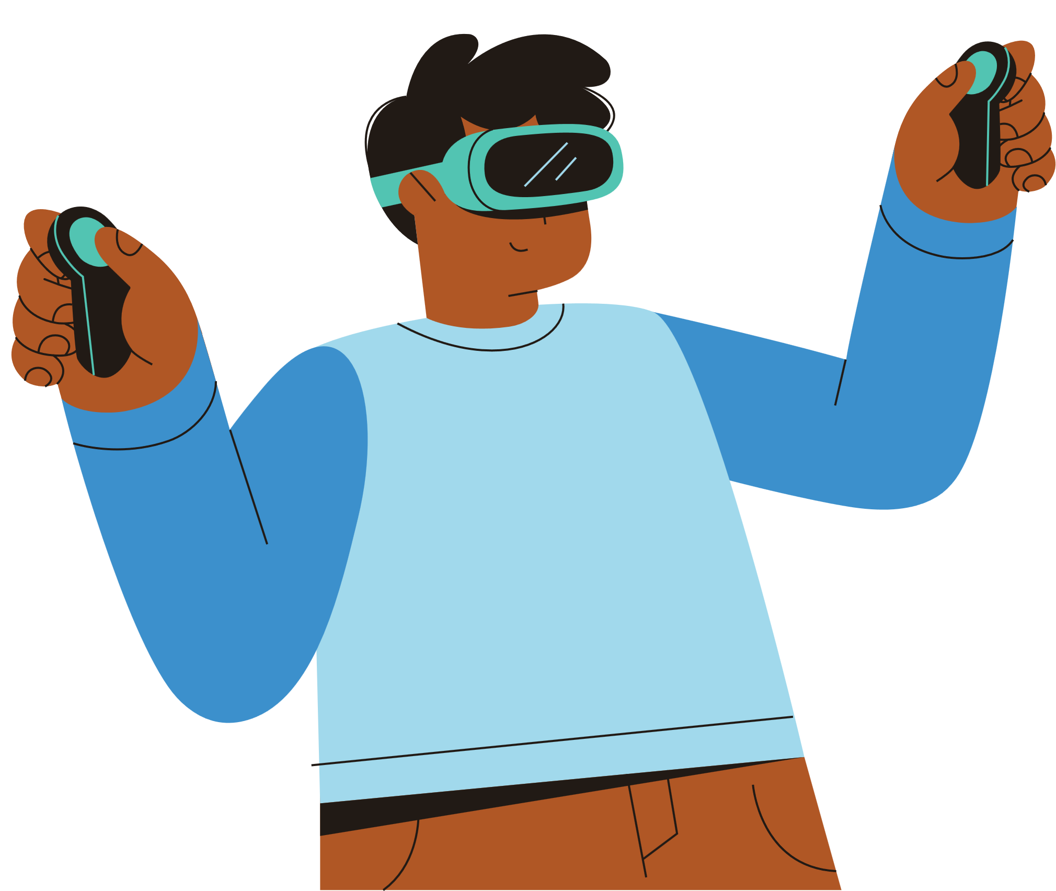
Motivation
Research Motivation
🎯 ADDRESSING REAL PROBLEMS
Solving genuine daily challenges
Improving quality of life
Bridging digital divide
🚀 TECHNOLOGY OPPORTUNITY
Mobile penetration: 75% in India
Growing acceptance of digital solutions
AI/ML potential for optimization
🌟 SOCIAL IMPACT
Digital empowerment of traditional vendors
Time savings for families
Sustainable business model
💡 ACADEMIC CONTRIBUTION
Real-time systems research
Location-based services innovation
Mobile commerce in emerging markets

Slide 6
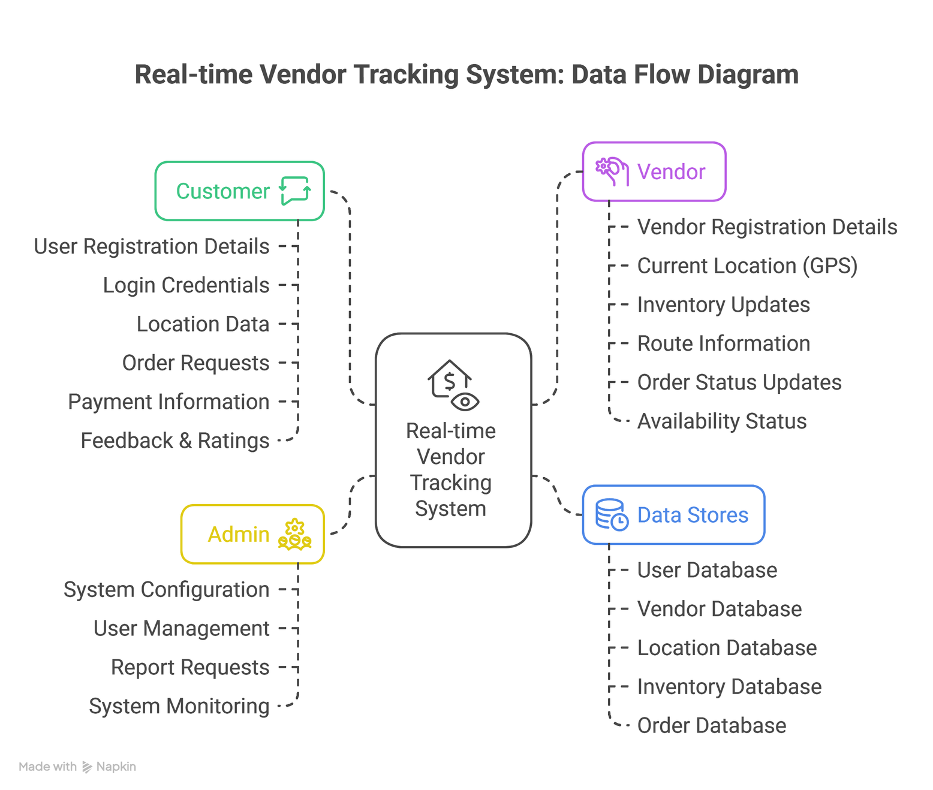
Real-time Vendor Tracking System: DFD L0

Slide 7
Literature Survey
Sr. No | Title | Author | Concept | Publishing Year
1 | Vehicle Tracking Application Based on Real‑Time Traffic | Shibghatullah, S. A. A.; Jalil, A.; Abd Wahab, M. H.; Ng Poh Soon, J.; Subramaniam, K.; Eldabi, T. | Prototype Android app using GPS + Firebase Realtime Database + Google Distance Matrix API to provide live tracking and accurate ETA under real‑time traffic conditions. | International Journal of Electrical and Electronic Engineering & Telecommunications, 11(1), 67–73 (2022)
2 | A Review of Last‑Mile Delivery Optimization: Strategies, Technologies, Drone Integration, and Future Trends | Shuaibu, L. A.; Mahmoud, M. M.; Sheltami, T. R. | Survey of AI/ML‑driven vehicle routing, multi‑agent systems, and drone integration for dynamic, real‑time last‑mile delivery optimization. | Drones, 9(3), 158 (2021)

Slide 8
Literature Survey
Sr. No | Title | Author | Concept | Publishing Year
3 | A Machine Learning Optimization Approach for Last‑Mile Delivery and Third‑Party Logistics Services | Bruni, M. E.; Frangioni, A.; Guerriero, E.; Hansen, M.; Pecori, R.; Savelsbergh, M. W. P. | Hybrid ML‑guided heuristic trained on real logistics data to produce near‑optimal delivery routes faster than classical VRP algorithms. | Computers & Operations Research (Article in press / Preprint 2023)
4 | Mobile Commerce: Pioneering Digital Transformation in Rural India – A Systematic Review | Joshi, G.; Oppliger, S. A. | Systematic literature review of m‑commerce in rural India, highlighting growth drivers, digital‑divide barriers, trust issues, and UX considerations for small vendors. | Bharatiya Shiksha Samachar Patrika, 43(2), 45–58 (2024)

Slide 9
Literature Survey
Sr. No | Title | Author | Concept | Publishing Year
5 | Adoption of UPI Among Indian Users: Using an Extended Meta‑UTAUT Model | Razi‑ur‑Rahim, M.; Rabbani, M. R.; Uddin, F.; Shaikh, Z. | Survey of 894 Indian users showing performance expectancy and trust as key drivers of UPI (real‑time payments) adoption, using SEM on Meta‑UTAUT constructs. | Digital Business, 4(2), 100093 (2024)
6 | Edge Computing‑Based Mobile Object Tracking in Internet of Things | Wu, Y.; Tian, P.; Cao, Y.; Ge, L.; Yu, W. | Edge‑computing framework (EC‑MTS) that offloads multivariate time‑series prediction (VAR) to edge servers for energy‑efficient, low‑latency tracking of mobile IoT devices. | High‑Confidence Computing, 2, 100045 (2022)

Slide 10
ReFrence
Shibghatullah, S. A. A., Jalil, A., Abd Wahab, M. H., Ng Poh Soon, J., Subramaniam, K., & Eldabi, T. (2022). Vehicle Tracking Application Based on Real-Time Traffic. International Journal of Electrical and Electronic Engineering & Telecommunications, 11(1), 67–73. DOI: 10.18178/ijeetc.11.1.67-73.
Wu, Y., Tian, P., Cao, Y., Ge, L., & Yu, W. (2022). Edge computing-based mobile object tracking in Internet of Things. High-Confidence Computing, 2, 100045. DOI: 10.1016/j.hcc.2021.100045.
Bruni, M. E., Frangioni, A., Guerriero, E., Hansen, M., Pecori, R., & Savelsbergh, M. W. P. (2023). A Machine Learning Optimization Approach for Last-Mile Delivery and Third-Party Logistics Services. Computers & Operations Research. [Preprint via SciArXiv].
Shuaibu, L. A., Mahmoud, M. M., & Sheltami, T. R. (2021). A Review of Last-Mile Delivery Optimization: Strategies, Technologies, Drone Integration, and Future Trends. Drones, 9(3), 158. DOI: 10.3390/drones9030158.
Joshi, G., & Oppliger, S. A. (2024). Mobile Commerce: Pioneering Digital Transformation in Rural India –A Systematic Review. Bharatiya Shiksha Samachar Patrika, 43(2), 45–58. (non-indexed).
Razi-ur-Rahim, M., Rabbani, M. R., Uddin, F., & Shaikh, Z. (2024). Adoption of UPI Among Indian Users: Using an Extended Meta-UTAUT Model. Digital Business, 4(2), 100093. DOI: 10.1016/j.digbus.2024.100093.

Slide 11
Thank you

Slide 12
Does Anyone Have a Questions?

