Slide 1
CAROTID ARTERY STENOSIS USING CNN REGRESSOR AND GRADCAM VISUALIZATION
KASINA SAAKET

Slide 2
PROBLEM STATEMENT AND OBJECTIVE
Problem statement
  Carotid artery stenosis (CAS) is a significant risk factor for ischemic stroke, caused by narrowing of the carotid arteries.
  Manual detection and segmentation is time-consuming, requires expert knowledge, and may miss subtle patterns.
Project Objective
  To develop a deep learning pipeline (CNN pentagon regressor) to analyze carotid artery images and:
  Extract meaningful deep and texture features
  Perform clustering to differentiate healthy vs stenotic regions
  Visualize image similarity using t-SNE and HDBSCAN/Kmeans
Motivation
  Bypass YOLO limitations (YOLO requires bounding boxes — unsuitable for this polygonal label format)
  Enable feature-based, label-independent diagnosis using deep representations from ResNet50
  Support scalable and automated screening of medical imagery

Slide 3
DATASET AND IMAGE LABEL FORMAT
Dataset Overview
  Medical images of carotid arteries
  Includes healthy and stenotic carotid artery samples
  Total number of images: 10896
Image Label Format
  Labels are polygonal segmentation masks (not bounding boxes)
  Polygon vertices define the stenotic region boundaries
  Polygonal masks better capture shape and texture of affected regions

Slide 4
Image Preprocessing
Image resizing and normalization applied.
Standardizes inputs for CNN training stability.
Noise reduction performed on ultrasound images.
Minimizes speckle noise inherent in ultrasound imaging.
Region of interest enhancement.
Focuses model attention on carotid artery structures.

Slide 5
CNN MODEL ARCHITECTURE
CNN Problem Formulation
Input consists of preprocessed ultrasound images.
Images are fed into the CNN in standardized tensor format.
Primary task is artery and plaque segmentation.
Pixel-wise classification separates lumen, plaque, and background.
Secondary task is feature extraction from segmented regions.
Clinical parameters are computed from segmentation outputs.
CNN Architecture
Encoder network extracts hierarchical features.
Lower layers capture edges, higher layers capture plaque textures.
Decoder network reconstructs segmentation masks.
Spatial resolution is restored to localize anatomical structures.
End-to-end trainable architecture.
The model learns optimal parameters during training.
Ensures precise localization in segmentation output.
This segmentation enables precise anatomical localization required for clinical parameter computation.”

Slide 6
CNN LAYERS
Convolution layers detect structural patterns.
Filters learn artery boundaries and plaque morphology.
ReLU activation introduces non-linearity.
Enables learning of complex relationships.
Pooling layers reduce dimensionality.
Improves computational efficiency and robustness.
Upsampling layers restore spatial details.
Ensures precise localization in segmentation output.

Slide 7
CNN TRAINING STRATEGY & OUTPUTS
Dice loss addresses class imbalance.
Useful when plaque regions are smaller than background.
Adam optimizer ensures fast convergence.
Adaptive learning rates improve stability.
Validation monitoring prevents overfitting.
Ensures model generalization on unseen data.
CNN outputs pixel-wise segmentation masks.
Each pixel is classified as lumen, plaque, or background.
Morphological operations refine boundaries.
Reduces segmentation noise and artifacts.
Final masks used for quantitative analysis.
Accurate boundaries enable reliable measurements.

Slide 8
“Hybrid Deep Learning Approach using Resnet50: Segmentation + Feature Learning”
Feature Extraction
Plaque area computed from segmented regions.
Represents plaque burden in the artery.
Lumen area extracted for stenosis calculation.
Used to assess degree of narrowing.
Intensity-based analysis for echolucency.
Indicates plaque composition and vulnerability.
Clinical Parameter Computation
Plaque percentage indicates disease severity.
Calculated as plaque area relative to artery area.
Lumen stenosis measures flow obstruction.
Derived from diameter or area reduction.
Calcification detection uses intensity thresholds.
Identifies hardened plaque regions.
Cap thickness estimation reflects plaque stability.
Thinner caps indicate higher rupture risk.

Slide 9
GUI Workflow
Screen 1: Login and session control.
Allows controlled start and end of analysis sessions.
Screen 2: Patient data entry and image upload.
Includes name, age, sex, ID, and ultrasound image input.
Automated processing after submission.
The system executes segmentation and analysis without manual intervention.
Dual-screen GUI-based application.
The first screen manages session control, while the second screen handles analysis.
Backend deep learning model for image analysis.
CNN processes ultrasound images automatically after upload.
Integrated clinical parameter computation module.
Extracted features are converted into meaningful medical metrics.

Slide 10
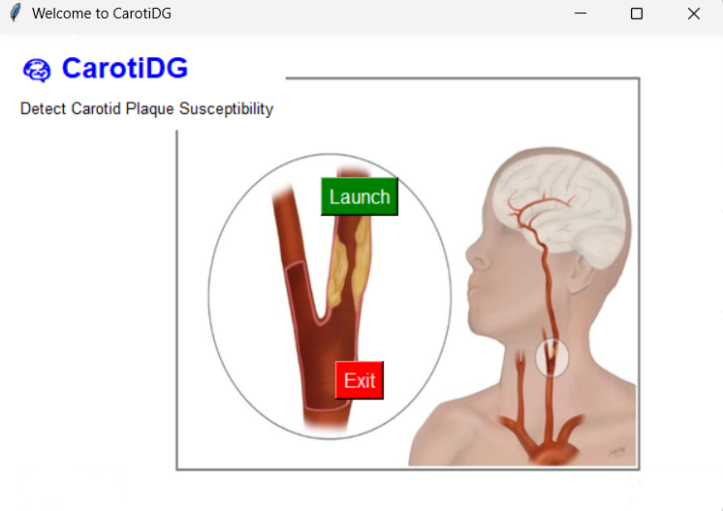
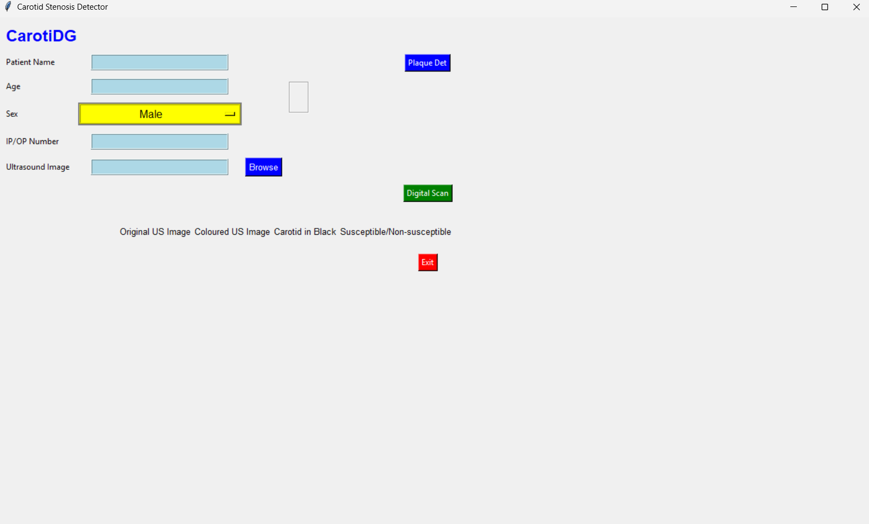
GUI WORKFLOW SAMPLE IMAGES

Slide 11
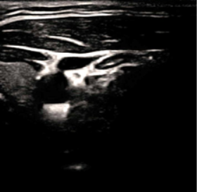
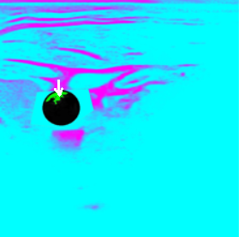
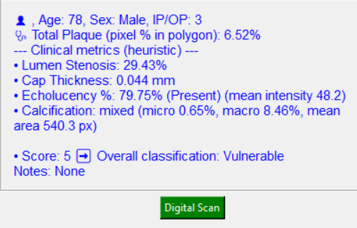
CAROTID STENOSIS IN GUI
Sample output.
Green colour inside the circular carotid artery is plaque, as pointed by an arrow.

Slide 12
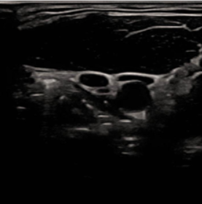
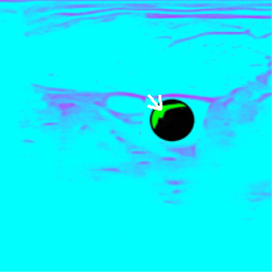
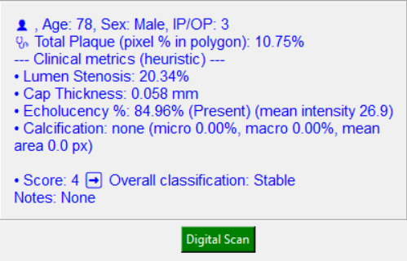
Clinical Parameter Computation
Plaque percentage indicates disease severity.
Calculated as plaque area relative to artery area.
Lumen stenosis measures flow obstruction.
Derived from diameter or area reduction.
Calcification detection uses intensity thresholds.
Identifies hardened plaque regions.
Cap thickness estimation reflects plaque stability.
Thinner caps indicate higher rupture risk.

Slide 13
Plaque Susceptibility Prediction & Results
Plaque Susceptibility Prediction:
Multiple parameters combined for risk assessment.
Provides holistic plaque evaluation.
Risk categorized into low, moderate, and high.
Simplifies clinical interpretation.
Results displayed clearly in GUI.
Supports clinical decision-making.
Accurate segmentation achieved on ultrasound images.
CNN effectively identifies artery and plaque regions.
Automated parameter extraction reduces manual effort.
Improves efficiency and consistency.
System demonstrates clinical applicability.
Provides reliable decision support.

Slide 14
Advantages & Limitations of Proposed System
Advantages of Proposed System
End-to-end automation reduces variability.
Minimizes human error.
User-friendly interface enables easy adoption.
Designed for clinical environments.
Scalable and extendable architecture.
Can integrate future improvements.
Limitations
Dependent on ultrasound image quality.
Poor images reduce accuracy.
Requires larger datasets for further improvement.
More data improves robustness.
Clinical validation still required.
Necessary before real-world deployment.

Slide 15
FUTURE SCOPE
Future Scope
Real-time ultrasound integration.
Allows live analysis during scanning.
Advanced deep learning architectures.
Improves segmentation accuracy.
Deployment as clinical decision support system.
Assists doctors in diagnosis.

