Slide 1
AgriFlow: Agricultural Market Price Analysis and Forecasting
Spatiotemporal Market Integration and Machine Learning-Based Price Prediction
CSI3004 Data Science Programming
Vellore Institute of Technology, Vellore
Kasinath C A - 24MID0124
Kamal Nayan C S - 24MID0189
Final Review | 13 October 2026

Slide 2
Problem Statement
Wholesale Onion prices vary sharply across markets and seasons.
Markets report on uneven dates, which complicates direct comparison.
Analysts need both descriptive market evidence and a cautious short-horizon forecast.
Intended users include market analysts, agricultural researchers and other stakeholders.
Uneven market reports
1
Validated historical panel
2
Analysis plus next-report forecast
3
The predictive task estimates the next reported observation, not an exact next-day or current market price.
02

Slide 3
Objectives
01
Acquire and clean historical market prices
7,794 validated market-day records
02
Characterize trends and reporting coverage
Existing exploratory dashboard
03
Analyze integration and price transmission
Lead-lag, network and geography modules
04
Develop and compare forecasting models
Six candidates on a common temporal cohort
05
Deliver a reproducible analytical dashboard
Offline training, saved inference and evidence
03

Slide 4
Proposed Solution and Architecture
Historical
market data
Validation
Preprocessing
Feature
engineering
Model
training
Temporal
evaluation
Model
selection
Forecasting
dashboard
1
2
3
4
5
6
7
8
Trends and coverage
Geography and integration
Existing analytical branch
Lead-lag and network
Quality and research status
All normal execution paths use local files. No cloud service, live market API or training inside dashboard callbacks is required.
04

Slide 5
Dataset Description
Field | Observed scope
Source | CEDA Agri Market Data / AGMARKNET
Commodity | Onion
Coverage | Maharashtra; 4 districts; 25 markets
Rows | 8,499 raw; 7,794 processed market-days
Dates | 01 Jan 2023 to 30 Oct 2025
Target and unit | modal_price; INR per quintal
Experimental evidence covers Maharashtra only. The India map remains a visualization capability, not a claim of national experimental coverage.
05

Slide 6
Data Preprocessing and Exploratory Analysis
Parsed dates and enforced positive numeric modal prices.
Removed duplicate market-date-commodity targets; none remained.
Kept missing reports absent rather than filling prices with zero.
Built market-specific lags and shifted rolling statistics.
Excluded 322 rows lacking complete 14-report history.
Observed row flow: 8,499 raw checkpoint rows to 7,794 processed market-days to 7,378 modeling rows across 23 eligible markets.
06

Slide 7
Methodology
Forecast horizon
Next reported market observation
TRAIN
VALIDATE
TEST
through 13 Jan 2025
14 Jan to 07 Jun 2025
08 Jun to 30 Oct 2025
5,199 rows
1,106 rows
1,073 rows
Global target-date boundaries prevent later targets from entering training.
Every rolling feature uses a one-observation shift within its market.
Validation MAE selects the model; validation RMSE resolves ties.
The held-out test set supports the final comparison only after selection.
07

Slide 8
Model Implementation
Model | Category | Principal parameters | Advantage | Drawback
M0 Persistence | Baseline | prediction = lag 1 | Strong local benchmark | Cannot anticipate turning points
M1 Lag-7 | Baseline | prediction = lag 7 | Simple longer memory | Ignores recent reports
M2 Ridge | Linear | alpha 1.0; scaled | Stable and interpretable | Linear response
M3 Decision Tree | Tree | depth 8; leaf 5 | Nonlinear rules | Overfitting risk
M4 Random Forest | Ensemble | 200 trees; depth 12; leaf 3 | Robust nonlinear fit | Less transparent
M5 Hist Gradient Boosting | Boosting | 150 iterations; rate 0.05; 15 leaves | Efficient nonlinear model | Sensitive to drift
Python 3.12; pandas 2.3.3; NumPy 2.5.3; scikit-learn 1.9.1; deterministic seed 42.
08

Slide 9
Evaluation Metrics
Metric | Definition | Unit / preferred direction
MAE | mean absolute error | INR/q; lower
MSE | mean squared error | squared INR/q; lower
RMSE | square root of MSE | INR/q; lower
R-squared | 1 - SSE/SST | unitless; higher
MAPE | mean absolute percentage error | percent; lower
sMAPE | symmetric percentage error | percent; lower
WAPE | weighted absolute percentage error | percent; lower
Median AE | median absolute error | INR/q; lower
Mean bias | mean(predicted - actual) | INR/q; near zero
Directional accuracy | matching movement signs vs lag 1 | percent; higher
MAE = mean(|y - yhat|)
RMSE = sqrt(mean((y - yhat)^2))
MAPE = 100 mean(|(y - yhat) / y|)
Direction = sign(price - lag 1)
Selection rule
Lowest validation MAE; validation RMSE breaks ties
09

Slide 10
Model Performance Comparison
Validation-selected model | M0 Persistence
Validation MAE | 128.2 INR/q
Held-out test MAE | 101.4 INR/q
Held-out test RMSE | 181.0 INR/q
Improvement vs persistence | 0.0%
Persistence won the validation rule. No machine-learning candidate improved the selected validation MAE; the baseline therefore remains the preferred model.
10

Slide 11
Prediction Results and Diagnostics
Focus market: Amrawati(Frui & Veg. Market)
Test range: 2025-06-08 to 2025-10-30
Mean bias: -1.2 INR/q
Median absolute error: 50.0 INR/q
Residual convention: predicted price minus actual price. Positive bias indicates overprediction.
11

Slide 12
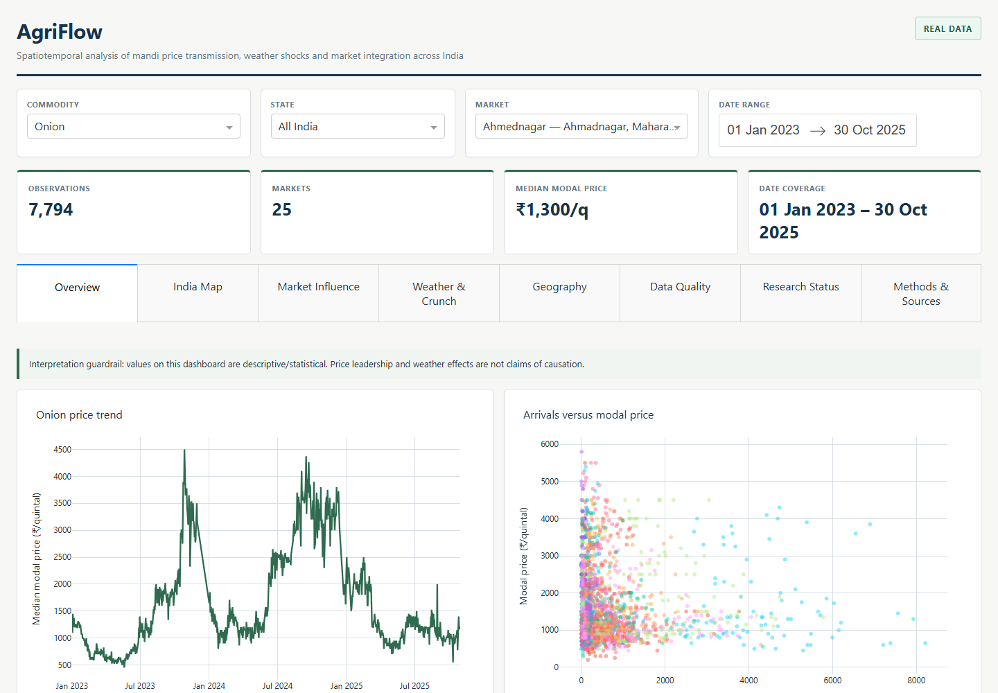
Application and Demonstration
Saved forecast output
Market
Ahmednagar
Last observation
2025-10-27 | INR 1150/q
Next-report forecast
INR 1150/q
Model: M0 Persistence
Held-out MAE: 101.4 INR/q
The dashboard also retains Overview, India Map, Market Influence, Weather and Crunch, Geography, Data Quality and Research Status views.
12

Slide 13
Challenges, Solutions and Drawbacks
Challenge | Implemented response or remaining limitation
Uneven reporting | Define horizon as next reported observation; never fill missing dates as prices.
Restricted acquisition | Train and run offline from traceable local CEDA checkpoints.
Limited geography | State four-district Maharashtra scope; avoid national performance claims.
Temporal leakage | Group by market, shift every rolling feature and split on global target dates.
Overfitting | Use constrained trees, a common cohort and validation-only selection.
Historical staleness | Display the last observation and 2025-10-30 data cutoff.
No exogenous variables | Keep the first model price-only; arrivals units remain uncertain.
Model drawback | Persistence cannot anticipate shocks or turning points, despite winning validation MAE.
13

Slide 14
Conclusion and Future Scope
What the project achieved
Future scope
Preserved the existing market-analysis dashboard.
Evaluated six forecasting approaches with ten metrics.
Selected M0 Persistence using validation MAE of 128.2 INR/q.
Measured held-out MAE of 101.4 INR/q and RMSE of 181.0 INR/q.
Delivered saved next-report forecasts and reproducible evidence.
Broaden market and commodity coverage.
Add verified weather and consistently measured arrivals.
Collect a longer historical series and refresh the data.
Evaluate fixed calendar horizons separately.
Revisit tuning only after stronger coverage becomes available.
Measured improvement versus persistence: 0.0%
The baseline won, so no unsupported ML advantage is claimed.
14

Slide 15
References
CEDA Agri Market Data documentation: https://api.ceda.ashoka.edu.in/documentation/
Government of India AGMARKNET / OGD resource: https://data.gov.in/resource/current-daily-price-various-commodities-various-markets-mandi
AgriFlow repository documentation: README.md; docs/04_DATA_SPECIFICATION.md; docs/05_ANALYTICS_SPECIFICATION.md
scikit-learn documentation: https://scikit-learn.org/stable/
pandas documentation: https://pandas.pydata.org/docs/
NumPy documentation: https://numpy.org/doc/
Dash documentation: https://dash.plotly.com/
Plotly Python documentation: https://plotly.com/python/
Hyndman and Athanasopoulos, Forecasting: Principles and Practice, https://otexts.com/fpp3/
All experimental values in this deck originate from the saved local dataset and generated forecasting artifacts.
15

