Slide 1
COURSE PROJECT / 2026–2027
AirConnect India
Machine Learning-Based Analysis of Indian Airport Passenger Traffic and Connectivity
K-Means · Random Forest regression · Offline research interface
Group members: [Names / Register numbers / University emails]
Vellore Institute of Technology | Machine Learning for Data Science
01

Slide 2
AIRCONNECT INDIA / MDI4001
Problem and motivation
•
India: 74 operational facilities in 2014; 165 as of July 2026.
•
Infrastructure growth ≠ number of airports reporting passenger movements.
•
Does traffic growth appear balanced? What patterns separate airports?
•
Can a simple model beat a previous-year prediction?
Vellore Institute of Technology | Machine Learning for Data Science
02

Slide 3
AIRCONNECT INDIA / MDI4001
Data collection and preprocessing
•
DGCA-derived national passenger movements: 2016–2025.
•
Airport-level source rows: 614, covering 2022–2025.
•
Arrival + departure movements; not unique passenger counts.
•
Validate keys and totals; pivot airport/year; transform numeric features.
Vellore Institute of Technology | Machine Learning for Data Science
03

Slide 4
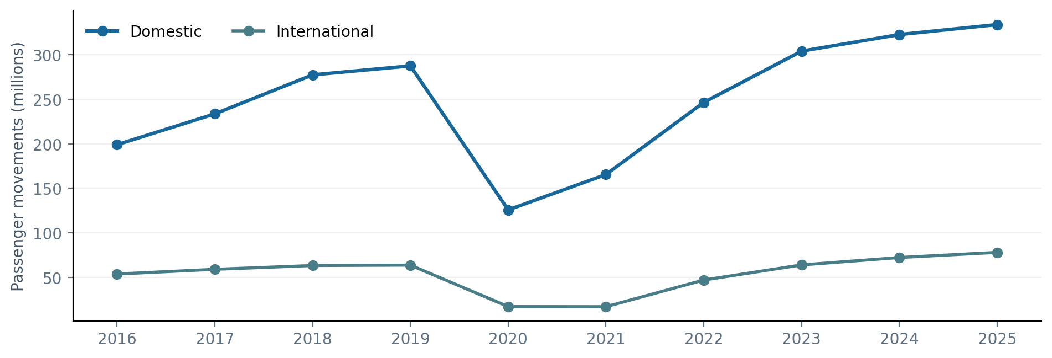
AIRCONNECT INDIA / MDI4001
National traffic patterns
2016–2025 domestic passenger movements: +67.8%. A sharp decline is visible in 2020.
Vellore Institute of Technology | Machine Learning for Data Science
04

Slide 5
AIRCONNECT INDIA / MDI4001
Machine learning workflow
•
Input CSV → validation → airport-year features.
•
K-Means: log traffic features → standard scaling → 3 clusters.
•
Random Forest: lag-1 and lag-2 domestic traffic → annual target.
•
Chronological holdout: 2024 train, 2025 test.
Vellore Institute of Technology | Machine Learning for Data Science
05

Slide 6
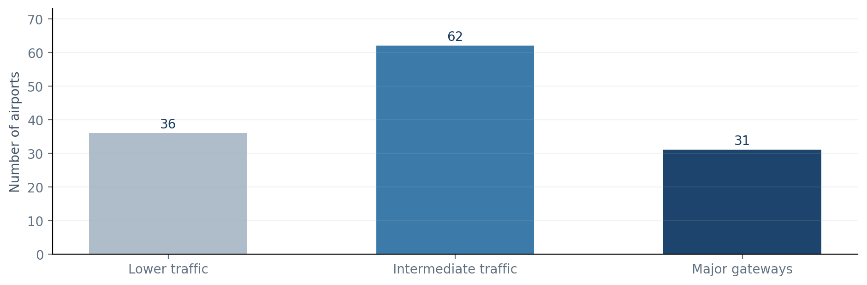
AIRCONNECT INDIA / MDI4001
K-Means results
129 airports | k = 3 | Silhouette Score = 0.6235
Vellore Institute of Technology | Machine Learning for Data Science
06

Slide 7
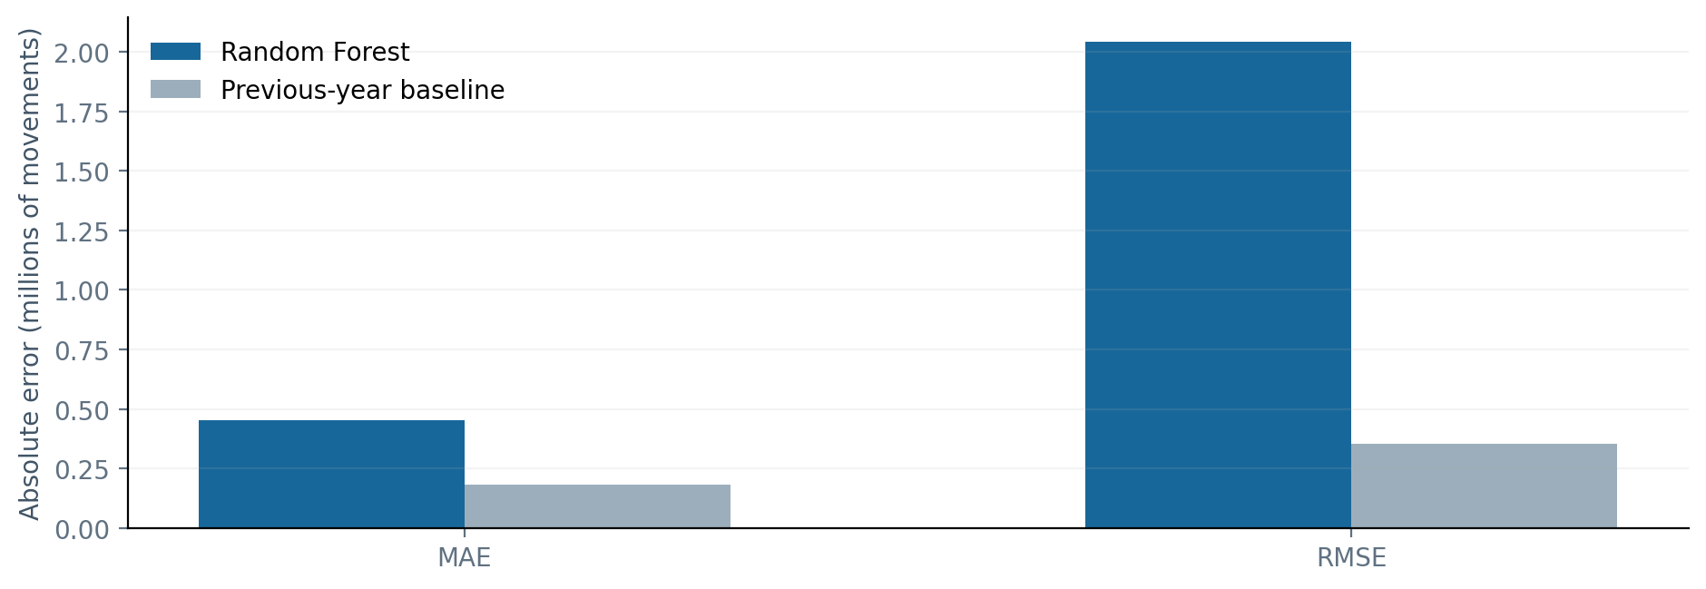
AIRCONNECT INDIA / MDI4001
Random Forest evaluation
Test 2025: Random Forest MAE 451,552 | Prior-year baseline MAE 182,476
Vellore Institute of Technology | Machine Learning for Data Science
07

Slide 8
AIRCONNECT INDIA / MDI4001
Website demonstration
•
Offline HTML / CSS / JavaScript; no login, server or cloud.
•
Overview: aviation growth indicators and historical traffic chart.
•
Explorer: India map, year filter, airport search, CSV export.
•
ML: cluster groups, prediction comparison and method definitions.
•
Methodology: reproducible steps, definitions and source citations.
Vellore Institute of Technology | Machine Learning for Data Science
08

Slide 9
AIRCONNECT INDIA / MDI4001
Findings and limitations
•
Observed domestic and international traffic increased over the period.
•
K-Means distinguishes substantially different traffic groups.
•
Prior-year forecast outperforms this Random Forest on 2025 holdout.
•
Low traffic ≠ proven underutilisation; international activity ≠ route permission.
Vellore Institute of Technology | Machine Learning for Data Science
09

Slide 10
AIRCONNECT INDIA / MDI4001
Conclusion and references
•
Airport traffic is measurable, but capacity utilisation needs other data.
•
Simpler forecast models can outperform complex alternatives.
•
A transparent, reproducible offline interface supports evaluation.
Sources: DGCA-derived India Aviation Stats (Kubicek, 2026); Ministry of Civil Aviation; airport coordinates (Himpfen); Natural Earth.
Vellore Institute of Technology | Machine Learning for Data Science
10

