Slide 1
MACHINE LEARNING · REGRESSION PROJECT
Wine Quality Prediction Using Ridge, Lasso and Elastic Net Regression
Predicting numerical wine quality from physicochemical properties using three regularized linear regression models.
TEAM
UNDER THE GUIDANCE OF
P. Bhavana Manaswini
Shaik Asif
Roll No: 2520030154 | Section: 8
Assistant Professor | CSE
Kasireddy Srihitha
Roll No: 2520030153 | Section: 8
01

Slide 2
Problem Statement
REGRESSION TASK
TARGET VARIABLE
Predict the numerical quality score of red wine samples from their measurable physicochemical properties — framed as a supervised regression problem.
quality — an integer score (3–8 in this dataset) rated by wine tasters; treated as a continuous numeric target for regression.
INPUT FEATURES (11)
WHY IT MATTERS
Fixed & volatile acidity, citric acid, residual sugar, chlorides, free/total sulfur dioxide, density, pH, sulphates, alcohol.
Sensory grading is slow and subjective. A reliable model built on lab-measurable chemistry lets producers screen batches and support quality control decisions objectively.
3
11
4
Models Compared
Input Features
Evaluation Metrics
Ridge · Lasso · Elastic Net
All physicochemical, numeric
MAE · MSE · RMSE · R²
Comparing Ridge (L2), Lasso (L1) and Elastic Net (L1+L2) isolates which regularization strategy best fits this feature set.
02

Slide 3
Dataset Identification
1,143 × 13
11
1
ROWS × COLUMNS
NUMERIC PREDICTORS
TARGET VARIABLE
WineQT.csv — Red Wine Physicochemical Properties Dataset
Structure: each row is one red-wine sample; 11 physicochemical lab measurements plus a sensory quality score (3–8) assigned by tasters. An Id column (0–1597) is present purely as a row identifier. This structure is consistent with the widely used UCI/Kaggle “Red Wine Quality” dataset format.
WHY THIS DATASET SUITS THE PROJECT
All 11 predictors are continuous numeric measurements — ideal for linear, regularization-based models. No missing data or duplicate rows were found (see Slide 5), and the target is a genuine ordinal/continuous score, making this a clean, well-posed regression problem for comparing Ridge, Lasso and Elastic Net.
03

Slide 4
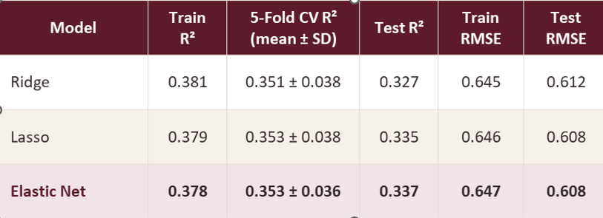
Generalization & Feature Selection
Models
Train and test R² differ by only 0.04–0.05, and 5-fold CV R² (≈ 0.35) sits between them — no sign of overfitting. Test RMSE is slightly below train RMSE, reflecting the particular 20% split.
Lasso keeps 9 of 11 features and Elastic Net keeps 8 (dropping citric acid, residual sugar and free SO₂); Ridge keeps all 11. Alcohol and volatile acidity carry the largest weights in all three models.
Coefficients are fitted on the scaled training set. Positive values raise predicted quality; zero means the L1 penalty removed the feature. CV uses 5 shuffled folds on the training split with the slide 13 hyperparameters.
14

Slide 5
Dataset Snapshot
df.shape → (1143, 13) df.head() shown below
fixed acidity | volatile acidity | citric acid | residual sugar | chlorides | free SO2 | total SO2 | density | pH | sulphates | alcohol | quality | Id
7.4 | 0.70 | 0.00 | 1.9 | 0.076 | 11.0 | 34.0 | 0.9978 | 3.51 | 0.56 | 9.4 | 5 | 0
7.8 | 0.88 | 0.00 | 2.6 | 0.098 | 25.0 | 67.0 | 0.9968 | 3.20 | 0.68 | 9.8 | 5 | 1
7.8 | 0.76 | 0.04 | 2.3 | 0.092 | 15.0 | 54.0 | 0.9970 | 3.26 | 0.65 | 9.8 | 5 | 2
11.2 | 0.28 | 0.56 | 1.9 | 0.075 | 17.0 | 60.0 | 0.9980 | 3.16 | 0.58 | 9.8 | 6 | 3
7.4 | 0.66 | 0.00 | 1.8 | 0.075 | 13.0 | 40.0 | 0.9978 | 3.51 | 0.56 | 9.4 | 5 | 5
Acidity & Composition
Sulfur & Stability
Sensory & ID
fixed/volatile acidity, citric acid, residual sugar, chlorides — determine taste balance and preservation.
free & total sulfur dioxide act as preservatives; density and pH describe the wine's physical/chemical profile.
sulphates and alcohol influence mouthfeel and strength; quality is the target; Id is a non-predictive row identifier.
04

Slide 6
Data Cleaning & Preparation
PROBLEM
OBSERVATION
HANDLING DECISION
Missing values
df.isnull().sum() → 0 for all 13 columns
No imputation required — dataset is complete.
Duplicate rows
df.duplicated().sum() → 0 duplicate records
No rows removed.
Data types
All 11 features are float64; quality and Id are int64
Types are already correct for numeric modeling.
Id column
Sequential row identifier (0–1597), not a chemical property
Dropped before training — it carries no predictive signal.
Outliers
chlorides, residual sugar and sulphates show heavy right-skew (see Slide 9)
Retained — regularization (Ridge/Lasso/EN) is naturally robust to moderate outliers; scaling applied instead of removal.
05

Slide 7
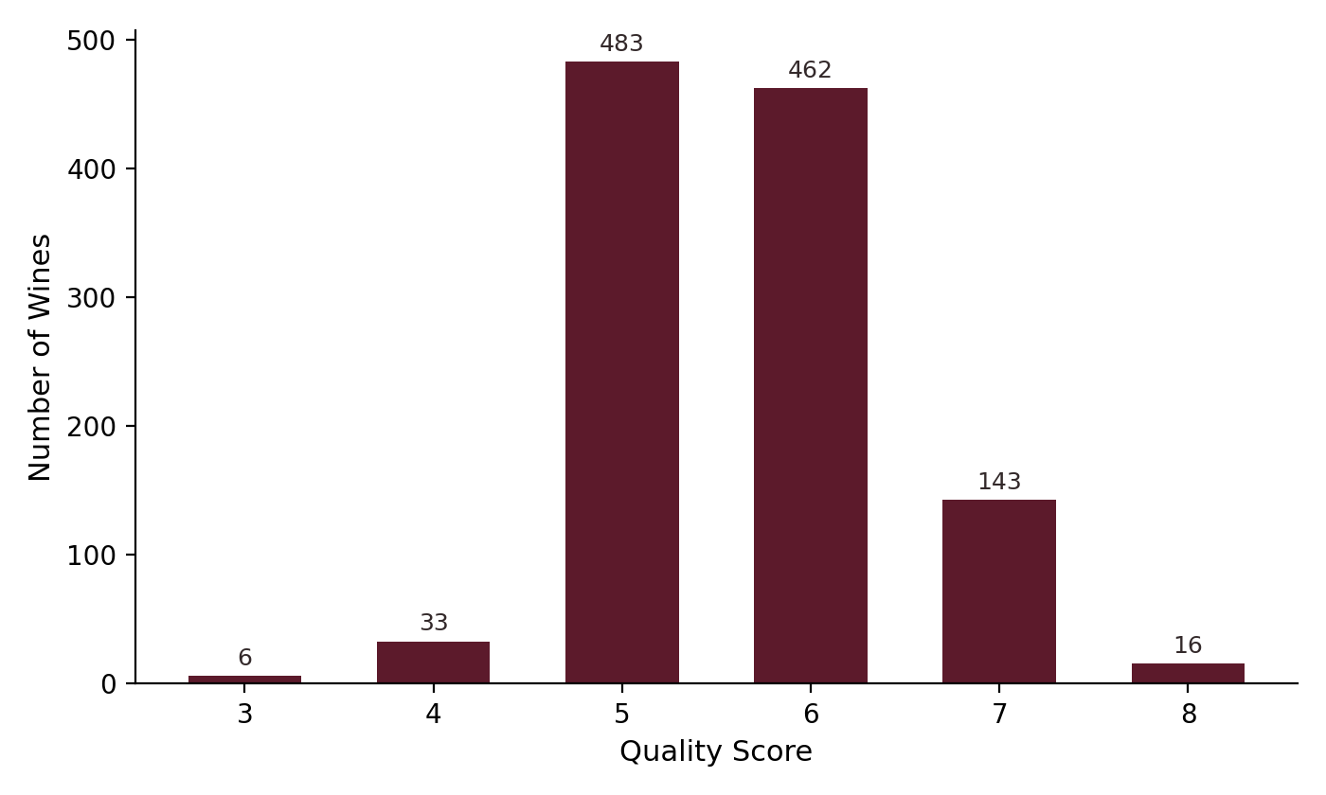
EDA — Wine Quality Distribution
quality.value_counts()
Quality 3
6
Quality 4
33
Quality 5
483
Quality 6
462
Quality 7
143
Quality 8
16
TAKEAWAY Quality scores concentrate heavily around 5 and 6 (83% of samples), with very few wines rated 3, 4 or 8. The target is imbalanced and roughly bell-shaped, not uniform — a factor to consider when interpreting model error at the distribution's tails.
06

Slide 8
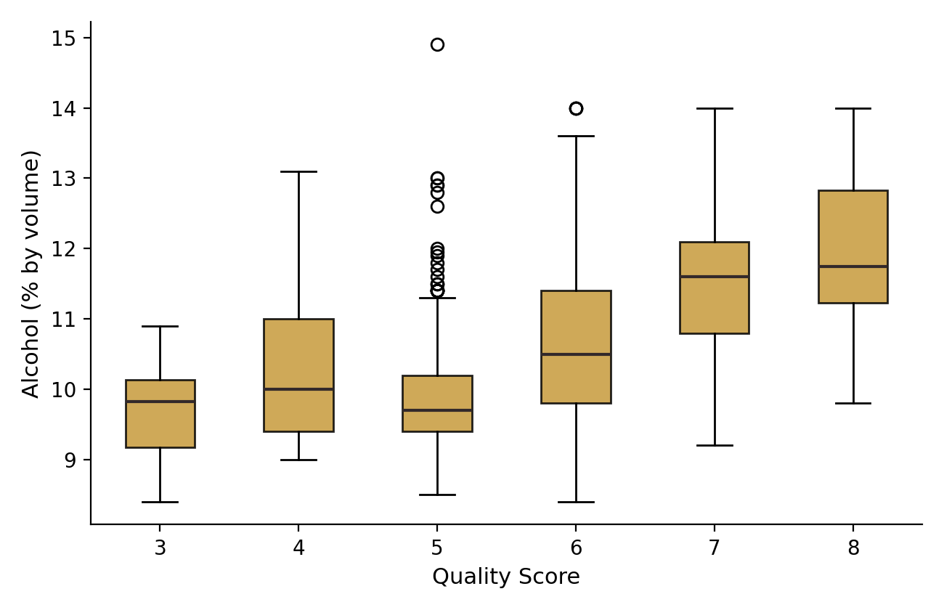
03 · EXPLORATORY ANALYSIS
EDA — Alcohol vs. Quality
CORRELATION WITH QUALITY
+0.48
The strongest single-feature correlation with quality in this dataset.
TAKEAWAY Median alcohol content rises visibly from quality 5 through 8 — higher-rated wines are consistently more alcoholic. This makes alcohol the single most informative physicochemical predictor of quality.
07

Slide 9
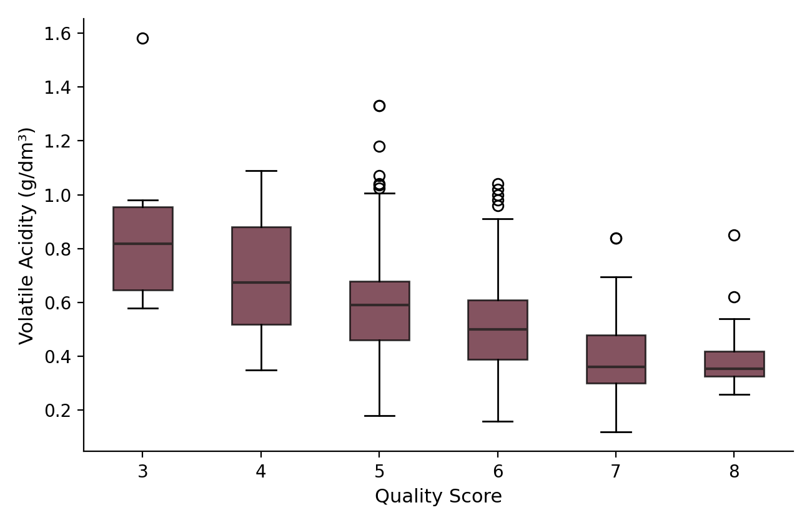
EDA — Volatile Acidity vs. Quality
CORRELATION WITH QUALITY
−0.41
The strongest negative correlation with quality among all 11 features.
TAKEAWAY Volatile acidity (acetic-acid content, linked to a vinegar-like taste) trends downward as quality rises. Together with alcohol, it forms the clearest two-feature signal in the dataset.
08

Slide 10
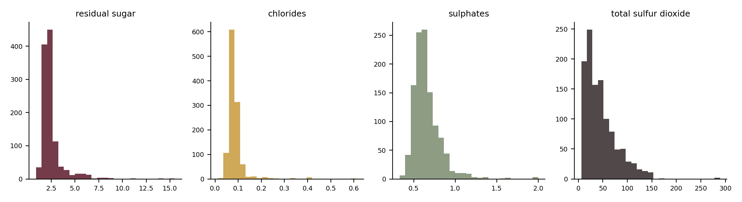
Feature Distributions & Outlier Analysis
Heavy Right-Skew
Moderate Skew
Scale Differences
chlorides (skew ≈ 6.0) and residual sugar (skew ≈ 4.4) show most values clustered low, with a long tail of high-outlier samples.
sulphates, total & free sulfur dioxide, fixed acidity and alcohol are moderately skewed (skew 0.9–2.5) — typical for chemical measurements.
Features range from ~0.01 (chlorides) to ~289 (total SO₂) — very different scales, which is why StandardScaler is required before regularized regression.
09

Slide 11
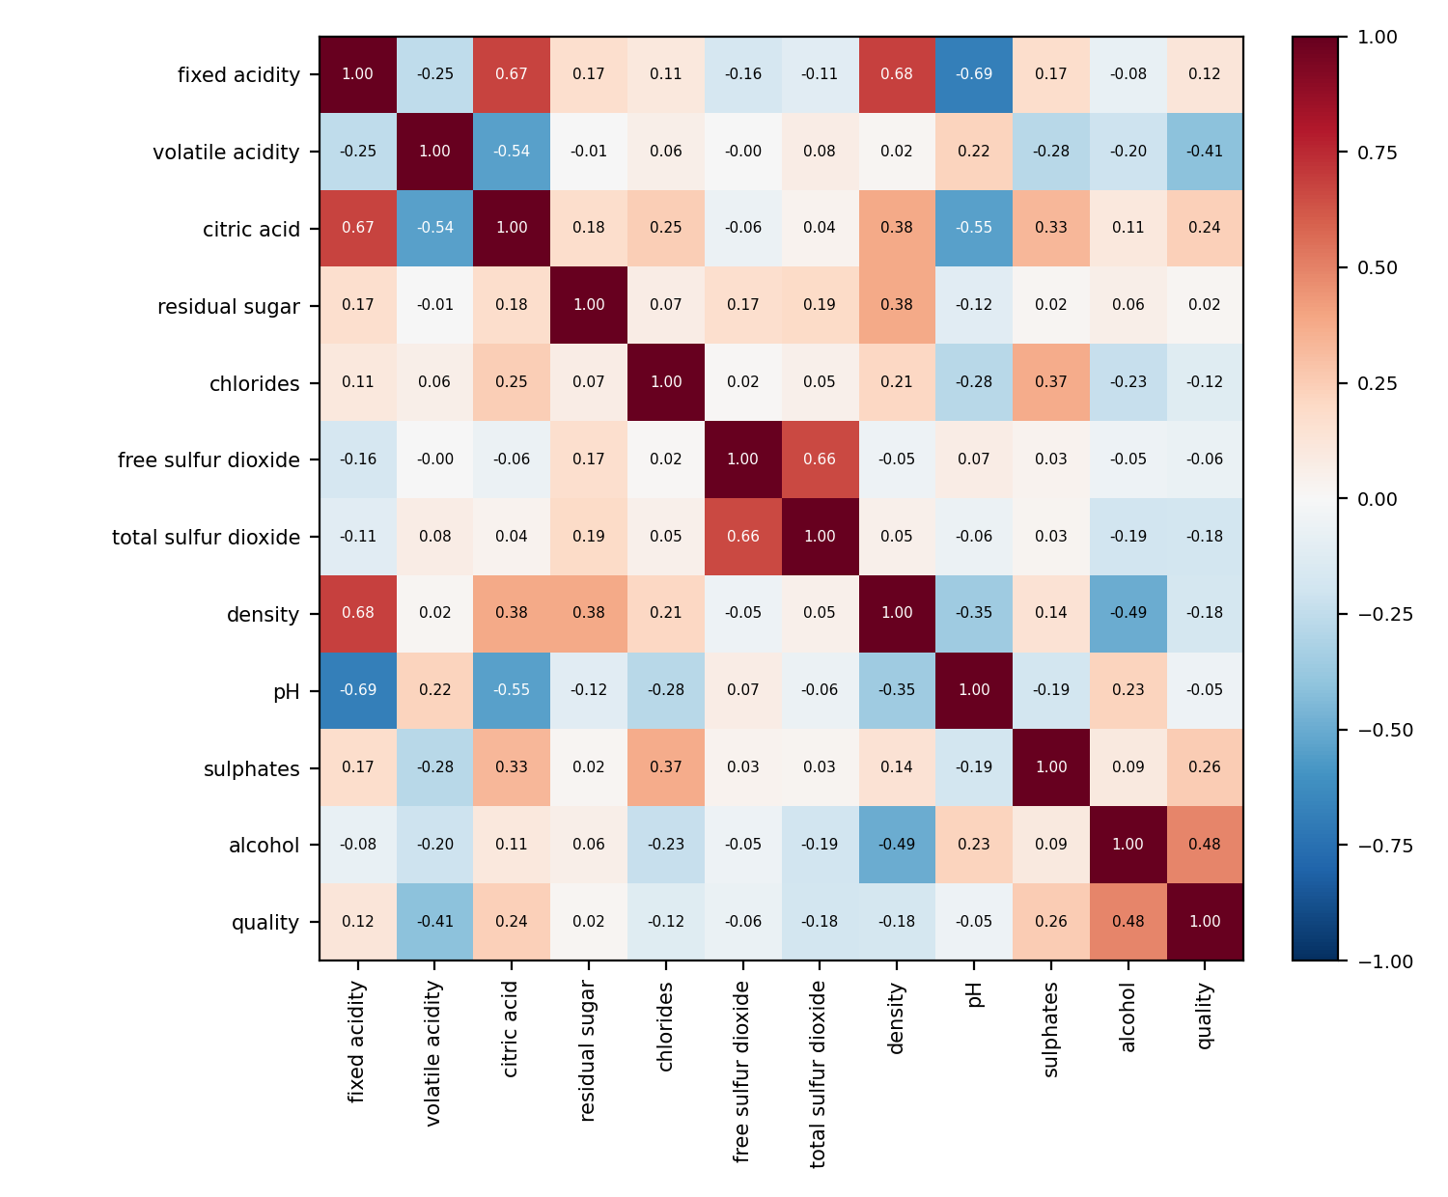
Correlation Analysis
STRONGEST LINKS TO QUALITY
alcohol
+0.48
volatile acidity
−0.41
sulphates
+0.26
citric acid
+0.24
total sulfur dioxide
−0.18
Possible multicollinearity: fixed acidity ↔ citric acid (0.67), fixed acidity ↔ density (0.68), fixed acidity ↔ pH (−0.69).
TAKEAWAY : Correlation shows association, not causation. Several predictors are inter-correlated — exactly the setting where Ridge, Lasso and Elastic Net's regularization helps stabilize coefficients.
10

Slide 12




Feature Preprocessing & Engineering
Feature / Target Separation
Drop Identifier Column
Train/Test Split
Feature Scaling — StandardScaler
X = 11 physicochemical columns; y = quality.
Id removed — it is a row index with no chemical meaning and would only inject noise.
80% train / 20% test, random_state = 42, applied after separating features and target.
All 11 features standardized to zero mean / unit variance after the split (fit on train, applied to test).
WHY SCALING IS ESSENTIAL FOR RIDGE, LASSO & ELASTIC NET
Regularization penalizes the magnitude of coefficients (L2 for Ridge, L1 for Lasso, both for Elastic Net). Features on larger raw scales — e.g. total sulfur dioxide (up to 289) versus chlorides (as low as 0.01) — would otherwise be penalized unevenly. Standardizing puts every feature on a comparable scale so the penalty reflects true predictive importance, not measurement units.
No additional engineered features were created — all 11 physicochemical measurements are used directly, since each represents an independent, meaningful lab measurement.
11

Slide 13
05 · MODELING WORKFLOW
Methodology
Wine Quality
Dataset
→
Data Inspection
& Cleaning
→
EDA &
Correlation
→
Feature/Target
Separation
→
Train-Test
Split
→
Feature
Scaling
↓
Ridge Regression
Lasso Regression
Elastic Net Regression
L2 Regularization
L1 Regularization
L1 + L2 Regularization
Shrinks coefficients smoothly; keeps all features, reduces variance.
Drives weak-feature coefficients to exactly zero; performs feature selection.
Blends both penalties — feature selection with correlated-feature stability.
↓
Prediction
→
Model Evaluation
→
Model Comparison
→
Best Model
12

Slide 14
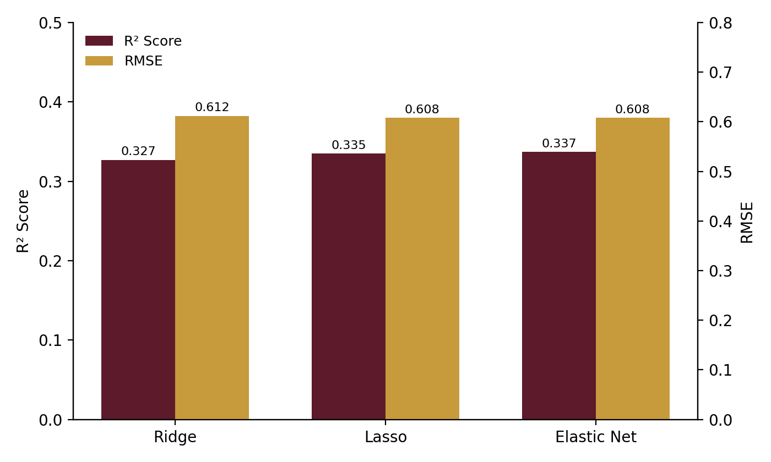
Model Results & Comparison
Model | Best Hyperparameter(s) | MAE | MSE | RMSE | R²
Ridge Regression | alpha = 50 | 0.476 | 0.374 | 0.612 | 0.327
Lasso Regression | alpha = 0.01 | 0.474 | 0.370 | 0.608 | 0.335
Elastic Net Regression | alpha = 0.05, l1_ratio = 0.2 | 0.475 | 0.369 | 0.608 | 0.337
Best Model: Elastic Net Regression
Highest R² (0.337) and lowest RMSE (0.608) on the held-out test set — narrowly ahead of Lasso and clearly ahead of Ridge.
All three models explain roughly a third of the variance in quality — expected given the moderate correlations seen in EDA (Slide 10) and the inherent noise in sensory ratings.
Elastic Net edges out Lasso and Ridge on both R² (higher is better) and RMSE (lower is better), confirming that combining L1 + L2 regularization suits this feature set best.
13

Slide 15
CONCLUSION
What We Found
Predicted the numerical quality score (3–8) of red wine samples from 11 physicochemical measurements using three regularized linear regression models.
Alcohol (+0.48) and volatile acidity (−0.41) emerged as the most influential predictors — higher alcohol and lower volatile acidity both associate with higher-rated wines.
Ridge, Lasso and Elastic Net were tuned via 5-fold cross-validated grid search and compared on MAE, MSE, RMSE and R² on a held-out test set.
Elastic Net Regression performed best (R² = 0.337, RMSE = 0.608), narrowly ahead of Lasso and ahead of Ridge — suggesting a blend of L1 feature selection and L2 stability fits this data slightly better than either penalty alone.
THANK YOU
1

