Slide 1
II301 INTERNSHIP PRESENTATION & VIVA
Kasish verma
2020eeb1176
October 17, 2023

Slide 2

Pandas
The pandas library is a powerful data manipulation and analysis tool for Python. It provides data structures like DataFrames and Series for handling and analyzing structured data in a way that is efficient and intuitive. It offers a wide range of functions for data cleaning, aggregation, and transformation, making it an essential tool for data scientists and analysts.

Slide 3
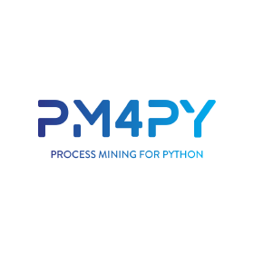
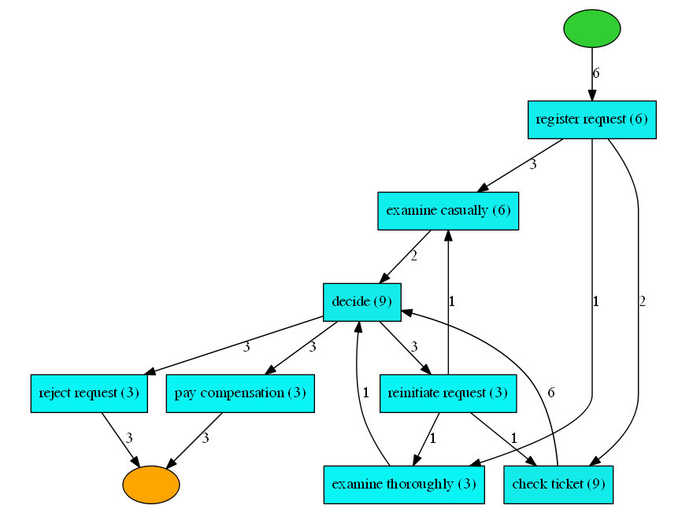
pm4py
The PM4Py library is an open-source process mining framework for Python. It offers a wide range of tools for analyzing business processes, enabling users to discover, visualize, and evaluate process models from event log data. The library supports various algorithms for process discovery, conformance checking, and performance analysis, making it a comprehensive solution for process mining tasks.

Slide 4
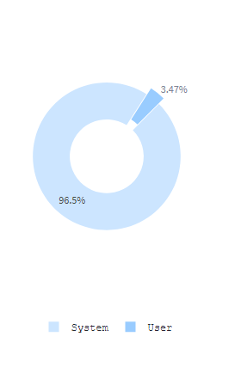
Streamlit & Plotly
Streamlit is an open-source Python library designed to create web apps for data science and machine learning projects quickly and easily. It offers a simple and intuitive API that allows developers to turn data scripts into shareable web apps without requiring extensive web development skills. With just a few lines of Python code, you can create interactive dashboards, data visualizations, and other applications.
The Plotly library is a data visualization tool that enables the creation of interactive, web-based plots and dashboards. It supports a wide range of chart types, such as scatter plots, line charts, bar graphs, and heat maps, among others. Plotly is available in multiple programming languages, including Python, R, and JavaScript, and offers both online and offline modes for chart creation. Its interactivity and customization features make it popular for data analysis and presentation.

Slide 5
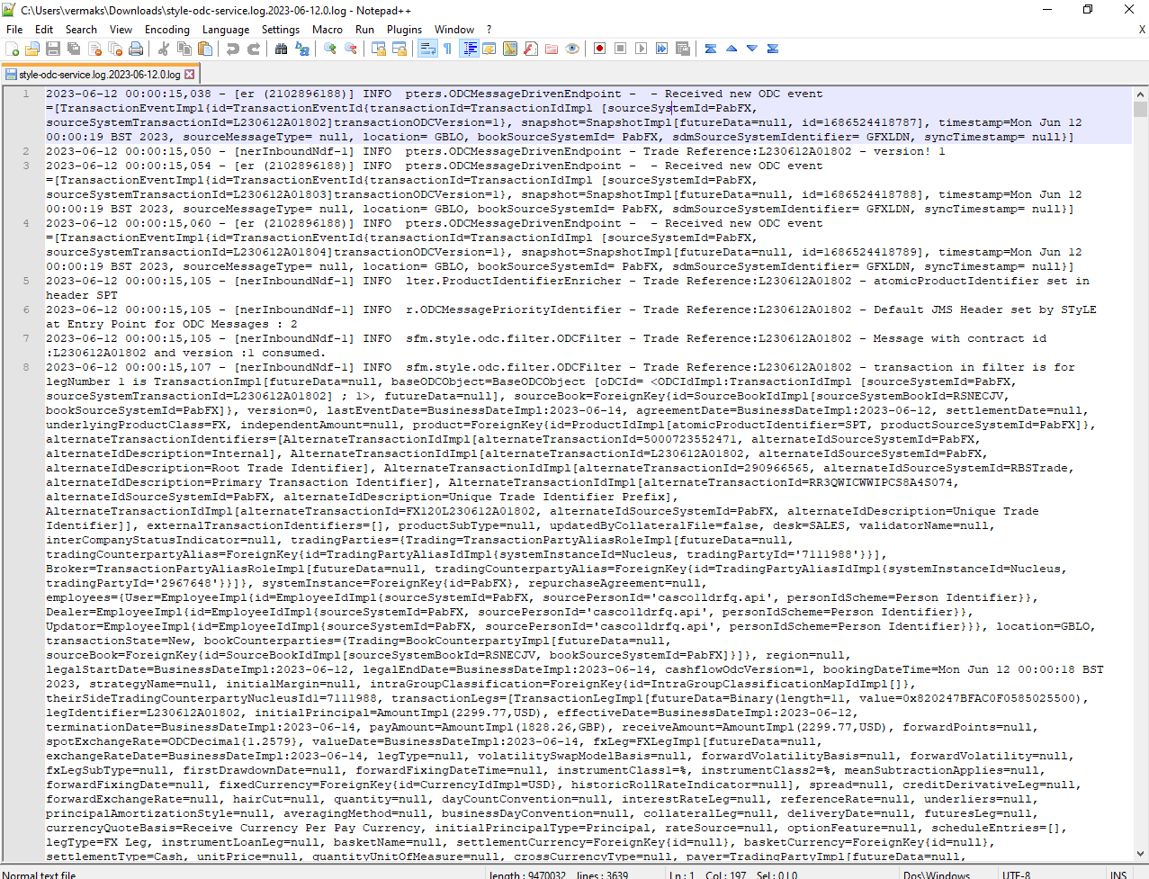
We are given raw data in form of logs, csv or json, which we are required to extract meaningful insights.

Slide 6
EDA Exploratory Data Analysis
Data Collection: Obtain the dataset from a reliable source.
Data Cleaning: Handle missing values, outliers, and duplicate entries.
Data Transformation: Normalize or standardize values, if needed.
Descriptive Statistics: Calculate measures like mean, median, standard deviation, etc.
Data Visualization: Use graphs and charts (like histograms, box plots, and scatter plots) to understand the distribution and relationship between variables.
The aim is to gain insights that can guide further data processing or model building.
It is a process used to understand the characteristics, structure, and patterns within a dataset. Here's a brief overview of typical steps involved:

Slide 7
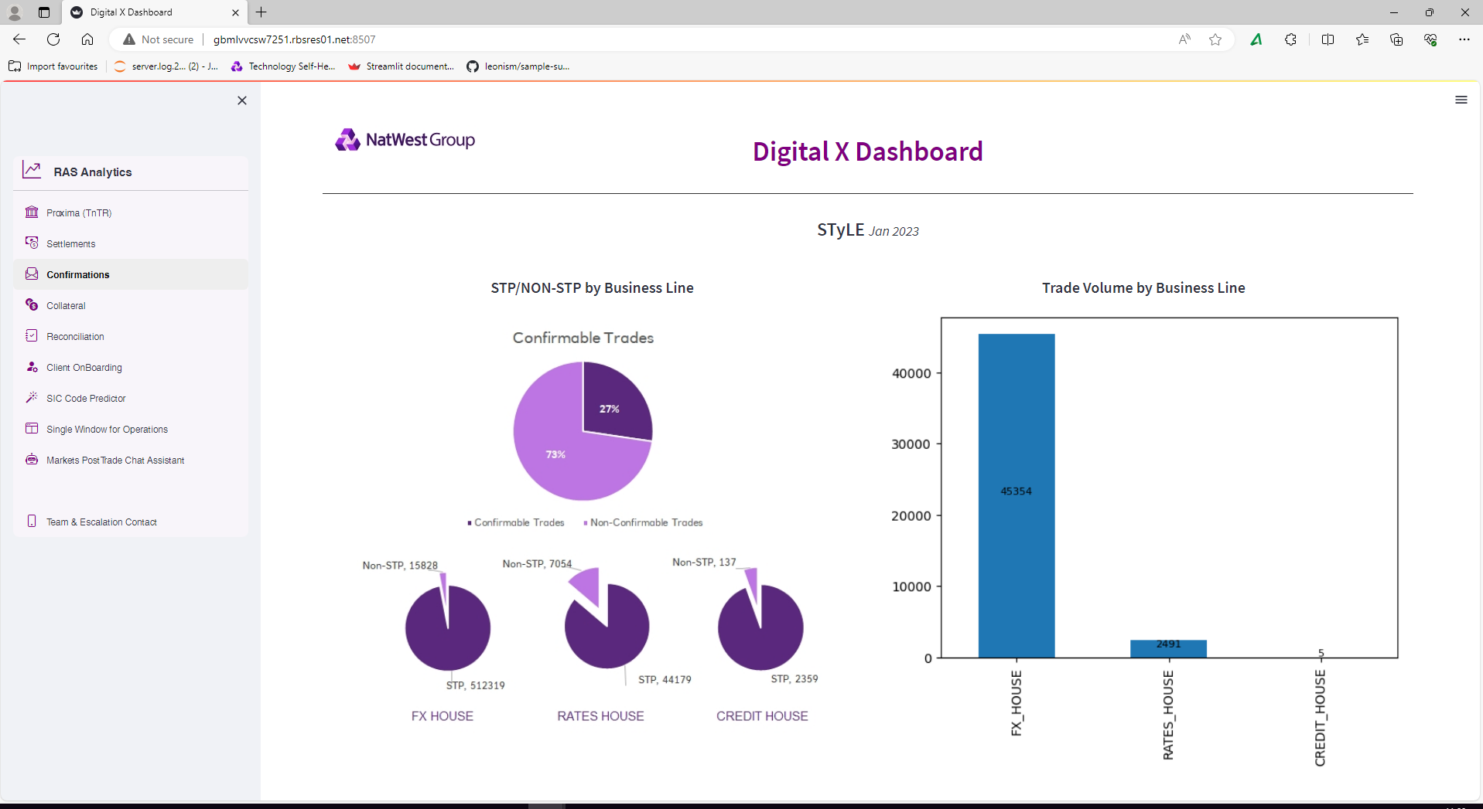
Dashboard created using Streamlit

Slide 8
Thank You

