Slide 1


Image Compression
High Performance Python Lab
Final Project
Olga Kupreeva, Iuliia Sadykova
2022

Slide 2
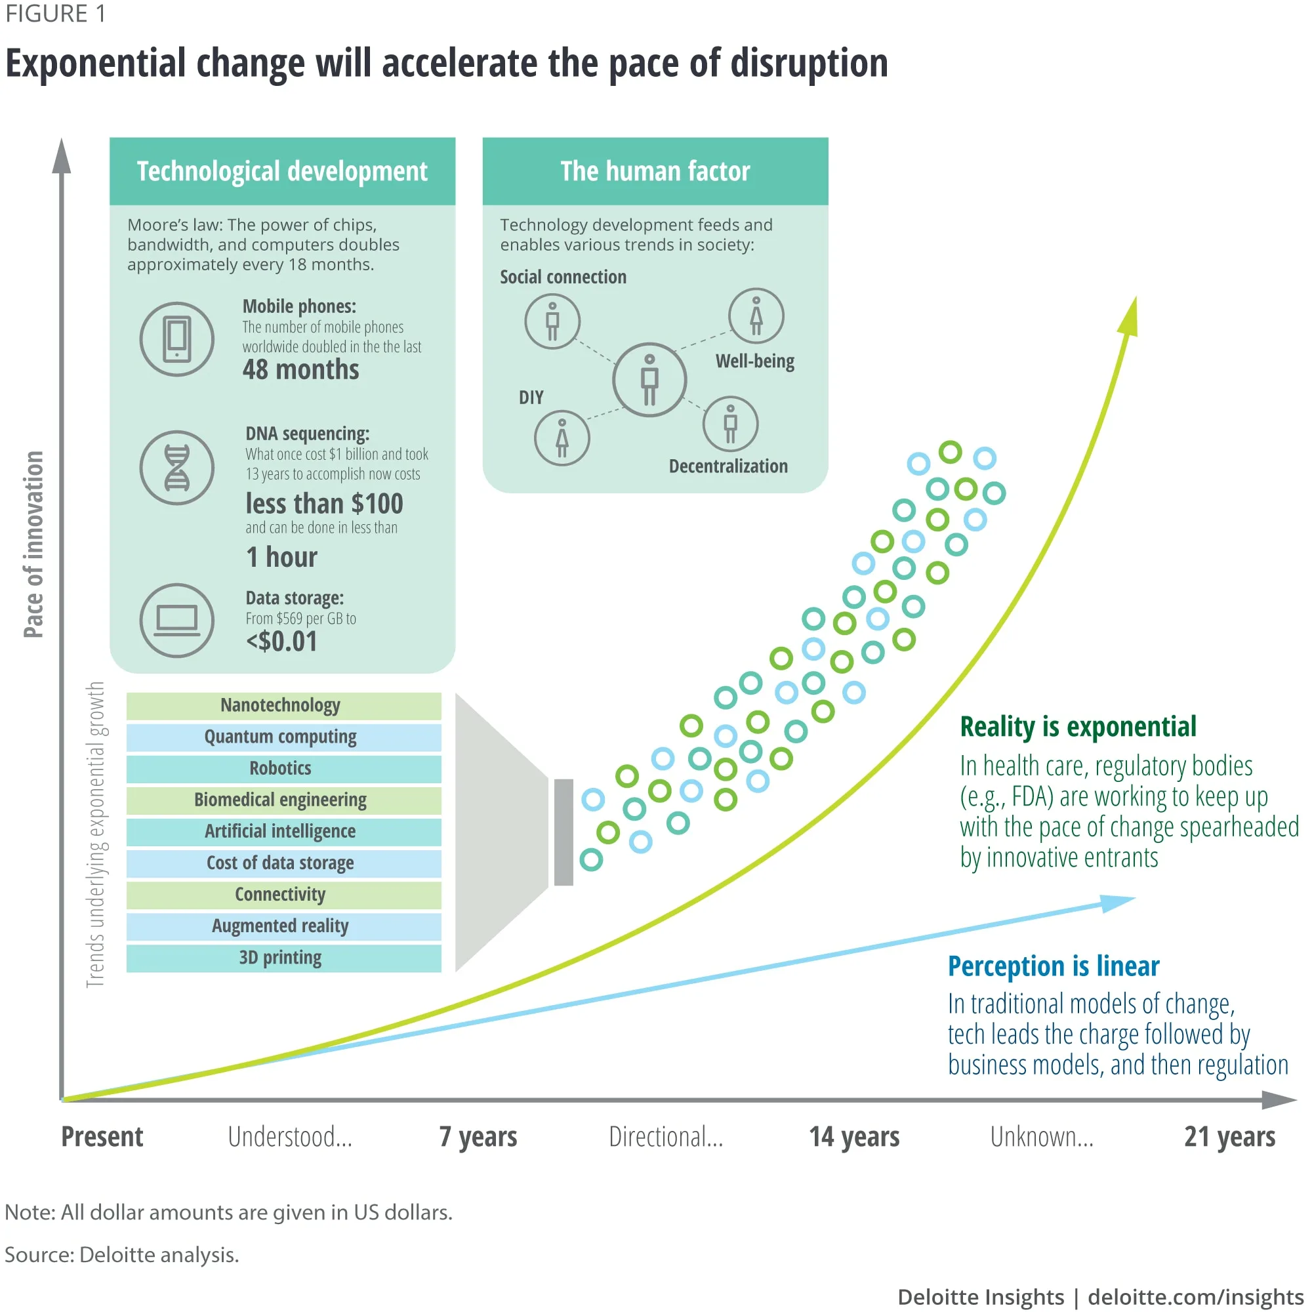
Modern Data problem
‹#›

Slide 3

Introduction
What is it? Image compression is a type of data compression applied to digital images, minimizing the number of bits to represent them
For what? To reduce space, cost and time for storage or transmission
How does it work? To provide superior results, algorithms may take advantage of visual perception and the statistical properties of image data

Slide 4

What makes compression possible?
Images are not noise, they are redundant and predictable;
Intensities are distributed non-uniformly;
Color channels are correlated;
Pixel values are spatially correlated;
Properties of human visual perception.
‹#›

Slide 5

Aim and objectives
Exploring different approaches to image compression using Single-threaded and Multi-threaded Processes
To apply Numpy library, mpi4py library module, Numba compiler and compare their parameters
To gain three compressed images and visually evaluate them
‹#›

Slide 6

Applications of lossy compression
Data storing and/or transferring, graphical computing area
Modern ways of people communication (messengers, social network);
Applying machine learning, deep neural networks, virtual machines and computer vision technologies;
Medical application (medical video, tomotherapy, ultrasound and X-ray results, phonocardiogram signals etc.)
Materials mechanics, structure analyzing
Satellite data
‹#›

Slide 7

Types
Image compression
Lossless compression
Lossy compression
After, image can be converted back with zero error, but compression rate - low
After, image cannot be converted back to the original without error;
The amount of error is inversely proportional to the storage space, can be controlled by the user
For artificially constructed images (graphics, program icons, or special cases, PNG, PCX)
Algorithms, while compression ratio ↑, usually generate artifacts (JPEG, MPEG, MP3)
‹#›

Slide 8
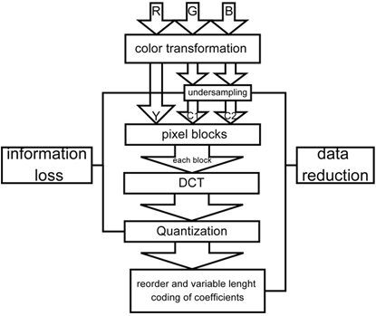
Discrete cosine transform
DCT - fast computing Fourier transform which maps real signal to corresponding values in frequency domain, expresses a signal as a linear combination of
cosine bases; real-valued
Steps:
1. Convert RGB Image ->equivalent YCbCr format
2. Break image into N*N blocks
3. Apply DCT to every block serially
4. Apply quantization to restrict the number of values that can be saved without loss of information
5. Store subset of the quantized blocks into an array from where it can be picked up for further processing
‹#›

Slide 9
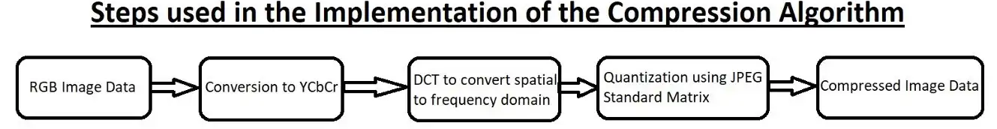
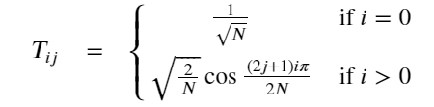
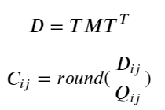
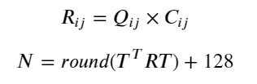
Discrete cosine transform
Calculation of the DCT matrix:
2) Compression process:
3) Decompression process:
‹#›

Slide 10
Comparison of applied approaches
Parameter | Numpy | mpi4py | Numba
Time, s | 0.6895 | 0.2957 | 0.0709
‹#›

Slide 11
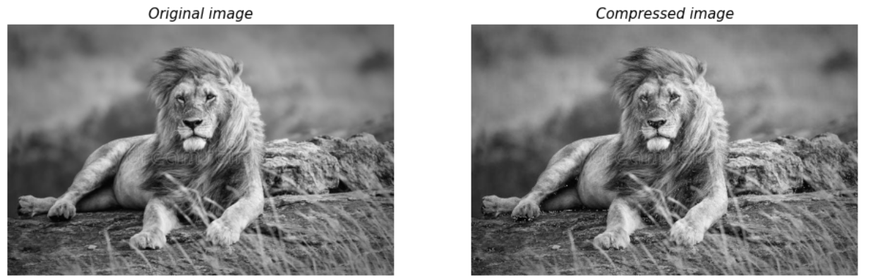
Results
Size Original: 150 KB Compressed: 143 KB
Δ = 7 KB
‹#›

Slide 12
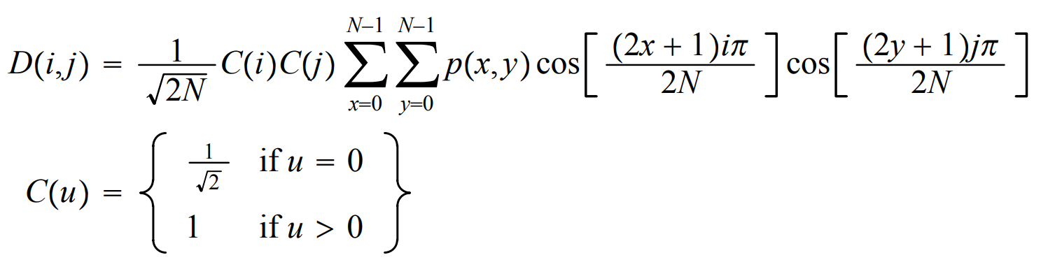
DCT formula
‹#›

