Slide 1
SQL Analysis of Olympic History
Conducted a comprehensive analysis of the "120 Years of Olympic History: Athletes and Results" dataset from kaggle using PostgreSQL. The project emphasized data manipulation, aggregation, and visualization to uncover trends in Olympic history.
- Kaslabad Srikar

Slide 2
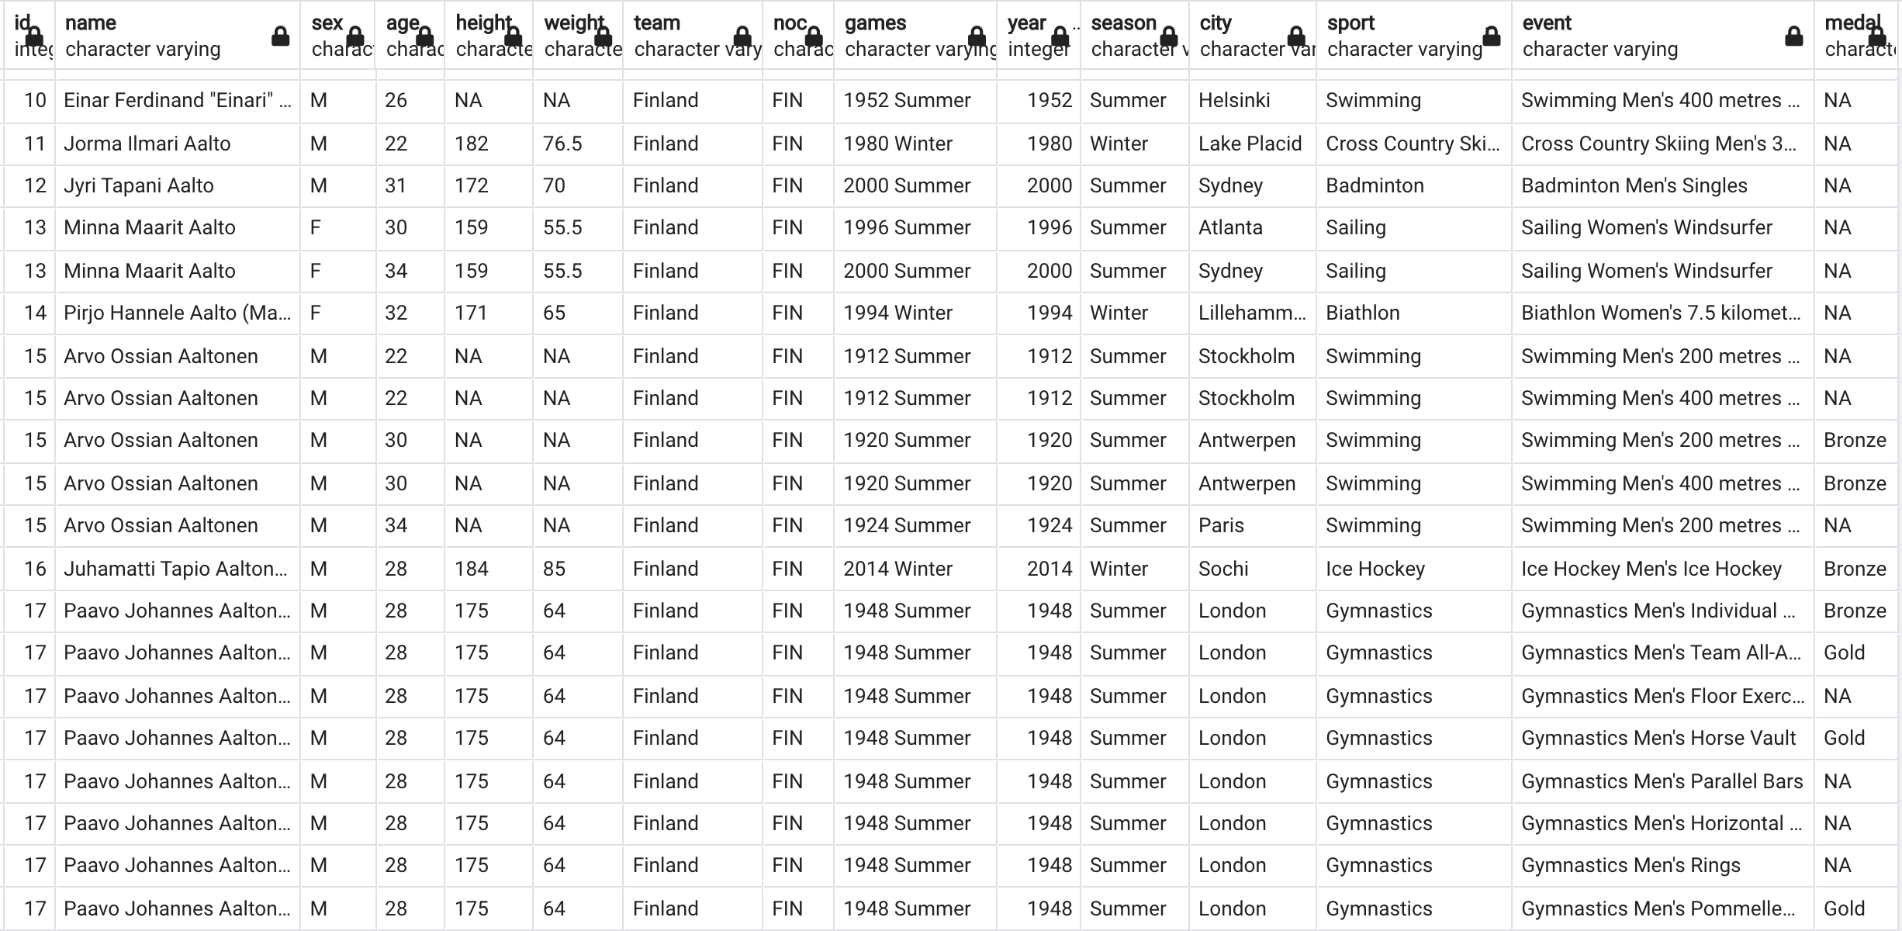
athlete_events.csv Data Set

Slide 3
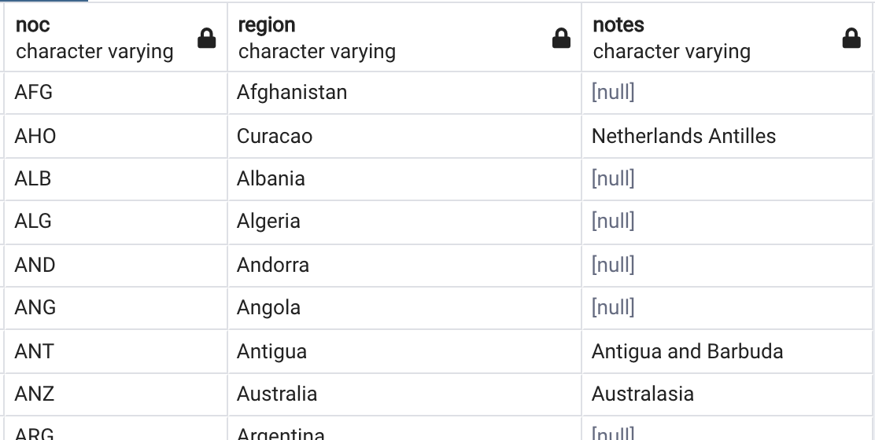
noc_regions.csv Data Set

Slide 4
The file noc_regions.csv consists of NOC (National Olympic Committee 3 letter code), Country name (matches with regions in map_data("world"))
The file athlete_events.csv contains 271116 rows and 15 columns. Each row corresponds to an individual athlete competing in an individual Olympic event (athlete-events).

Slide 5
Creates the OLYMPICS_HISTORY table if it doesn't already exist.
CREATE TABLE IF NOT EXISTS OLYMPICS_HISTORY
(
id INT,
name VARCHAR,
sex VARCHAR,
age VARCHAR,
height VARCHAR,
weight VARCHAR,
team VARCHAR,
noc VARCHAR,
games VARCHAR,
year INT,
season VARCHAR,
city VARCHAR,
sport VARCHAR,
event VARCHAR,
medal VARCHAR
);

Slide 6
CREATE TABLE IF NOT EXISTS OLYMPICS_HISTORY_NOC_REGIONS
(
noc VARCHAR,
region VARCHAR,
notes VARCHAR
);
--Then import .csv files into created tables.

Slide 7
Queries to select all records from the OLYMPICS_HISTORY and OLYMPICS_HISTORY_NOC_REGIONS tables
select * from OLYMPICS_HISTORY;
select * from OLYMPICS_HISTORY_NOC_REGIONS;

Slide 8

1)HOW MANY OLYMPICS GAMES HAVE BEEN HELD?
select count(distinct games) as total_olympic_games from olympics_history;

Slide 9
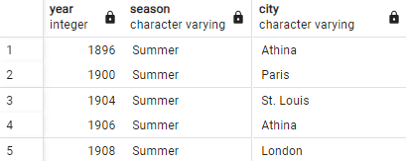
2)LIST DOWN ALL OLYMPICS GAMES HELD SO FAR.
select distinct oh.year, oh.season, oh.city from olympics_history oh order by year;

Slide 10
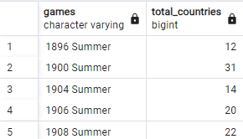
3)MENTION THE TOTAL NO OF NATIONS WHO PARTICIPATED IN EACH OLYMPICS GAME?
SELECT games, COUNT(DISTINCT region) AS total_countries
FROM olympics_history oh
JOIN olympics_history_noc_regions nr ON nr.noc = oh.noc
GROUP BY games
ORDER BY games;

Slide 11

4)WHICH YEAR SAW THE HIGHEST AND LOWEST NO OF COUNTRIES PARTICIPATING IN OLYMPICS?
SELECT
MIN(CONCAT(games, ' - ', total_countries)) AS Lowest_Countries,
MAX(CONCAT(games, ' - ', total_countries)) AS Highest_Countries
FROM (
SELECT games,COUNT(DISTINCT region) AS total_countries
FROM olympics_history oh
JOIN olympics_history_noc_regions nr ON nr.noc = oh.noc
GROUP BY games
) AS country_counts;

Slide 12
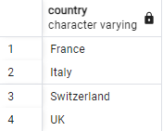
5)WHICH NATION HAS PARTICIPATED IN ALL OF THE OLYMPIC GAMES
SELECT nr.region AS country
FROM olympics_history oh
JOIN olympics_history_noc_regions nr ON nr.noc = oh.noc
GROUP BY nr.region
HAVING COUNT(DISTINCT oh.games) = (SELECT COUNT(DISTINCT games)
FROM olympics_history);

Slide 13
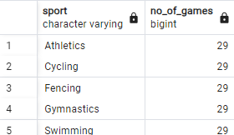
6)IDENTIFY THE SPORT WHICH WAS PLAYED IN ALL SUMMER OLYMPICS.
SELECT sport, COUNT(DISTINCT games) AS no_of_games FROM olympics_history
WHERE season = 'Summer'
GROUP BY sport
HAVING COUNT(DISTINCT games) =
(SELECT COUNT(DISTINCT games) FROM olympics_history
WHERE season = 'Summer');

Slide 14
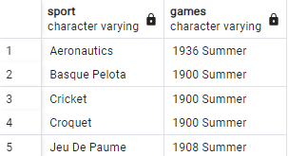
7)WHICH SPORTS WERE JUST PLAYED ONLY ONCE IN THE OLYMPICS.
SELECT DISTINCT o.sport, o.games
FROM olympics_history o
JOIN (
SELECT sport
FROM olympics_history
GROUP BY sport
HAVING COUNT(DISTINCT games) = 1
) AS subquery
ON o.sport = subquery.sport
ORDER BY o.sport;

Slide 15
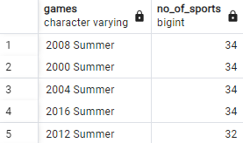
8)FETCH THE TOTAL NO OF SPORTS PLAYED IN EACH OLYMPIC GAMES.
SELECT games, COUNT(DISTINCT sport) AS no_of_sports
FROM olympics_history
GROUP BY games
ORDER BY no_of_sports DESC;

Slide 16
9)FETCH OLDEST ATHLETES TO WIN A GOLD MEDAL
SELECT name, sex,
CAST(CASE WHEN age = 'NA' THEN '0' ELSE age END AS int) AS age,
team, games, city, sport, event, medal
FROM olympics_history
WHERE medal = 'Gold'
ORDER BY age DESC NULLS LAST
LIMIT 1;

Slide 17

10)FIND THE RATIO OF MALE AND FEMALE ATHLETES PARTICIPATED IN ALL OLYMPIC GAMES.
SELECT CONCAT('1 : ', ROUND(MAX(cnt)::decimal / MIN(cnt), 2)) AS ratio
FROM (
SELECT sex, COUNT(1) AS cnt FROM olympics_history
GROUP BY sex
) AS subquery;

Slide 18
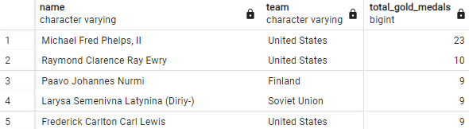
11)Fetch the top 5 athletes who have won the most gold medals.
SELECT name, team, COUNT(*) AS total_gold_medals
FROM olympics_history
WHERE medal = 'Gold'
GROUP BY name, team
ORDER BY total_gold_medals DESC
LIMIT 10;

Slide 19
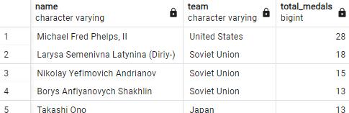
12)Fetch the top 5 athletes who have won the most medals (gold/silver/bronze).
SELECT name, team, COUNT(*) AS total_medals
FROM olympics_history
WHERE medal IN ('Gold', 'Silver', 'Bronze')
GROUP BY name, team
ORDER BY total_medals DESC
LIMIT 5;

Slide 20
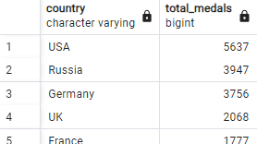
13)Fetch the top 5 most successful countries in olympics. Success is defined by no of medals won.
SELECT nr.region AS country, COUNT(*) AS total_medals
FROM olympics_history oh
JOIN olympics_history_noc_regions nr ON nr.noc = oh.noc
WHERE medal <> 'NA'
GROUP BY nr.region
ORDER BY total_medals DESC
LIMIT 5;

Slide 21
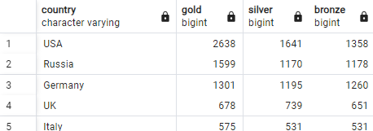
14)List down total gold, silver and bronze medals won by each country.
SELECT
nr.region AS country,
COUNT(CASE WHEN oh.medal = 'Gold' THEN 1 END) AS gold,
COUNT(CASE WHEN oh.medal = 'Silver' THEN 1 END) AS silver,
COUNT(CASE WHEN oh.medal = 'Bronze' THEN 1 END) AS bronze
FROM olympics_history oh
JOIN olympics_history_noc_regions nr ON nr.noc = oh.noc
WHERE oh.medal <> 'NA'
GROUP BY nr.region
ORDER BY gold DESC, silver DESC, bronze DESC;

Slide 22
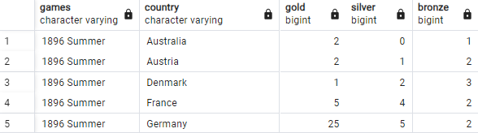
15)List down total gold, silver and bronze medals won by each country corresponding to each olympic games.
SELECT oh.games,nr.region AS country,
COUNT(CASE WHEN oh.medal = 'Gold' THEN 1 END) AS gold,
COUNT(CASE WHEN oh.medal = 'Silver' THEN 1 END) AS silver,
COUNT(CASE WHEN oh.medal = 'Bronze' THEN 1 END) AS bronze
FROM olympics_history oh
JOIN olympics_history_noc_regions nr ON nr.noc = oh.noc
WHERE oh.medal <> 'NA'
GROUP BY oh.games, nr.region
ORDER BY oh.games, nr.region;

Slide 23
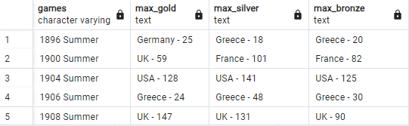
16)Identify which country won the most gold, most silver and most bronze medals in each olympic games.
WITH medal_counts AS (
SELECT oh.games,nr.region AS country,
SUM(CASE WHEN oh.medal = 'Gold' THEN 1 ELSE 0 END) AS gold,
SUM(CASE WHEN oh.medal = 'Silver' THEN 1 ELSE 0 END) AS silver,
SUM(CASE WHEN oh.medal = 'Bronze' THEN 1 ELSE 0 END) AS bronze
FROM olympics_history oh
JOIN olympics_history_noc_regions nr ON nr.noc = oh.noc
WHERE oh.medal <> 'NA'
GROUP BY oh.games, nr.region
),
ranked_medals AS (
SELECT games,country,gold,silver,bronze,
ROW_NUMBER() OVER (PARTITION BY games ORDER BY gold DESC) AS rnk_gold,
ROW_NUMBER() OVER (PARTITION BY games ORDER BY silver DESC) AS rnk_silver,
ROW_NUMBER() OVER (PARTITION BY games ORDER BY bronze DESC) AS rnk_bronze
FROM medal_counts
)
SELECT games,
MAX(CASE WHEN rnk_gold = 1 THEN CONCAT(country, ' - ', gold) END) AS Max_Gold,
MAX(CASE WHEN rnk_silver = 1 THEN CONCAT(country, ' - ', silver) END) AS Max_Silver,
MAX(CASE WHEN rnk_bronze = 1 THEN CONCAT(country, ' - ', bronze) END) AS Max_Bronze
FROM ranked_medals
GROUP BY games
ORDER BY games;

Slide 24
17)Identify which country won the most gold, most silver, most bronze medals and the most medals in each olympic games.
WITH medal_counts AS (
SELECT oh.games,nr.region AS country,
SUM(CASE WHEN oh.medal = 'Gold' THEN 1 ELSE 0 END) AS gold,
SUM(CASE WHEN oh.medal = 'Silver' THEN 1 ELSE 0 END) AS silver,
SUM(CASE WHEN oh.medal = 'Bronze' THEN 1 ELSE 0 END) AS bronze,
COUNT(1) AS total_medals
FROM olympics_history oh
JOIN olympics_history_noc_regions nr ON nr.noc = oh.noc
WHERE oh.medal <> 'NA'
GROUP BY oh.games, nr.region
),
ranked_medals AS (
SELECT games,country,gold,silver,bronze,total_medals,
ROW_NUMBER() OVER (PARTITION BY games ORDER BY gold DESC, silver DESC, bronze DESC) AS rnk_gold,
ROW_NUMBER() OVER (PARTITION BY games ORDER BY silver DESC, gold DESC, bronze DESC) AS rnk_silver,
ROW_NUMBER() OVER (PARTITION BY games ORDER BY bronze DESC, gold DESC, silver DESC) AS rnk_bronze,
ROW_NUMBER() OVER (PARTITION BY games ORDER BY total_medals DESC) AS rnk_total
FROM medal_counts)

Slide 25
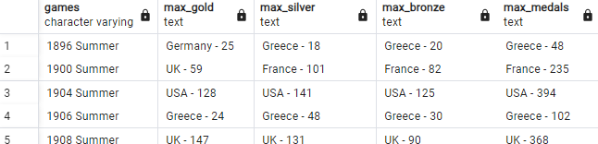
SELECT games,
MAX(CASE WHEN rnk_gold = 1 THEN CONCAT(country, ' - ', gold) END) AS Max_Gold,
MAX(CASE WHEN rnk_silver = 1 THEN CONCAT(country, ' - ', silver) END) AS Max_Silver,
MAX(CASE WHEN rnk_bronze = 1 THEN CONCAT(country, ' - ', bronze) END) AS Max_Bronze,
MAX(CASE WHEN rnk_total = 1 THEN CONCAT(country, ' - ', total_medals) END) AS Max_Medals
FROM ranked_medals
GROUP BY games
ORDER BY games;

Slide 26
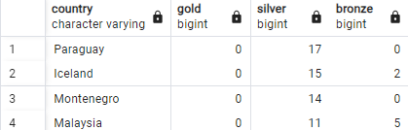
18)Which countries have never won gold medal but have won silver/bronze medals?
SELECT nr.region AS country,
COALESCE(SUM(CASE WHEN oh.medal = 'Gold' THEN 1 ELSE 0 END), 0) AS gold,
COALESCE(SUM(CASE WHEN oh.medal = 'Silver' THEN 1 ELSE 0 END), 0) AS silver,
COALESCE(SUM(CASE WHEN oh.medal = 'Bronze' THEN 1 ELSE 0 END), 0) AS bronze
FROM olympics_history oh
JOIN olympics_history_noc_regions nr ON nr.noc = oh.noc
WHERE oh.medal <> 'NA'
GROUP BY nr.region
HAVING SUM(CASE WHEN oh.medal = 'Gold' THEN 1 ELSE 0 END) = 0
AND (SUM(CASE WHEN oh.medal = 'Silver' THEN 1 ELSE 0 END) > 0
OR SUM(CASE WHEN oh.medal = 'Bronze' THEN 1 ELSE 0 END) > 0)
ORDER BY gold DESC NULLS LAST, silver DESC NULLS LAST, bronze DESC NULLS LAST;

Slide 27

19)In which Sport/event, India has won highest medals.
SELECT sport, total_medals
FROM (
SELECT sport, COUNT(1) AS total_medals
FROM olympics_history
WHERE medal <> 'NA'
AND team = 'India'
GROUP BY sport
) AS medal_counts
ORDER BY total_medals DESC
LIMIT 1;

Slide 28
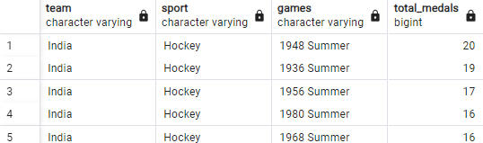
20)Break down all olympic games where India won medal for Hockey and how many medals in each olympic games
SELECT team, sport, games, total_medals
FROM (
SELECT team, sport, games, COUNT(1) AS total_medals
FROM olympics_history
WHERE medal <> 'NA'
AND team = 'India'
AND sport = 'Hockey'
GROUP BY team, sport, games
) AS medal_summary
ORDER BY total_medals DESC;

