Slide 1
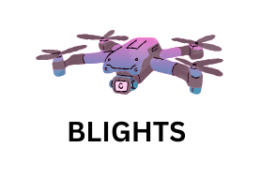
Problem Statement
Title: Centralized Monitoring System
for Street Light Fault Detection and Location Tracking

Slide 2
Idea/Approach Details
Data Collection:
Drone Flight: Fly the drone over areas with street lights to capture high-resolution images.
Image Annotation: Manually label street lights and their conditions in images for training.
Data Preprocessing:
Image Augmentation: Enhance dataset diversity with techniques like rotation and scaling.
Dataset Splitting: Divide the dataset into training, validation, and test sets.
Model Training:
Architecture Selection: YOLOV8deep learning structure like CNNs for image recognition.
Training: Train the model with the labeled dataset, tweaking as needed for best results.
Model Deployment:
Integration: Combine the trained model with the drone system for real-time analysis.
Testing: Test the integrated system's accuracy and assessing street light conditions.
Analysis & Reporting:
Condition Detection: The model analyzes drone-captured images to determine street light conditions.
Data Visualization: Display results on a map indicating each street light's location and condition for maintenance decisions.

Slide 3
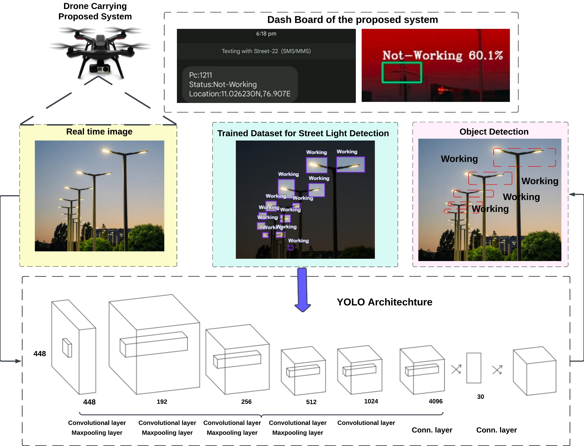
Architecture of the proposed system

Slide 4
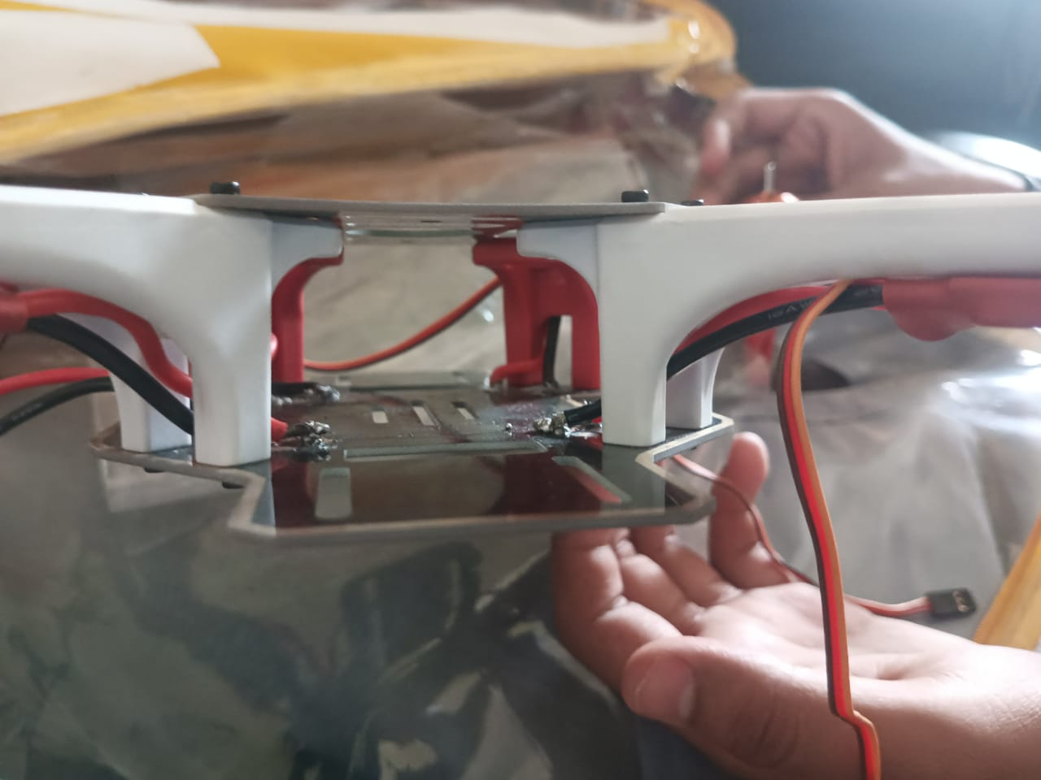
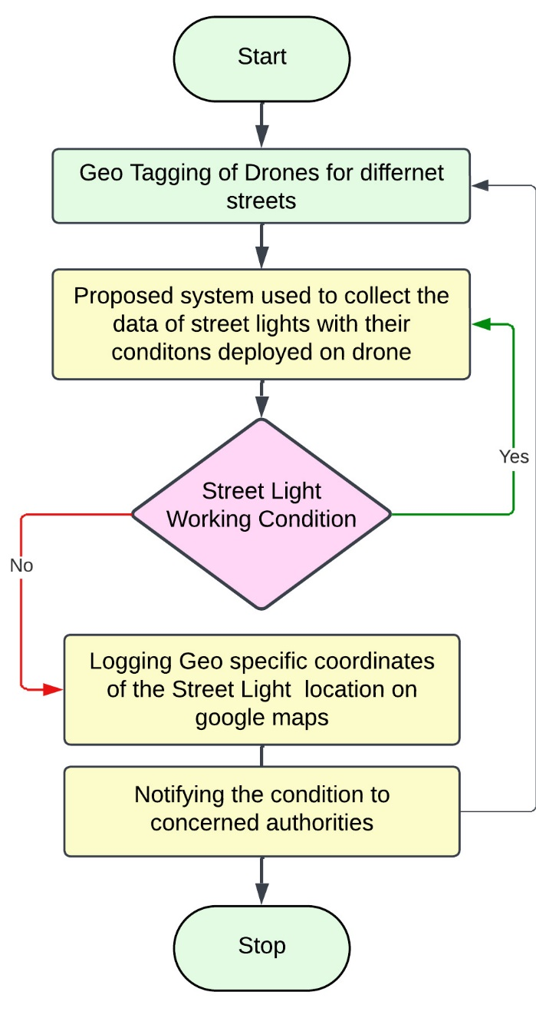
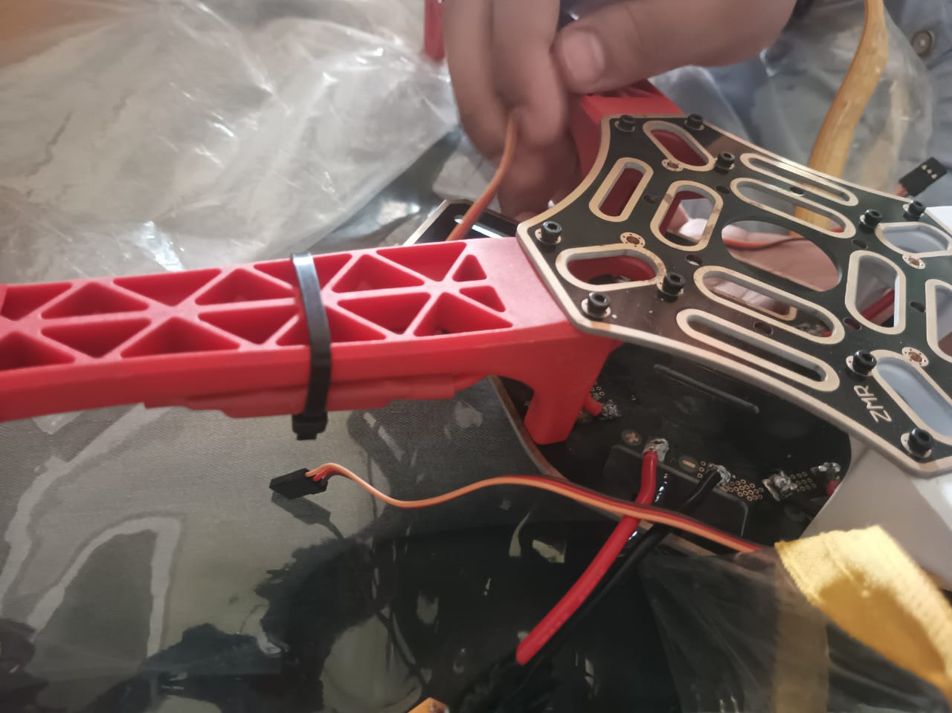
Proposed system

Slide 5
Idea/Approach Details
Describe your Use Cases here:
1.Fault Finding and Upkeep:
In a nutshell, this use case focuses on the system's capacity to quickly identify problems or flaws with street lights, and maintenance procedures by identifying troublesome lights for rapid repairs and ensure a well-lit urban environment.
2.Analytics of data:
In a nutshell, this use case concentrates on gathering and analyzing data from street lights. Municipalities can know about fault trends, operating efficiencies, and energy consumption patterns by processing this data.
3.Get Directions:
In a nutshell, this use case concerns the system's capacity to precisely find malfunctioning street lights, enabling maintenance crew.To locate and resolve problems more rapidly and minimizing response times.
4.Keeping Safe at Night:
In a nutshell, this use case emphasizes the system's involvement in averting mishaps at night. It lowers the possibility of accidents, increases visibility, and promotes safety for both automobiles and pedestrians by providing operational street lighting.

Slide 6
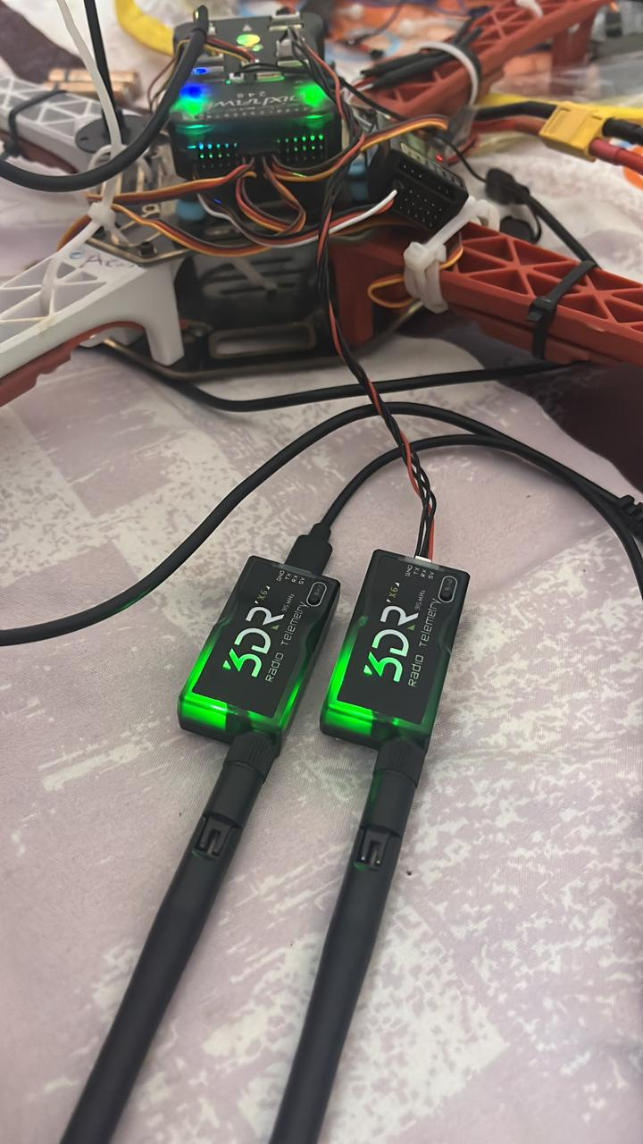
Idea/Approach Details
Describe your Dependencies / Show stopper here:
Fault Detection:
Assess the system's accuracy in identifying faults.
Validate its ability to pinpoint faults in clear weather with at least one faulty street light.
Rain-Induced Fault Detection:
Evaluating rain-related fault detection capabilities.
In rainy conditions with at least one rain-induced fault, checks if the system accurately reports the fault location, showcasing adaptability in adverse weather conditions.
Snow-Induced Fault Detection:
Examine snow-induced fault detection proficiency.
In snowy weather with at least one snow-related fault, ensure the system correctly identifies and reports the fault location, highlighting reliability in winters.
Extreme Weather Resillence:
Test system resilience during severe weather like storms.
Assess its robustness and fault-reporting accuracy under stormy conditions, emphasizing its dependability in extreme scenarios.
Estimated Price:
Component: Price:​
​
1.Flying Drone- 25,000​
2.Jetson nano- 18,000​
3.Proximity Sensor- 300​
4.Camera- 2000​
5.DroneController- 5000​
----- ​
50,300​
​

